Slide 1
Dynamic Programming: Matrix-Chain Multiplication
Dr. N. Subhash Chandra

Slide 2
Matrix chain multiplication
The chain matrix multiplication problem involves the question of determining the optimal sequence for performing a series of operations.
Applications: Used in complier design for code optimization and in databases for query optimization.

Slide 3
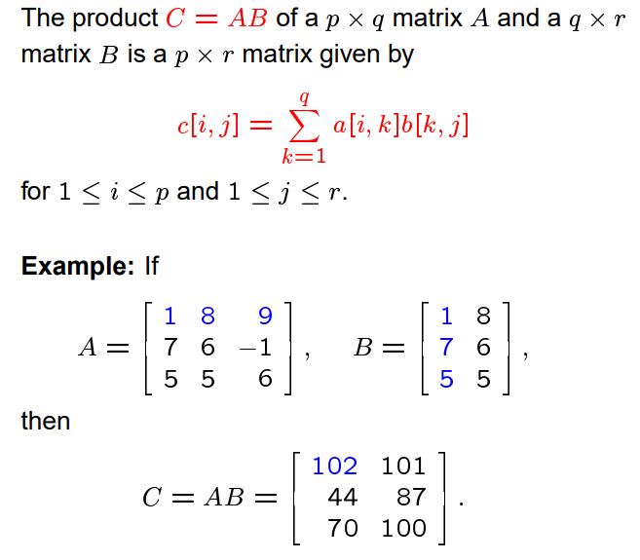
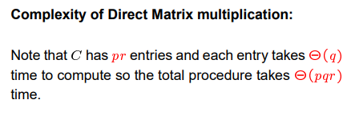
Recall Matrix multiplication

Slide 4
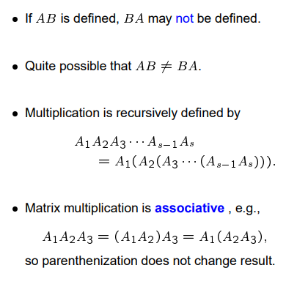
Remarks on Matrix Multiplication

Slide 5
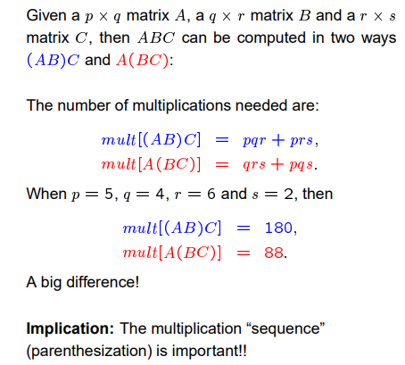
Direct Matrix multiplication of ABC

Slide 6
Parenthesize change the no. of Scalar Matrix Multiplications
Example: Consider three matrices A_{10×100}, B_{100×5}, and C_{5×50}
There are 2 ways to parenthesize
((AB)C) = D_{10×5} · C_{5×50}
AB ⇒ 10·100·5=5,000 scalar multiplications
DC ⇒ 10·5·50 =2,500 scalar multiplications
(A(BC)) = A_{10×100} · E_{100×50}
BC ⇒ 100·5·50=25,000 scalar multiplications
AE ⇒ 10·100·50 =50,000 scalar multiplications
Total: 7,500
Total: 75,000

Slide 7
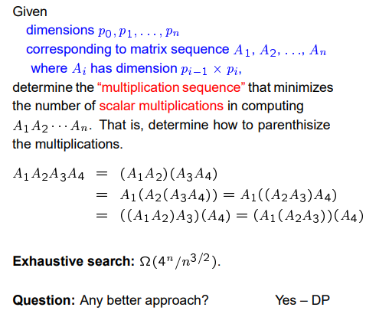
The Chain Matrix Multiplication Problem

Slide 8
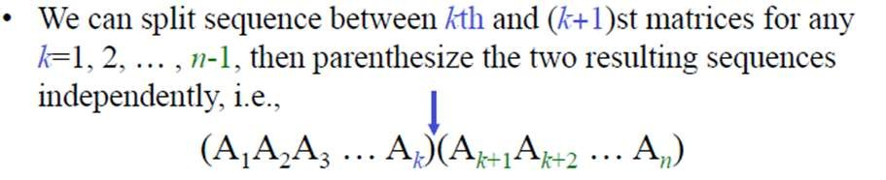
Naive Algorithm: Counting the Number of Parenthesizations
Before solving by Dynamic programming exhaustively check all paranthesizations.
P(n) : paranthesization of a sequence of n matrices

Slide 9
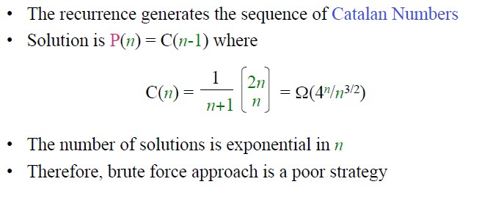
We obtain the recurrence
⎧
1
if n = 1
if n ≥ 2
P( n) = ^{⎪n−1}
⎨ ∑ P( k ) P( n − k )
⎪⎩k =1

Slide 10
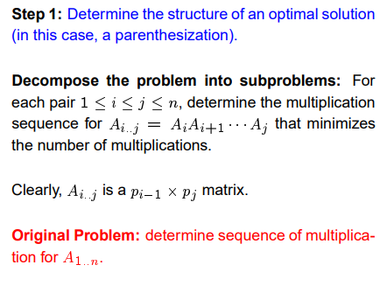
Developing a Dynamic Programming Algorithm

Slide 11
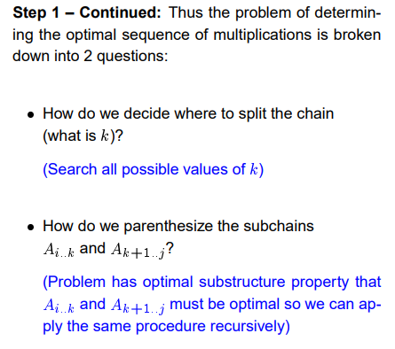
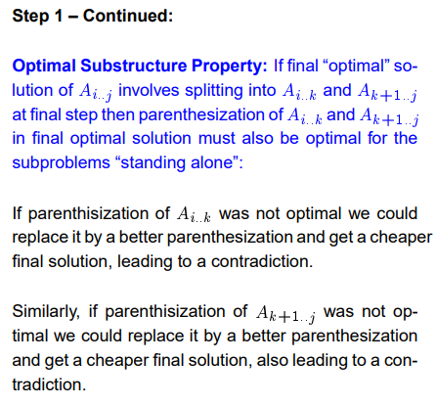
Developing a Dynamic Programming Algorithm

Slide 12
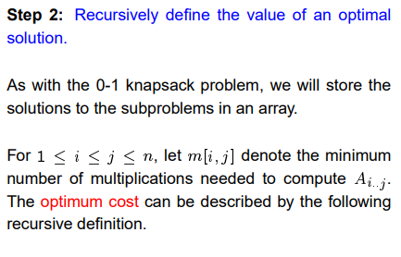
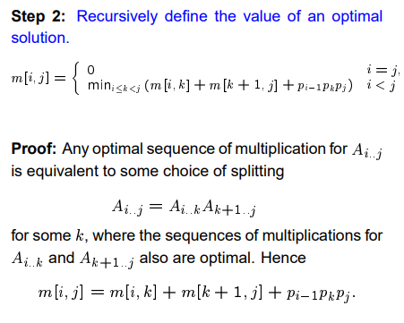

Developing a Dynamic Programming Algorithm

Slide 13
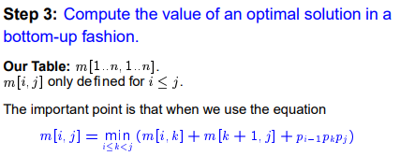
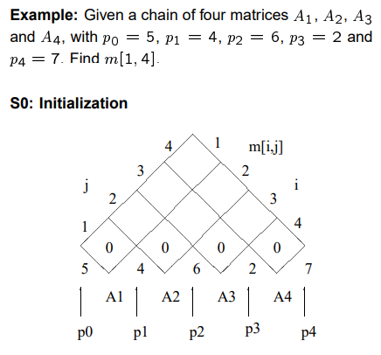
Developing a Dynamic Programming Algorithm

Slide 14
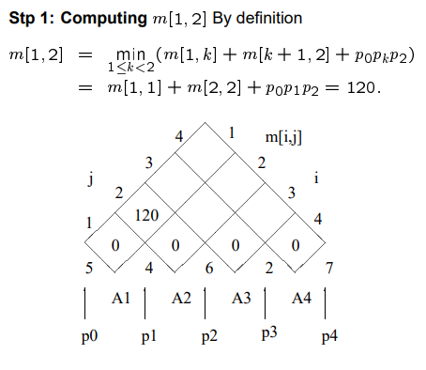
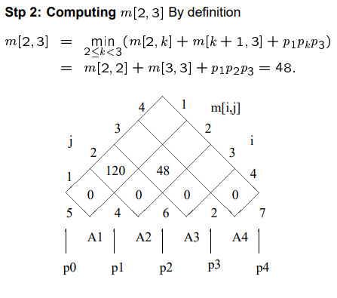
Example -Continued

Slide 15
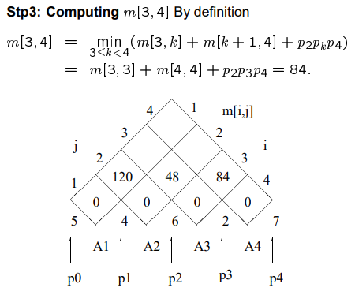
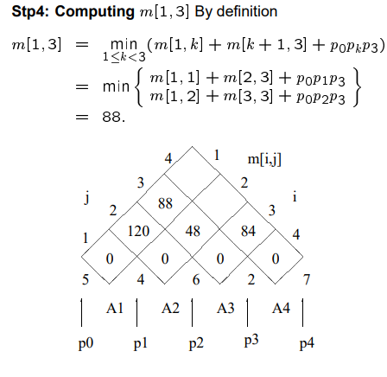
Example -Continued

Slide 16
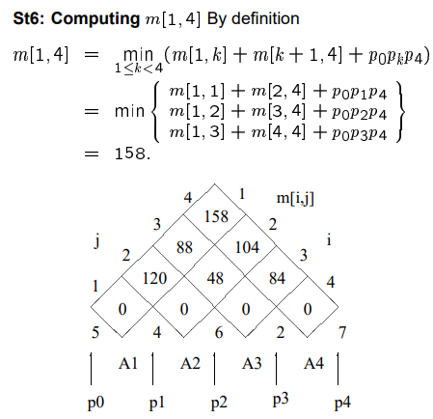
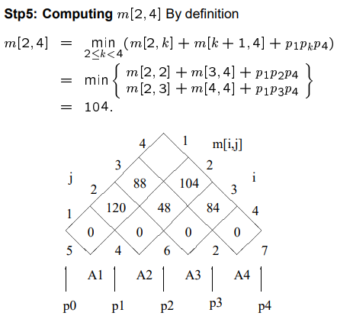
Example -Continued

Slide 17
Example min {m[i, k] + m[k+1, j] + p_{i-1}p_{k}p_{j}}
1
2
3
Compute A₁ ⋅ A₂ ⋅ A₃
A₁: 10 x 100 (p₀ x p₁)
A₂: 100 x 5 (p₁ x p₂)
A₃: 5 x 50 (p₂ x p₃)
m[i, i] = 0 for i = 1, 2, 3
m[1, 2] = m[1, 1] + m[2, 2] + p₀p₁p₂ (A₁A₂)
= 0 + 0 + 10 *100* 5 = 5,000
m[2, 3] = m[2, 2] + m[3, 3] + p₁p₂p₃ (A₂A₃)
= 0 + 0 + 100 * 5 * 50 = 25,000
m[1, 3] = min m[1, 1] + m[2, 3] + p₀p₁p₃ = 75,000 (A₁(A₂A₃))
m[1, 2] + m[3, 3] + p₀p₂p₃ = 7,500 ((A₁A₂)A₃)
3
2
2
7500
25000
0
2
1
5000
0
1
0

Slide 18
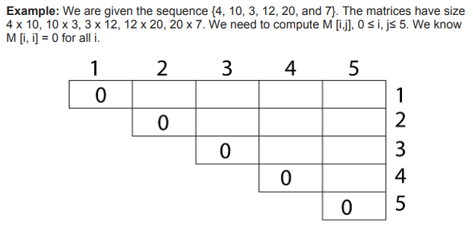
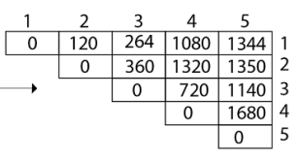
Example
Answer:

Slide 19
Example:
A₁ | 30 × 35 | = p₀ × p₁
A₂ | 35×15 | = p₁ × p₂
A₃ | 15× 5 | = p₂ × p₃
A₄ | 5 ×10 | = p₃ × p₄
A₅ A₆ | 10 × 20 20 × 25 | = p₄ × p₅ = p₅ × p₆

Slide 20
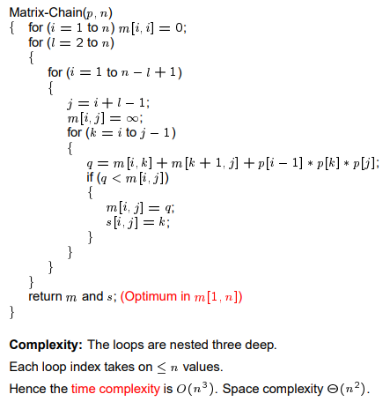
Matrix Chain Multiplication Algorithm
The space complexity of this procedure Ο(n2). Since the tables m and s require Ο(n2) space.
The running time of this procedure is Ο(n3).

Slide 21
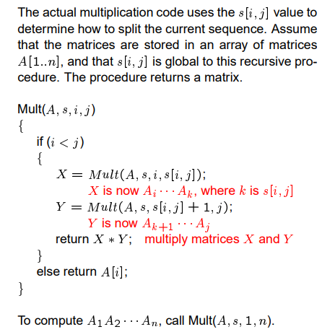
Constructing an Optimal Solution

