Slide 1
Unit-II Logistic Regression
Logistic regression
Estimation and Interpretation of Coefficients
From: Business Analytics by Dr Dinesh Kumar

Slide 2
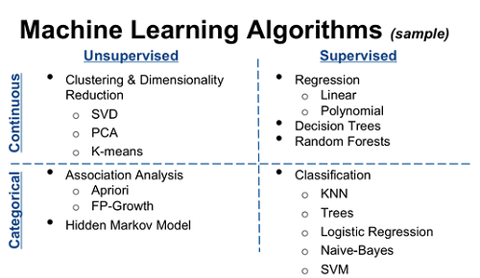
Types of Machine learning Algorithms

Slide 3
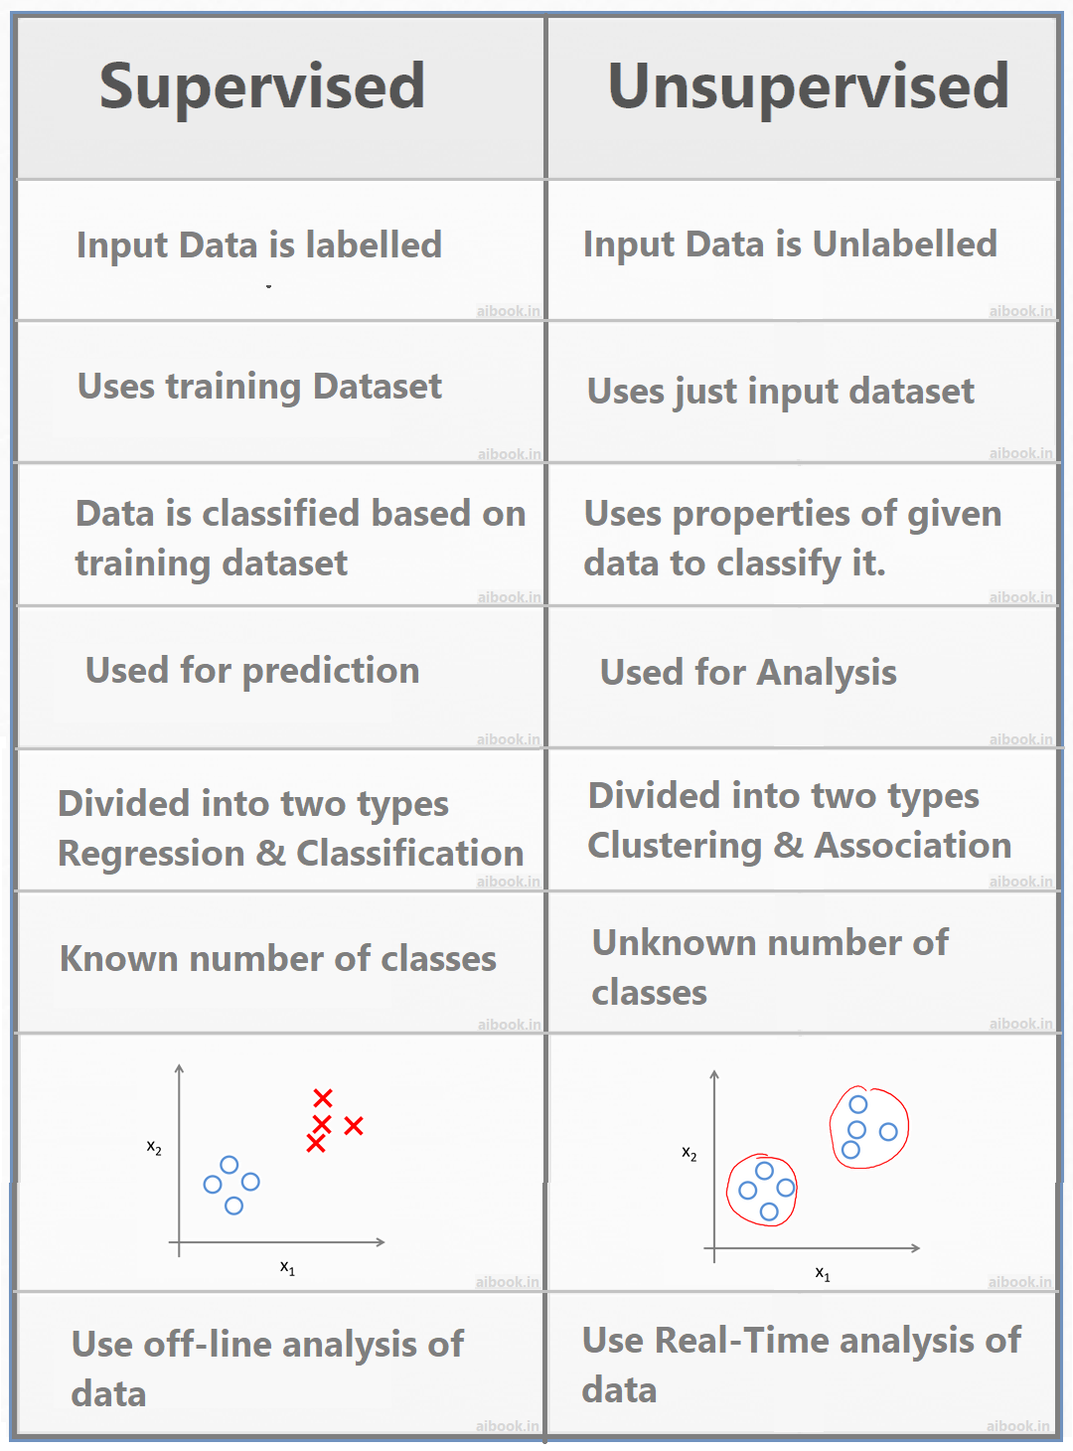
Supervised vs Unsupervised learning

Slide 4
Logistic Regression
Logistic regression is one of the most popular Machine Learning algorithms, which comes under the Supervised Learning technique. It is used for predicting the categorical dependent variable using a given set of independent variables.
Logistic regression predicts the output of a categorical dependent variable. Therefore, the outcome must be a categorical or discrete value. It can be either Yes or No, 0 or 1, true or False, etc. but instead of giving the exact value as 0 and 1, it gives the probabilistic values which lie between 0 and 1.
Logistic Regression is much similar to the Linear Regression except that how they are used. Linear Regression is used for solving Regression problems, whereas Logistic regression is used for solving the classification problems.
In Logistic regression, instead of fitting a regression line, we fit an "S" shaped logistic function, which predicts two maximum values (0 or 1).

Slide 5
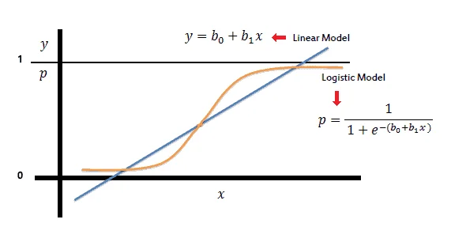
Logistic Function (Sigmoid Function):
The sigmoid function is a mathematical function used to map the predicted values to probabilities.
It maps any real value into another value within a range of 0 and 1.
The value of the logistic regression must be between 0 and 1, which cannot go beyond this limit, so it forms a curve like the "S" form. The S-form curve is called the Sigmoid function or the logistic function.
In logistic regression, we use the concept of the threshold value, which defines the probability of either 0 or 1. Such as values above the threshold value tends to 1, and a value below the threshold values tends to 0.

Slide 6
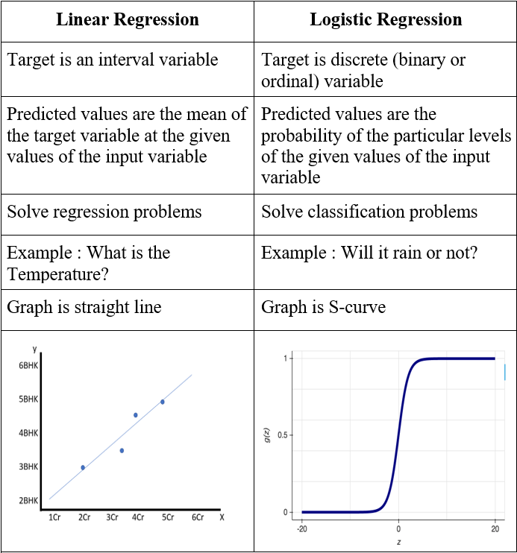
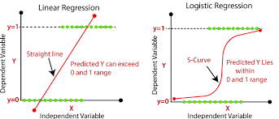
Linear Regression vs Logistic regression

Slide 7
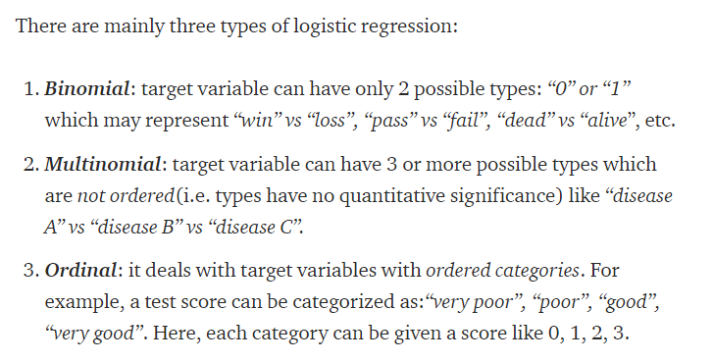
Types of Logistic Regression

Slide 8
Logistic Regression –Classification Problems
Classification problems are an important category of problems in analytics in which the response variable (Y) takes a discrete value.
A bank may like to classify their customers based on risk such as low-, medium- and high-risk customers under loan portfolio. Here the response variable Y takes 3 values (e.g., Y = 1 for low risk, Y = 2 for medium risk and Y = 3 for high risk).
Health service providers based on diagnostic tests may classify the patients as positive, that is presence of a disease (Y = 1) or negative, that is absence of a disease (Y = 0).
Movie production houses may like to predict whether a movie will be a hit or not at the box office.

Slide 9
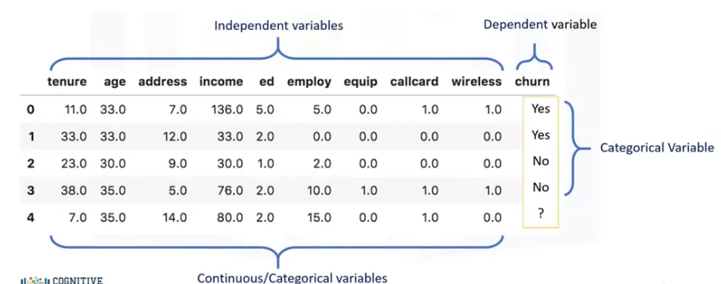
Example

Slide 10
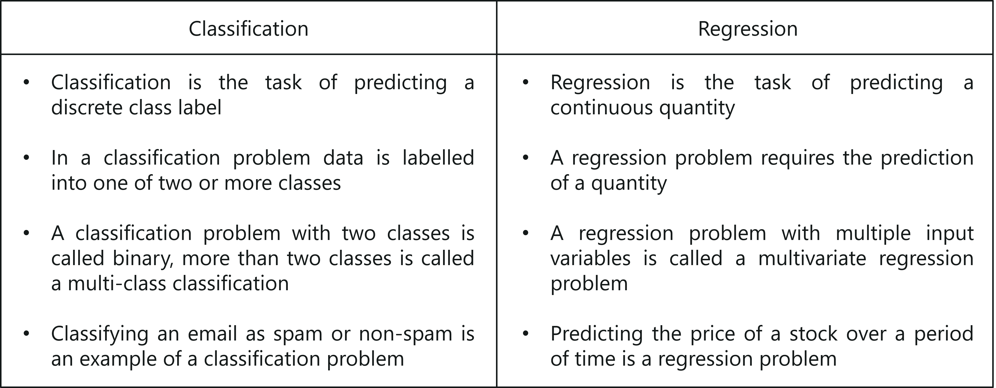
Regression vs Classification

Slide 11
Applications of Logistic Regression
Image Segmentation and Categorization.
Geographic Image Processing.
Handwriting recognition.
Healthcare .
Prediction whether a person is depressed or not based ,etc.

Slide 12
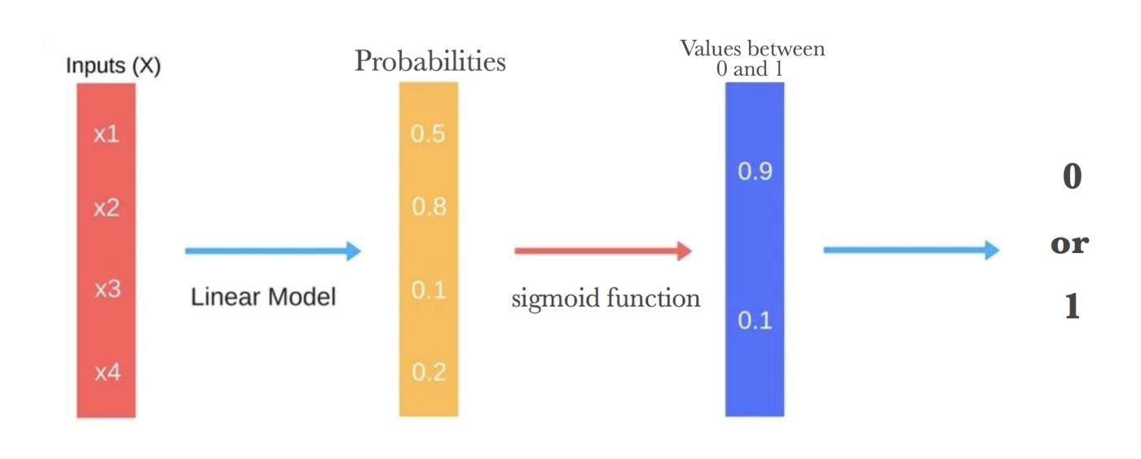
Flow sequence of Logistic Regression

Slide 13
Terminologies involved in Logistic Regression:
Logistic function: The formula used to represent how the independent and dependent variables relate to one another. The logistic function transforms the input variables into a probability value between 0 and 1, which represents the likelihood of the dependent variable being 1 or 0.
Odds: The proportion of an event’s chances of happening to its chances of not happening. The chances are used in logistic regression to model the connection between the independent and dependent variables.
Log-odds: The logistic regression model’s calculation is made simpler by using the logarithm of the odds.
Coefficient: The logistic regression model’s estimated parameters, which show how the independent and dependent variables relate to one another.
Intercept: A constant term in the logistic regression model, which represents the log-odds when all independent variables are equal to zero.
Maximum likelihood estimation: The method used to estimate the coefficients of the logistic regression model, which maximizes the likelihood of observing the data given the model.

Slide 14
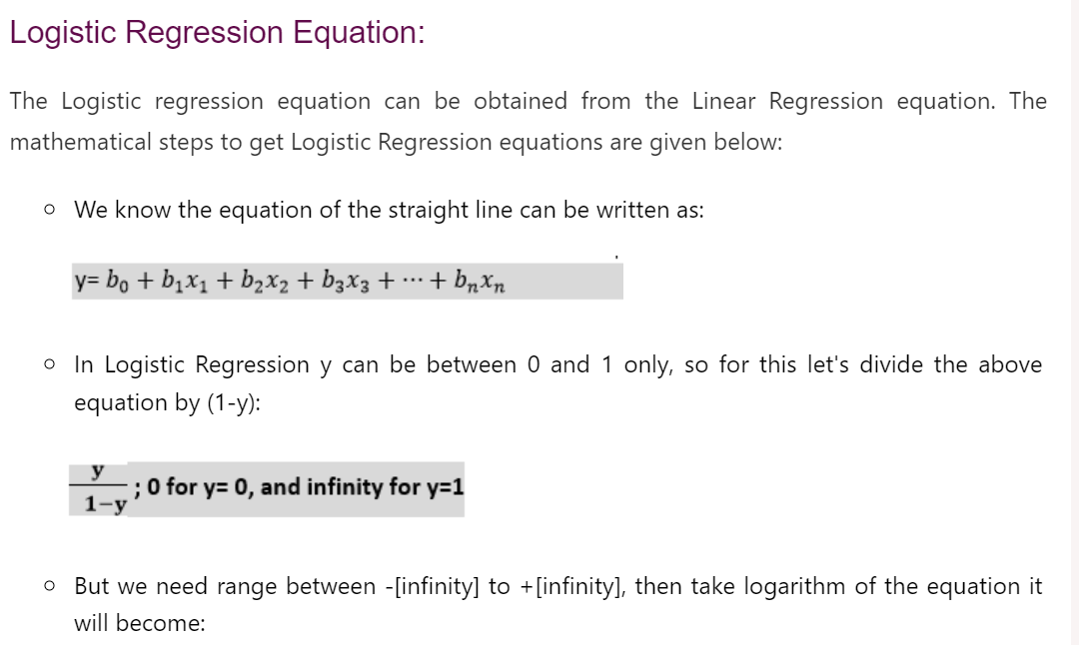
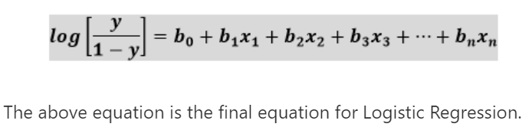

Slide 15
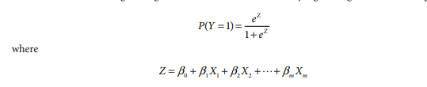
Binary logistic regression(Dichotomous Predictor)
Binary logistic regression function is
Here X1 , X2 , …, Xm are the independent variables

Slide 16
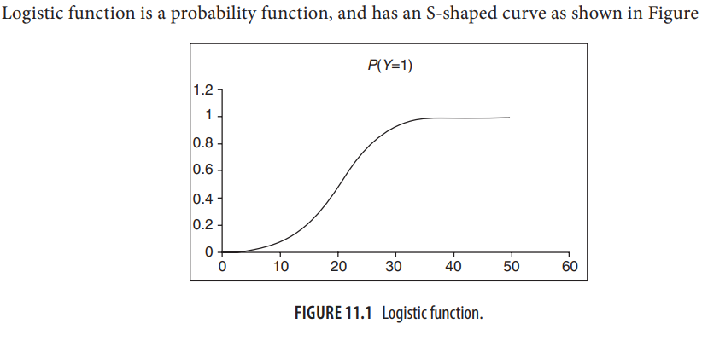
Logistic function

Slide 17
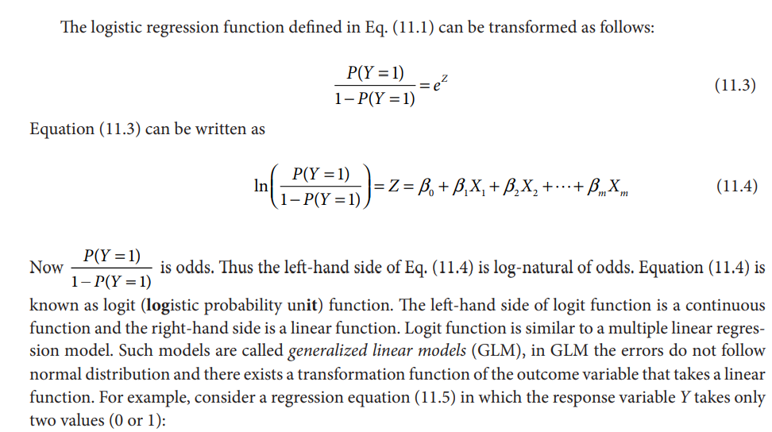
Logistic Regression model

Slide 18
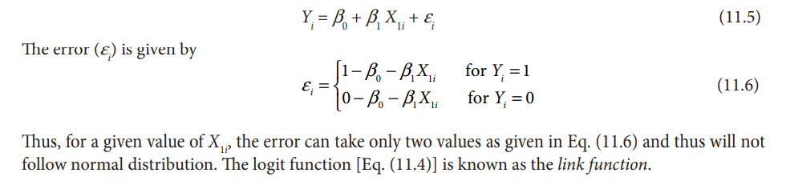
Logistic Regression model

Slide 19
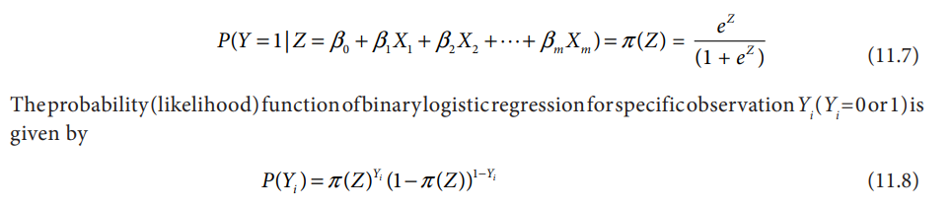
Estimation of parameters in LR
One of the major assumptions of multiple linear regression model is that the residuals follow a normal distribution (or approximate normal distribution). However, the residuals in logistic regression will not a follow normal distribution and thus we cannot use method of ordinary least squares (OLS) to estimate the regression parameters
The errors in LR are inherently heteroscedastic. Regression parameters in the case of logistic regression are estimated using Maximum Likelihood Estimator (MLE).
In binary logistic regression, the response variable Y takes only two values (Y = 0 and 1).
Let

Slide 20
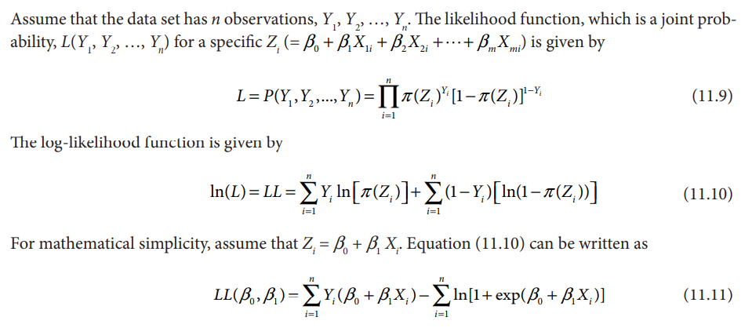
Estimation of parameters in LR

Slide 21
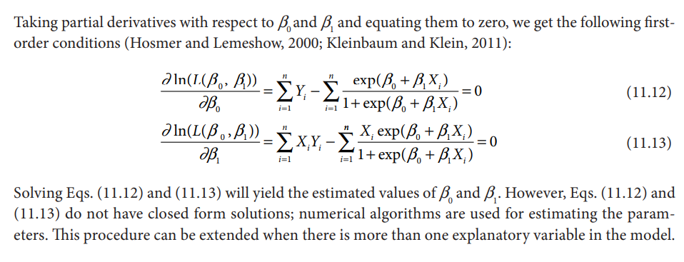
Estimation of parameters in LR

Slide 22
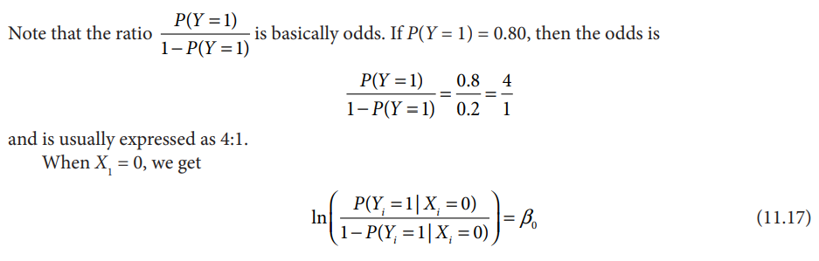
Interpretation of LR parameters
Let logit function

Slide 23
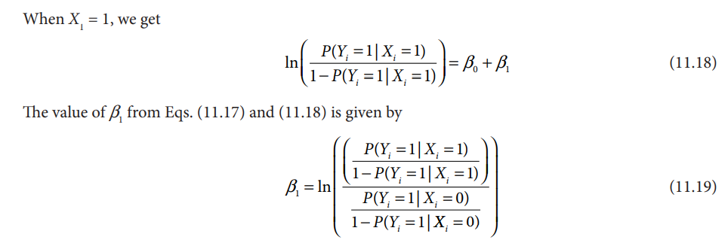
Interpretation of LR parameters

Slide 24
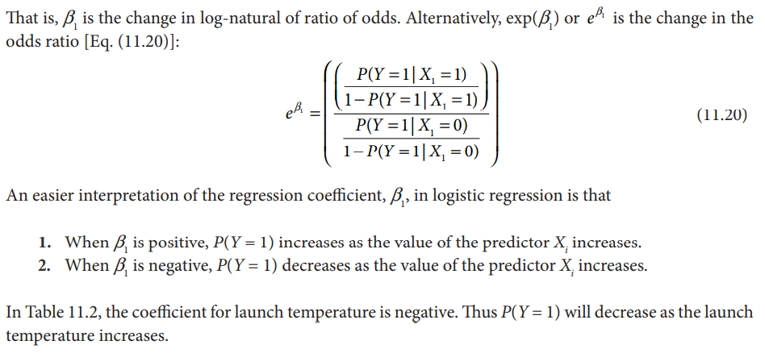
Interpretation of LR parameters

Slide 25
LR-Coefficients-Probability , Odds and Log of Odds
Let’s say that the probability of success is p=0.8p=0.8,
then the probability of failure is 1−p=1-0.8=0.2
The odds of success is Probability, Odds and Log of Odds
i.e. the odds of success is 4 to 1 and the odds of failure is 0.25 to 1.
Note that:
Probability ranges from 0 to 1
Odds range from 0 to ∞∞
Log Odds range from −∞−∞ to ∞∞
That is why the log odds are used to avoid modeling a variable with a restricted range such as probability.

Slide 26
Example: Odds
Given some event with probability p of being 1, the odds of that event are given by:
Consider the following data
The odds of being delinquent if you are in the Normal group are:
pdelinquent/(1–pdelinquent) = (402/4016) / (1 - (402/4016)) = 0.1001 / 0.8889 = 0.111
odds = p / (1–p)
Delinquent
Testosterone

Slide 27
Example : Odds Ratio
The odds of being not delinquent in the Normal group is the reciprocal of this:
0.8999/0.1001 = 8.99
Now, for the High testosterone group
odds(delinquent) = 101/345 = 0.293
odds(not delinquent) = 345/101 = 3.416
When we go from Normal to High, the odds of being delinquent nearly triple:
Odds ratio: 0.293/0.111 = 2.64
2.64 times more likely to be delinquent with high testosterone levels

Slide 28
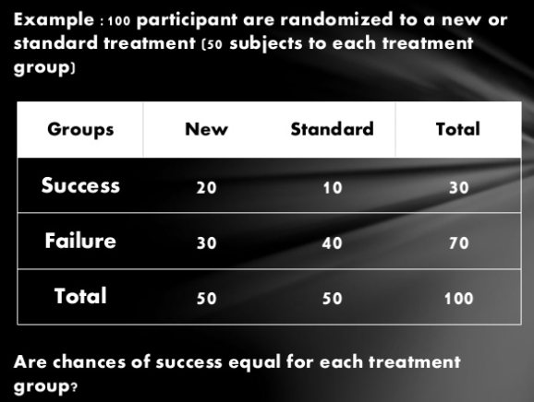
Example

Slide 29
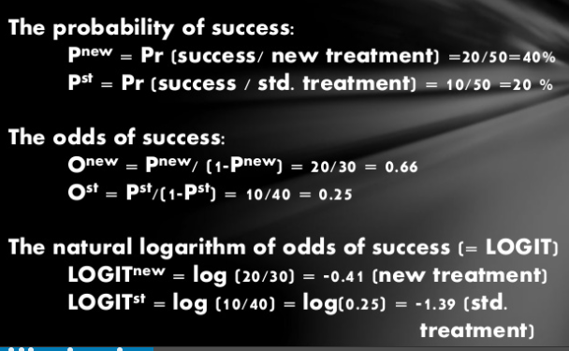
Example: Measure chances of success

Slide 30
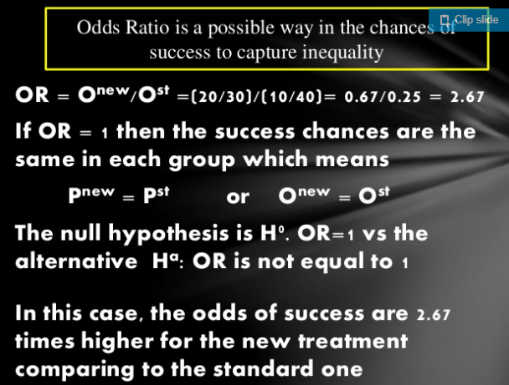
Example: Odds Ratio is a possible way in the chances of success to capture inequality

Slide 31
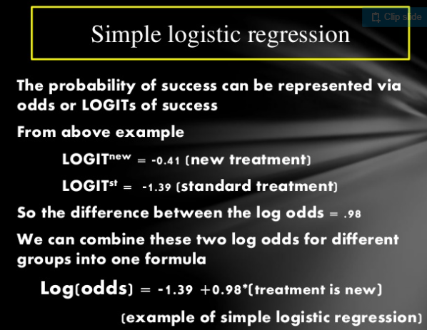
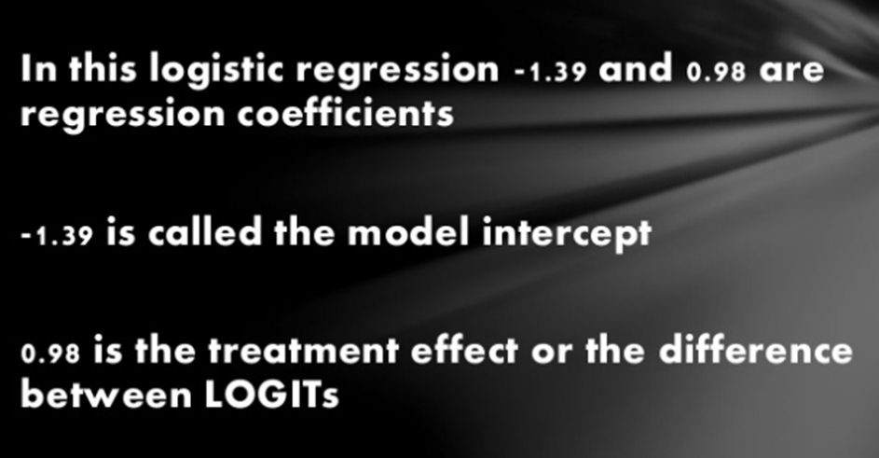
Example: LR model

Slide 32
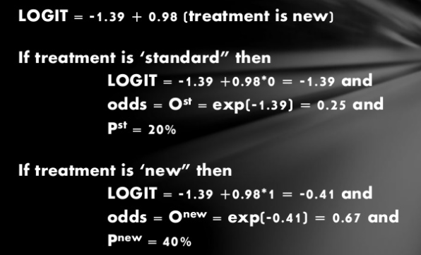
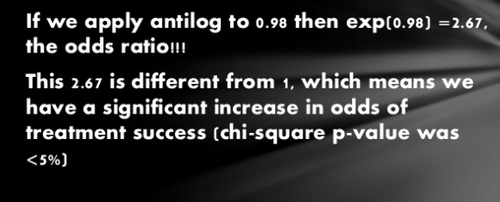
Example

Slide 33
Statistic testing
Question
Does model including given independent variable provide more information about dependent variable than model without this variable?
Three tests
Likelihood ratio statistic (LRS)
Wald test
Score test

Slide 34
Likelihood ratio statistic
Compares two nested models
Log(odds) = α + β₁x₁ + β₂x₂ + β₃x₃ (model 1)
Log(odds) = α + β₁x₁ + β₂x₂ (model 2)
LR statistic
-2 log (likelihood model 2 / likelihood model 1) =
-2 log (likelihood model 2) minus -2log (likelihood model 1)
LR statistic is a χ² with DF = number of extra parameters in model

