Slide 1
Unit-II Logistic Regression
Logistic regression
Estimation and Interpretation of Coefficients
From: Business Analytics by Dr Dinesh Kumar

Slide 2
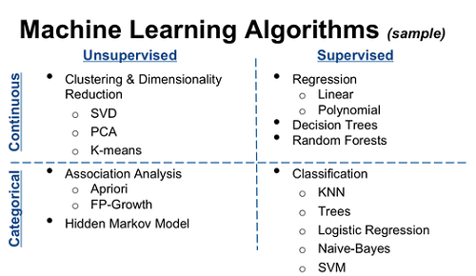
Types of Machine learning Algorithms

Slide 3
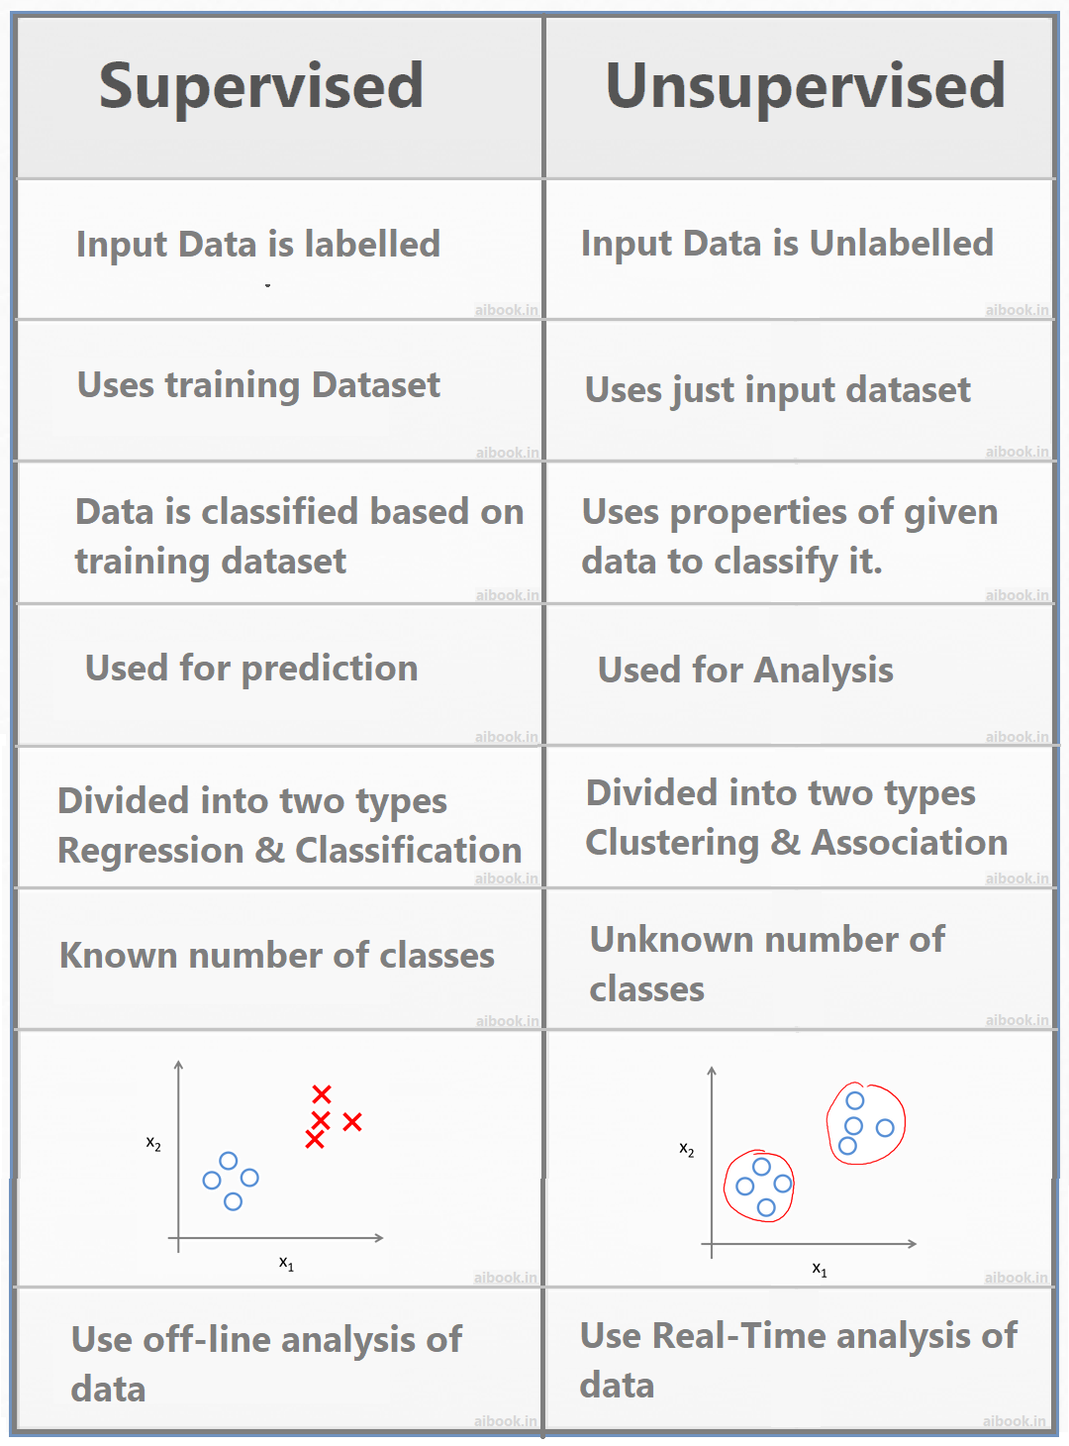
Supervised vs Unsupervised learning

Slide 4
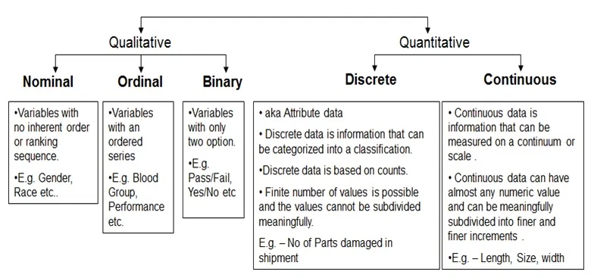
Discrete vs Continuous data

Slide 5
Essence of Logistic Regression
Logistic regression is one of the supervised learning algorithms.
Logistic regression (LR) is a statistical technique for finding existence of a relationship between a qualitative (discrete) dependent variable (or outcome variable) and several independent variables (aka explanatory variables or predictors).
In LR, the primary objective is to find the conditional probability of occurrence of an event (class probability) given the values of several independent variables.
LR is one of the most popular tools used for solving classification problems.

Slide 6
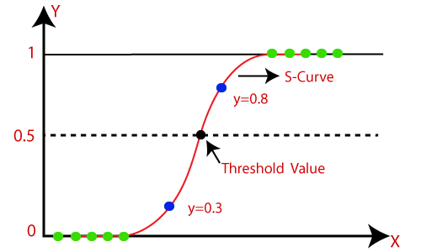
In Logistic regression, instead of fitting a regression line, we fit an "S" shaped logistic function, which predicts two maximum values (0 or 1).
The curve from the logistic function indicates the likelihood of something such as whether the cells are cancerous or not, a mouse is obese or not based on its weight, etc.
Logistic Regression is a significant machine learning algorithm because it has the ability to provide probabilities and classify new data using continuous and discrete datasets.
Logistic Regression can be used to classify the observations using different types of data and can easily determine the most effective variables used for the classification. The below image is showing the logistic function:

Slide 7
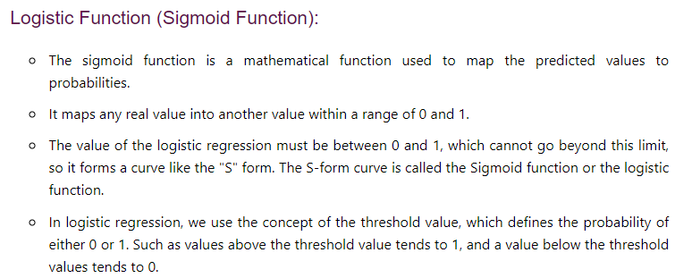

Slide 8
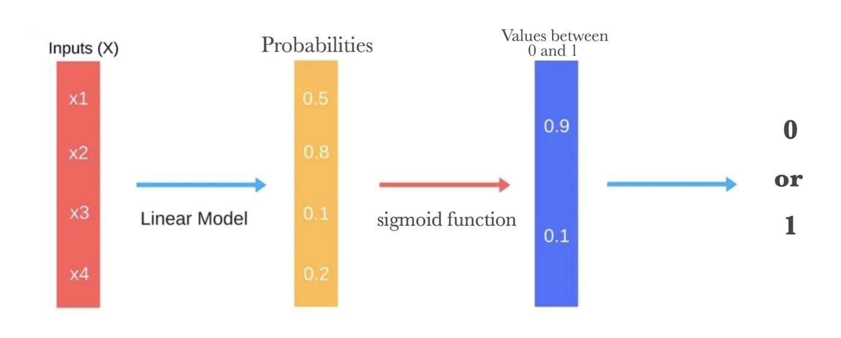
Flow sequence of Logistic Regression

Slide 9
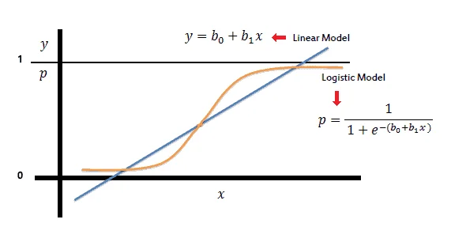
Applications of Logistic Regression
Image Segmentation and Categorization.
Geographic Image Processing.
Handwriting recognition.
Healthcare : Analyzing a group of over million people for myocardial infarction within a period of 10 years is an application area of logistic regression.
Prediction whether a person is depressed or not based ,etc.

Slide 10
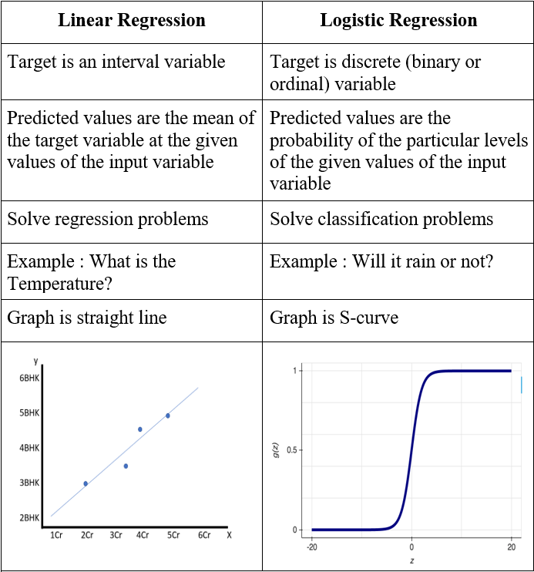
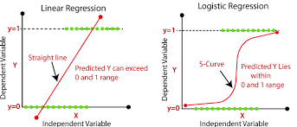
Linear Regression vs Logistic regression

Slide 11
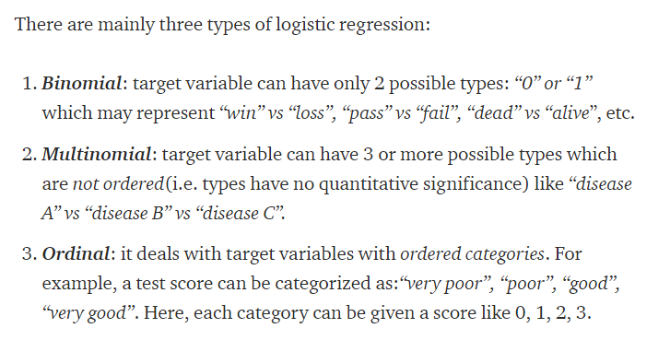
Types of Logistic Regression

Slide 12
Logistic Regression –Classification Problems
Classification problems are an important category of problems in analytics in which the response variable (Y) takes a discrete value.
A bank may like to classify their customers based on risk such as low-, medium- and high-risk customers under loan portfolio. Here the response variable Y takes 3 values (e.g., Y = 1 for low risk, Y = 2 for medium risk and Y = 3 for high risk).
Health service providers based on diagnostic tests may classify the patients as positive, that is presence of a disease (Y = 1) or negative, that is absence of a disease (Y = 0).
Movie production houses may like to predict whether a movie will be a hit or not at the box office.

Slide 13
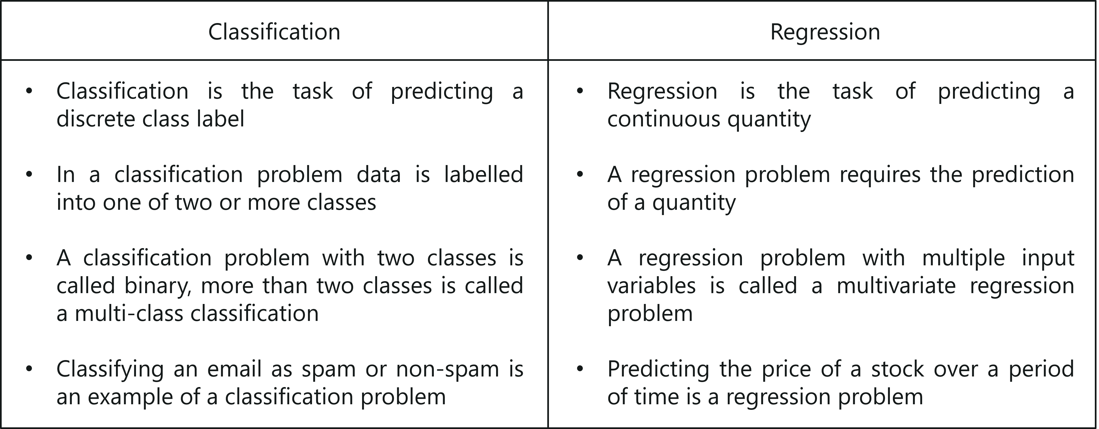
Regression vs Classification

Slide 14
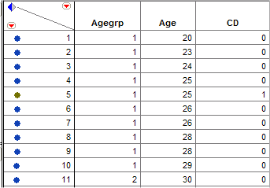
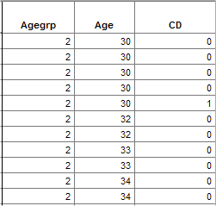

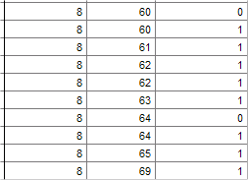
Logistic Regression
Example: Coronary Heart Disease (CD) and Age In this study sampled individuals were examined for signs of CD (present = 1 / absent = 0) and the potential relationship between this outcome and their age (yrs.) was considered.
…
This is a portion of the raw data for the 100 subjects who participated in the study.

Slide 15
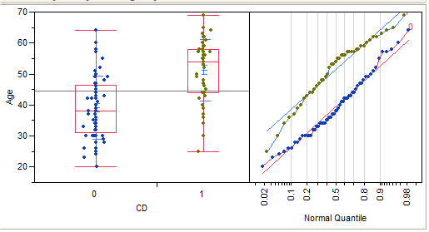
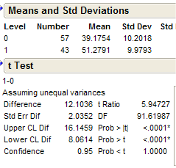
Logistic Regression
How can we analyze these data?
Non-pooled t-test
The mean age of the individuals with some signs of coronary heart disease is 51.28 years vs. 39.18 years for individuals without signs (t = 5.95, p < .0001).

Slide 16
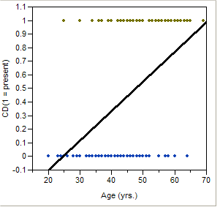
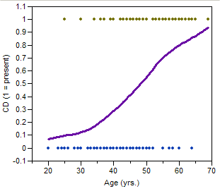
Logistic Regression
Simple Linear Regression? Smooth Regression Estimate?
The smooth regression estimate is “S-shaped” but what does the estimated mean value represent?
Answer: P(CD|Age)!!!!

Slide 17

Binary logistic regression(Dichotomous Predictor)
Binary logistic regression function is
Here X1 , X2 , …, Xm are the independent variables

Slide 18
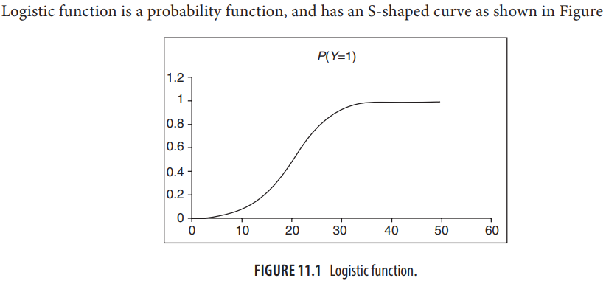
Logistic function

Slide 19
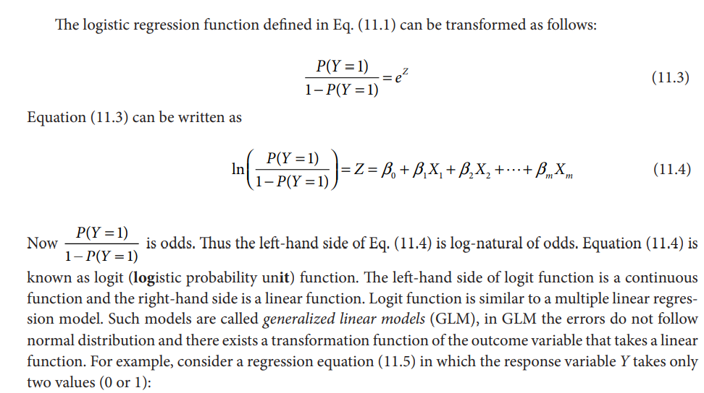
Logistic Regression model

Slide 20
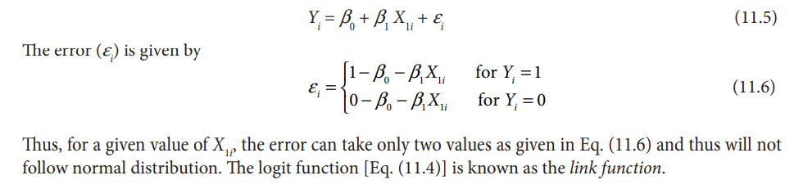
Logistic Regression model

Slide 21
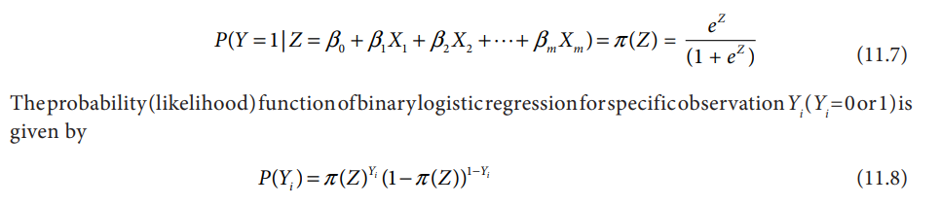
Estimation of parameters in LR
One of the major assumptions of multiple linear regression model is that the residuals follow a normal distribution (or approximate normal distribution). However, the residuals in logistic regression will not a follow normal distribution and thus we cannot use method of ordinary least squares (OLS) to estimate the regression parameters
The errors in LR are inherently heteroscedastic. Regression parameters in the case of logistic regression are estimated using Maximum Likelihood Estimator (MLE).
In binary logistic regression, the response variable Y takes only two values (Y = 0 and 1).
Let

Slide 22
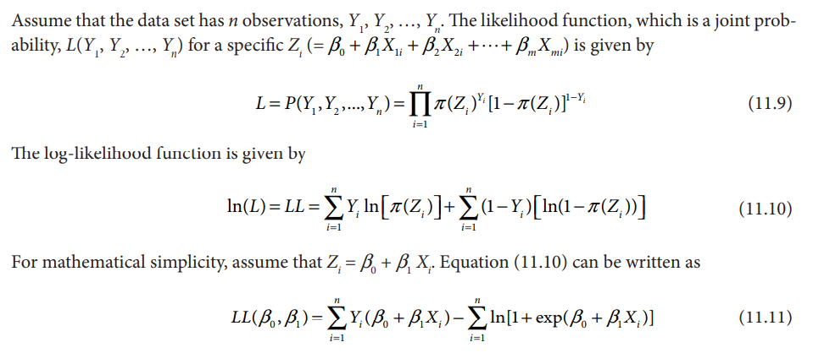
Estimation of parameters in LR

Slide 23
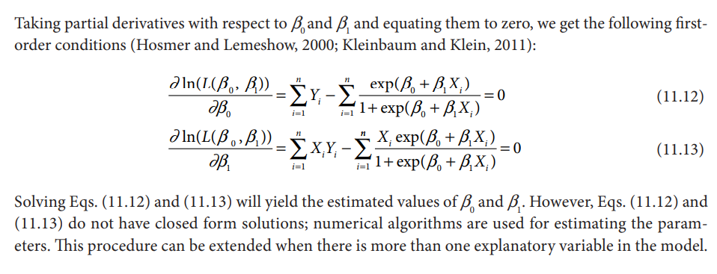
Estimation of parameters in LR

Slide 24
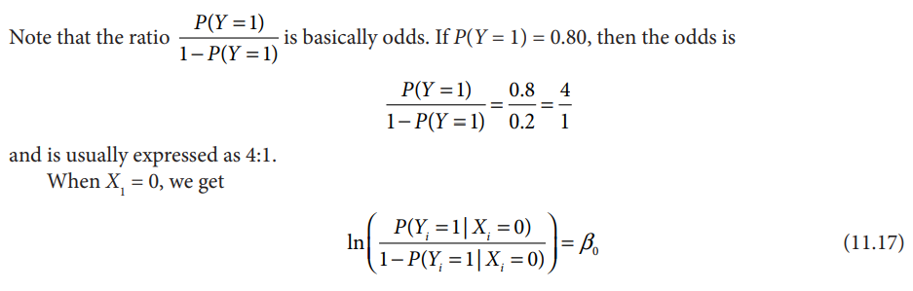
Interpretation of LR parameters
Let logit function

Slide 25
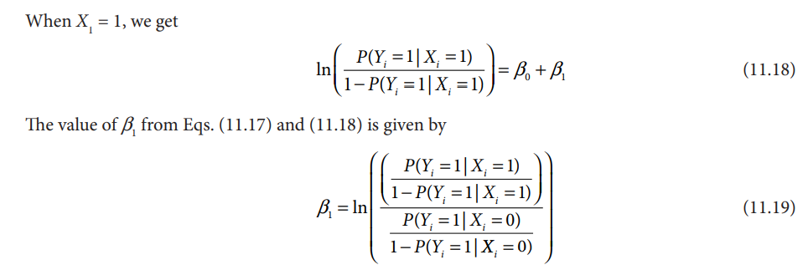
Interpretation of LR parameters

Slide 26
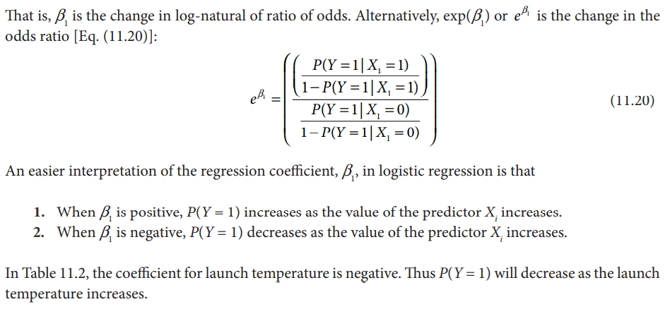
Interpretation of LR parameters

Slide 27
