Slide 1
FAI
Unit-IV
K-Nearest Neighbor Classifier

Slide 2
Contents
Eager learners vs Lazy learners
What is KNN?
Discussion about categorical attributes
Discussion about missing values
How to choose k?
KNN algorithm – choosing distance measure and k
Solving an Example
Advantages and Disadvantages of KNN
Applications of KNN

Slide 3
KNN Classifier
K-nearest neighbours (KNN) algorithm is a type of supervised ML algorithm which can be used for both classification as well as regression predictive problems.
The following two properties would define KNN well
Lazy learning algorithm − KNN is a lazy learning algorithm because it does not have a specialized training phase and uses all the data for training while classification.
Non-parametric learning algorithm − KNN is also a non-parametric learning algorithm because it doesn’t assume anything about the underlying data.

Slide 4
K-NN Classifier
Types Of Learners In Classification
Lazy Learners :
Lazy learners simply store the training data and wait until a testing data appears.
The classification is done using the most related data in the stored training data.
They take more predicting time compared to eager learners.
Eg – k-nearest neighbour, case-based reasoning.
Eager Learners :
Eager learners construct a classification model based on the given training data before getting data for predictions.
It must be able to commit to a single hypothesis that will work for the entire space.
Due to this, they take a lot of time in training and less time for a prediction.
Eg– Decision Tree, Naive Bayes, Artificial Neural Networks.

Slide 5
What is k- NN??
Nearest-neighbor classifiers are based on learning by analogy, that is, by comparing a given test tuple with training tuples that are similar to it.
The training tuples are described by n attributes.
When k = 1, the unknown tuple is assigned the class of the training tuple that is closest to it in pattern space.

Slide 6
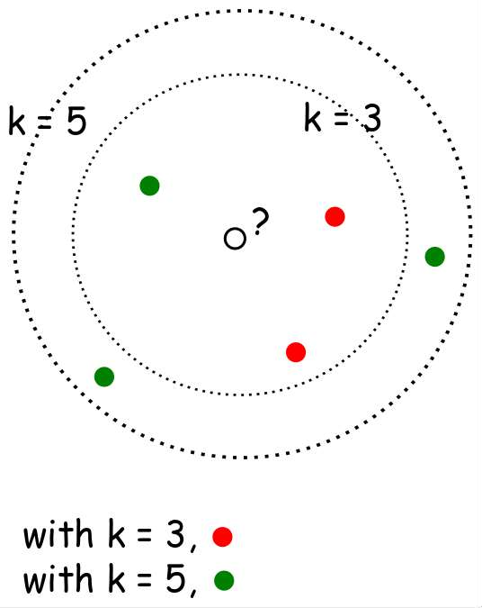
When k=3 or k=5??

Slide 7


Closeness
The Euclidean distance between two points or tuples, say,
X1 = (x11,x12,...,x1n) and X2 =(x21,x22,...,x2n), is
Min-max normalization can be used to transform a value v of a numeric attribute A to v0 in the range [0,1] by computing

Slide 8
What if attributes are categorical??
How can distance be computed for attribute such as colour?
-Simple Method: Compare corresponding value of attributes
-Other Method: Differential grading
What about missing values ??
If the value of a given attribute A is missing in tuple X1 and/or in tuple X2, we assume the maximum possible difference.
For categorical attributes, we take the difference value to be 1 if either one or both of the corresponding values of A are missing.
If A is numeric and missing from both tuples X1 and X2, then the difference is also taken to be 1.

Slide 9
KNN Algorithm and Example

Slide 10
Distance Measures
𝐸𝑢𝑐𝑙𝑖𝑑𝑒𝑎𝑛 𝑑𝑖𝑠𝑡𝑎𝑛𝑐𝑒 ∶ 𝑑 𝑥, 𝑦
= ∑ 𝑥_{𝑖} − 𝑦𝑖
2
𝑆𝑞𝑢𝑎𝑟𝑒𝑑 𝐸𝑢𝑐𝑙𝑖𝑑𝑒𝑎𝑛 𝑑𝑖𝑠𝑡𝑎𝑛𝑐𝑒 ∶ 𝑑 𝑥, 𝑦
= ∑ 𝑥_{𝑖} − 𝑦𝑖
2
𝑀𝑎𝑛ℎ𝑎𝑡𝑡𝑎𝑛 𝑑𝑖𝑠𝑡𝑎𝑛𝑐𝑒 ∶ 𝑑 𝑥, 𝑦
= ∑ |(𝑥𝑖 − 𝑦𝑖)|
Which distance measure to use?
We use Euclidean Distance as it treats each feature as equally important.

Slide 11
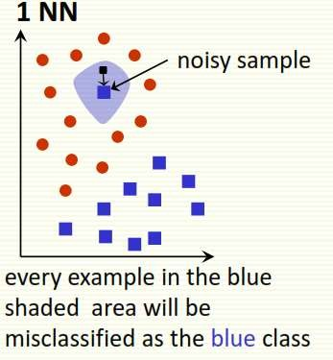
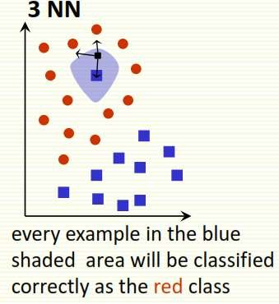
How to choose K?
If infinite number of samples available, the larger is k, the better is classification.
k = 1 is often used for efficiency, but sensitive to “noise”

Slide 12
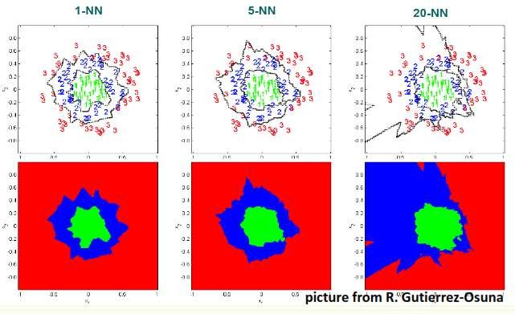
Larger k gives smoother boundaries, better for generalization, but only if locality is preserved. Locality is not preserved if end up looking at samples too far away, not from the same class.
Interesting relation to find k for large sample data : k = sqrt(n)/2 where n is # of examples
Can choose k through cross-validation

Slide 13
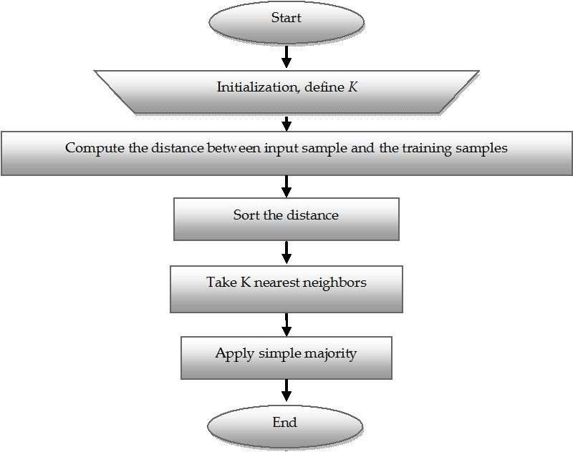
KNN Classifier Algorithm

Slide 14
K-NN Algorithm
KNN working with the help of following steps :
Step 1 − For implementing any algorithm, we need dataset. So during the first step of KNN, we must load the training as well as test data.
Step 2 − Next, we need to choose the value of K i.e. the nearest data points. K can be any integer.
Step 3 − For each point in the test data do the following −
3.1 − Calculate the distance between test data and each row of training data with the help of any of the method namely: Euclidean, Manhattan or Hamming distance. The most commonly used method to calculate distance is Euclidean.
3.2 − Now, based on the distance value, sort them in ascending order.
3.3 − Next, it will choose the top K rows from the sorted array.
3.4 − Now, it will assign a class to the test point based on most frequent class of these rows.
Step 4 − End

Slide 15
Example
We have data from the questionnaires survey and objective testing with two attributes (acid durability and strength) to classify whether a special paper tissue is good or not. Here are four training samples :
X1 = Acid Durability (seconds) | X2 = Strength (kg/square meter) | Y = Classification
7 | 7 | Bad
7 | 4 | Bad
3 | 4 | Good
1 | 4 | Good
Now the factory produces a new paper tissue that passes the laboratory test with X1 = 3 and X2 = 7. Guess the classification of this new tissue.

Slide 16
Step 1 : Initialize and Define k.
Lets say, k = 3
(Always choose k as an odd number if the number of attributes is even to avoid a tie in the class prediction)
Step 2 : Compute the distance between input sample and
training sample
Co-ordinate of the input sample is (3,7).
Instead of calculating the Euclidean distance, we
calculate the Squared Euclidean distance.
X1 = Acid Durability (seconds) | X2 = Strength (kg/square meter) | Squared Euclidean distance
7 | 7 | (7-3)² + (7-7)² = 16
7 | 4 | (7-3)² + (4-7)² = 25
3 | 4 | (3-3)² + (4-7)² = 09
1 | 4 | (1-3)² + (4-7)² = 13

Slide 17
Step 3 : Sort the distance and determine the nearest neighbours based of the K^{th} minimum distance :
X1 = Acid Durability (seconds) | X2 = Strength (kg/square meter) | Squared Euclidean distance | Rank minimum distance | Is it included in 3-Nearest Neighbour?
7 | 7 | 16 | 3 | Yes
7 | 4 | 25 | 4 | No
3 | 4 | 09 | 1 | Yes
1 | 4 | 13 | 2 | Yes

Slide 18
Step 4 : Take 3-Nearest Neighbours:
Gather the category Y of the nearest neighbours.
X1 = Acid Durability (seconds) | X2 = Strength (kg/square meter) | Squared Euclidean distance | Rank minimum distance | Is it included in 3-Nearest Neighbour? | Y = Category of the nearest neighbour
7 | 7 | 16 | 3 | Yes | Bad
7 | 4 | 25 | 4 | No | -
3 | 4 | 09 | 1 | Yes | Good
1 | 4 | 13 | 2 | Yes | Good

Slide 19
Step 5 : Apply simple majority
Use simple majority of the category of the nearest
neighbours as the prediction value of the query instance.
We have 2 “good” and 1 “bad”. Thus we conclude that the new paper tissue that passes the laboratory test with X1 = 3 and X2 = 7 is included in the “good” category.

Slide 20
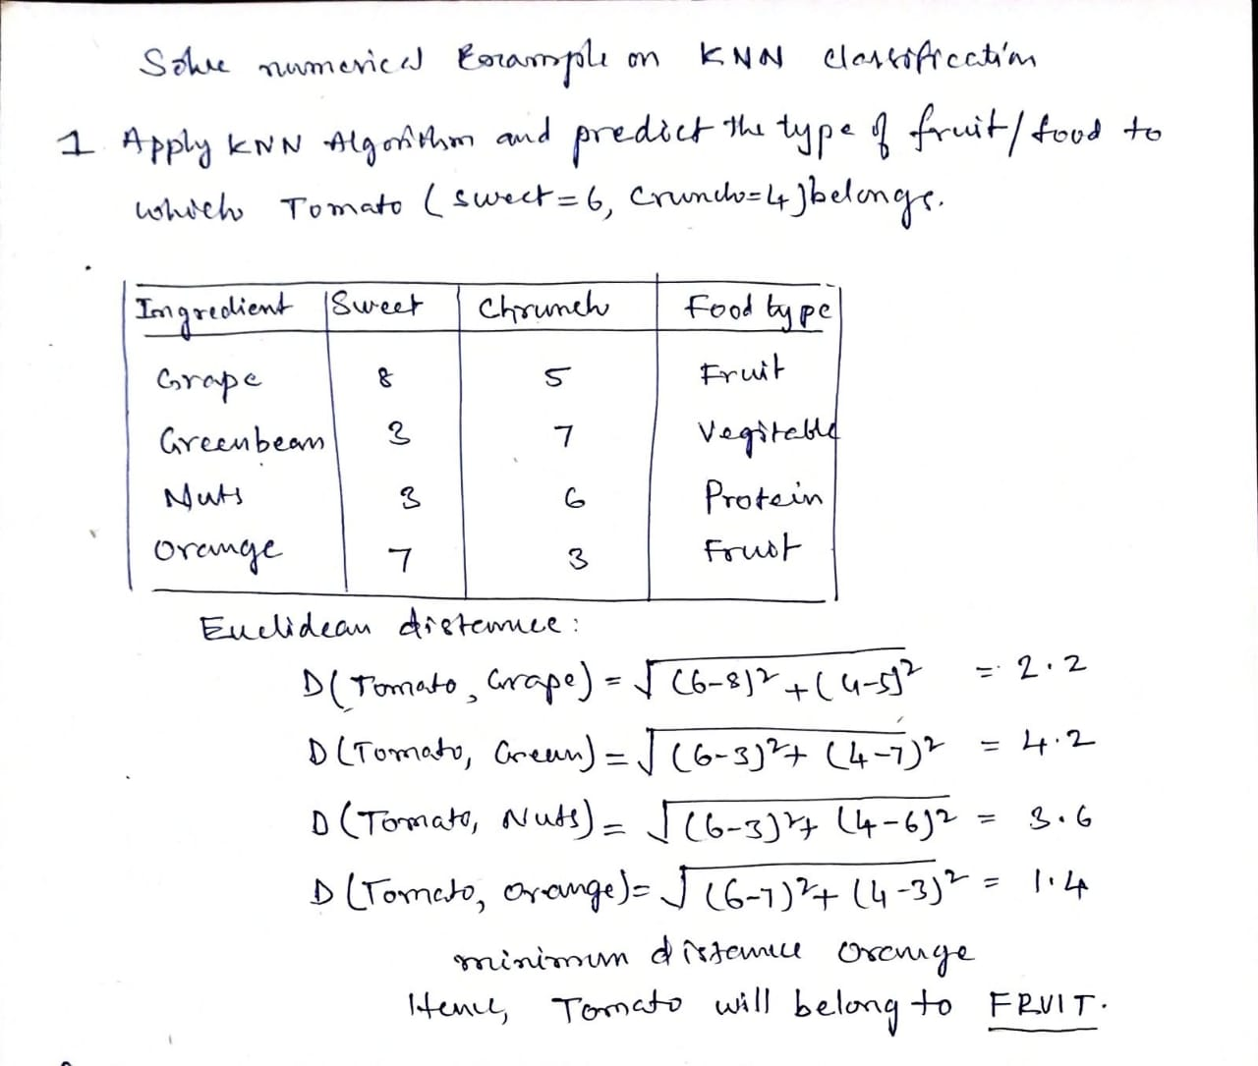
Example

Slide 21
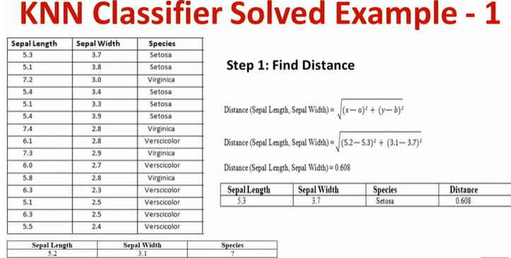

Slide 22
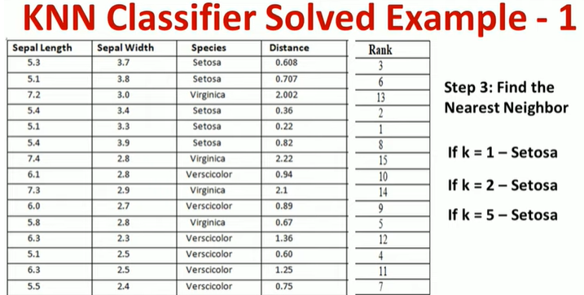

Slide 23
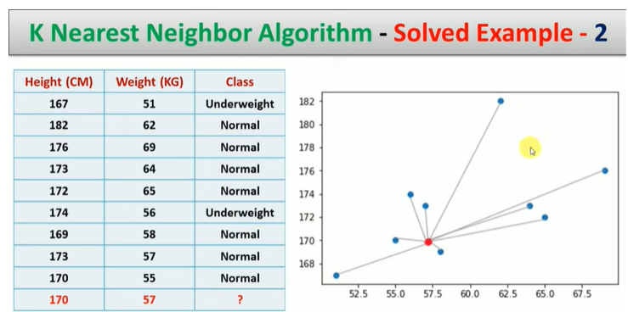

Slide 24
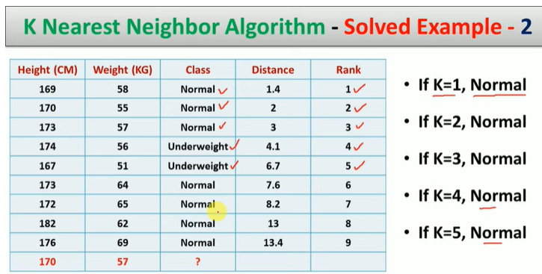

Slide 25
Complexity
Basic kNN algorithm stores all examples
Suppose we have n examples each of dimension d
O(d) to compute distance to one examples
O(nd) to computed distances to all examples
Plus O(nk) time to find k closest examples
Total time: O(nk+nd)
Very expensive for a large number of samples
But we need a large number of samples for kNN to to work well!!

Slide 26
Advantages of KNN classifier :
Can be applied to the data from any distribution for example, data does not have to be separable with a linear boundary
Very simple and intuitive
Good classification if the number of samples is large enough
Disadvantages of KNN classifier :
Choosing k may be tricky
Test stage is computationally expensive
No training stage, all the work is done during the test stage
This is actually the opposite of what we want. Usually we can afford training step to take a long time, but we want fast test step

Slide 27
Applications of KNN Classifier
Used in classification
Used to get missing values
Used in pattern recognition
Used in gene expression
Used in protein-protein prediction
Used to get 3D structure of protein
Used to measure document similarity

