Slide 1
DS- UNIT-III
Multiple Linear Regression
Chap 14-<number>

Slide 2
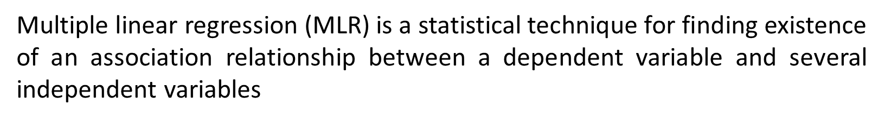
Multiple Regression Model
Idea: Examine the linear relationship between
1 dependent (Y) & 2 or more independent variables (X_{i})
Multiple Regression Model with k Independent Variables:
Y-intercept
Population slopes
Random Error
Chap 14-<number>

Slide 3

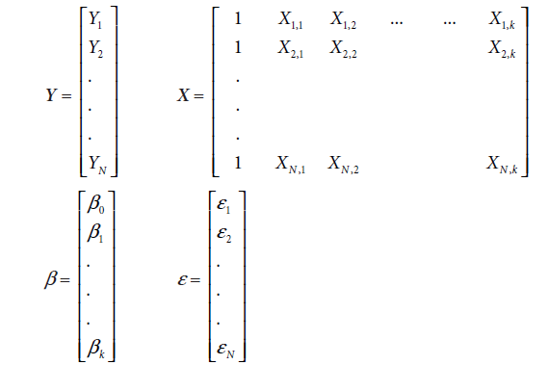
Elements of matrix representation of the multiple regression
Chap 14-<number>

Slide 4
ORDINARY LEAST SQUARES ESTIMATION
The assumptions of multiple linear regression model are as follows:
1. The regression model is linear in parameter.
2. The explanatory variable, Xi, is assumed to be non-stochastic (that is, Xi is deterministic). 273
3. The conditional expected value of the residuals, E(ei|Xi), is zero.
4. In a time series data, residuals are uncorrelated, that is, Cov(ei, ej) = 0 for all i ≠ j.
5. The residuals, ei, follow a normal distribution.
6. The variance of the residuals, Var(ei|Xi), is constant for all values of Xi. When the variance of the residuals is constant for different values of Xi, it is called homoscedasticity. A non-constant variance of residuals is called heteroscedasticity.
7. There is no high correlation between independent variables in the model (called multi-collinearity). Multi-collinearity can destabilize the model and can result in incorrect estimation of the regression parameters.
The sum of squared errors for the model in
Chap 14-<number>

Slide 5
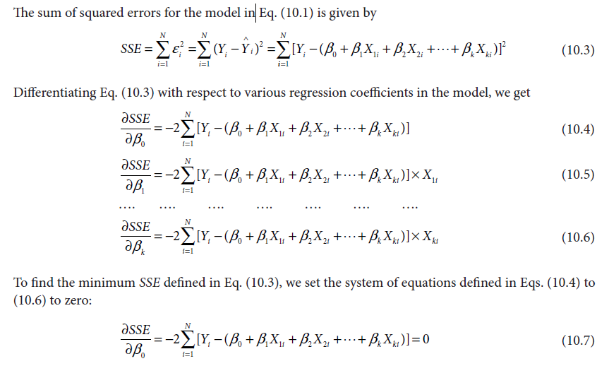
Chap 14-<number>

Slide 6
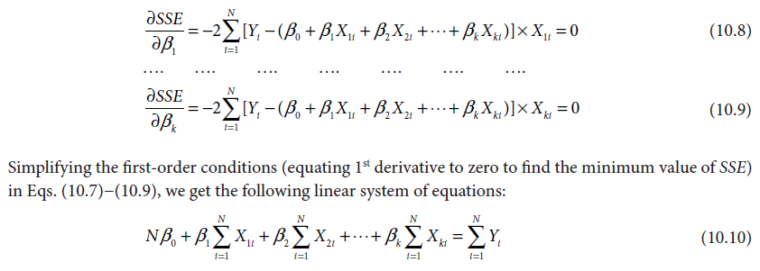
Chap 14-<number>

Slide 7
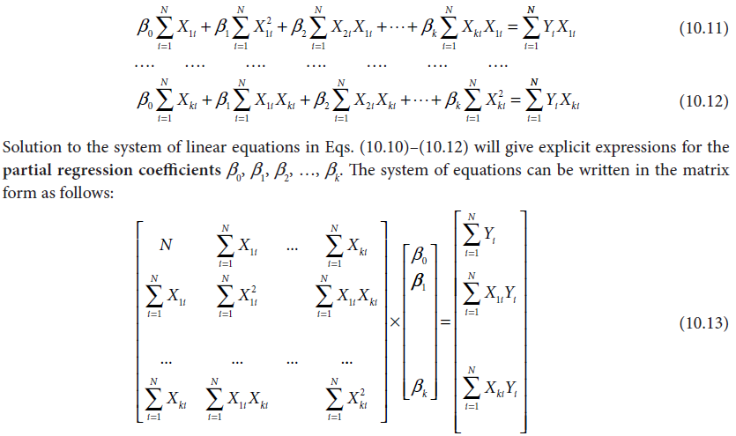
Chap 14-<number>

Slide 8
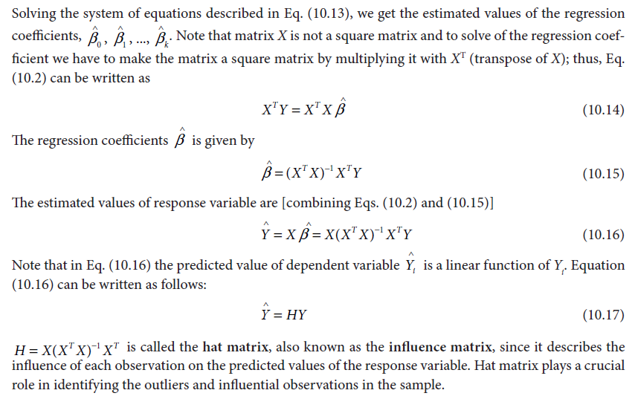
Chap 14-<number>

Slide 9
Find a multilinear regression model for the given data set consist of data object with attributes age, height, and weight values (15,145,45), (18,154, 58),(20, 167, 69), (30,170,95) and (50,178,102) using least square method
Solution:
Let a + b1 * Age + b2 * Height = W, where a, b1 and b2 are coefficients, (Age, Height) is independent variables and W be the dependent variables.
Given dataset consist of five data objects:
AGE | HEIGHT | WEIGHT
15 | 145 | 45
18 | 154 | 58
20 | 167 | 69
30 | 170 | 95
50 | 178 | 102

Slide 10
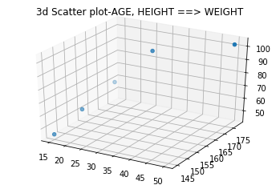
System of Equations and Graphical View
Then there are 5 linear equation as follows
a + 15b1+145b2 = 45
a + 18b1+154b2 = 58
a + 20b1+167b2 = 69
a + 30b1+170b2 = 95
a + 50b1+178b2 = 102

Slide 11
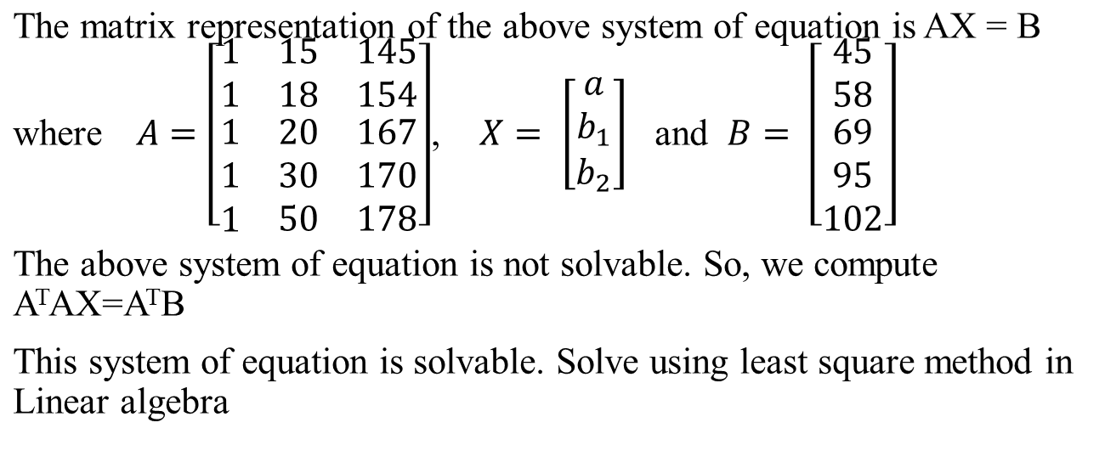
Matrix Representation

Slide 12
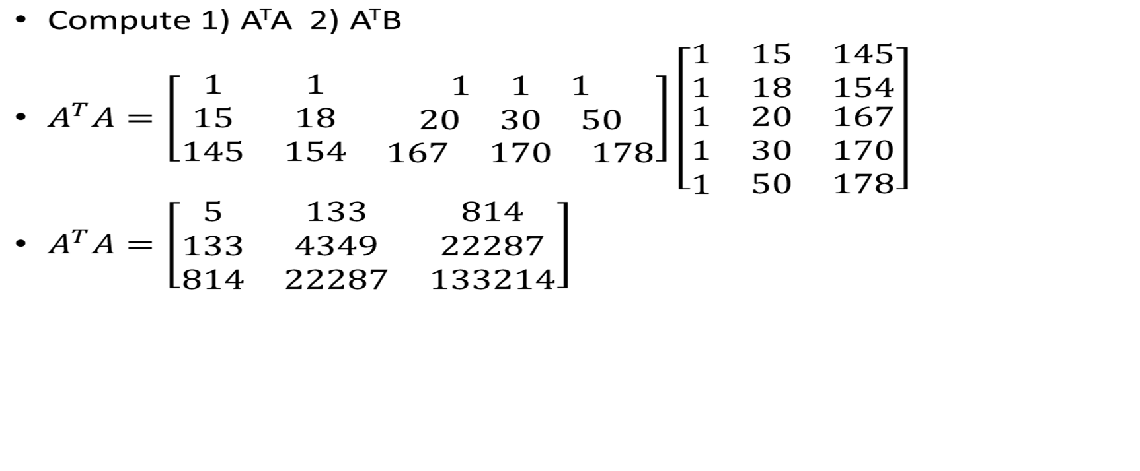
Solvable Model

Slide 13
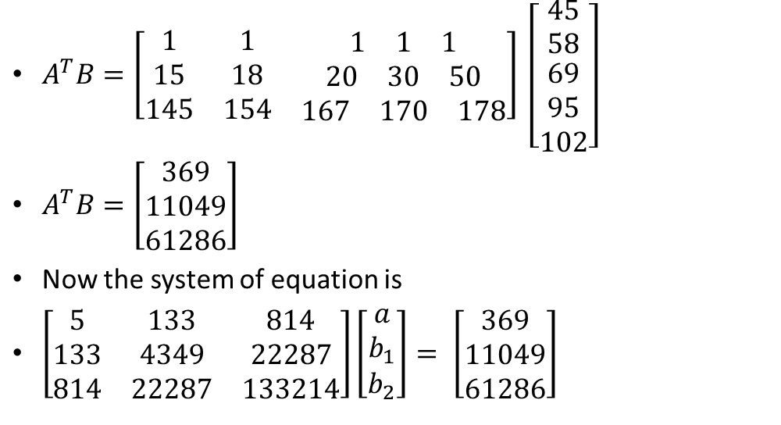
Cont…

Slide 14
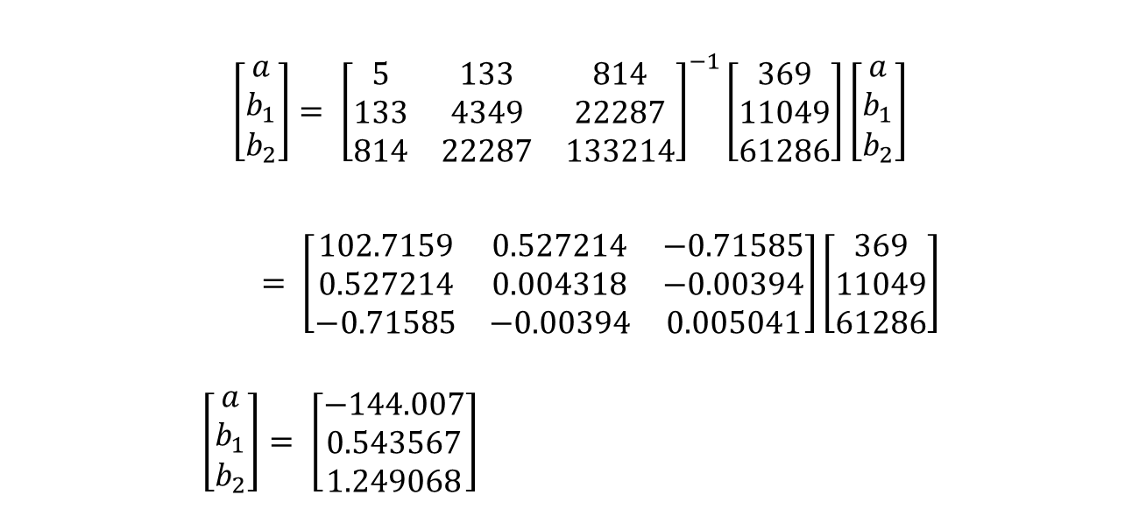
Inverse Method

Slide 15
Multiple Regression Model
Therefore, the multilinear model is
W = -144.007 + 0.543567 * Age + 1.249068 * Height
AGE | HEIGHT | WEIGHT | W = -144.007 + 0.543567 * Age + 1.249068 * Height | Residual Error(W- W^{p})
15 | 145 | 45 | 45.1614 | -0.1614
18 | 154 | 58 | 58.1337 | -0.1337
20 | 167 | 69 | 75.4587 | -6.4587
30 | 170 | 95 | 84.6416 | 10.3584
50 | 178 | 102 | 105.5055 | -3.5055

Slide 16

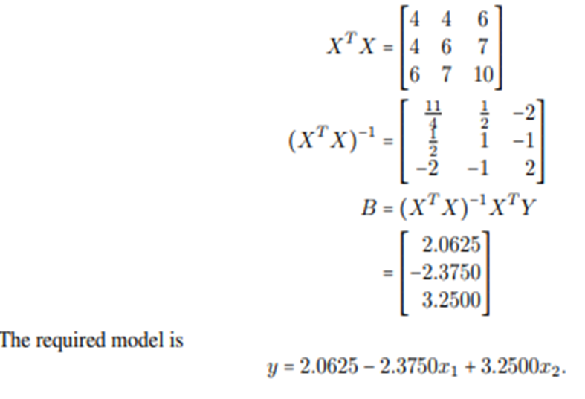
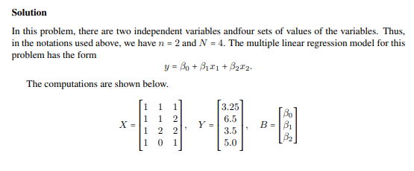
Example
Chap 14-<number>

Slide 17
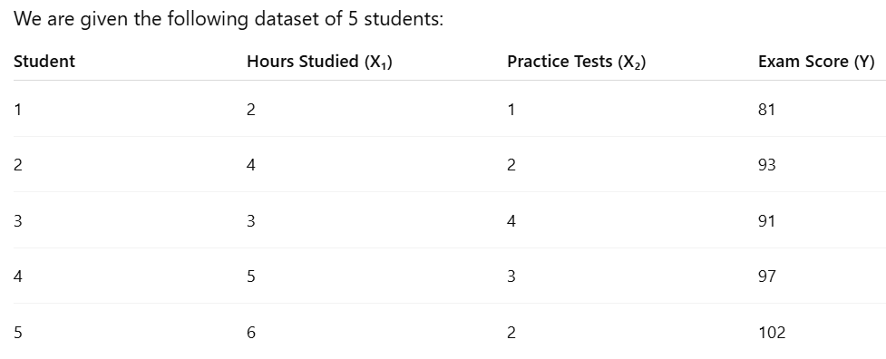
Example
Chap 13-<number>

Slide 18

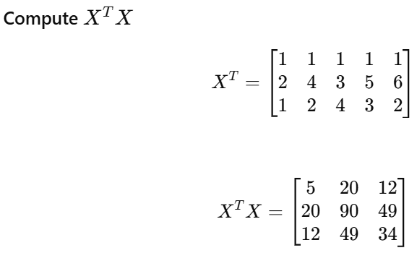
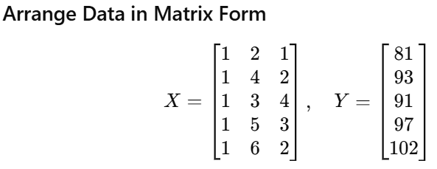

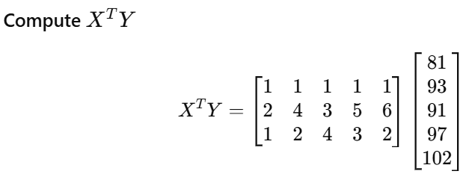
Chap 13-<number>

Slide 19
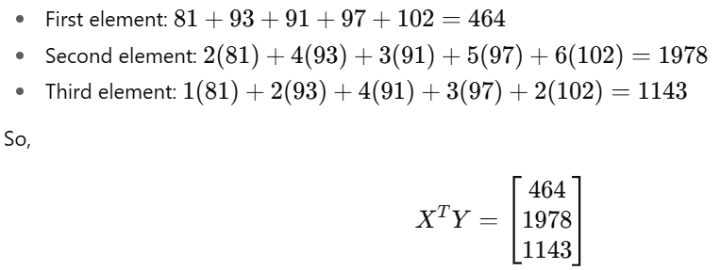
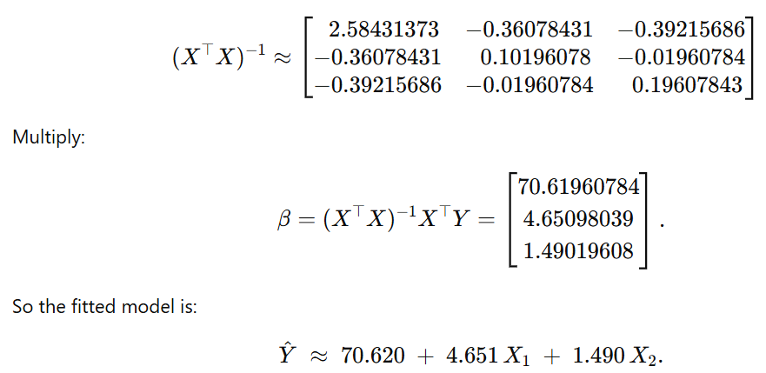
Chap 13-<number>

Slide 20
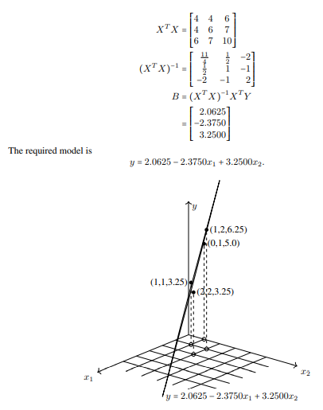
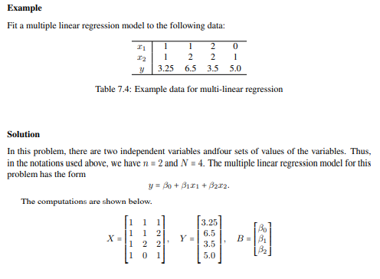
Example 2
Chap 14-<number>

Slide 21
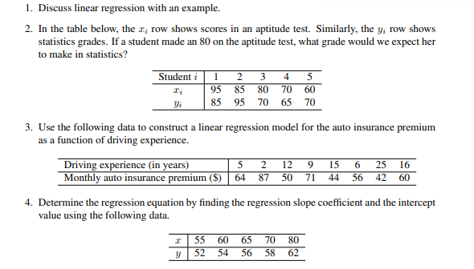
Exercise problems
Chap 14-<number>

Slide 22
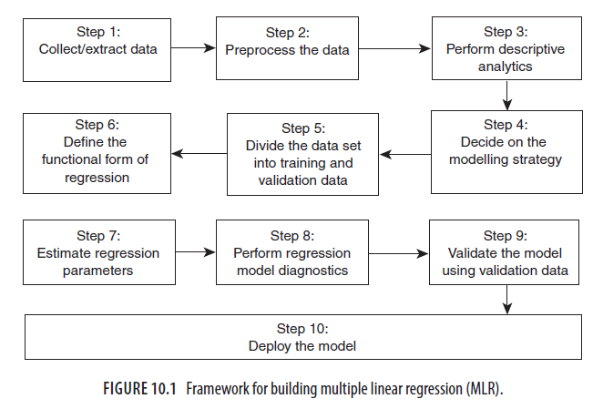
MULTIPLE LINEAR REGRESSION MODEL BUILDING
Chap 14-<number>

Slide 23
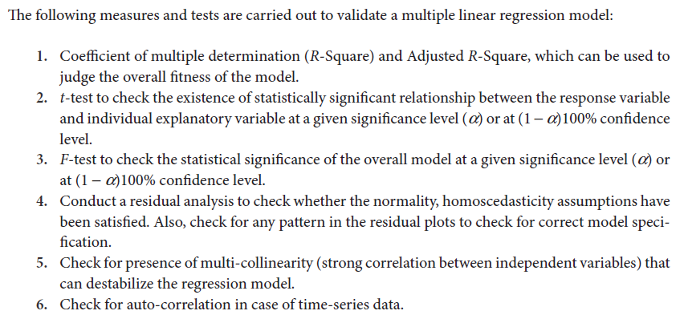
VALIDATION OF MULTIPLE REGRESSION MODEL
Chap 14-<number>

Slide 24
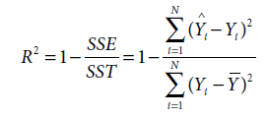


CO-EFFICIENT OF MULTIPLE DETERMINATION (R-SQUARE) AND ADJUSTED R-SQUARE
In case of MLR, SSE will decrease as the number of explanatory variables increases, and SST remains constant. So, it is possible, that R-square will increase even when there is no statistically significant relationship between the explanatory variable and the response variable.
To counter this, R2 value is adjusted by normalizing both SSE and SST with the corresponding degrees of freedom. The
adjusted R-square with k predictors is given by
Chap 14-<number>

Slide 25
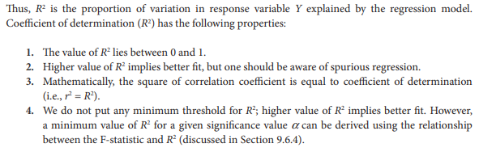
Properties of Coefficient of determination
Chap 14-<number>

Slide 26
The adjusted R-square value is always less than or equal to the R-square value.
No increase in adjusted R-square after adding a new predictor variable to the model may indicate that the newly added variable may not be statistically significant, or it is not explaining the variation in the response variables that is not explained by the variables that are already present in the model.
Chap 14-<number>

Slide 27
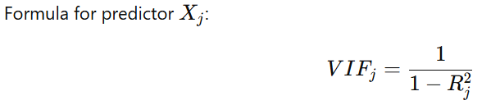
MULTI-COLLINEARITY AND VARIANCE INFLATION FACTOR(VIF)
In Multiple Linear Regression, multicollinearity happens when independent variables (predictors) are highly correlated with each other.
This causes:
Regression coefficients (β\betaβ) to become unstable (large standard errors).
Difficulty in interpreting which variable really affects the outcome.
Inflated t-statistics (variables may look insignificant).
VIF measures how much the variance of a regression coefficient is inflated due to multicollinearity.
Chap 14-<number>

Slide 28
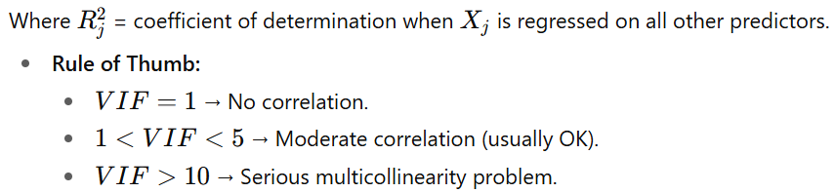
Chap 14-<number>

Slide 29
Detection of Multicollinearity
Study pairwise scatter plots of pairs of independent variables, looking for near-perfect relationships.
Consider the variance inflation factors (VIF). VIFs over 10 indicate collinear variables.
Eigenvalues of the correlation matrix of the independent variables near zero indicate multicollinearity.
Investigate the signs of the regression coefficients. Variables whose regression coefficients are opposite in sign from what you would expect may indicate multicollinearity

Slide 30
Remedies for Handling Multi-Collinearity
There are many approaches that can be used to handle the impact of multi-collinearity. One easier approach is to remove one of the variables from the model building.
When there are many variables in the data, the data scientists can use Principal Component Analysis (PCA) to avoid multi-collinearity.
PCA will create orthogonal components and thus remove potential multi-collinearity.
In the recent years, authors use advanced regression models such as Ridge regression and LASSO regression to handle multi-collinearity.
Chap 14-<number>

Slide 31
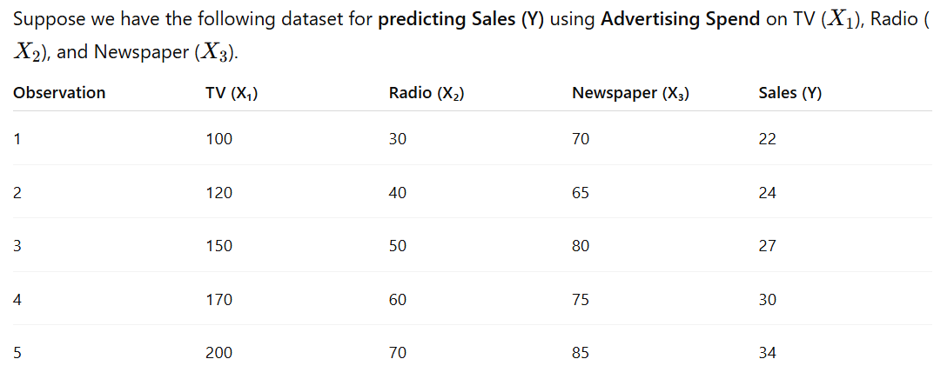
Numerical Example
Chap 14-<number>

Slide 32
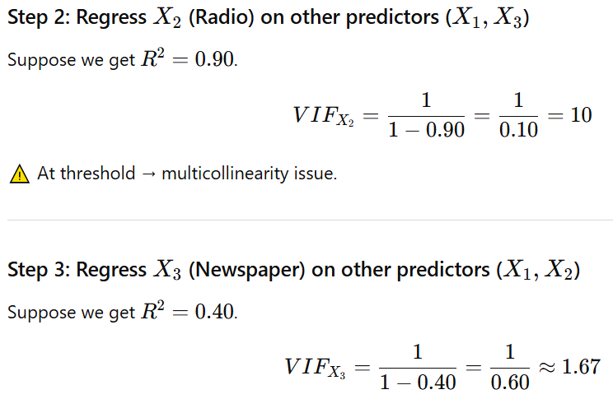
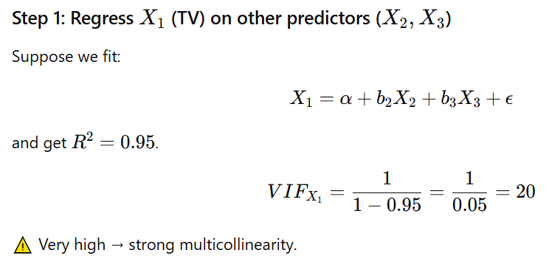
Chap 14-<number>

Slide 33
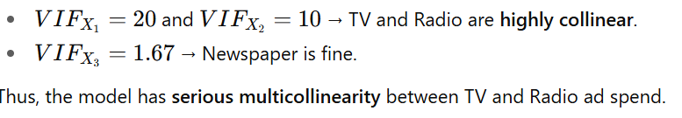
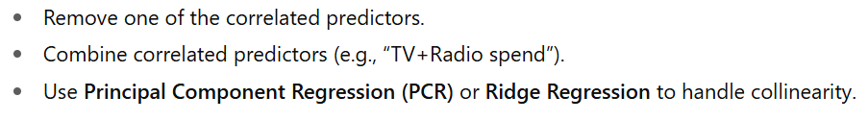
Interpretation:
Solution:
Chap 14-<number>

Slide 34
Lasso, Ridge & Elastic Regression

Slide 35
Multicollinearity: Regularization
To handle Multicollinearity issue:
Regularization in a regression model adds a penalty to the model's cost function, which discourages large coefficient values and helps prevent overfitting, leading to better generalization on unseen data. By adding a penalty, the model is encouraged to be simpler, reduce variance, and better balance bias and variance.
Overfitting is a phenomenon that occurs when a Machine Learning model is constraint to training set and not able to perform well on test data.
The commonly used regularization techniques are :
1. L1 regularization- Lasso Regression (Least Absolute Shrinkage and Selection Operator)
2. L2 regularization- Ridge Regression
3. L1 and L2 Regularization- Elastic Regularization

Slide 36
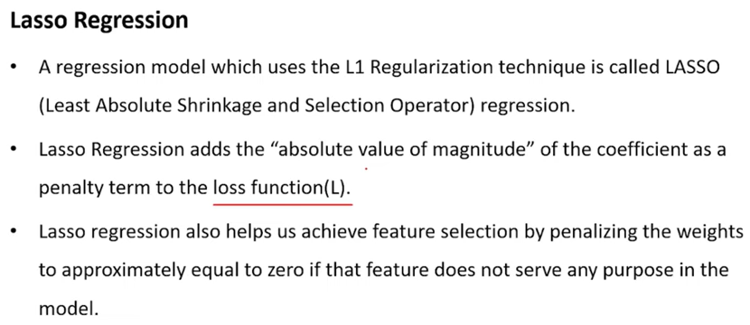
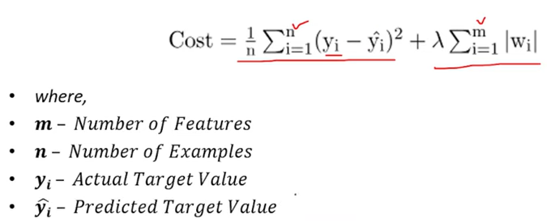

Slide 37
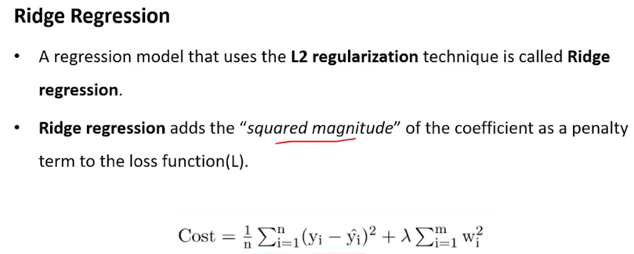

Slide 38
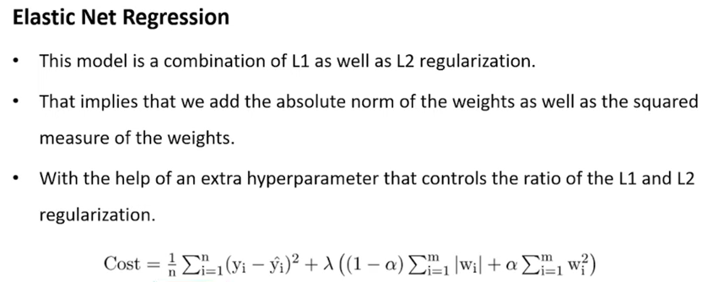

Slide 39
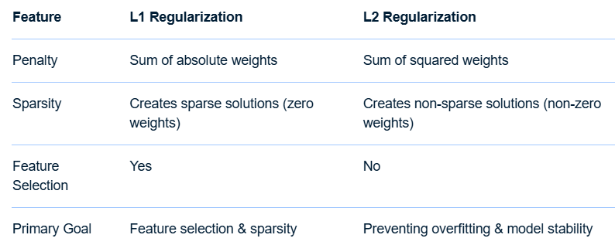
Ridge regression vs Lasso regression

Slide 40
Limitations of Lasso regression- Elastic net
Lasso limitations: Lasso sometimes struggles with some types of data. If the number of predictors (p) is greater than the number of observations (n), Lasso will pick at most n predictors as non-zero, even if all predictors are relevant (or may be used in the test set).
If there are two or more highly collinear variables then LASSO regression select one of them randomly which is not good for the interpretation of data
Elastic Net :
Elastic Net Regression is needed to handle situations with a large number of features, especially when they are highly correlated or similar, as it performs both feature selection (like Lasso) and prevents overfitting (like Ridge) simultaneously.
This combined approach makes models more stable and better at generalizing to new, unseen data by shrinking or setting coefficients to zero, and by keeping related features grouped together.

