Slide 1
DS- UNIT-III
Simple Linear Regression
Chap 14-<number>

Slide 2
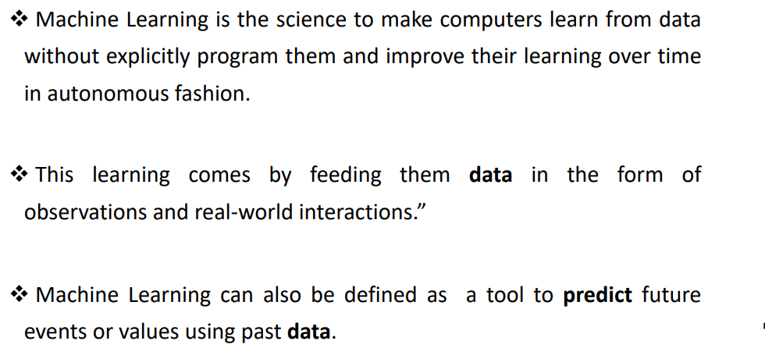
Machine Learning

Slide 3
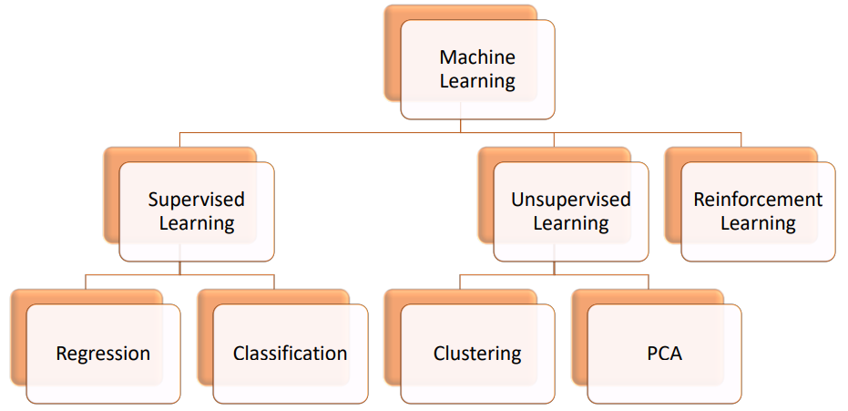
Types of Machine Learning

Slide 4
Simple Linear Regression
Regression analysis is the statistical technique of developing a statistical model, which can be used to predict the value of one variable (output variable) with the help of another variable (input variable).
Simple linear regression is a statistical technique for finding the existence of an association relationship between a dependent variable and an independent variable.
Simple linear regression implies that there is only one independent variable in the model.
Regression analysis is used to:
  Predict the value of a dependent variable based on the value of at least one independent variable
  Explain the impact of changes in an independent variable on the dependent variable
Dependent variable: the variable we wish to predict or explain
Independent variable: the variable used to predict or explain the dependent variable

Slide 5
Applications of Regression
Financial Industry- Understand the trend in the stock prices, forecast the prices, and evaluate risks in the insurance domain
Marketing- Understand the effectiveness of market campaigns, and forecast pricing and sales of the product.
Manufacturing- Evaluate the relationship of variables that determine to define a better engine to provide better performance
Medicine- Forecast the different combinations of medicines to prepare generic medicines for diseases.
Chap 14-<number>

Slide 6
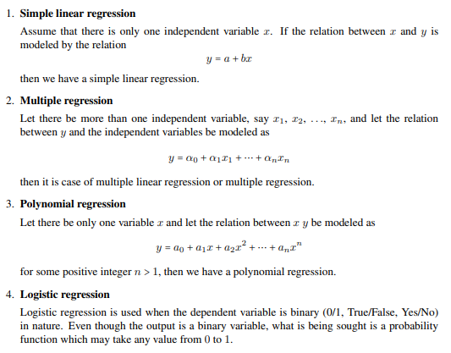
Types of Regression Models
Chap 14-<number>

Slide 7
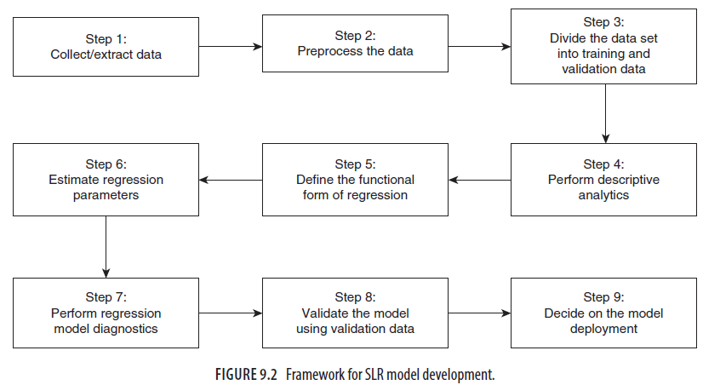
Framework for Model development
Chap 14-<number>

Slide 8
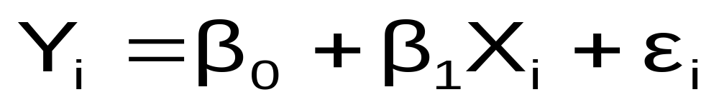
Simple Linear Regression (SLR) is a statistical model in which there is only one independent variable and the functional relationship between the dependent variable and the regression coefficient is linear.
One of the functional forms of SLR is given as follows:
Simple Linear Regression
Population Slope
Coefficient
Random Error term
Population
Y intercept
Independent Variable
Dependent Variable
Linear component
Random Error
component
Where
Yi is the value of ith observation of the dependent variable in the sample
Xi is the value of ith observation of the independent variable in the sample
ei is the random error (also known as residuals)
b0 and b1 are the regression parameters (or regression coefficients)
Chap 14-<number>

Slide 9
Simple Linear Regression Model
Y
Observed Value of Y for X_{i}
ε_{i}
Slope = β₁
Predicted Value of Y for X_{i}
Random Error for this X_{i} value
Intercept = β₀
X_{i}
X
Chap 14-<number>

Slide 10
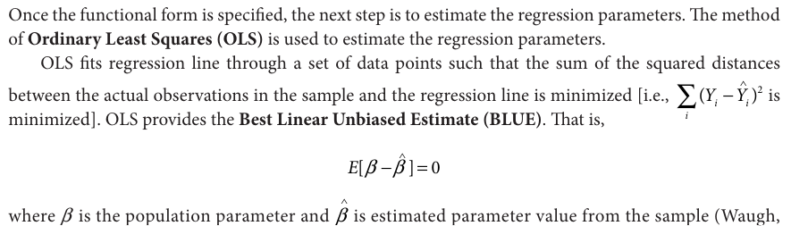
Estimate the Regression Parameters

Slide 11
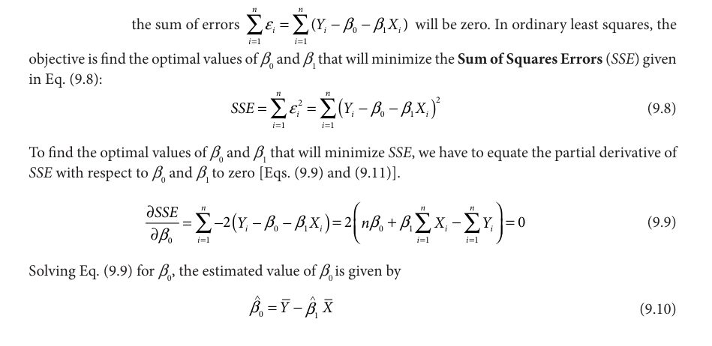
ESTIMATION OF PARAMETERS USING ORDINARY LEAST SQUARES
Chap 14-<number>

Slide 12
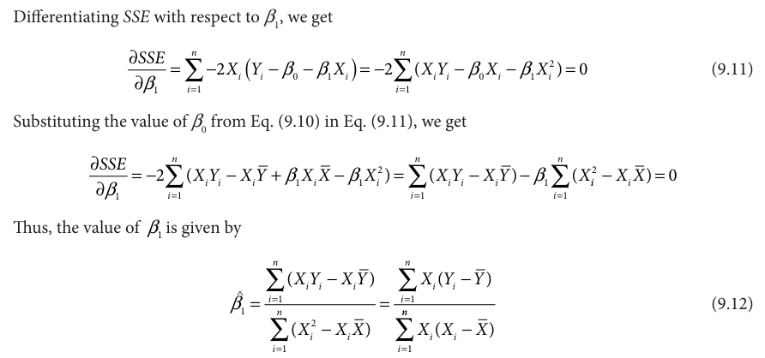
ESTIMATION OF PARAMETERS USING ORDINARY LEAST SQUARES

Slide 13
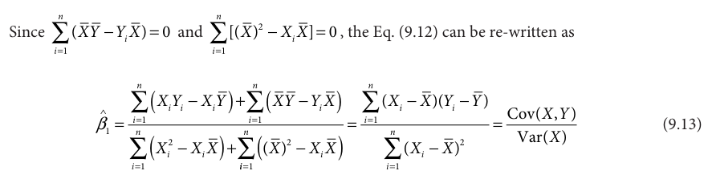
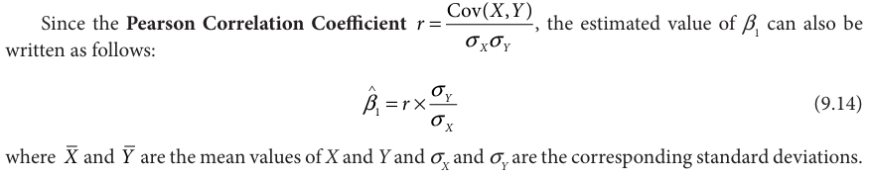
ESTIMATION OF PARAMETERS USING ORDINARY LEAST SQUARES

Slide 14
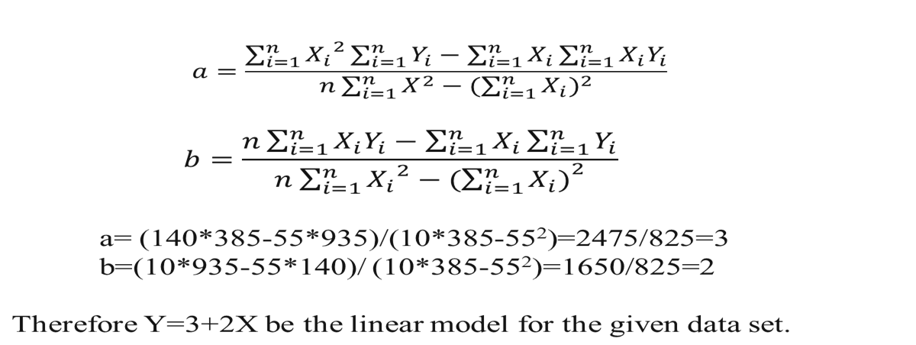
Example 1: Find a simple linear regression model for the given data set of values (1,5), (2,7),(3,9), (4,11), (5,13),(6,15) , (7,17), (8,19),(9,21) and (10,23) using LS Method.
Solution:
Let Y = a + bX be the simple linear regression model(line equation) for the given data set.
Then the LS Method
X | Y | XY | X²
1 | 5 | 5 | 1
2 | 7 | 14 | 4
3 | 9 | 27 | 9
4 | 11 | 44 | 16
5 | 13 | 65 | 25
6 | 15 | 90 | 36
7 | 17 | 119 | 49
8 | 19 | 152 | 64
9 | 21 | 189 | 81
10 | 23 | 230 | 100
55 | 140 | 935 | 385
Chap 14-<number>

Slide 15
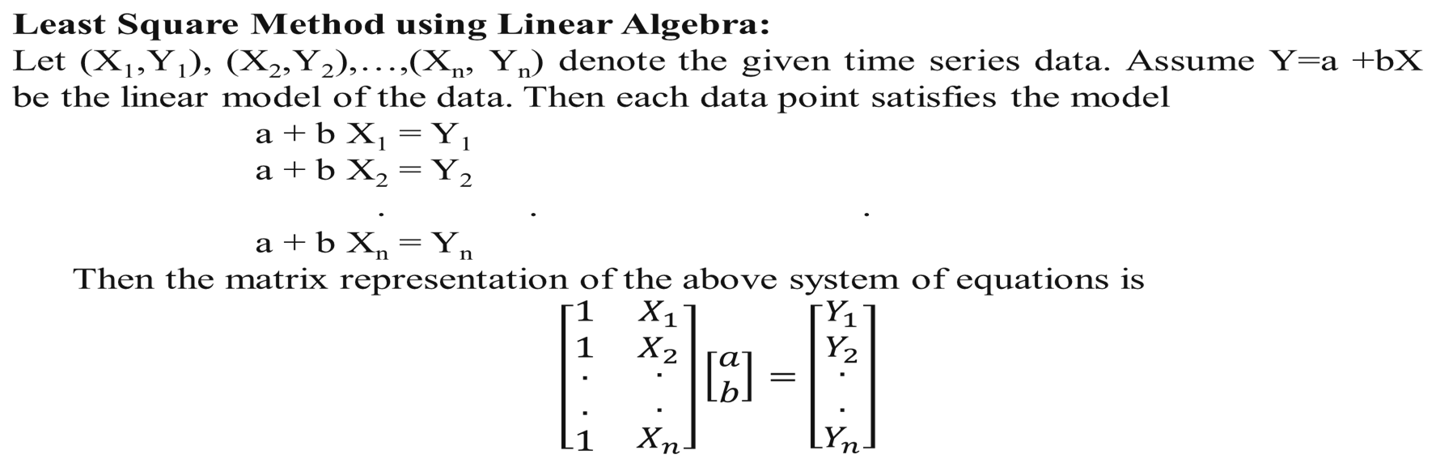
ESTIMATION OF PARAMETERS USING LINEAR ALGEBRA
Chap 14-<number>

Slide 16
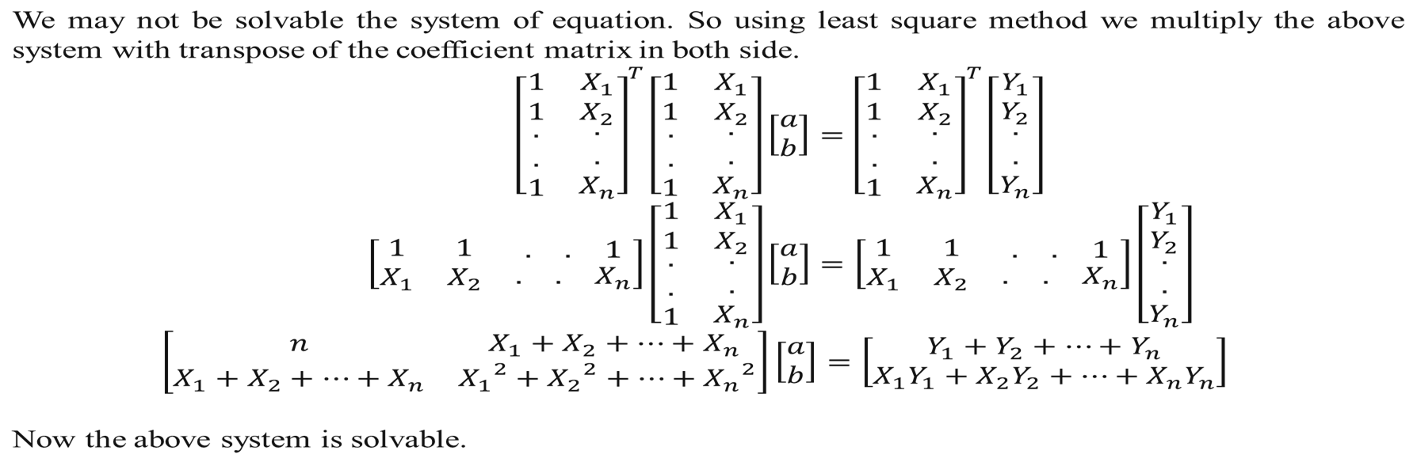
Chap 14-<number>

Slide 17
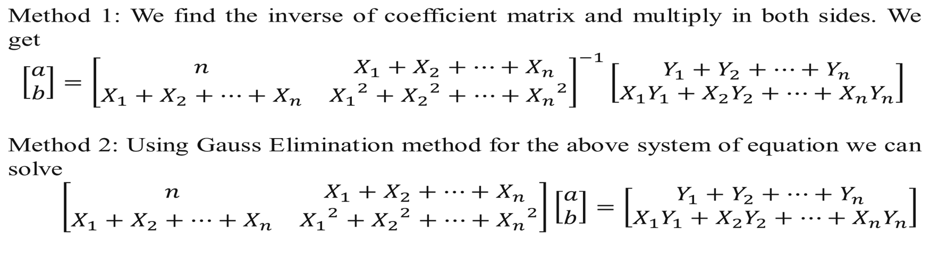
Cont--
Chap 14-<number>

Slide 18
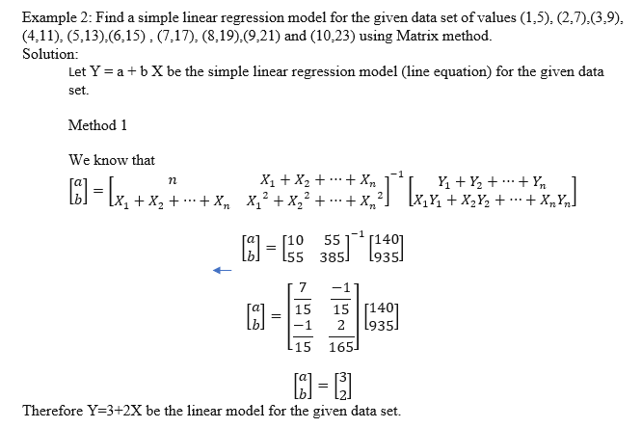
Chap 14-<number>

Slide 19
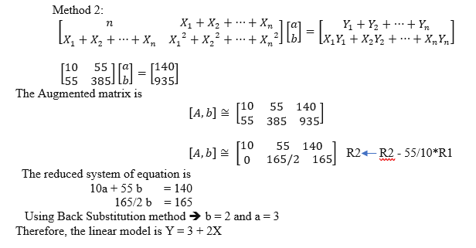
Chap 14-<number>

Slide 20
Merits and Demerits of Least Square Method
Merits
The method is mathematically sound.
The estimates a and b are unbiased.
The least square method gives trend values for all the years and the method is devoid of all kinds of subjectivity.
The algebraic sum of deviations of actual values from trend values is zero and the sum of the deviations is minimum.
Demerits
The least square method is highly mathematical; therefore, it is difficult for a layman to understand it.
The method is not flexible. If certain new values are included in the given, time series, the values of n, and other computational value would change. Which affects the trend values.
It has been assumed that y is only a linear function of time period x. Which may not be true in many situations.
Chap 14-<number>

Slide 21
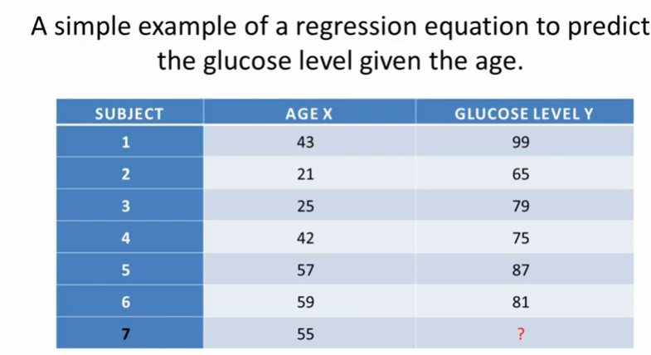
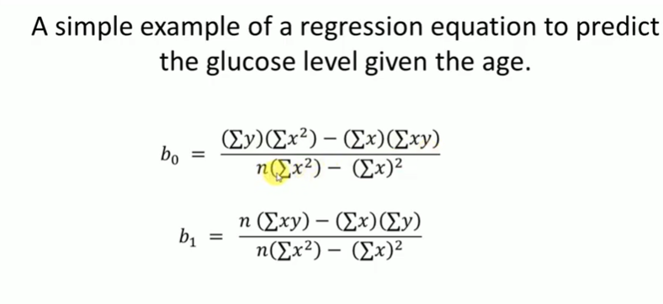
Example
Chap 14-<number>

Slide 22
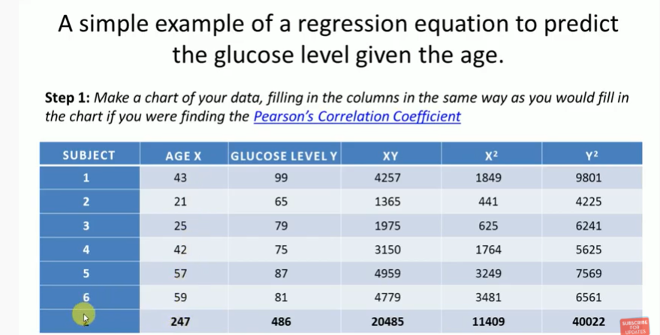
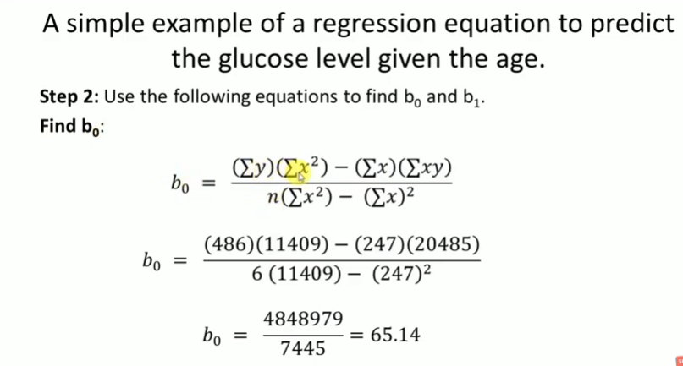
Chap 14-<number>

Slide 23
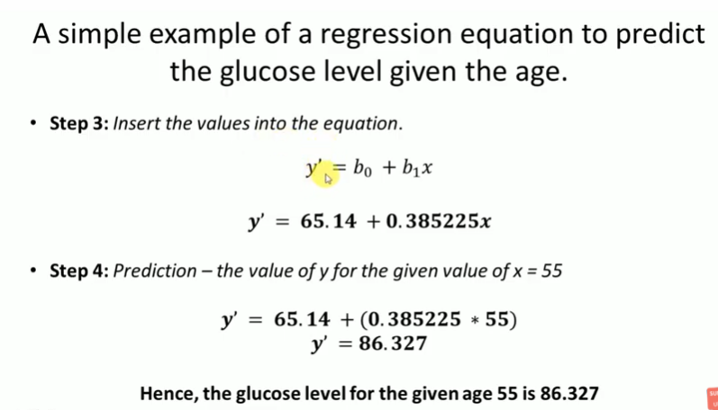
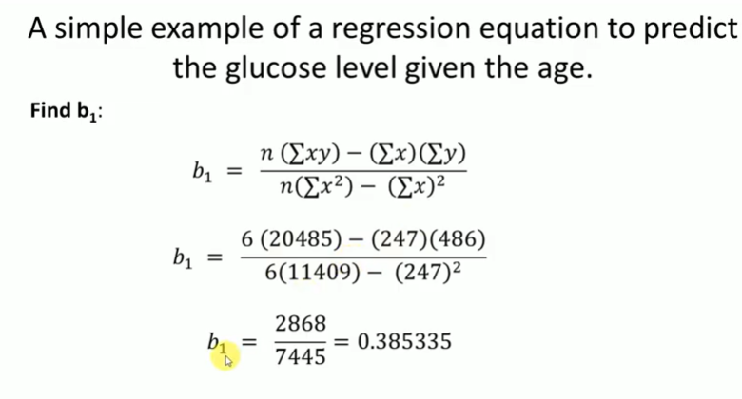
Chap 14-<number>

Slide 24
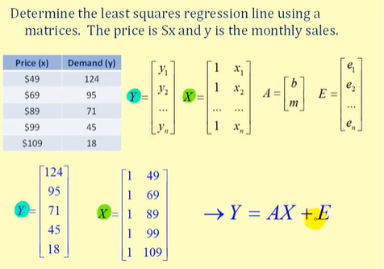
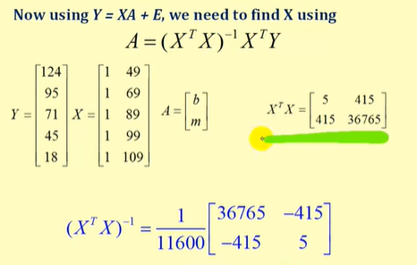
Example:
Chap 14-<number>

Slide 25
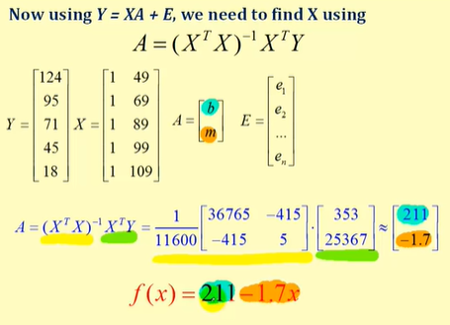
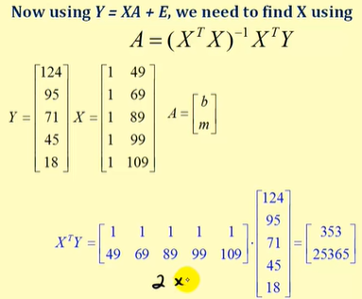
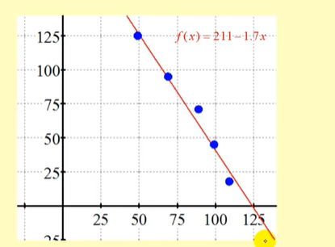
Chap 14-<number>

Slide 26
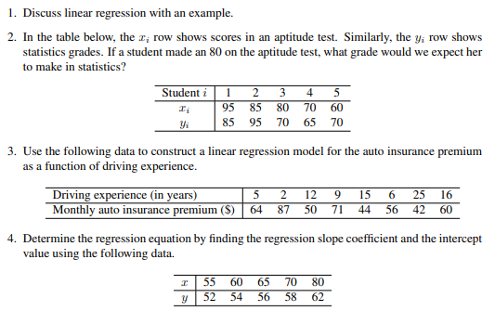
Chap 14-<number>

Slide 27
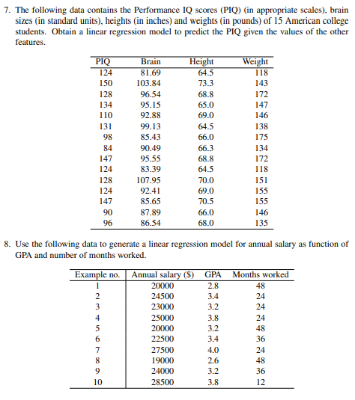
Chap 14-<number>

Slide 28
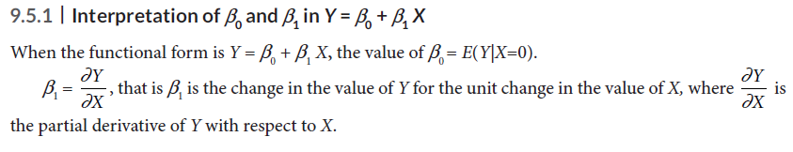
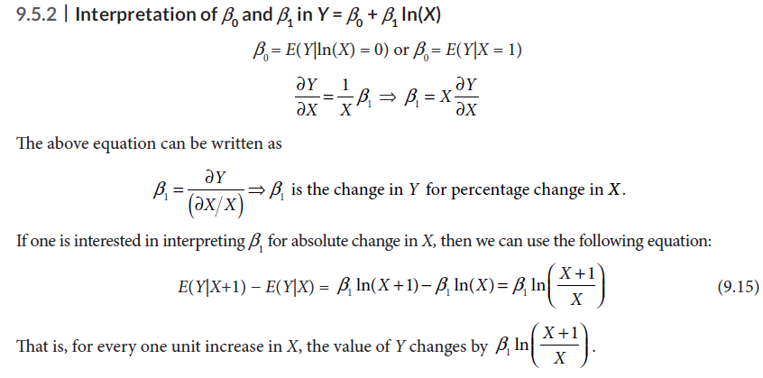
INTERPRETATION OF SIMPLE LINEAR REGRESSION COEFFICIENTS

Slide 29
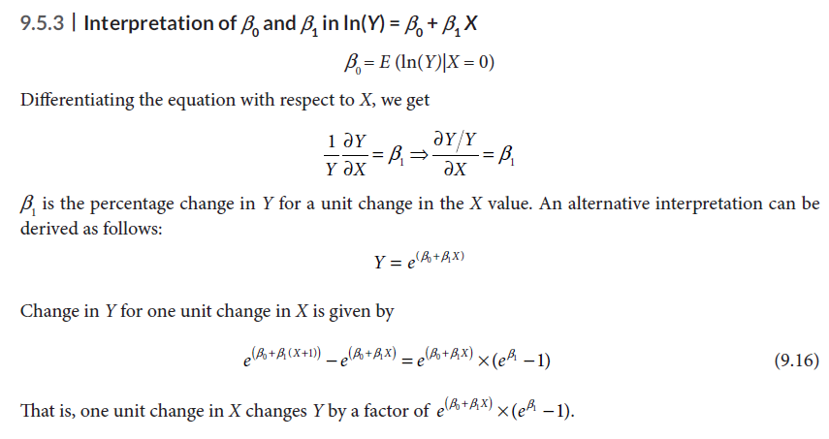
INTERPRETATION OF SIMPLE LINEAR REGRESSION COEFFICIENTS

Slide 30
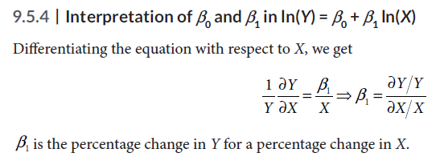
INTERPRETATION OF SIMPLE LINEAR REGRESSION COEFFICIENTS

Slide 31
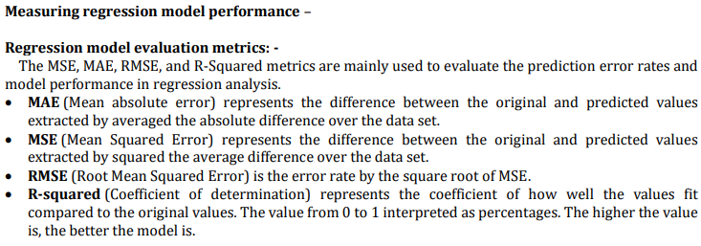

Slide 32
VALIDATION OF THE SIMPLE LINEAR REGRESSION MODEL
The following measures are used to validate the simple linear regression models:
1. Co-efficient of determination (R-square).
2. Hypothesis test for the regression coefficient b1.
3. Analysis of Variance for overall model validity (relevant more for multiple linear regression).
4. Residual analysis to validate the regression model assumptions.
5. Outlier analysis.
The above measures and tests are essential, but not exhaustive.

Slide 33

Coefficient of Determination (R-Square or R2)
The primary objective of regression is to explain the variation in Y using the knowledge of X. The coefficient of determination (or R-square or R2) measures the percentage of variation in Y explained by the model (b0 + b1 X).
The simple linear regression model can be broken into explained variation and unexplained variation as shown in Eq. (9.17):
In absence of the predictive model for Yi, the users will use the mean value of Yi. Thus, the total variation is measured as the difference between Yi and Y (i.e., Yi − Y ). The total variation can be broken into components

Slide 34
Measures of Variation
(continued)
Y
Y_{i}
∧
∧
SSE = ∑(Y_{i} - Y_{i} )²
Y
_
SST = ∑(Y_{i} - Y)²
∧
_
Y
∧
_
SSR = ∑(Y_{i} - Y)²
_
Y
Y
X
X_{i}

Slide 35
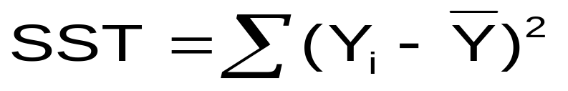
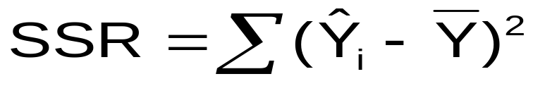
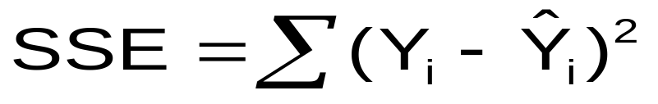


Types of Variations
Total variation is made up of two parts:
Total Sum of Squares
Regression Sum of Squares
Error Sum of Squares
where:
= Mean value of the dependent variable
Y_{i} = Observed value of the dependent variable
= Predicted value of Y for the given X_{i} value

Slide 36
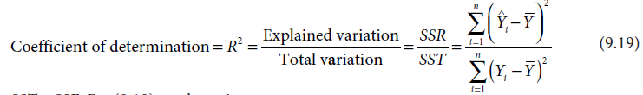
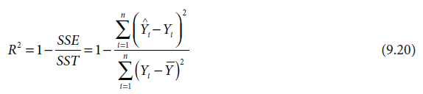
Coefficient of Determination (R-Square or R2)
Since SSR = SST – SSE, Eq. (9.19) can be written as

Slide 37
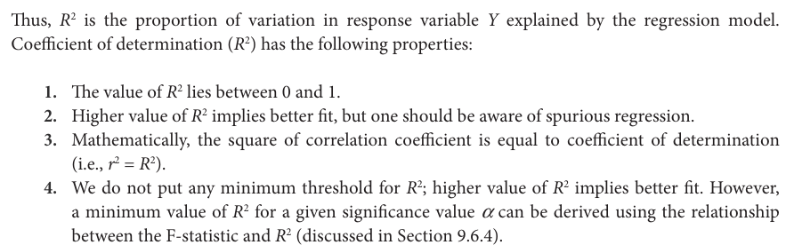
Coefficient of Determination (R-Square or R²)

Slide 38
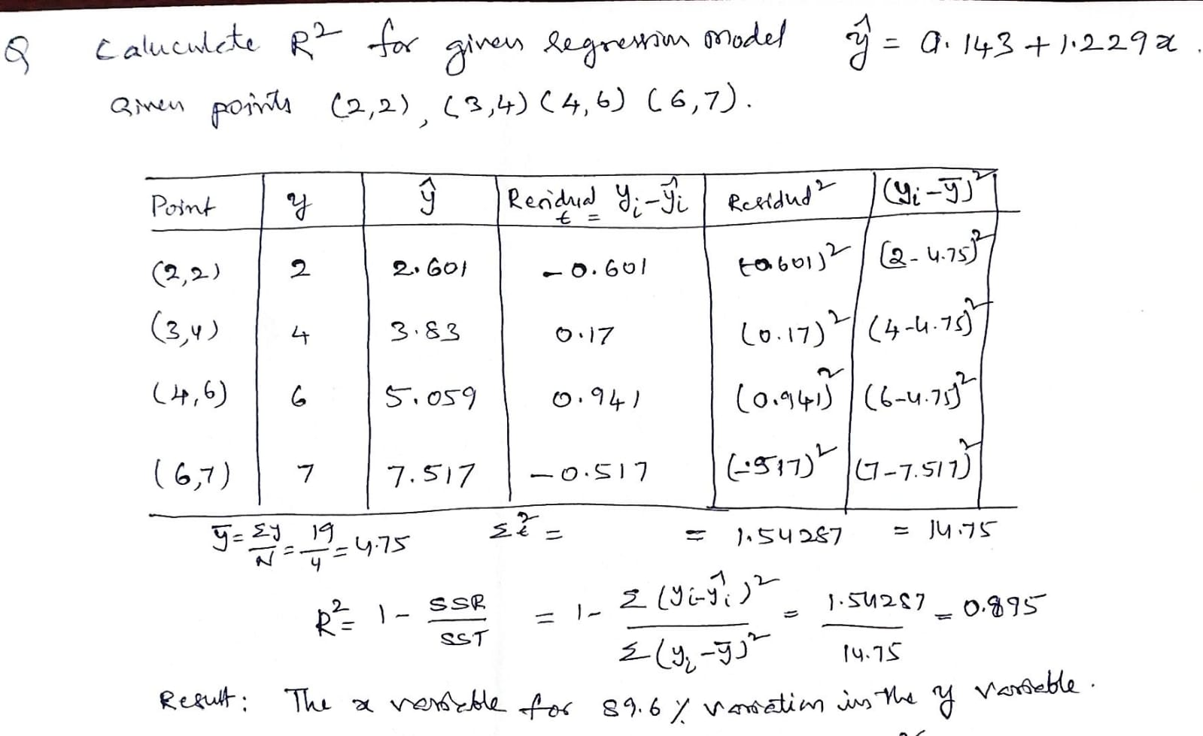

Slide 39
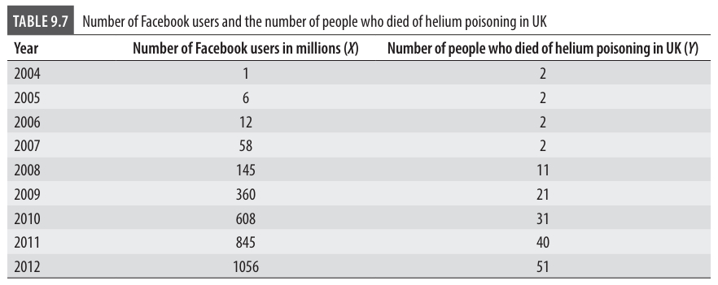
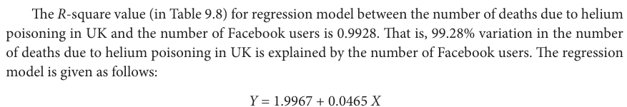
Spurious Regression
One of the major problems with coefficient of determination (R2) is that two sets of data without any relationship can have a very high coefficient of determination value.

Slide 40
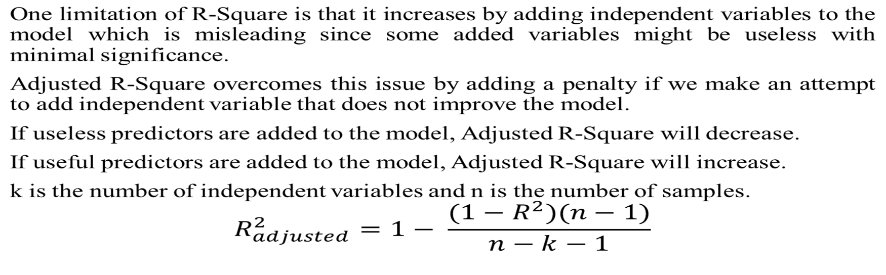
Adjusted-R²
The adjusted R-squared increases when the new term improves the model more than would be expected by chance. It decreases when a predictor improves the model by less than expected. Typically, the adjusted R-squared is positive, not negative. It is always lower than the R-squared.
Chap 14-<number>

Slide 41
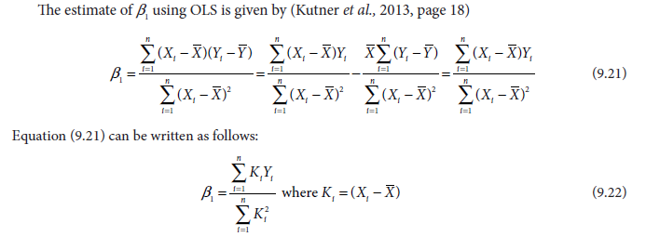
Hypothesis Test for Regression Co-Efficient (t-Test)
The regression co-efficient (b1) captures the existence of a linear relationship between the response variable
and the explanatory variable. If b1 = 0,
we can conclude that there is no statistically significant linear relationship between the two variables.
In this section, we will discuss the appropriate test statistic to carry out a hypothesis test on the regression coefficient b1.

Slide 42
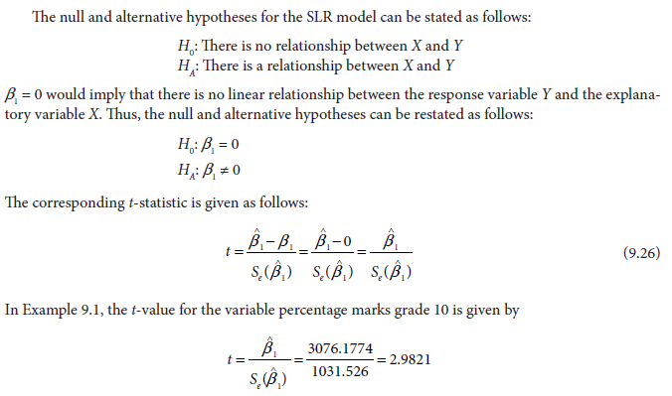

Slide 43
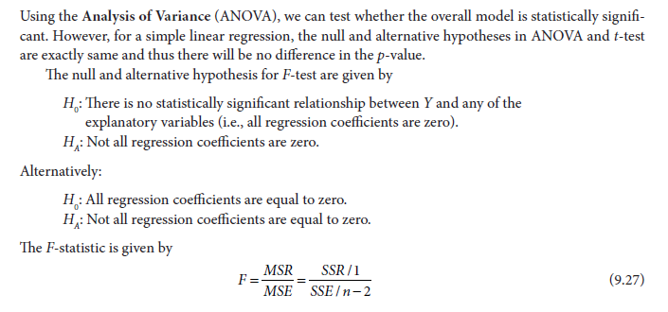
Test for Overall Model: Analysis of Variance (F-test)

Slide 44
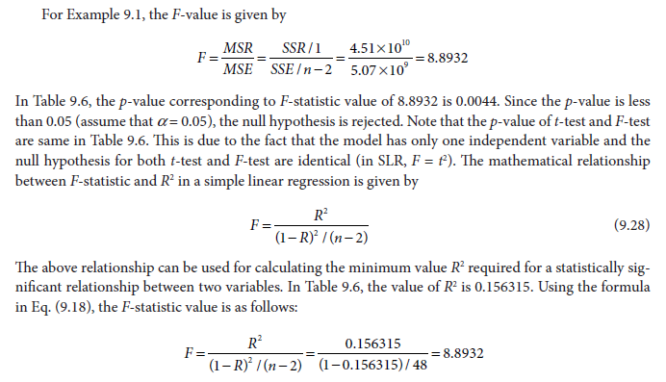

Slide 45
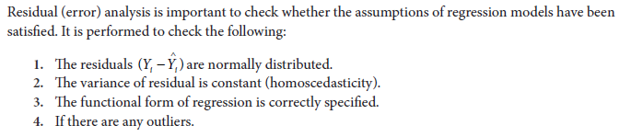
Residual Analysis

Slide 46
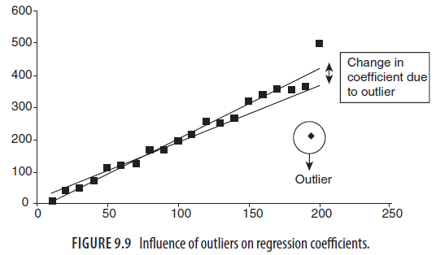
Outlier Analysis
Outliers are observations whose values show a large deviation from mean value, that is (Y-Y bar) is large. Presence of an outlier can have significant influence on values of regression coefficients.
Thus, it is important to identify the existence of outliers in the data.
The following distance measures are useful in identifying the influential observations:
1. Z-Score
2. Mahalanobis Distance
3. Cook’s Distance
4. Leverage Values
5. DFBeta and DFFit values
Chap 14-<number>

Slide 47

Z-Score
Z-score is the standardized distance of an observation from its mean value. For the predicted value of the dependent variable Y, the Z-score is given by
where Y and sY are, respectively, the mean and the standard deviation of dependent variable estimated from the sample data.
Any observation with a Z-score of more than 3 may be flagged as outlier and influential observations that may change the regression parameter values significantly.

Slide 48

MahalanobisDistance
Mahalanobis distance is the distance between specific values of the independent variable (Xi) to the centroid of all observations of the explanatory variable. Mahalanobis distance value of more than chi-square critical value (with degrees of freedom is equal to the number of explanatory variables) is classified as outliers.

Slide 49

Cook’s Distance
Cook’s distance measures how much the predicted value of the dependent variable changes for all the observations in the sample when a particular observation is excluded from sample for the estimation of regression parameters. Cook’s distance for simple linear regression is given by

Slide 50

Leverage Value
Leverage value of an observation measures the influence of that observation on the overall fit of the regression function. Leverage value for an observation in SLR is given by
Leverage value of more than 2/n or 3/n is treated as highly influential observation. In Eq. the first term (1/n) will tend to zero for large value of n.

Slide 51

Machine learning Model errors

Slide 52

Bias
Bias is calculated as the difference between average prediction and actual value. In machine learning, bias (systematic error) occurs when a model makes incorrect assumptions about data.
High bias: high errors in training and test data.
Low bias: low error in training data but high error in test data.

Slide 53

Variance
Variance is the variability of target function on different datasets.
The variance shows how much model prediction varies when there is a slight variation in data.
If model accuracies on training and test data vary greatly, the model has high variance.
High variance models show high training accuracy but low test accuracy- leads Overfitting.
Low variance leads Underfitting.

Slide 54



Slide 55

Overfitting, Underfitting and Best fitting:
Over fitting | Underfitting | Best fitting
Model tries to cover all the data points or more than the required data points present in the given dataset. | Model is not able to capture the underlying trend of the data. | it defines how closely the result or predicted values match the true values of the dataset.
The overfitted model has low bias and high variance. The model is too complex. | An underfitted model has high bias and low variance. The model is too simple. | Low bias , low variance
Cross-Validation, Training with more data, Removing features Early stopping the training, Regularization, Ensembling | By increasing the training time of the model. By increasing the number of features.

Slide 56

Bias Variance Trade-off
The bias-variance trade-off is finding a balance between the error introduced by bias and the error introduced by variance.
With increased model complexity, the bias will decrease, but the variance will increase.
However, when we decrease the model complexity, the bias will increase, and the variance will decrease.
So, we need a balance between bias and variance so total prediction error is minimized.

Slide 57
Bias Variance Trade-off
Mathematical Representation:
The prediction error in the machine learning model can be written mathematically as follows
Error = bias² + variance + irreducible error.
To minimize the model prediction error, we need to choose model complexity in such a way so that a balance between these two errors can be met.
The main objective of the bias-variance tradeoff is to find optimal values of bias and variance (model complexity) that minimize the error.

Slide 58
Reducing High Bias
Choosing a more complex model − As we have seen in the above diagram, choosing a more complex model may reduce the bias error of the model prediction.
Adding more features − Adding mode features can increase the complexity of the model that can capture even better hidden patterns that will decrease the bias error of the model.
Reducing regularization − Regularization prevents overfitting, but while decreasing the variance, it can increase bias. So, reducing the regularization parameters or removing regularization overall can reduce bias errors.

Slide 59
Reducing High Variance
Applying regularization techniques − Regularization techniques add penalty to complex model that will eventually result in reduced complexity of the model. A less complex model will show less variance.
Simplifying model complexity − A less complex model will have low variance. You can reduce the variance by using a simpler algorithm.
Adding more data − Adding more data to the dataset can help the model to perform better showing less variance.
Cross-validation − Cross-validation can be useful to identify overfitting by comparing the performance on training and validation sets of the datasets.

Slide 60
Cost Function Gradient Descent
Chap 14-<number>

Slide 61

Cost function for Regression models
The cost function for regression computes the differences between the actual values and the model's predicted values.
The most common cost functions for regression problems are mean absolute error (MAE) and mean squared error (MSE).
Chap 14-<number>

Slide 62


Slide 63
Optimize cost function-Gradient descent
Gradient descent is used to minimize the MSE by calculating the gradient of the cost function.
A regression model uses gradient descent to update the coefficients of the line by reducing the cost function.
It is done by a random selection of values of coefficient and then iteratively update the values to reach the minimum cost function.
Gradient descent was initially discovered by "Augustin-Louis Cauchy" in mid of 18th century. Gradient Descent is defined as one of the most commonly used iterative optimization algorithms of machine learning to train the machine learning and deep learning models. It helps in finding the local minimum of a function.

Slide 64

Optimise cost function- Gradient descent
The best way to define the local minimum or local maximum of a function using gradient descent is as follows:
If we move towards a negative gradient or away from the gradient of the function at the current point, it will give the local minimum of that function.
Whenever we move towards a positive gradient or towards the gradient of the function at the current point, we will get the local maximum of that function.

Slide 65

The main objective of using a gradient descent algorithm is to minimize the cost function using iteration.
To achieve this goal, it performs two steps iteratively:
Calculates the first-order derivative of the function to compute the gradient or slope of that function.
Move away from the direction of the gradient, which means slope increased from the current point by alpha times, where Alpha is defined as Learning Rate. It is a tuning parameter in the optimization process which helps to decide the length of the steps.
Chap 14-<number>

Slide 66

Learning Rate:
It is defined as the step size taken to reach the minimum or lowest point.
This is typically a small value that is evaluated and updated based on the behavior of the cost function. If the learning rate is high, it results in larger steps but also leads to risks of overshooting the minimum. At the same time, a low learning rate shows the small step sizes, which compromises overall efficiency but gives the advantage of more precision.

Slide 67



Cost function, Gradient decent
Chap 14-<number>

Slide 68


Gradient descent
Chap 14-<number>

Slide 69


Gradient descent

Slide 70


Example : Cost function, Gradient descent, Learning rate

Slide 71



Example : Cost function

Slide 72
Types of Gradient Descent
Based on the error in various training models, the Gradient Descent learning algorithm can be divided into
Batch gradient descent,
stochastic gradient descent, and
mini-batch gradient descent.

