Slide 1
Data Science
Unit-IV
Support Vector Machine (SVM)
Classifier
The Support Vector Machine (SVM) classifier was invented by Vladimir Vapnik and his colleague Alexey Chervonenkis in the 1960s while working at the Institute of Control Sciences in Moscow.

Slide 2
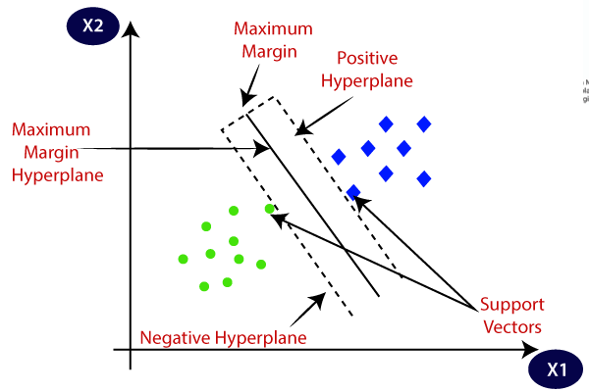
Support Vector Machine
It is Supervised Learning algorithms.
It is used for Classification as well as Regression problems.
The goal of the SVM algorithm is to create the best line or decision boundary that can segregate n-dimensional space into classes.
This best decision boundary is called a hyperplane.
SVM chooses the extreme points/vectors that help in creating the hyperplane.
These extreme cases are called as support vectors, and hence algorithm is termed as Support Vector Machine.

Slide 3
Hyperplane and Support Vectors in the SVM algorithm:
Hyperplane: There can be multiple lines/decision boundaries to segregate the classes in n-dimensional space, but we need to find out the best decision boundary that helps to classify the data points. This best boundary is known as the hyperplane of SVM.
The dimensions of the hyperplane depend on the features present in the dataset, which means if there are 2 features (as shown in image), then hyperplane will be a straight line. And if there are 3 features, then hyperplane will be a 2-dimension plane.
Goal: Always create a hyperplane that has a maximum margin, which means the maximum distance between the data points.

Slide 4
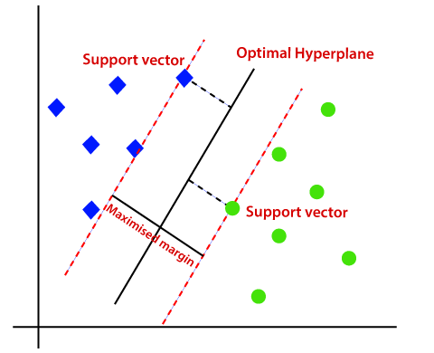
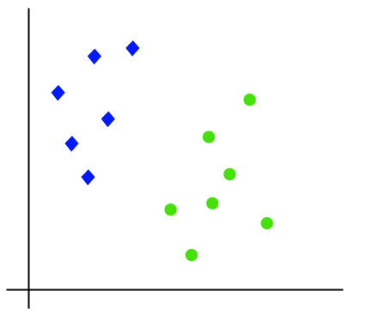
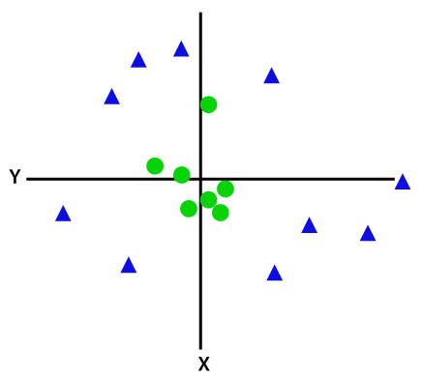
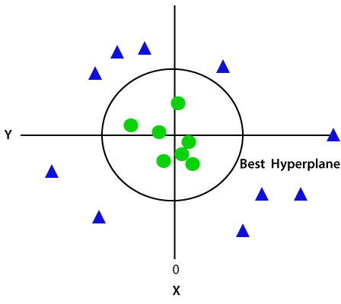
Support Vector Machine-Types
Linear SVM: A dataset can be classified into two classes by using a single straight line, then such data is termed as linearly separable data, and classifier is used called as Linear SVM classifier.
Non-linear SVM: A dataset cannot be classified by using a straight line, then such data is termed as non-linear data and classifier used is called as Non-linear SVM classifier.

Slide 5
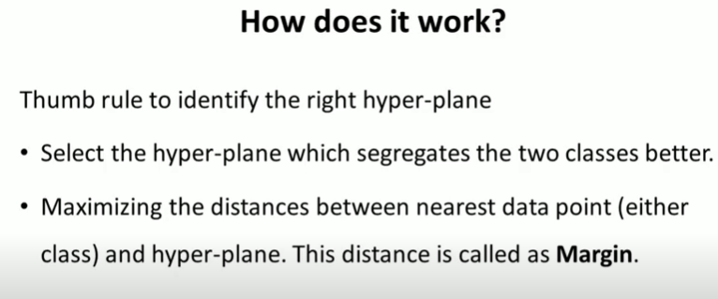
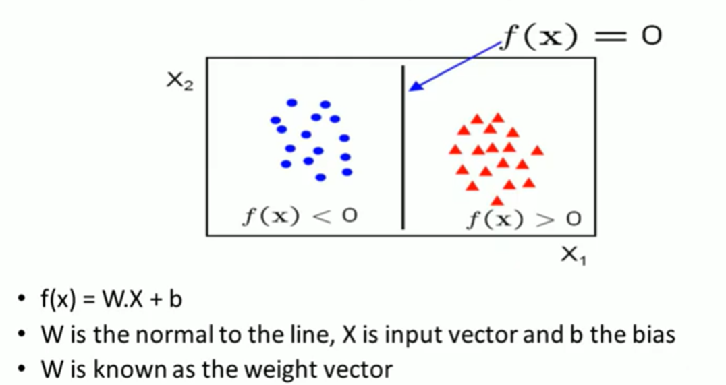
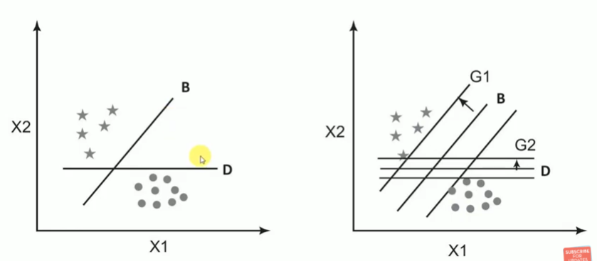
SVM How it works?

Slide 6
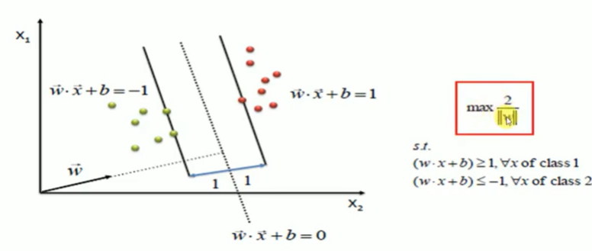
SVM Model

Slide 7
Advantages
Support vector machine is very effective even with high dimensional data.
When you have a data set where number of features is more than the number of rows of data, SVM can perform in that case as well.
When classes in the data are points are well separated SVM works really well.
SVM can be used for both regression and classification problem.
And last but not the least SVM can work well with image data as well.

Slide 8
Disadvantages
When classes in the data are points are not well separated, which means overlapping classes are there, SVM does not perform well.
SVM on large data set comparatively takes more time to train.
SVM or Support vector machine is not a probabilistic model so we can not explanation the classification in terms of probability.
It is difficult to understand and interpret the SVM model compared to Decision tree as SVM is more complex.

Slide 9
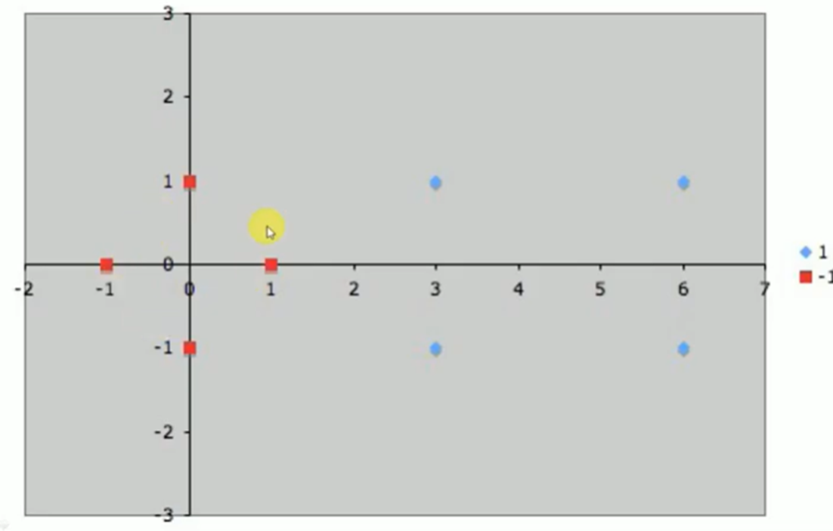
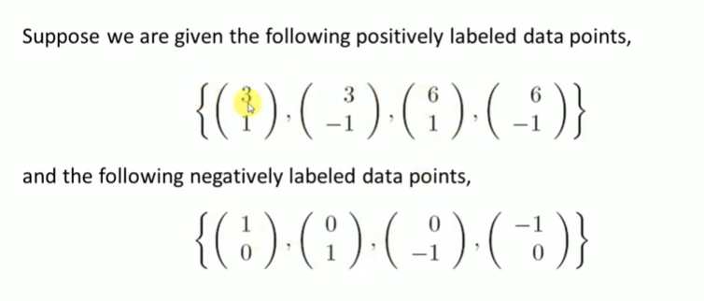
Linear SVM : Example
3 | 1 | +
3 | -1 | +
6 | 1 | +
6 | -1 | +
1 | 0 | -
0 | 1 | -
0 | -1 | -
-1 | 0 | -
Design SVM classifier to classify the following dataset as positive and negative class.

Slide 10
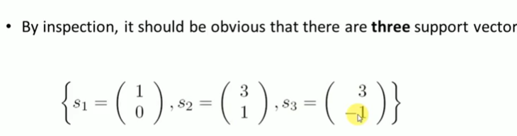
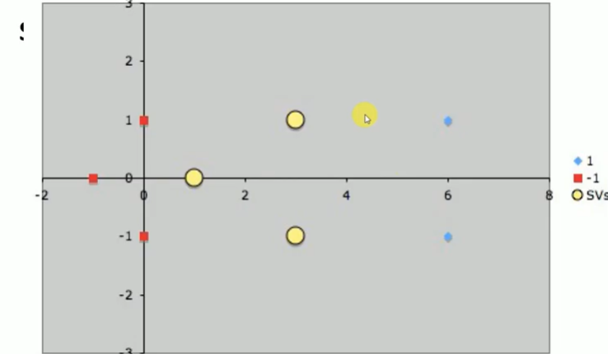
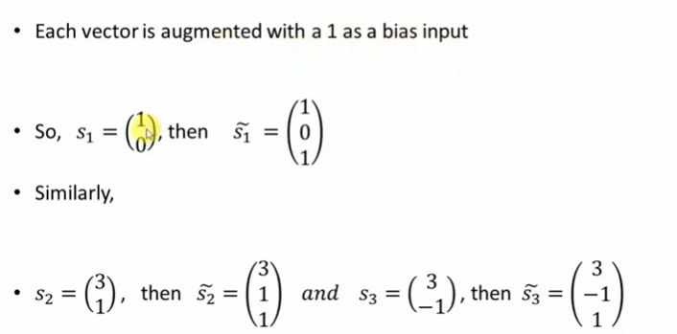
Example

Slide 11
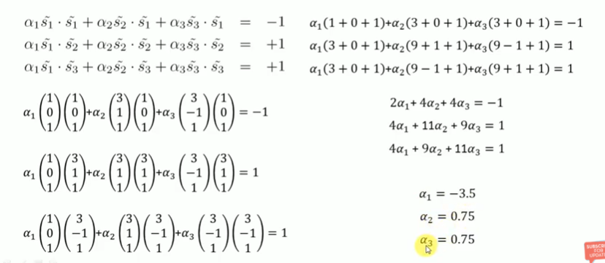
Example

Slide 12
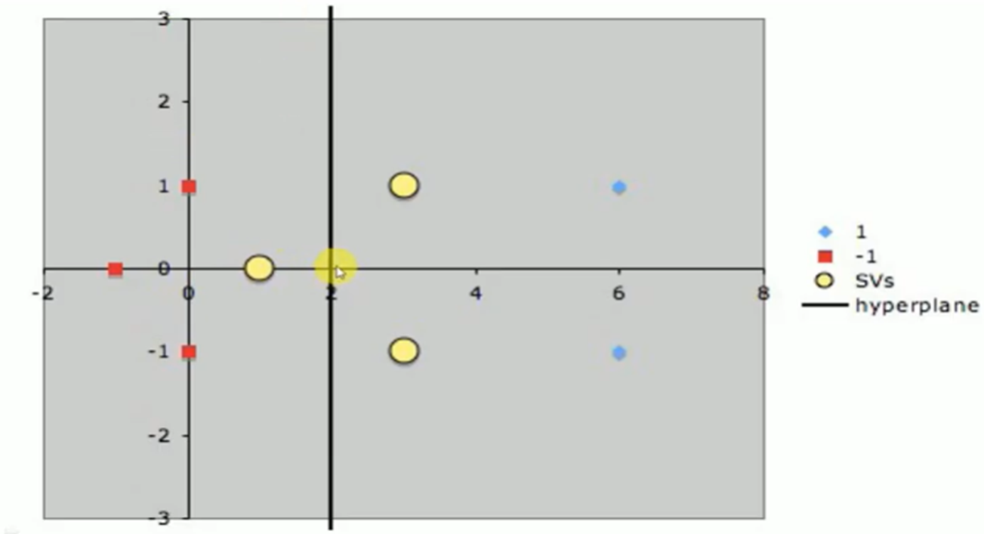
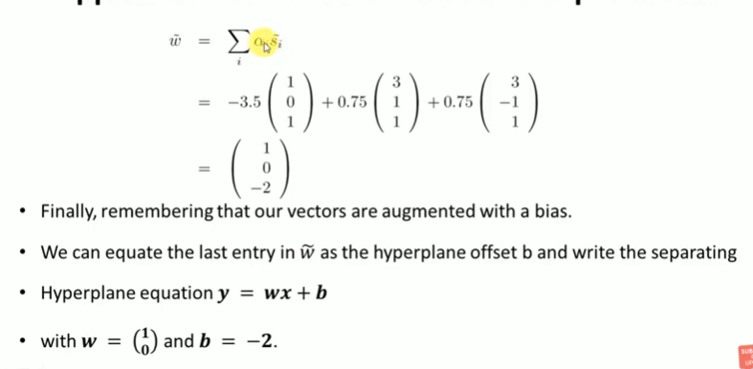
Example:

Slide 13
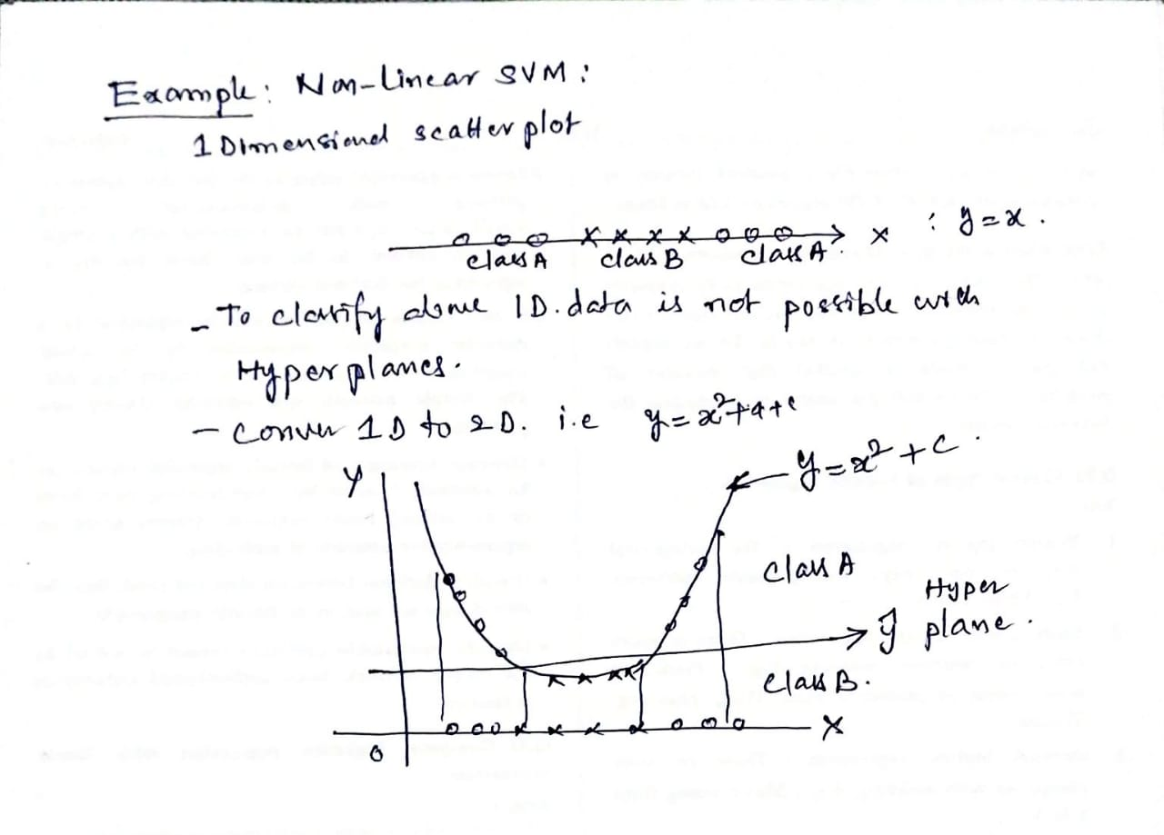
Non-Linear SVM : Example 1

Slide 14
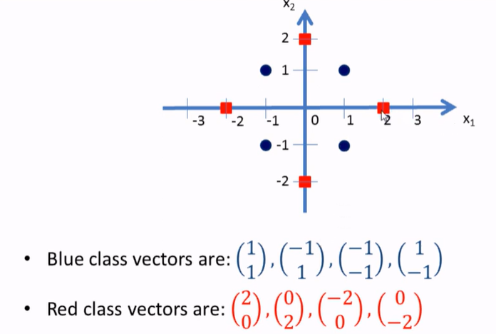
Non-Linear SVM : Example 2
1 | 1 | B
-1 | 1 | B
-1 | -1 | B
1 | -1 | B
2 | 0 | R
0 | 2 | R
-2 | 0 | R
0 | -2 | R
Design Non-Linear SVM classifier to classify the following dataset as Blue and red class.

Slide 15
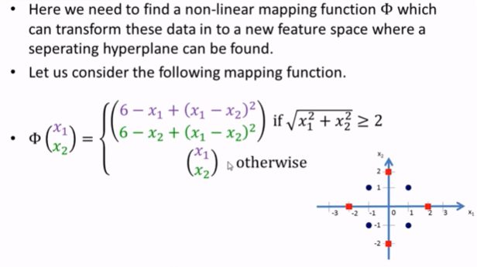
Non-Linear SVM : Example 2

Slide 16
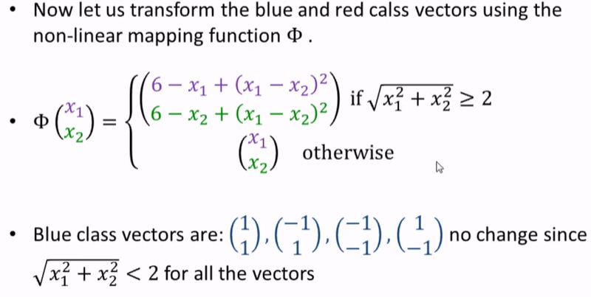
Non-Linear SVM : Example 2

Slide 17
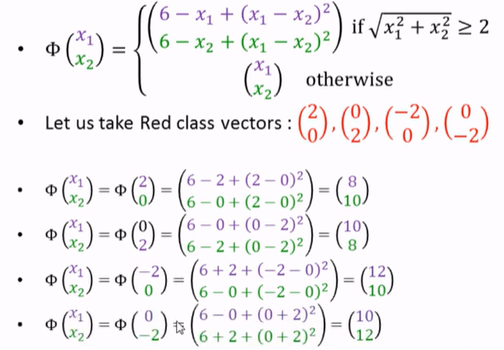
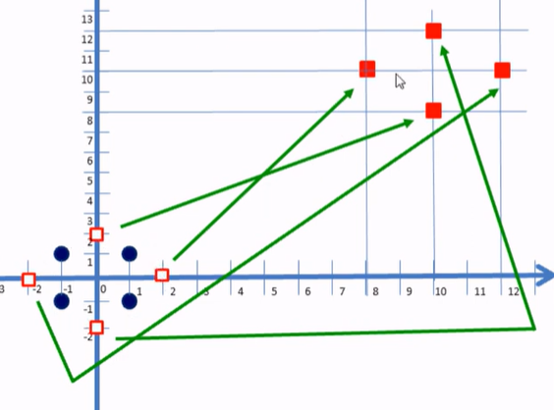
Non-Linear SVM : Example 2

Slide 18
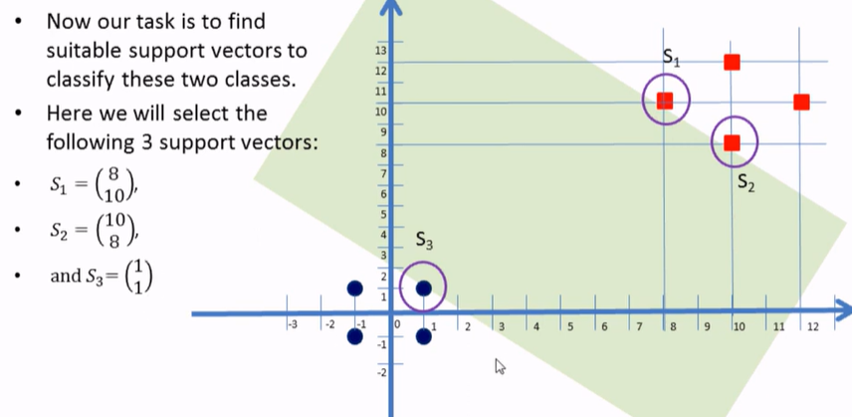
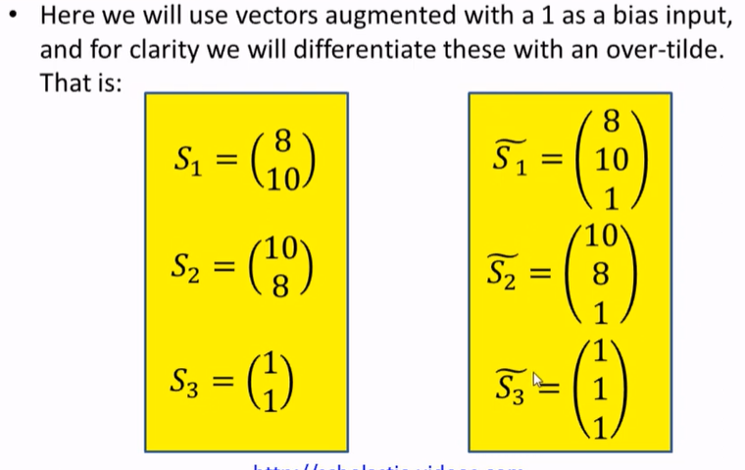
Non-Linear SVM : Example 2

Slide 19
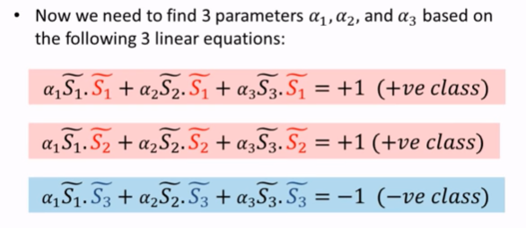
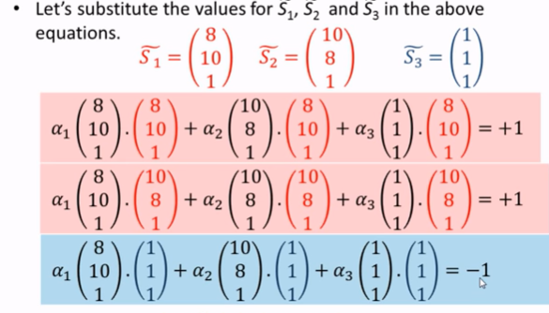
Non-Linear SVM : Example 2

Slide 20
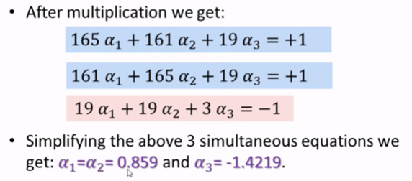
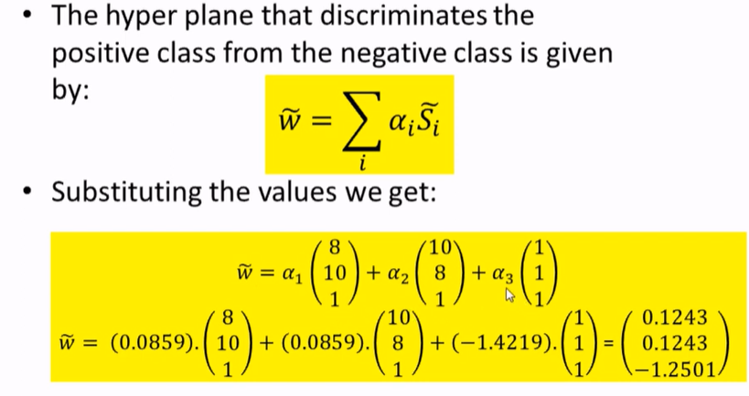
Non-Linear SVM : Example 2

Slide 21
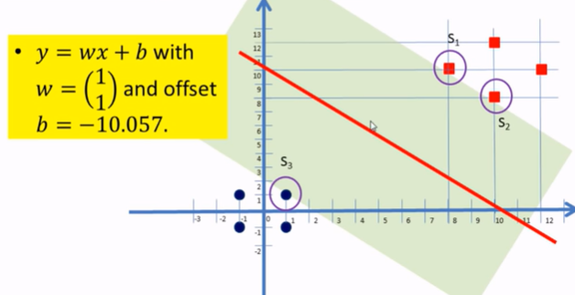
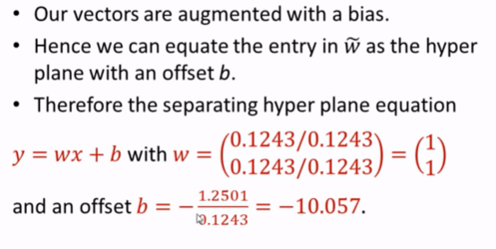
Non-Linear SVM : Example 2

Slide 22
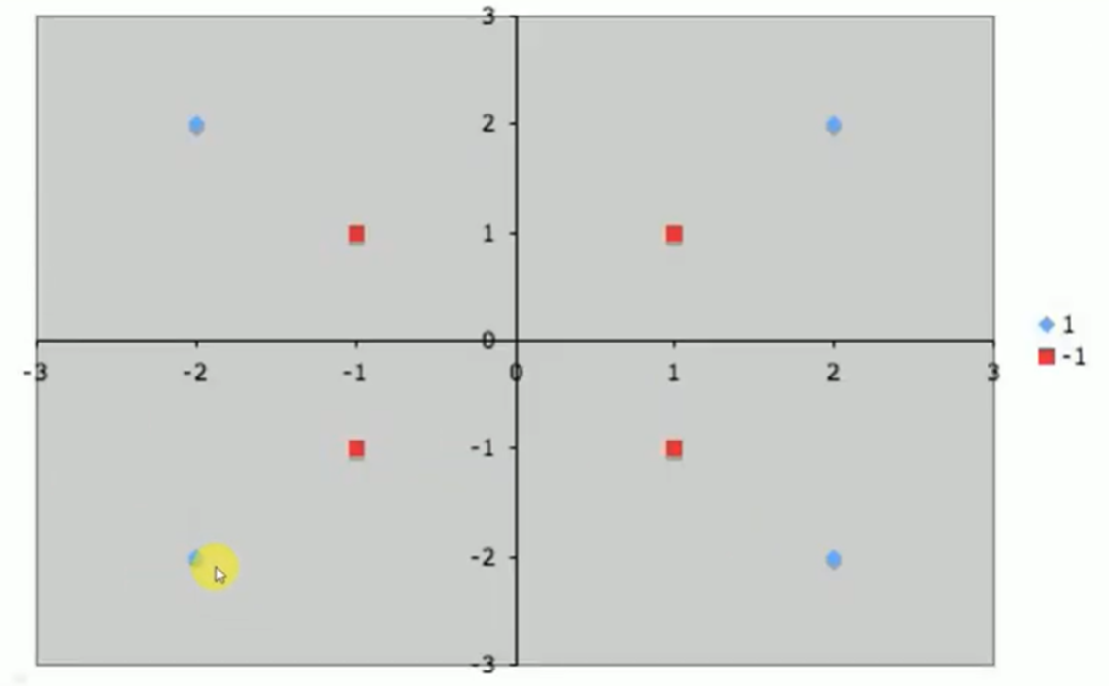
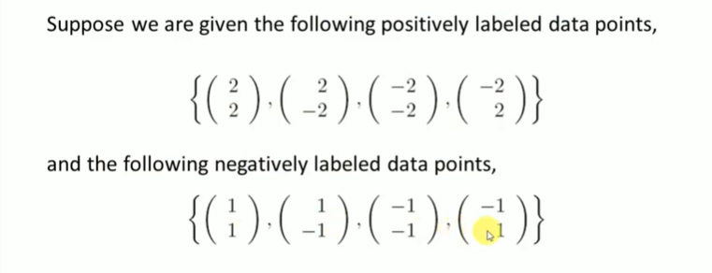
Non-Linear SVM : Example 3

Slide 23
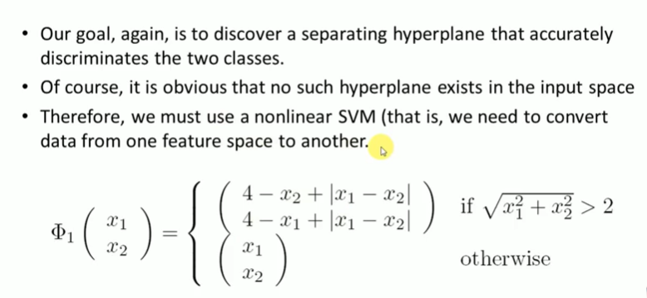
Example 3

Slide 24
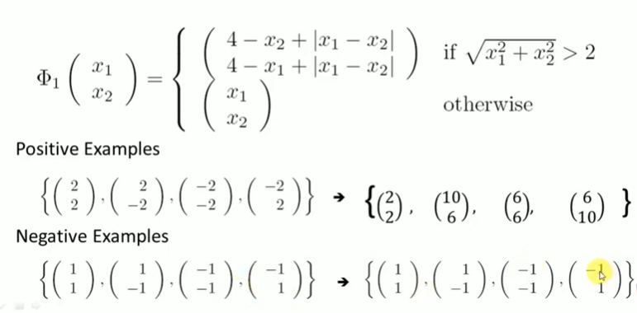
Example

Slide 25
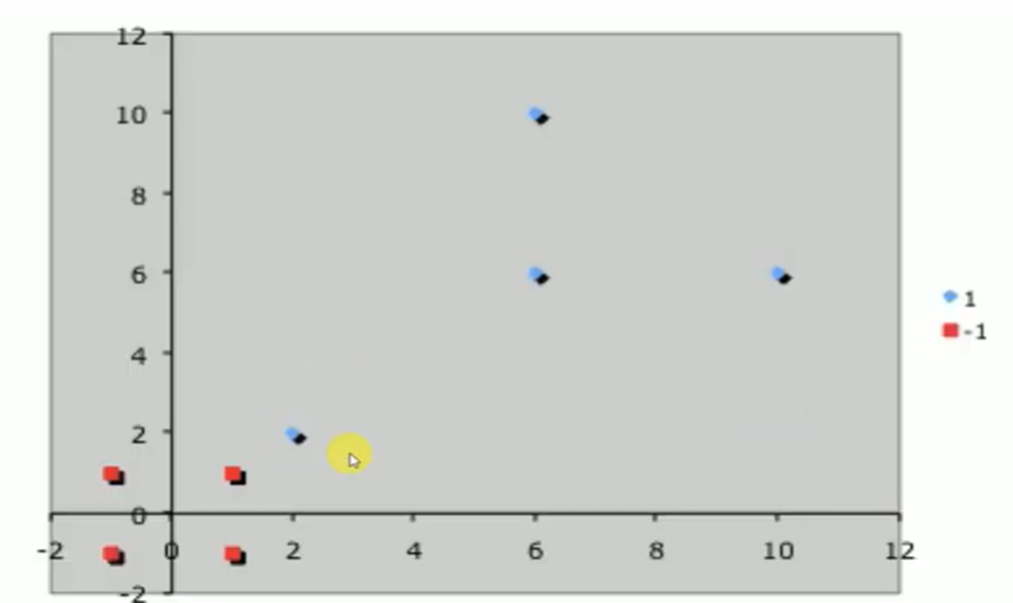
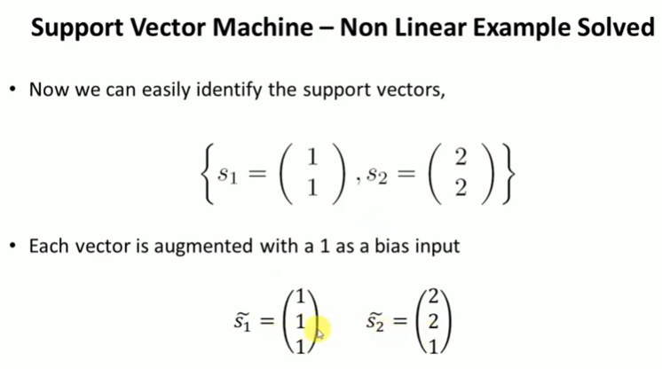
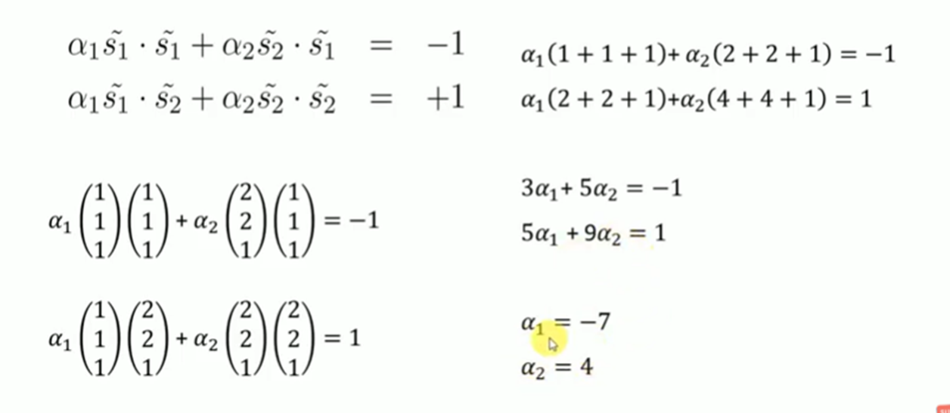
Example

Slide 26
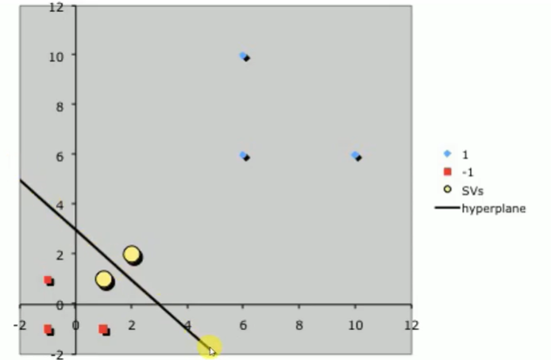
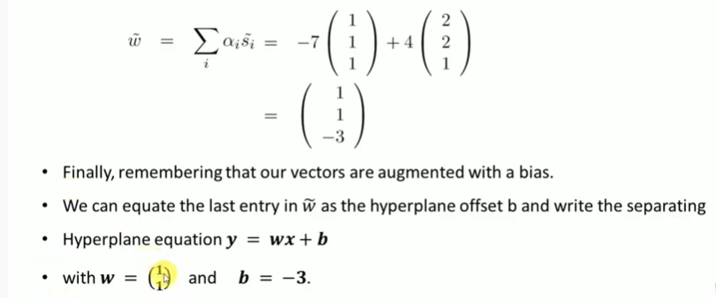
Example

Slide 27
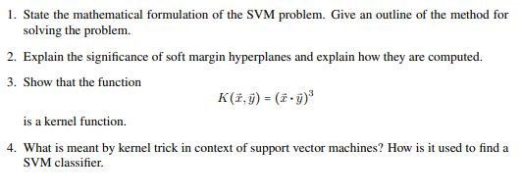
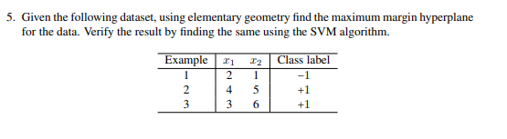
Exercise

Slide 28
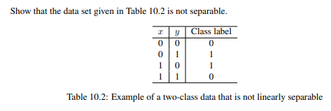
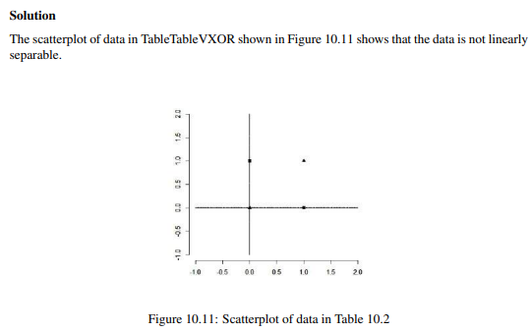
Exercise

