Slide 1
Data Sciences
Unit-IV
Classification Basic concepts,
K-Nearest Neighbor Classifier

Slide 2
Supervised vs. Unsupervised Learning
Supervised learning (classification)
Supervision: The training data (observations, measurements, etc.) are accompanied by labels indicating the class of the observations
New data is classified based on the training set
Unsupervised learning (clustering)
The class labels of training data is unknown
Given a set of measurements, observations, etc. with the aim of establishing the existence of classes or clusters in the data

Slide 3
Prediction Problems: Classification vs. Numeric Prediction
Classification
predicts categorical class labels (discrete or nominal)
classifies data (constructs a model) based on the training set and the values (class labels) in a classifying attribute and uses it in classifying new data
Numeric Prediction
models continuous-valued functions, i.e., predicts unknown or missing values
Classification: Typical applications
Credit/loan approval:
Medical diagnosis: if a tumor is cancerous or benign
Fraud detection: if a transaction is fraudulent
Web page categorization: which category it is

Slide 4
Classification Algorithm
The Classification algorithms are a Supervised Learning Algorithms.
It is used to identify the category of new observations on the basis of training data.
Classes can be called as targets/labels or categories.
In classification algorithm, a discrete output function(y) is mapped to input variable(x).

Slide 5
Classification—A Two-Step Process
Model construction: describing a set of predetermined classes
Each tuple/sample is assumed to belong to a predefined class, as determined by the class label attribute
The set of tuples used for model construction is training set
The model is represented as classification rules, decision trees, or mathematical formulae
Model usage: for classifying future or unknown objects
Estimate accuracy of the model
The known label of test sample is compared with the classified result from the model
Accuracy rate is the percentage of test set samples that are correctly classified by the model
Test set is independent of training set (otherwise overfitting)
If the accuracy is acceptable, use the model to classify new data
Note: If the test set is used to select models, it is called validation (test) set

Slide 6
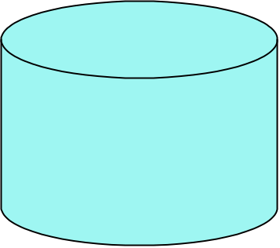
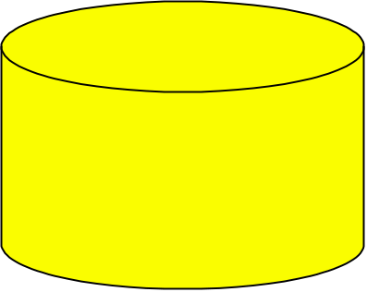
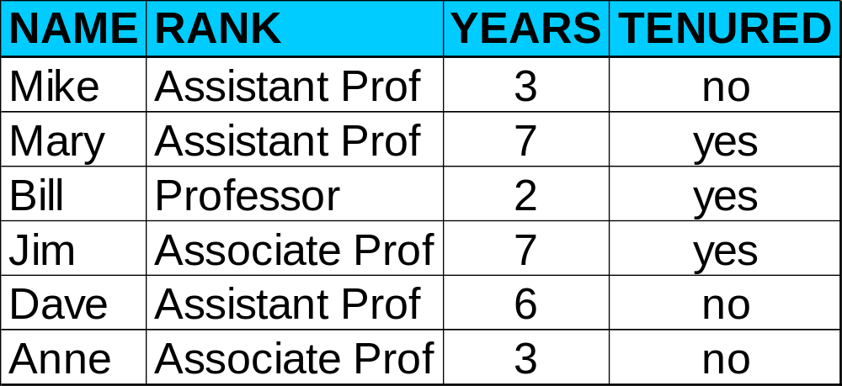
Process (1): Model Construction
Classification
Algorithms
Training
Data
Classifier
(Model)
IF rank = ‘professor’
OR years > 6
THEN tenured = ‘yes’

Slide 7
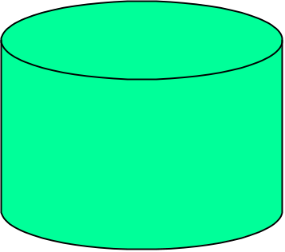
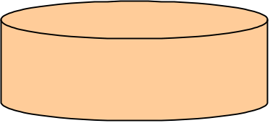
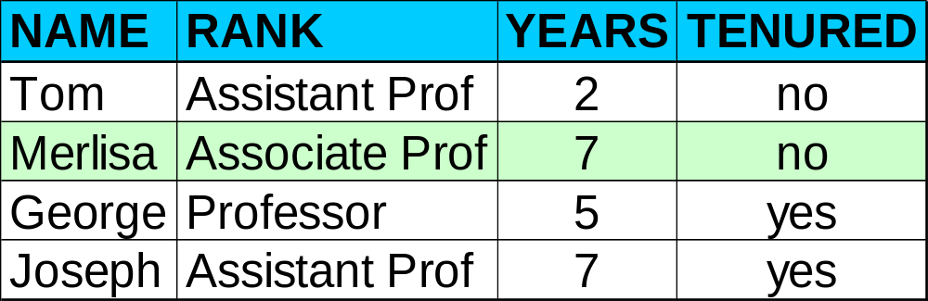

Process (2): Using the Model in Prediction
Classifier
Testing
Data
Unseen Data
(Jeff, Professor, 4)
Tenured?

Slide 8
Types of Classifications
There are two types of Classifications:
1. Binary Classifier: If the classification problem has only two possible outcomes, then it is called as Binary Classifier.
Examples: YES or NO, MALE or FEMALE, SPAM or NOT SPAM, CAT or DOG, etc.
2. Multi-class Classifier: If a classification problem has more than two outcomes, then it is called as Multi-class Classifier.
Example: Classifications of types of crops, Classification of types of music.
Types of Models:
Linear Models
  Logistic Regression
  Support Vector Machines
Non-linear Models
  K-Nearest Neighbours
  Kernel SVM
  Naive Bayes
  Decision Tree Classification
  Random Forest Classification

Slide 9
Types of Learners
Lazy Learners :
Lazy learners simply store the training data and wait until a testing data appears.
The classification is done using the most related data in the stored training data.
They take more predicting time compared to eager learners.
Eg – k-nearest neighbour, case-based reasoning.
Eager Learners :
Eager learners construct a classification model based on the given training data before getting data for predictions.
It must be able to commit to a single hypothesis that will work for the entire space.
Due to this, they take a lot of time in training and less time for a prediction.
Eg– Decision Tree, Naive Bayes, Artificial Neural Networks.

Slide 10
Machine learning Algorithms: Parameters
Machine learning algorithms are classified into two distinct groups:
parametric and
nonparametric models.
Parametric: A learning model that summarizes data with a set of fixed-size parameters. Ex:
Logistic Regression
Linear Discriminant Analysis
Perceptron
Naive Bayes
Simple Neural Networks
Non- Parametric: Nonparametric machine learning algorithms are those which do not make specific assumptions about the type of the mapping function.
k-Nearest Neighbors
Decision Trees like CART and C4.5
Support Vector Machines

Slide 11
K-Nearest Neighbor Classifier
In 1951, Evelyn Fix and Joseph Hodges developed a non-parametric method for pattern classification, which was later expanded by Thomas Cover. Later on, this came to be known as the K-Nearest Neighbor algorithm. It is one of the simplest supervised machine learning algorithms used for classification and regression.

Slide 12
K-NN Classifier
K-nearest neighbours (KNN) algorithm is a type of supervised ML algorithm.
It is used for both classification as well as regression predictive problems.
KNN is a
Lazy learning algorithm − KNN is a lazy learning algorithm because it does not have a specialized training phase and uses all the data for training while classification.
Non-parametric learning algorithm − KNN is also a non-parametric learning algorithm because it doesn’t assume anything about the underlying data.

Slide 13
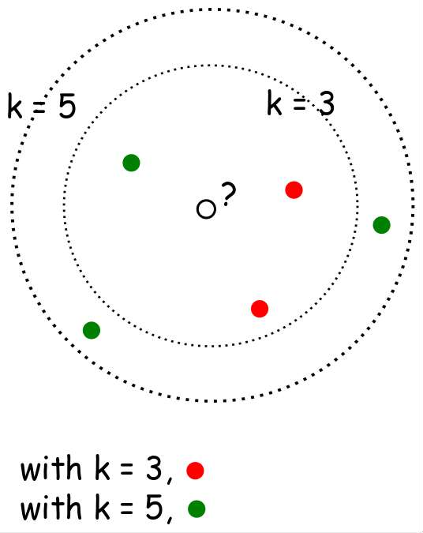
What is k- NN??
When k=3 or k=5??
Nearest-neighbor classifiers are based on learning by comparing a given test tuple with training tuples that are similar to it.
The training tuples are described by n attributes.
When k = 1, the unknown tuple is assigned the class of the training tuple that is closest to it in pattern space.

Slide 14
Distance Measures
𝐸𝑢𝑐𝑙𝑖𝑑𝑒𝑎𝑛 𝑑𝑖𝑠𝑡𝑎𝑛𝑐𝑒 ∶ 𝑑 𝑥, 𝑦
= ∑ 𝑥_{𝑖} − 𝑦𝑖
2
𝑆𝑞𝑢𝑎𝑟𝑒𝑑 𝐸𝑢𝑐𝑙𝑖𝑑𝑒𝑎𝑛 𝑑𝑖𝑠𝑡𝑎𝑛𝑐𝑒 ∶ 𝑑 𝑥, 𝑦
= ∑ 𝑥_{𝑖} − 𝑦𝑖
2
𝑀𝑎𝑛ℎ𝑎𝑡𝑡𝑎𝑛 𝑑𝑖𝑠𝑡𝑎𝑛𝑐𝑒 ∶ 𝑑 𝑥, 𝑦
= ∑ |(𝑥𝑖 − 𝑦𝑖)|
Which distance measure to use?
We use Euclidean Distance as it treats each feature as equally important.

Slide 15
How to choose K?
If infinite number of samples available, the larger is k, the better is classification.
k = 1 is often used for efficiency, but sensitive to “noise”
Larger k gives smoother boundaries, better for generalization, but only if locality is preserved. Locality is not preserved if end up looking at samples too far away, not from the same class.
Interesting relation to find k for large sample data :
k = sqrt(n)/2 where n is number of examples
Can choose k through cross-validation

Slide 16
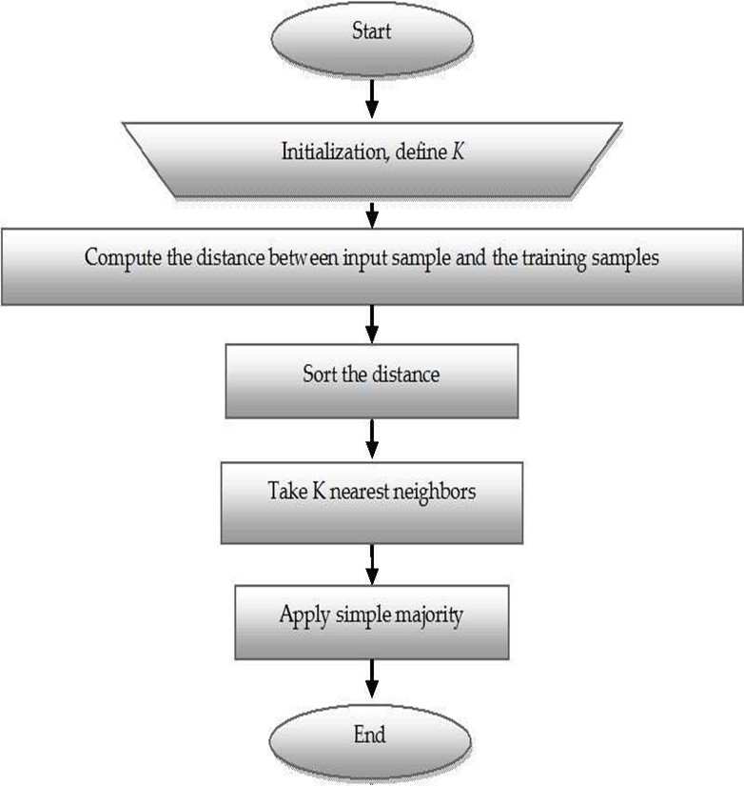
K-NN Algorithm
KNN working with the help of following steps :
Step 1 − Load the training as well as test data.
Step 2 − Choose the value of K i.e. the nearest data points. K can be any integer.
Step 3 − For each point in the test data do the following −
  3.1 − Calculate the distance between test data and each row of training data with the help of any of the method namely: Euclidean, Manhattan or Hamming distance. The most commonly used method to calculate distance is Euclidean.
  3.2 − Now, based on the distance value, sort them in ascending order.
  3.3 − Next, it will choose the top K rows from the sorted array.
  3.4 − Now, it will assign a class to the test point based on most frequent class of these rows.
Step 4 − End

Slide 17
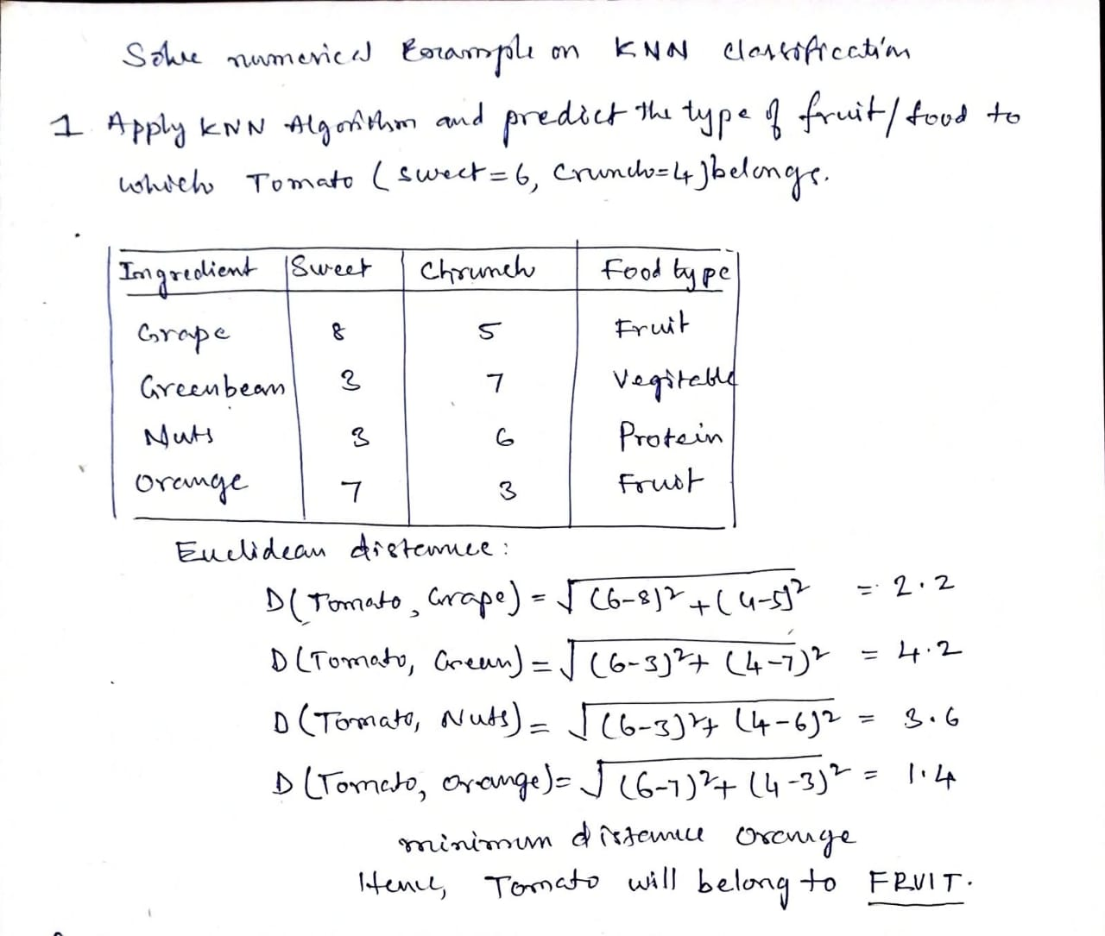
Example

Slide 18
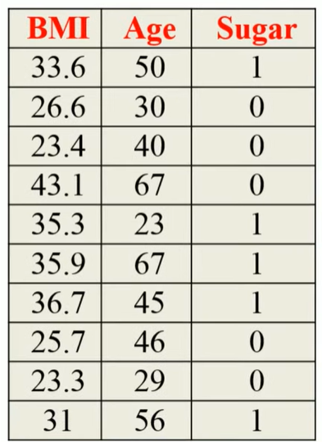
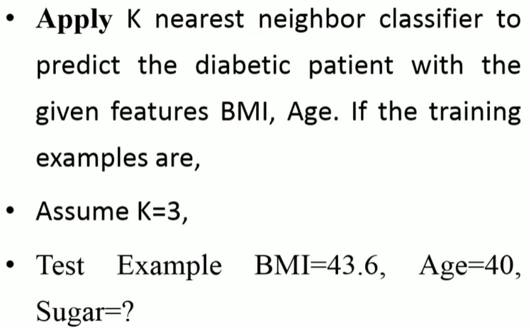

Slide 19
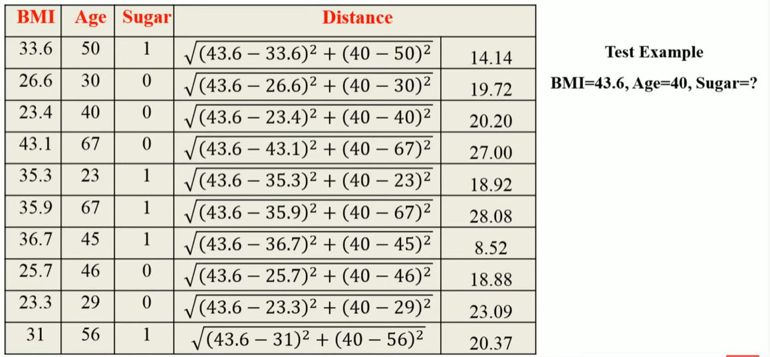

Slide 20
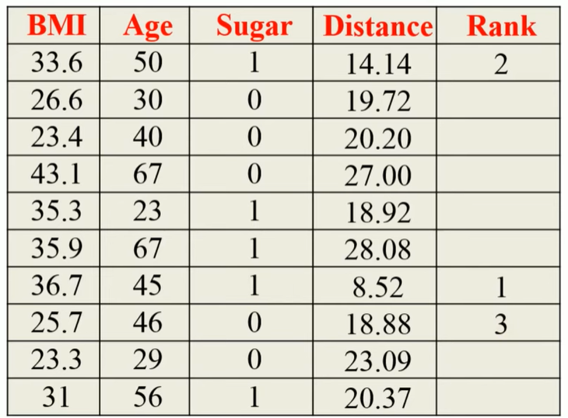
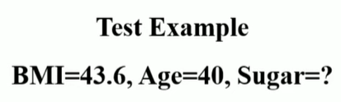


Slide 21
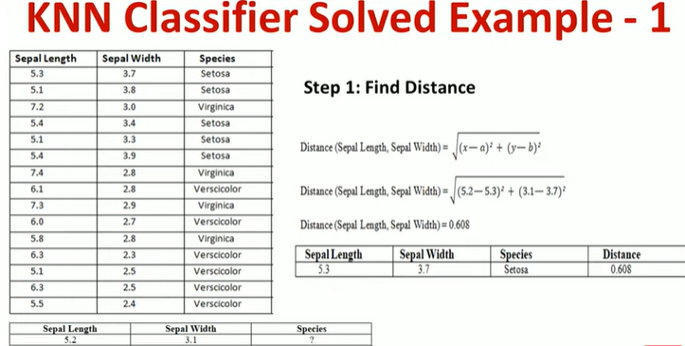

Slide 22
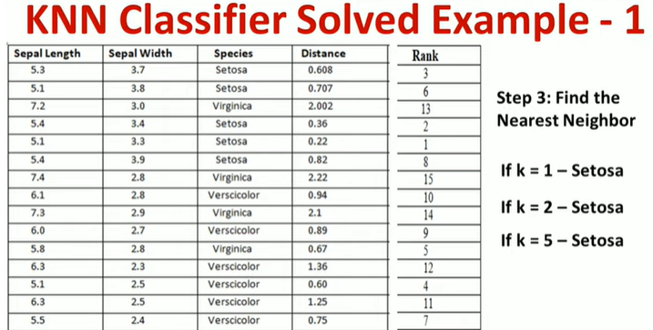

Slide 23
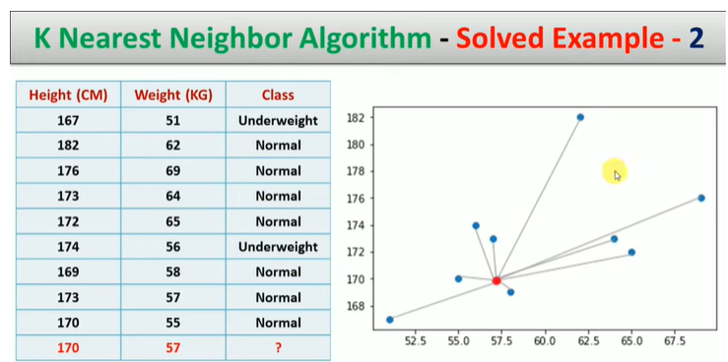

Slide 24
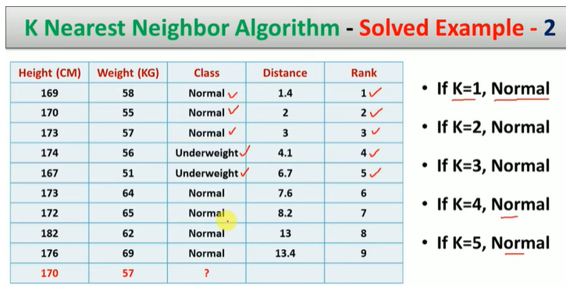

Slide 25
Complexity
O(d) to compute distance to one examples
O(nd) to computed distances to all examples
Plus O(nk) time to find k closest examples
Total time: O(nk+nd)
Very expensive for a large number of samples
But we need a large number of samples for kNN to to work well!!

Slide 26
Advantages of KNN classifier :
Can be applied to the data from any distribution for example, data does not have to be separable with a linear boundary
Very simple and intuitive
Good classification if the number of samples is large enough
Disadvantages of KNN classifier :
Choosing k may be tricky
Test stage is computationally expensive
No training stage, all the work is done during the test stage
This is actually the opposite of what we want. Usually we can afford training step to take a long time, but we want fast test step

Slide 27
Applications of KNN Classifier
Used in classification
Used to get missing values
Used in pattern recognition
Used in gene expression
Used in protein-protein prediction
Used to get 3D structure of protein
Used to measure document similarity

