Slide 1
Data Science
Unit-II
Principal Component Analysis (PCA)
Dimensionality Reduction
From : Web resources

Slide 2
Dimensionality Reduction:
In machine learning classification problems, there are often too many factors on the basis of which the final classification is done. These factors are basically variables called features. The higher the number of features, the harder it gets to visualize the training set and then work on it. Sometimes, most of these features are correlated, and hence redundant. This is where dimensionality reduction algorithms come into play.
Dimensionality reduction is the process of reducing the number of random variables under consideration, by obtaining a set of principal variables. It can be divided into feature selection and feature extraction.
Problem with high dimensional data?
It can mean high computational cost to perform learning.
It often leads to over-fitting when learning a model, which means that the model will perform well on the training data but poorly on test data.
Data are rarely randomly distributed in high-dimensions and are highly correlated, often with spurious correlations.
The distances between a nearest and farthest data point can become equidistant in high dimensions, that can hamper the accuracy of some distance-based analysis tools.

Slide 3
Importance of Dimensionality reduction?
It reduces the time and storage space required.
It helps Remove multi-collinearity which improves the interpretation of the parameters of the machine learning model.
It becomes easier to visualize the data when reduced to very low dimensions such as 2D or 3D.
It avoids the curse of dimensionality.
It removes irrelevant features from the data, Because having irrelevant features in the data can decrease the accuracy of the models and make your model learn based on irrelevant features.
Methods for Dimensionality Reduction:
Principal Component Analysis (PCA)
Multi Dimensionality Scaling (MDS)

Slide 4
Introduction to PCA
Principal Components Analysis, or PCA, is a data analysis tool that is usually used to reduce the dimensionality (number of variables) of a large number of interrelated variables, while retaining as much of the information (variation) as possible
PCA calculates an uncorrelated set of variables (components or pc’s). These components are ordered so that the first few retain most of the variation present in all of the original variables.
Unlike its cousin Factor Analysis, PCA always yields the same solution from the same data (apart from arbitrary differences in the sign).
The computations of PCA reduce to an eigenvalue-eigenvector problem. PCA is eigen vector of maximum eigen value
Note that PCA is a data analytical, rather than statistical, procedure. Hence, you will not find many t-tests or F-tests in PCA.

Slide 5
Introduction to PCA
Principal component analysis (PCA) is a statistical procedure that uses an orthogonal transformation to convert a set of observations of possibly correlated variables into a set of values of linearly uncorrelated variables called principal components.
The number of principal components is less than or equal to the smaller of the number of original variables or the number of observations.
This transformation is defined in such a way that the first principal component has the largest possible variance (that is, accounts for as much of the variability in the data as possible), and each succeeding component in turn has the highest variance possible under the constraint that it is orthogonal to the preceding components.

Slide 6
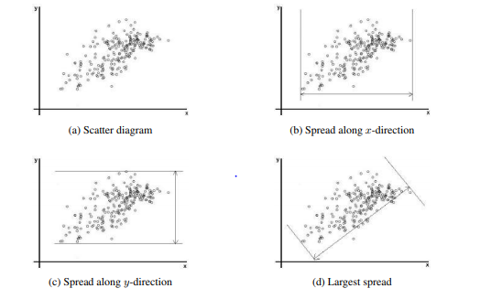
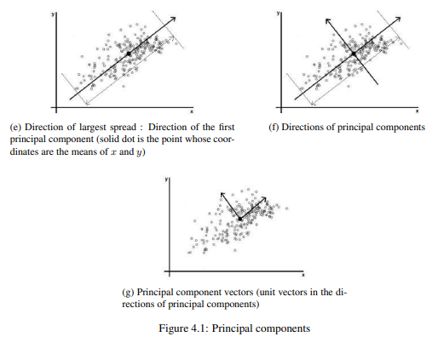
Graphical illustration of the idea

Slide 7
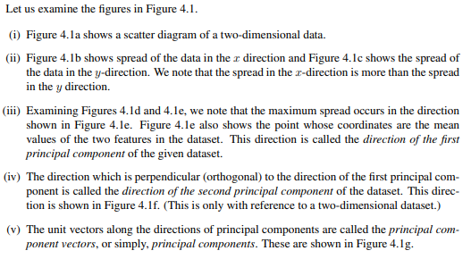
Graphical illustration of the idea

Slide 8
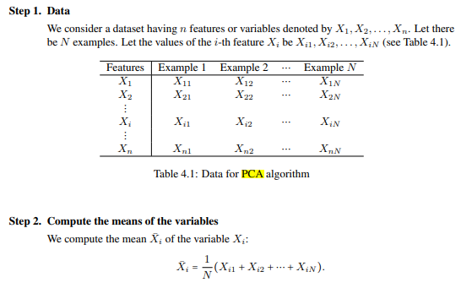
PCA Algorithm

Slide 9
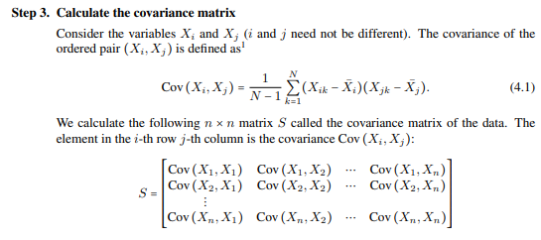
PCA Algorithm

Slide 10
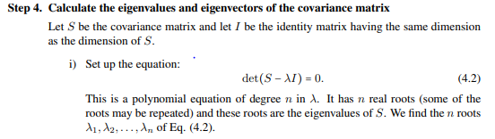
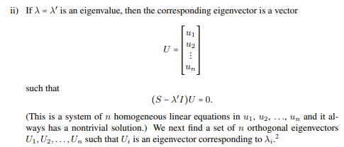
PCA Algorithm

Slide 11
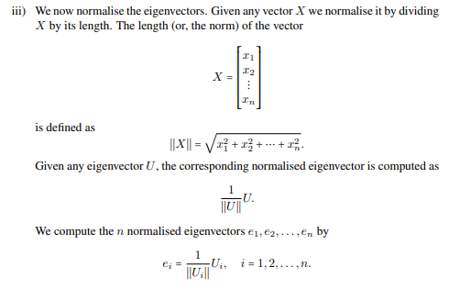
PCA Algorithm

Slide 12
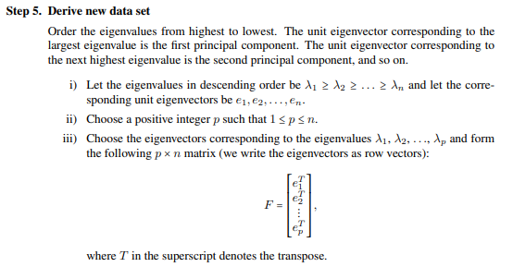
PCA Algorithm

Slide 13
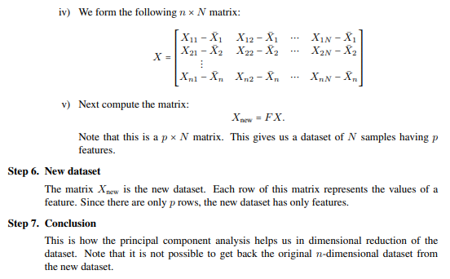
PCA Algorithm

Slide 14
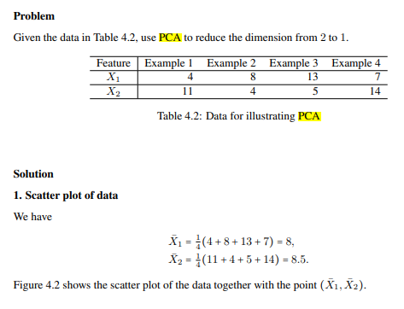
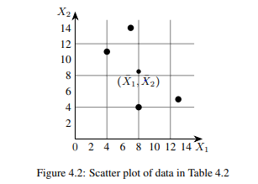
PCA: Example

Slide 15
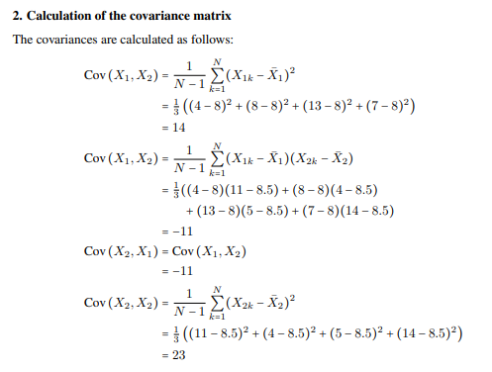
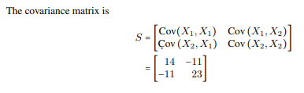
Example

Slide 16
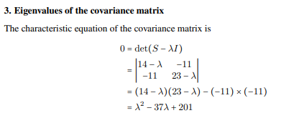

Example

Slide 17
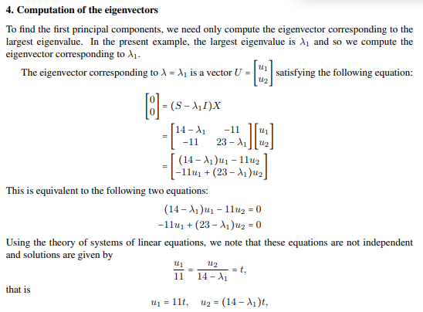
Example

Slide 18
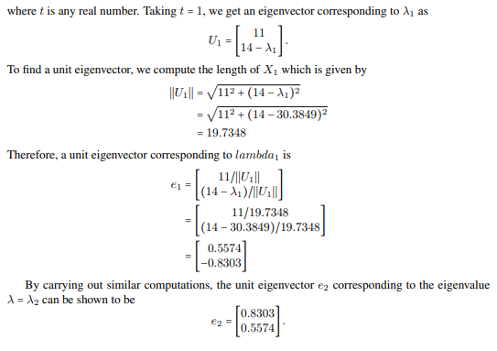
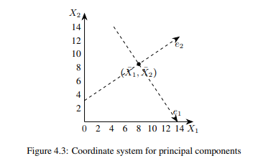
Example

Slide 19
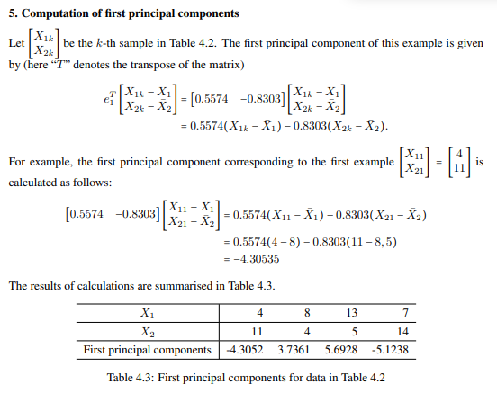
Example

Slide 20
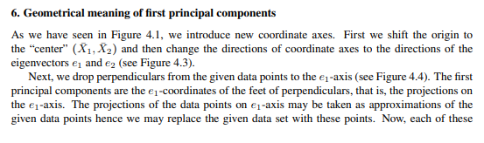
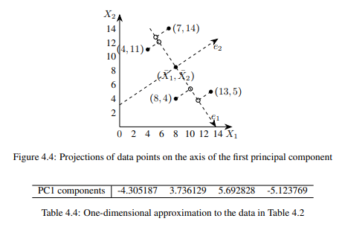
Example

Slide 21
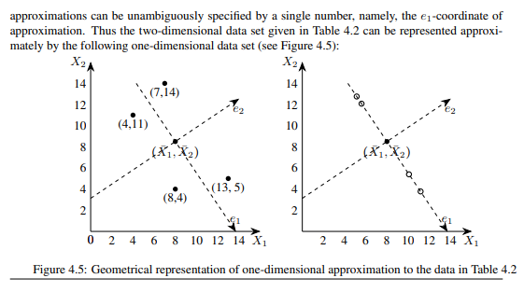
Example

Slide 22
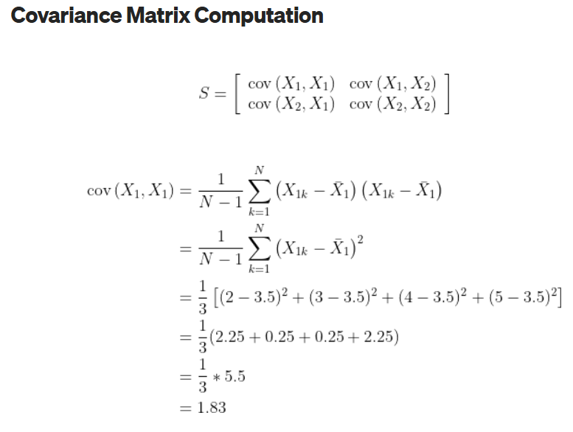
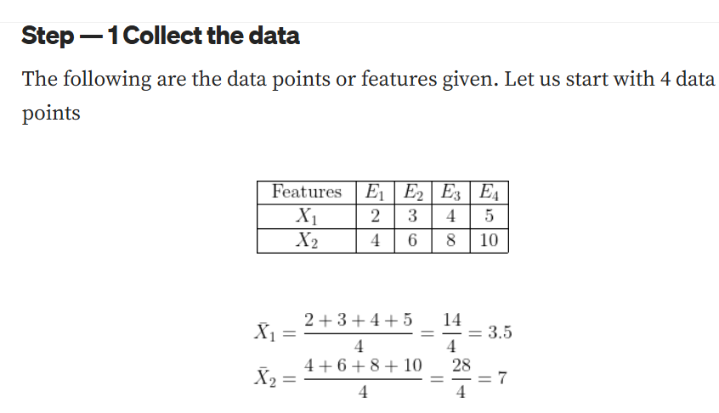
Example: Convert 2D to 1D using PCA

Slide 23
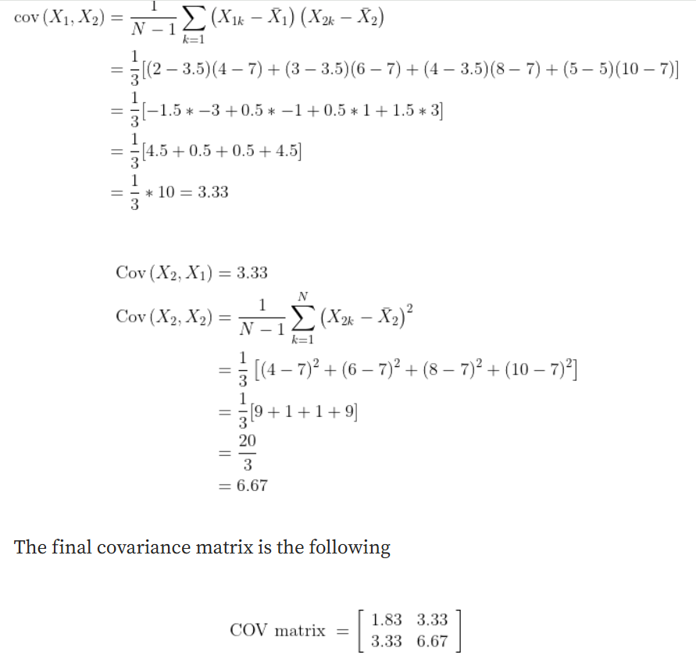

Slide 24
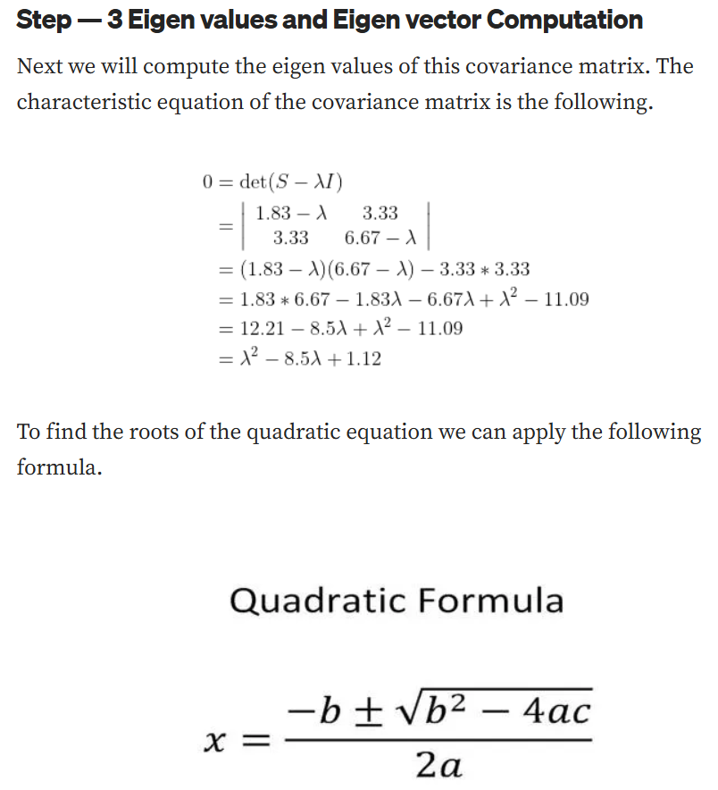

Slide 25
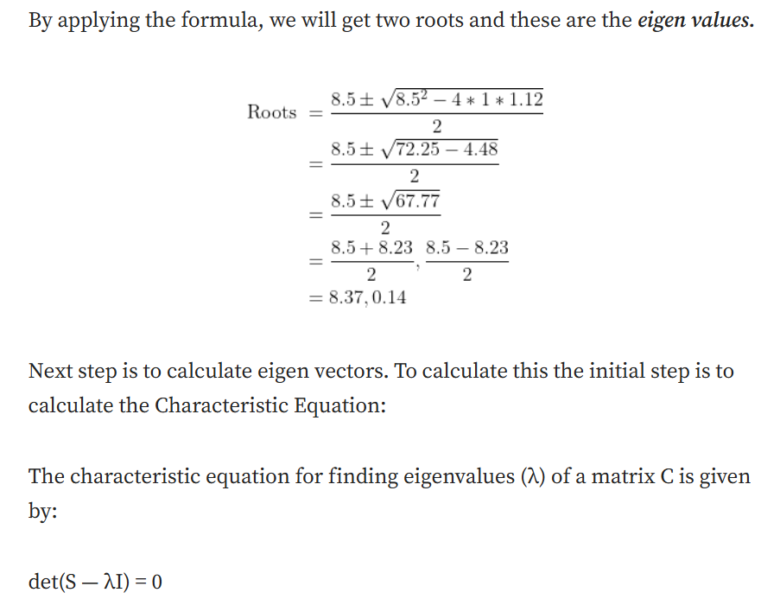

Slide 26
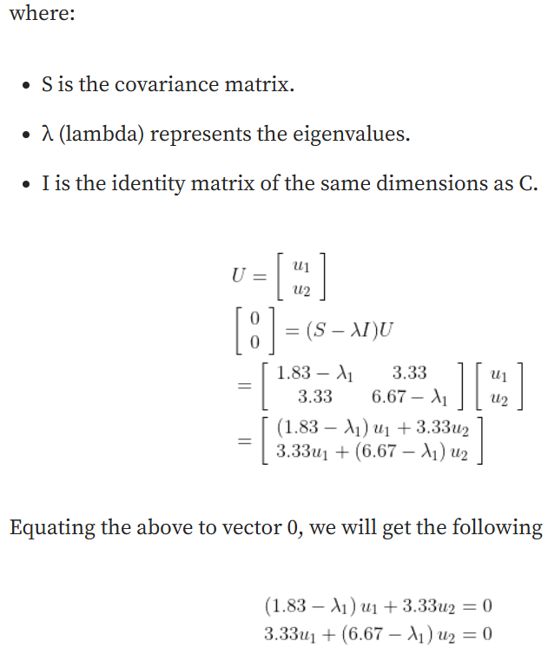
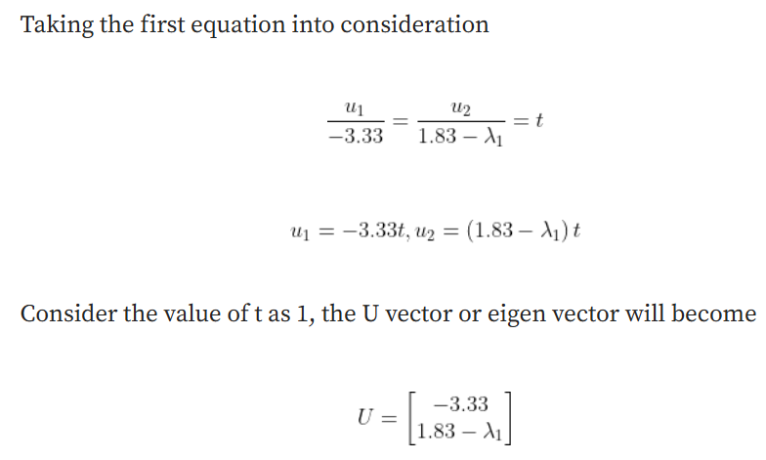

Slide 27
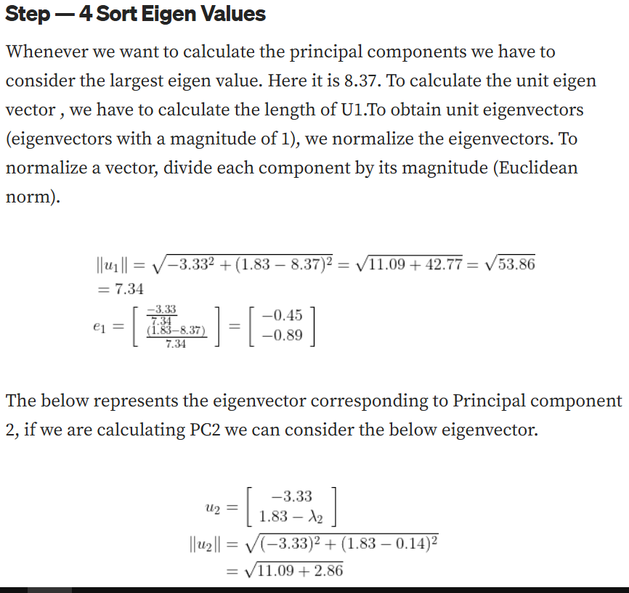

Slide 28
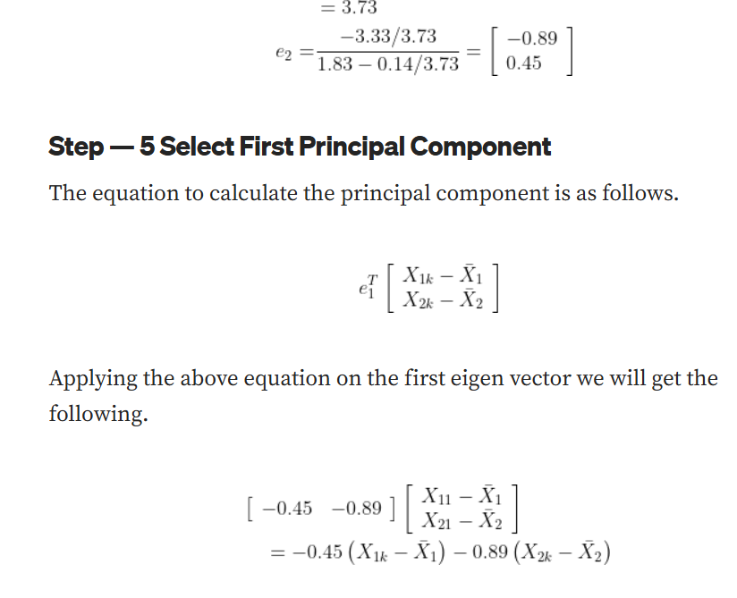

Slide 29
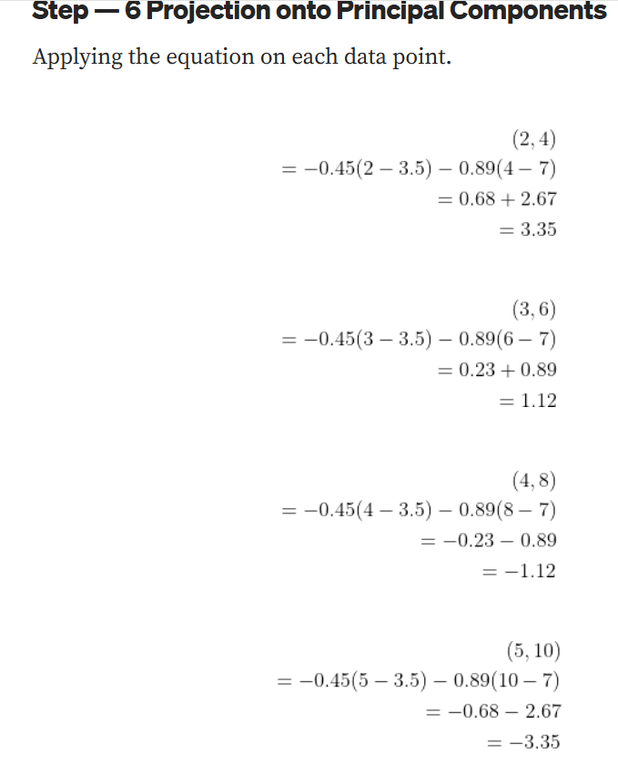

Slide 30
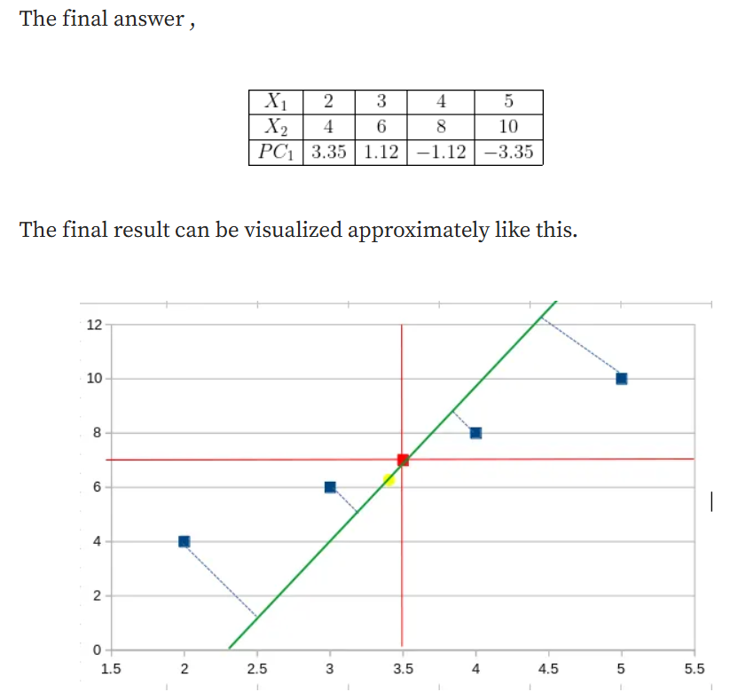

Slide 31
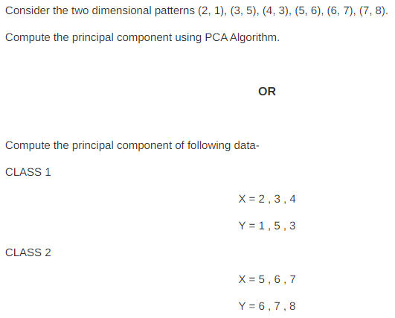
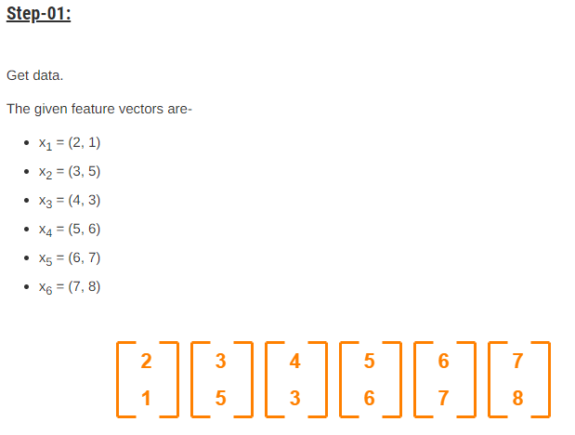
PCA: Example: Find PCAs for given data set

Slide 32
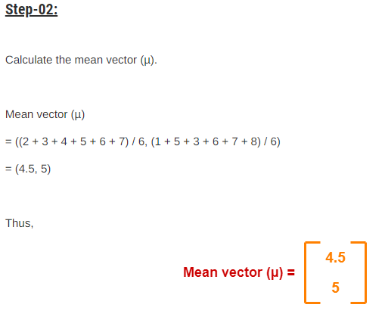
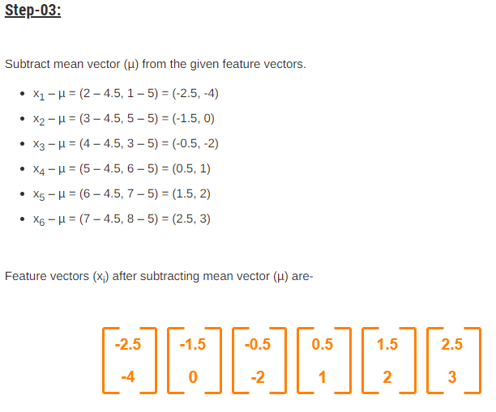
Example

Slide 33
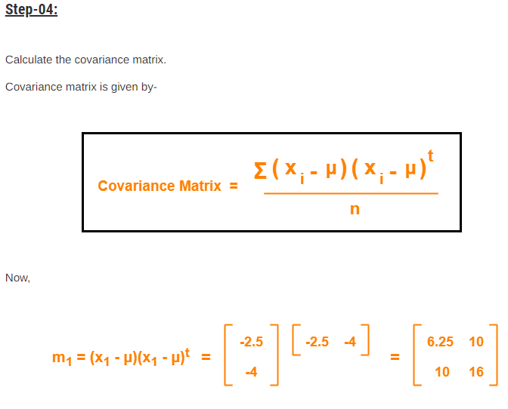
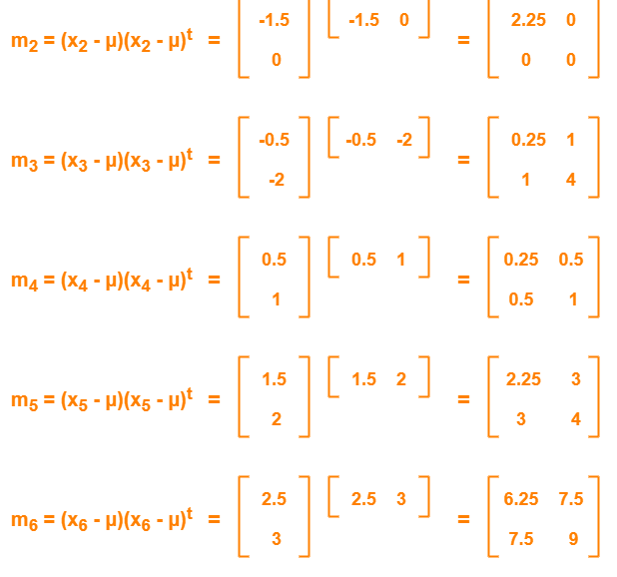
Example: Covariance matrix method

Slide 34
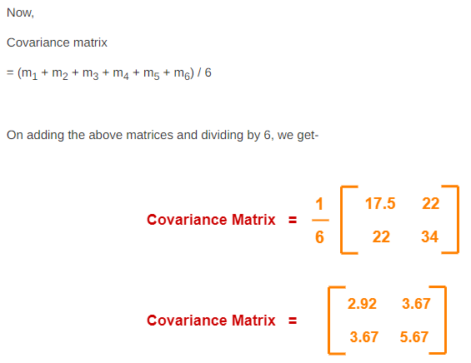
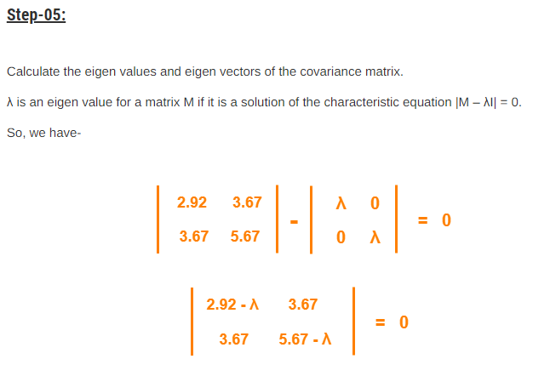
Example

Slide 35
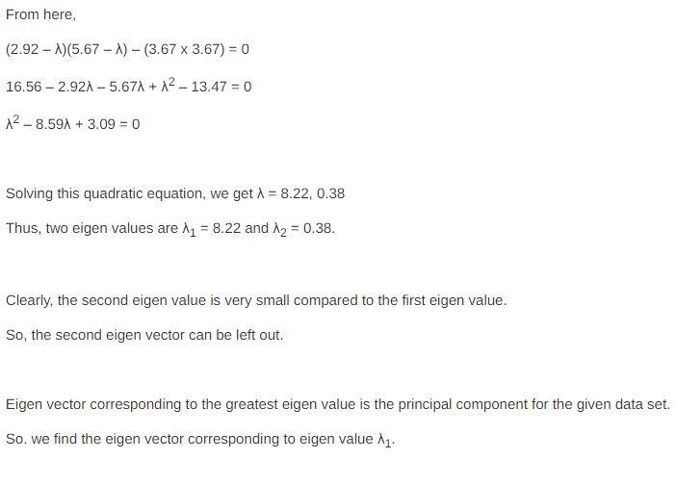
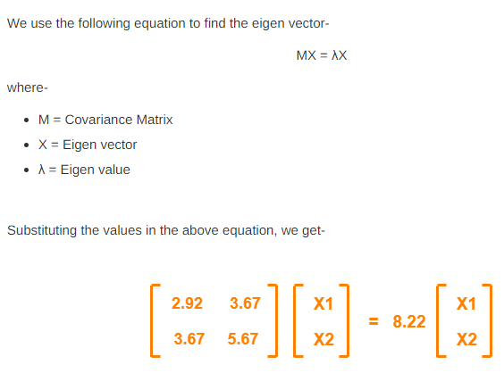
Example

Slide 36
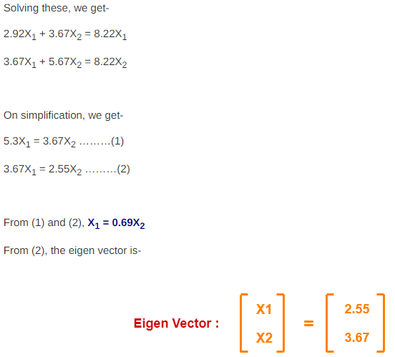
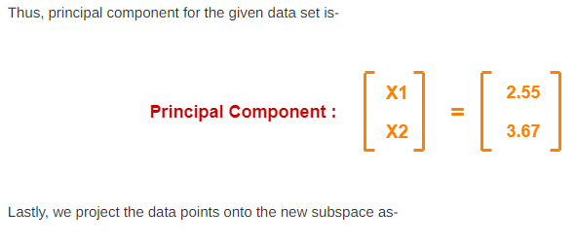
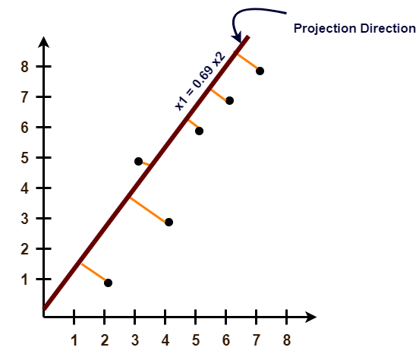
Example

Slide 37
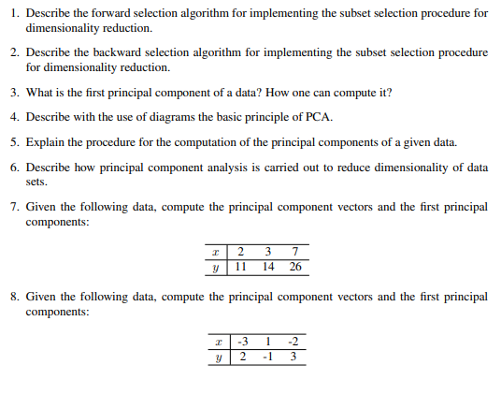
Exercise

Slide 38
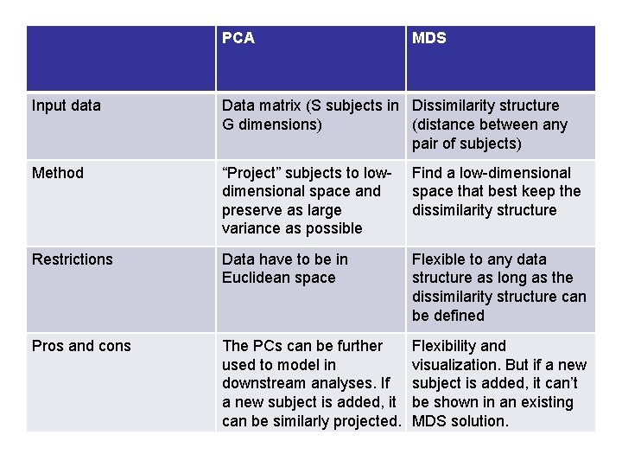
Difference between PCA and MDS

