Slide 1
The Parks Department
Team Members: Ryan Williams, Nate Suer, Kyle Young, Owen Richards
Advisor: William Hawkins III
Notes:
Nate

Slide 2
Goals
Goals of the Project
Teach responsible forestry and management of species.
Engage players through an educational simulation focusing on environmental management.
Promote understanding of wildlife preservation and management in a fun, interactive format.
Background
Players manage animal populations, balancing ecosystems by controlling both animal and plant species.
It combines elements of animal reserve management with strategic gameplay.
Set in an isometric 3D style
Set in a simulated Ohio-like environment, the game addresses challenges like forestry management and animal conservation.

Slide 3
Intellectual Merits
Uses AI to simulate realistic animal behavior. This includes running away from predators, forming social groups, and seeking out mates.
Leveraged real life behaviors in order to make features in the game. This includes the animals having stamina.
Furthers the discussion of education in video games.
Uses advanced modeling techniques to simulate and animate the bones in each animal’s body.

Slide 4
Broader Impact
Players learn the fragility of a healthy ecosystem by attempting to maintain one themselves.
Players discover the major species of Ohio, and learn their roles in our state’s ecosystem.
Players take on the dilemma faced by real park and forest systems: balancing revenue against keeping human influence out of the wilds.
The game teaches through play, attaching consequences to each decision the player makes.
More in-depth information is available, but the player interacts with the core message without having to dive into fact books.

Slide 5
Design Specifications
Our project is built in Godot and is separated into scenes, scripts, and assets.
The main scene, OhioPreserve, holds components that help manage the camera, day night cycle, and animal spawning.
The simulation handler script starts everything up, spawning animals into the scene, and starting a time interval.
From there, the animals and plants have logic in them that dictate their actions. They may move towards food, friends, or randomly depending on their needs.
Additionally, we have UI elements in their own scenes that can then be instantiated on top of our gameplay scenes.

Slide 6
Technologies
The main technology that we have developed is the complex animal AI.
Each animal species has its own parameters, setting their speed, maximum hunger, reproduction frequency, maximum stamina, diet type, size of social group, etc.
Each animal evaluates its needs (with some randomness for variation), and acts accordingly. They can scan nearby objects for potential food and friends.
The animals can also flee from predators if any are spotted nearby. They can run away, but only for a set amount of time, as they all have a preset amount of stamina.
Likewise, we have developed a complex plant AI
Each plant species has parameters that help define how fast they spread, how densely they may grow, and how resilient they are to consumption.

Slide 7
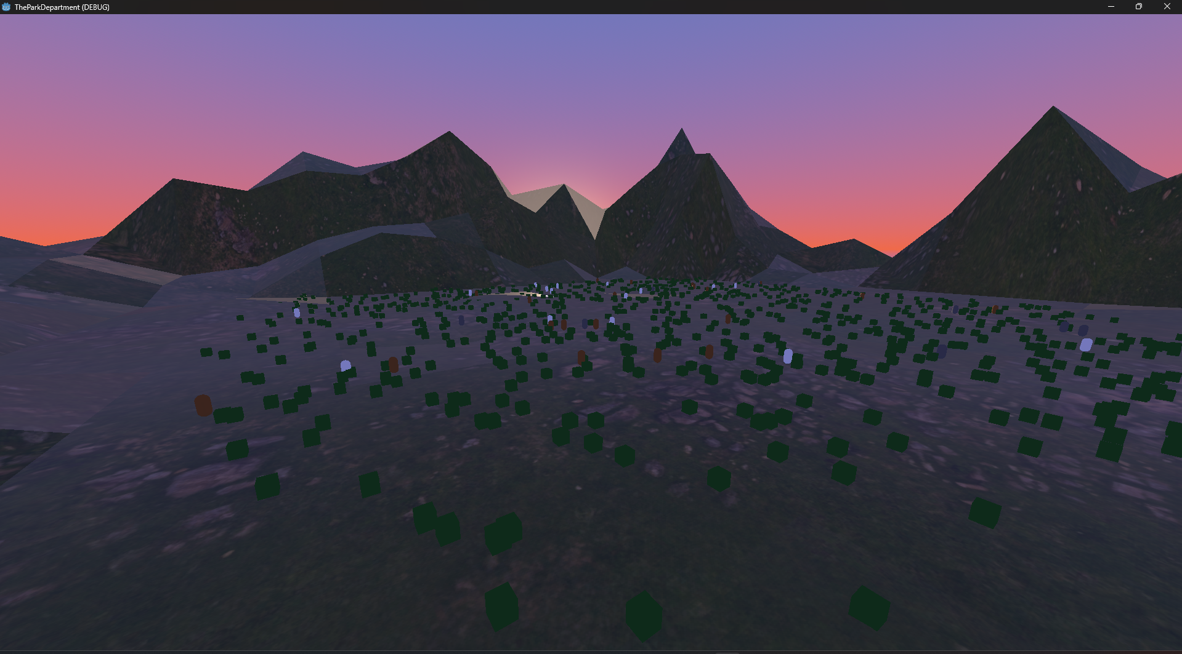
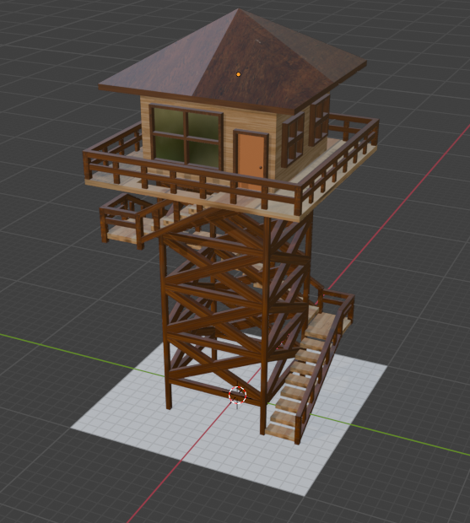
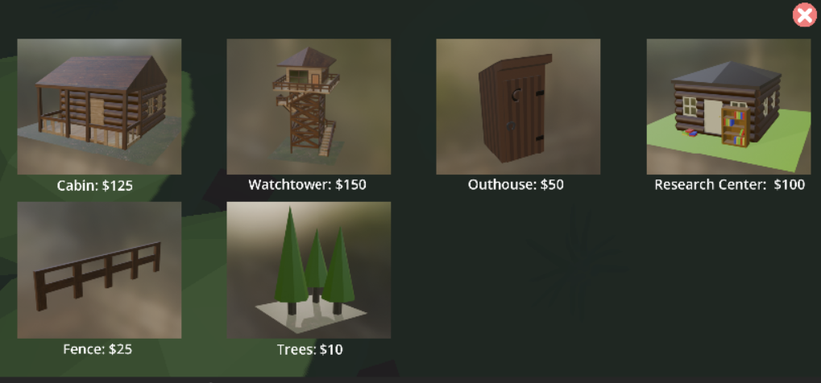
Completed Milestones
Map Creation
Environment Creation
Plants
Animal Simulation
UI Integration
Structure Models
Animal Models and Animations
Drag-and-drop Building
Animal Releases + Limit
Income based on Biodiversity
Sunset on the park (completed 1/9/25)
A Watchtower (completed 3/4/25)
The Build menu (completed 4/7/25)

Slide 8
Challenges
Ecosystem balancing
Kyle and Nate worked together on a system to balance out the animal ecosystem.
Getting the AI for animals to work properly involved a lot of bugfixing.
There were bugs with animals defaulting to a certain part of the map, they got stuck while deciding what task to do and died of starvation, etc.
3D Development
Ryan handled the graphical design of the animals. Creating their topology was difficult enough with little prior Blender experience, but rigging and animating the animals took lots more time to look correct.
Owen similarly started from very little Blender experience to create a beautiful mountain range to border the preserve, as well as buildings to place.
Godot
Nate, Ryan, and Owen were all new to using Godot prior to this project. It took a while, but we all took the time to research and develop different aspects of the project to make us more comfortable with the Software.

Slide 9
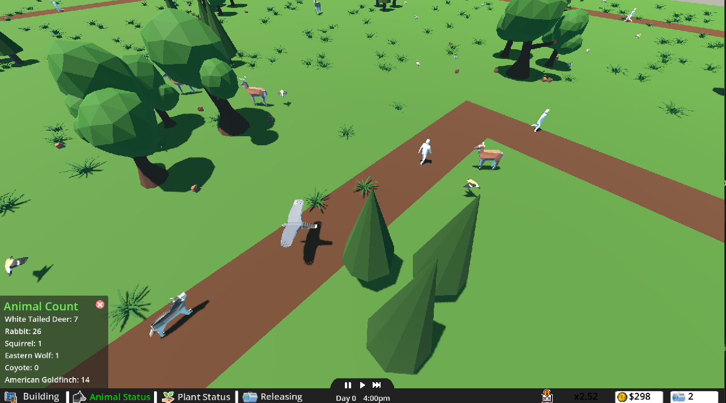
Results
Created a fully playable wildlife simulator game.
Implemented seven animals native to Ohio.
Wolf (extinct in Ohio), Coyote, Deer, Cooper’s Hawk, Goldfinch, Rabbit, and Squirrel
All with animations, separate texture/model for male and female where appropriate
Implemented complex rule-based AI for animals and plant growth.
Implemented drag-and-drop placement for buildings and animals
Counts against stored currency, daily animal placement limit
Smooth, consistent UI across all fronts
Implemented basic visitor system with model and animation for visitors.
An example screenshot from the game

