Slide 1
Обнаружение ботов

Slide 2
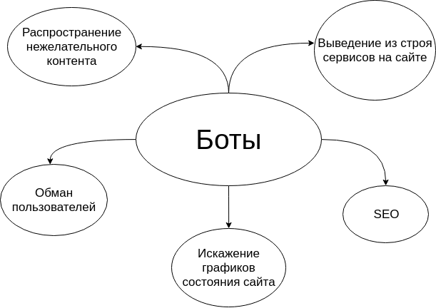

Slide 3
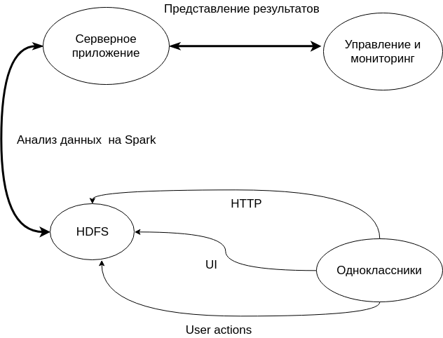
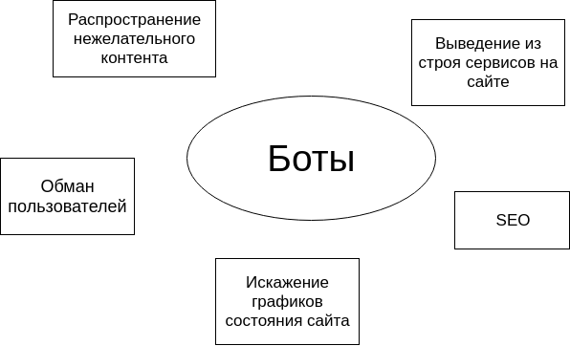
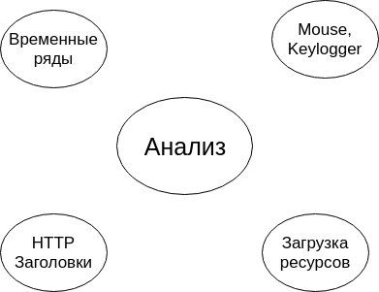

Slide 4
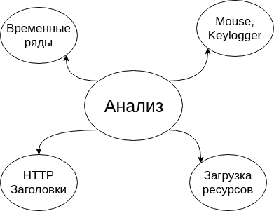

Slide 5

Full stack bots
Features:
Use full web technologies stack.
HTTP signatures are similar to those of browsers.
May mock user behavior.
There are a lot of tools to build such bots (iMacros, Selenium, …)
Detection approaches:
Behavior analysis.
Suspicions usage of inputs (mouse moves, clicks, ...)

Slide 6

Request based bots
Features:
Send forged request directly (do not use browsers)
Require less resources that full stack bots.
Detection approaches:
Odd http headers.
Suspicious session and authentication tokens usage.
Partial web content downloading.

