Slide 1
Document Intelligence Platform
Extract, validate and serve data from invoices and financial statements
AI Engineer Internship · Technical case study · <Your name>
Notes:
Introduce the problem and the one-line solution: upload a document, get validated structured JSON, stored and visible in a dashboard.

Slide 2
The problem: no two documents look alike
Invoices and statements come as native or scanned PDF, JPG or PNG
Layouts, image quality and OCR errors differ for every document
Numbers must reconcile (totals, balances, cash flows) before anyone trusts them
Result must be reusable: REST API, dashboard, stored history
4
document types
Invoice · Balance sheet · P&L · Cash flow
≤ 3
pages per file
PDF, JPG or PNG; validated first
0
invented values
Missing means null, never guessed
Notes:
Manual extraction is slow and inconsistent. The brief asks for a reusable service, not a one-off script.

Slide 3
One pipeline, six controlled stages
1
Validate file
2
Independent OCR
3
LLM extraction
Type from content, size, corruption, page limit
PDF text layer or Tesseract
Gemini reads the file into a schema
4
Financial checks
5
Evidence + confidence
6
Store + serve
Deterministic PASS / FAIL / N/A
Source text, page, OCR agreement
Database, REST API, dashboard
Notes:
Each stage is a separate service module, so failures are isolated and testable.

Slide 4
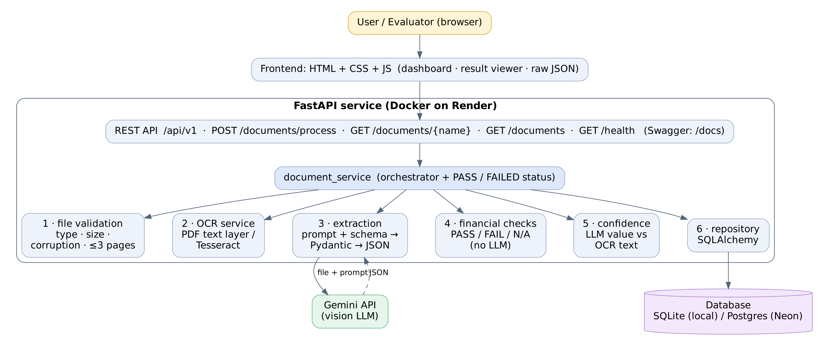
Architecture: thin API, separated services
The LLM never decides PASS/FAIL: validation is plain Python on the extracted numbers.
Notes:
Mirror of the required repository structure: api, core, models, schemas, services, repositories, utils.

Slide 5
Extraction: schema-bound and evidence-first
Vision LLM reads the PDF/image directly, temperature 0
Per-type prompt + JSON schema; output parsed by Pydantic
Invalid JSON is re-asked once, then fails cleanly
Every value carries source_text and page_number
Unreadable or absent values stay null
Statement row model
label: "Total"
row_type: item|subtotal|total|heading
section: assets|capital_and_liabilities
canonical_key: total_income
values: { "FY2023": 204666.10, "FY2022": 167695.40 }
source_text, page_number
Notes:
Canonical keys decouple validation from the wording used in a specific statement.

Slide 6
Financial validation: every check shows its working
Document | Checks (per period / year)
Invoice | qty × price = line · Σ lines vs subtotal · subtotal + tax − discount = total (tax-inclusive handled) · cash − total = change
Balance sheet | assets = capital & liabilities · Σ asset items · Σ liability items
Profit & loss | income · expenditure · profit before minority · profit to group · appropriation
Cash flow | op + inv + fin (+ FX) = net change · opening + net change = closing
Each check returns: formula · operands · calculated · reported · variance · tolerance · PASS / FAIL / NOT_APPLICABLE
Notes:
Tolerance: statements 1.0 in document units, invoices 0.05 to allow cash rounding. Missing inputs give NOT_APPLICABLE.

Slide 7
Confidence you can explain
confidence = 0.60 + 0.35 × share of value found in OCR text
0.95
0.60
none
Corroborated
Not corroborated
Null or no OCR
The value appears in the OCR text
Flagged low (< 0.80) and highlighted
No score shown; never faked
Limit: OCR can miss stamps and handwriting, so low means not corroborated, not wrong.
Notes:
Not an LLM self-rating: the model's value is compared against an independent OCR/text-layer pass.

Slide 8
API, dashboard and persistence
REST API
Dashboard
Persistence
POST /api/v1/documents/process
GET /api/v1/documents/{name}
GET /api/v1/documents
GET /api/v1/health
One error shape, correct status codes, no stack traces
Pick type, upload, process
Searchable, filterable list
Result view: fields, tables, evidence
Missing, low-confidence, failed checks highlighted
Raw JSON view, copy and download
SQLAlchemy repository
SQLite locally, Postgres in production
History kept; GET returns the latest
Failed attempts stored too
Files processed in memory, not saved
Notes:
All endpoints are documented in Swagger. The frontend is plain HTML/CSS/JS that calls the same API.

Slide 9
Testing: model faked, everything else real
40
File validation: valid, empty, renamed, corrupt, 4-page PDF
Financial maths: pass, fail, NOT_APPLICABLE, per-year, tax-inclusive receipt
Extraction: normalisation, retry on bad JSON, null stays null
API flow: process, latest-by-name, list, 415 / 400 / 422 / 404 / 502 / 500
Real scanned PDF and receipt image through OCR confidence
automated tests passing
pytest · clean-venv install verified
Notes:
Tests need no API key. Two tests run the real scanned sample files through OCR when SAMPLES_DIR is set.

Slide 10
Deployment, limitations and next steps
Deployment
Known limits
Production next
Docker image with Tesseract
Render web service, health-checked
Neon Postgres for durable data
Secrets only in environment variables
Handwriting and stamps can be misread
Synchronous, 5 to 40 s per file
Free-tier rate limits and cold starts
No authentication yet
Async queue with status polling
Evaluation set for field-level accuracy
Original-file viewer with evidence boxes
Alembic, metrics, rate limiting
Notes:
Be upfront about limits; this is what an interviewer will probe.

