Slide 1




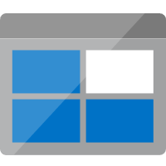


Validation
Have signed-in with Azure AD and MSAL
Validate Jwt signature with Azure AD Open ID Configuration Url
React application
On Azure Blob Storage
Azure API Management
(Or your HTTP Middleware)
Azure Functions
Valid token
return 2xx
Forget token return 401
Validate with following
Expired ?
Correct issuer ?
Correct audience ?
Invalid token return 401
Invalid token return 401

Slide 2
You can download Azure Icons https://www.microsoft.com/en-us/download/details.aspx?id=41937

