Slide 1
AeroUS
Group 4-
Aishwarya Chaubal
Bhupinder Jagwani Nivedita Thapa
Shruti Garg

Slide 2
01 Business Case Scenario
02 Swim Lane Diagram
03 Our Approach
04 Technology Overview
05 Analytics
06 Airline Modeling System
07 ETL Process
08 Tableau Demo
CONTENTS

Slide 3
Business Case Scenario
“John wanted to book a flight from San Francisco to New York to visit his parents for Christmas. He knew that AeroUS Airlines was having a sale for Christmas and decided to book the flight 4 months in advance. He logged on to the site, signed in with his email ID and password, and started searching for the flights. He entered the source and destination, the required travel date, the number of passengers, and the class he wanted to travel in. He found a few flights departing at night(which he preferred), was within his budget and seemed like a good option for him. However, he had a few doubts regarding baggage allowance and decided to use the AeroUS chatbot to resolve his doubts. He asked the agent about the check-in baggage allowance and the charges for an extra bag. After getting all his queries answered from the chatbot, John selected the preferred flight. He navigated to check-out, entered his personal information, billing and mailing address, credit card details, and finally purchased the ticket. His ticket details were emailed to him. Satisfied with the services provided and the ease of the entire process, he logged off.
On the day of his flight departure, he received an email update from AeroUS stating that the flight would be delayed by 3 hours due to bad weather. John went on AeroUS’s website to confirm the delay, and decided to leave for the airport at a later time than previously planned.”

Slide 4
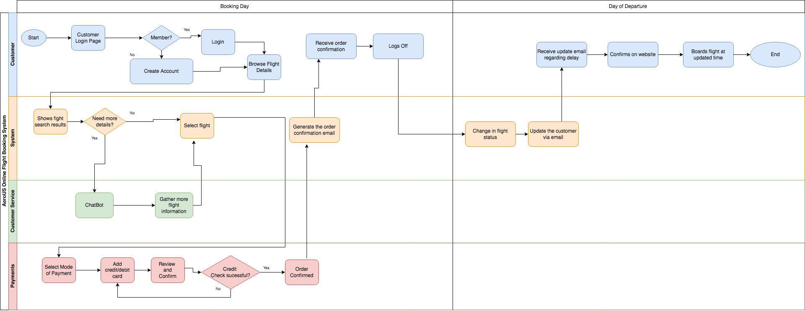
Swimlane Diagram

Slide 5
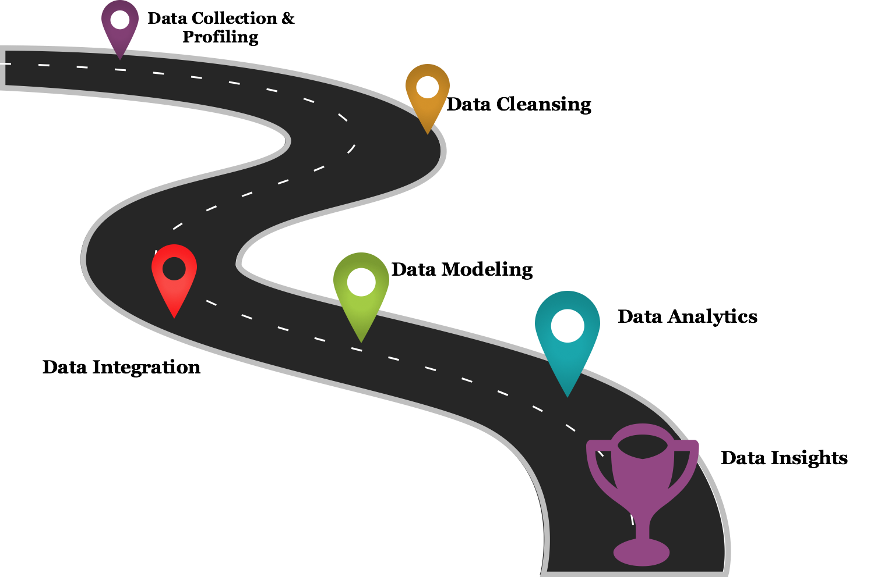
Our Approach
Integration
Modeling
Notes:
For gathering key business insights for our Airline, we followed the below steps:
Data Collection & Profiling: Before we collected any data, we focused on the business scenario and the users of such data. The types of methods we used for data collection were - Observations, Documents and records, and creating questionnaires. Once all the information gathering was done, we performed data profiling by reviewing source data, understanding structure, content and interrelationships, and identifying potential for data projects. Data profiling which is a crucial part of Data warehouse and business intelligence (DW/BI) projects in the sense that data profiling can uncover data quality issues in data sources, and what needs to be corrected in ETL.
Data Cleansing: Next we performed Data cleansing. We had data from multiple sources. When combining multiple data sources, we observed that some data was duplicated, mislabeled. So we had to fix the data and remove incorrect, corrupt, incorrectly formatted, duplicate, or incomplete data within a dataset.
Data Modeling:Once the data was cleaned, we performed data modeling where we identified entities, their properties, the relationship, mapped the attributes, decided upon the degree of normalization and finally finalized upon the data models. We created an OLTP and a Dimensional Model for our airline system
Data Integration: Once the data was cleaned and we could now make sense out of that data and have a data model ready, we performed Data Integration. We had data from multiple sources, and of various types like JSON, EXCEL, MySQL Table formats. Hence, there was a requirement to combine this data from multiple separate business systems into a single unified view, called data warehouse. We used Pentaho Data Integration tool for it
Data Analytics: Next was to perform data analytics where we analyzed the data from the warehouse to find trends and answer questions. We focused on the Lead, lag measures and Descriptive and predictive analytics question which would be necessary by different teams in our company and how they will utilize these for getting insights for our organization.
Data Insights: we used the data visualization tool Tableau for this step where we Graphically represented the information and data depending on the data analytics we performed in the earlier steps. We utilized various charts such as bar chart, stacked bar chart, trend lines, maps, etc and also performed forecasts for predictive analytics. This provided an accessible way to see and understand trends, outliers, and patterns in data for our users.

Slide 6
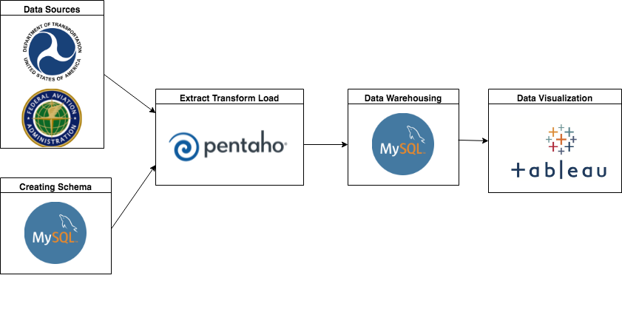
Technology Overview

Slide 7
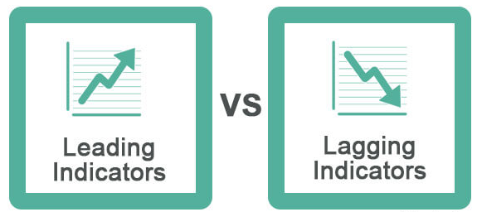
Analytics - Lead and Lag
Lead Measures:
How many left on time in a day?
What are the causes of delay per day?
What are the airports where delays were caused?
Maximum and Minimum Total Sales per Week
Lag Measures:
Increase in the number of flights in the last 1 year?
How many left on time in a month?
Cause of delay per year?
Top 10 Airport names where delays were in a month?
Number of bookings via third-party website in the past month
Total yearly sales
Total sales per quarter

Slide 8
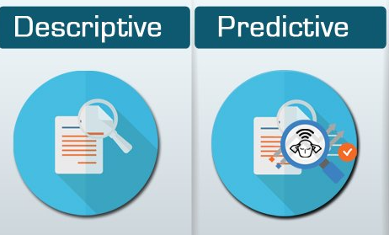
Analytics - Descriptive and Predictive
Descriptive Analytics:
Revenue increase/decrease over the period of 1 year
Increase in the number of flights in the last 1 year
Increase in the number of new routes
Top 5 fully-booked flight routes in the last year
Revenue generated by each airline service category (cargo/passenger) in the past 1 year.
Predictive Analytics:
Cost prediction based on average aircraft delay projections
Offers or upgrades based on customer history
Increase in the flight frequency based on analysing overbooked flights for certain routes.
Forecast sales based on past promotions (Eg: sales during Christmas,Thanksgiving promotion)
Reduction in expenses by analysing past marketing costs ( Eg: targeted marketing based on demographics/ economic status)
Analyze flight data based on aircraft type & weight, weather and the route, etc. to predict the optimal amount of fuel needed for the flight

Slide 9
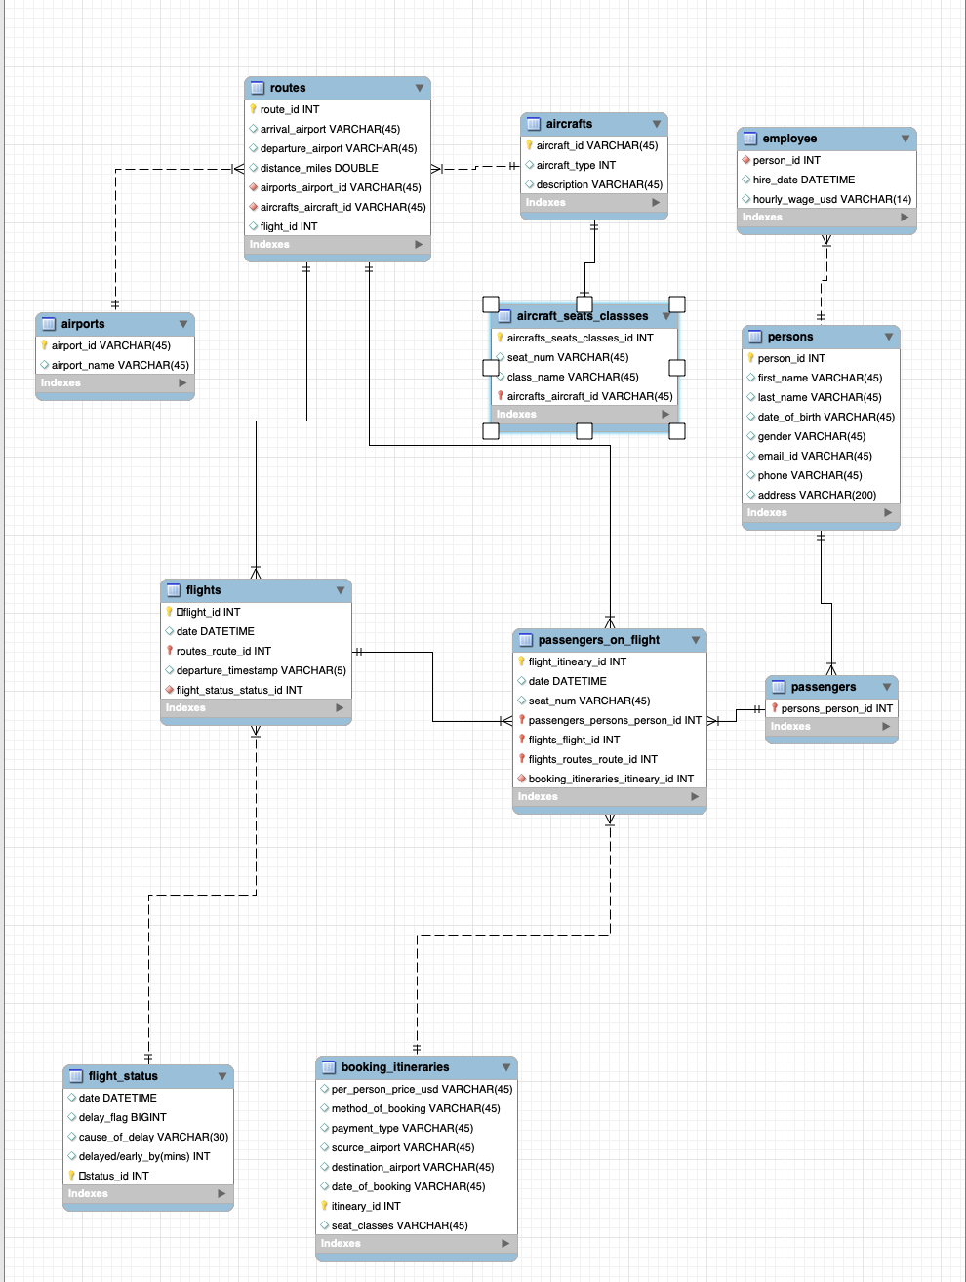
Airline Modeling System - OLTP Data Model

Slide 10
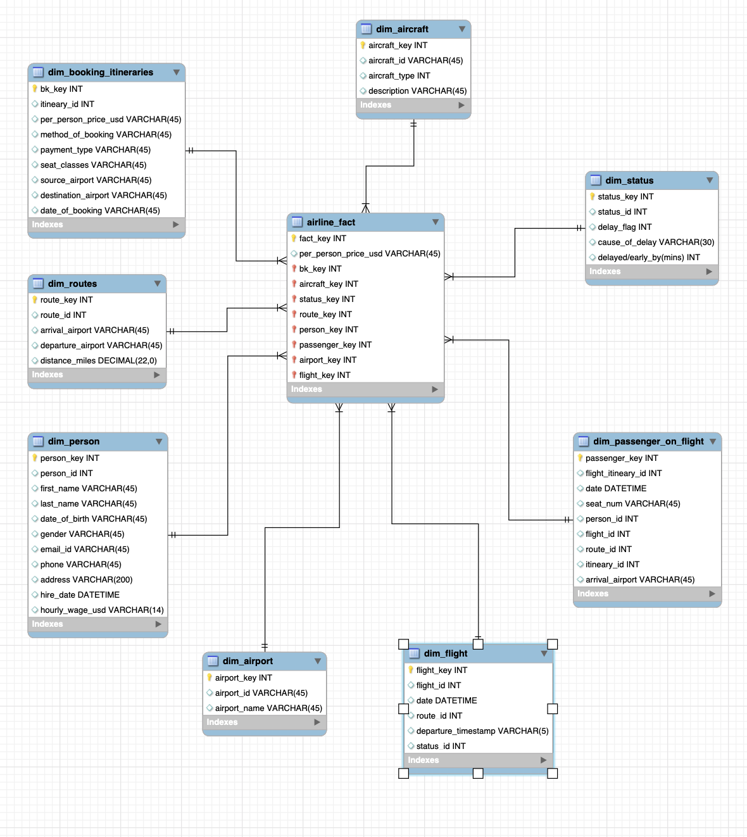
Airline Modeling System - Dimensional Data Model

Slide 11
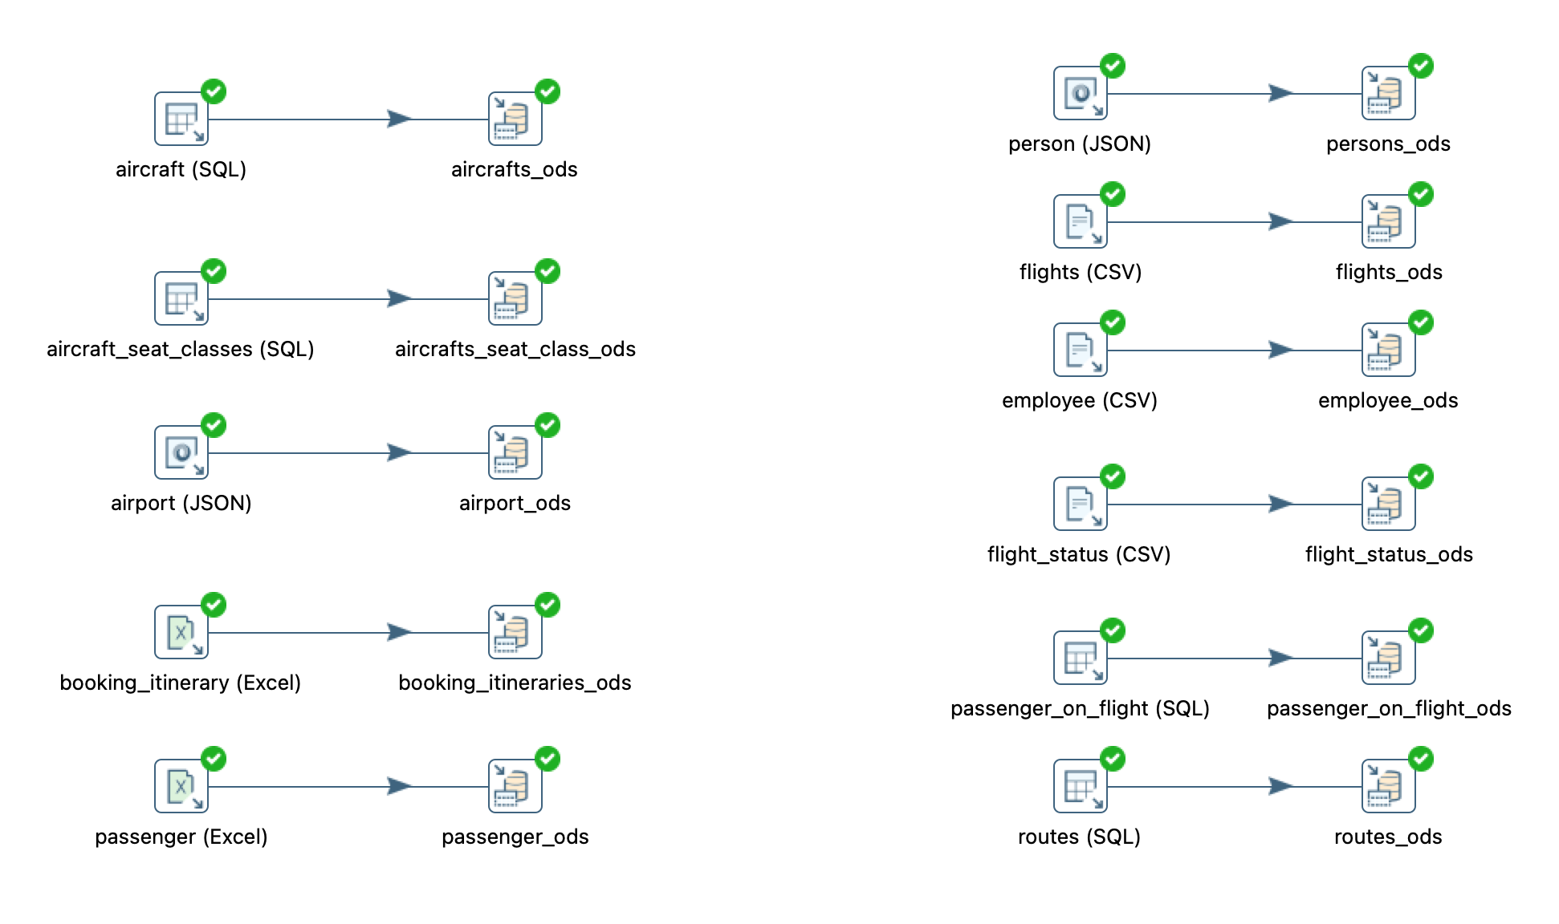
ETL : Extract & Transform
OLTP to ods

Slide 12
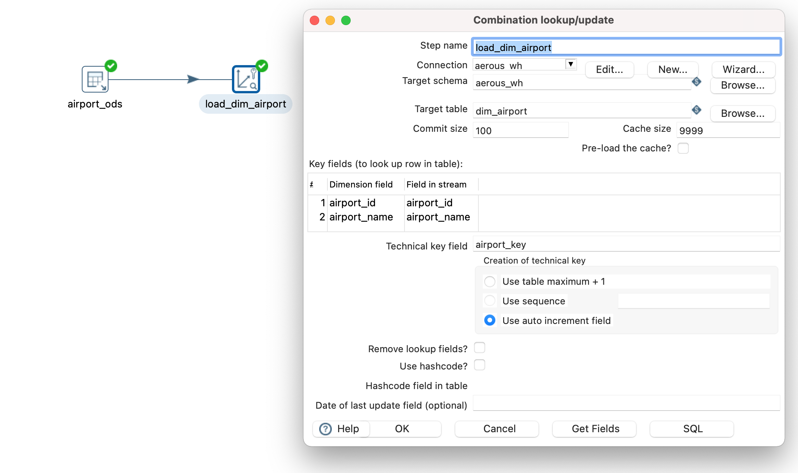
ETL : Load
Ods to WH

Slide 13
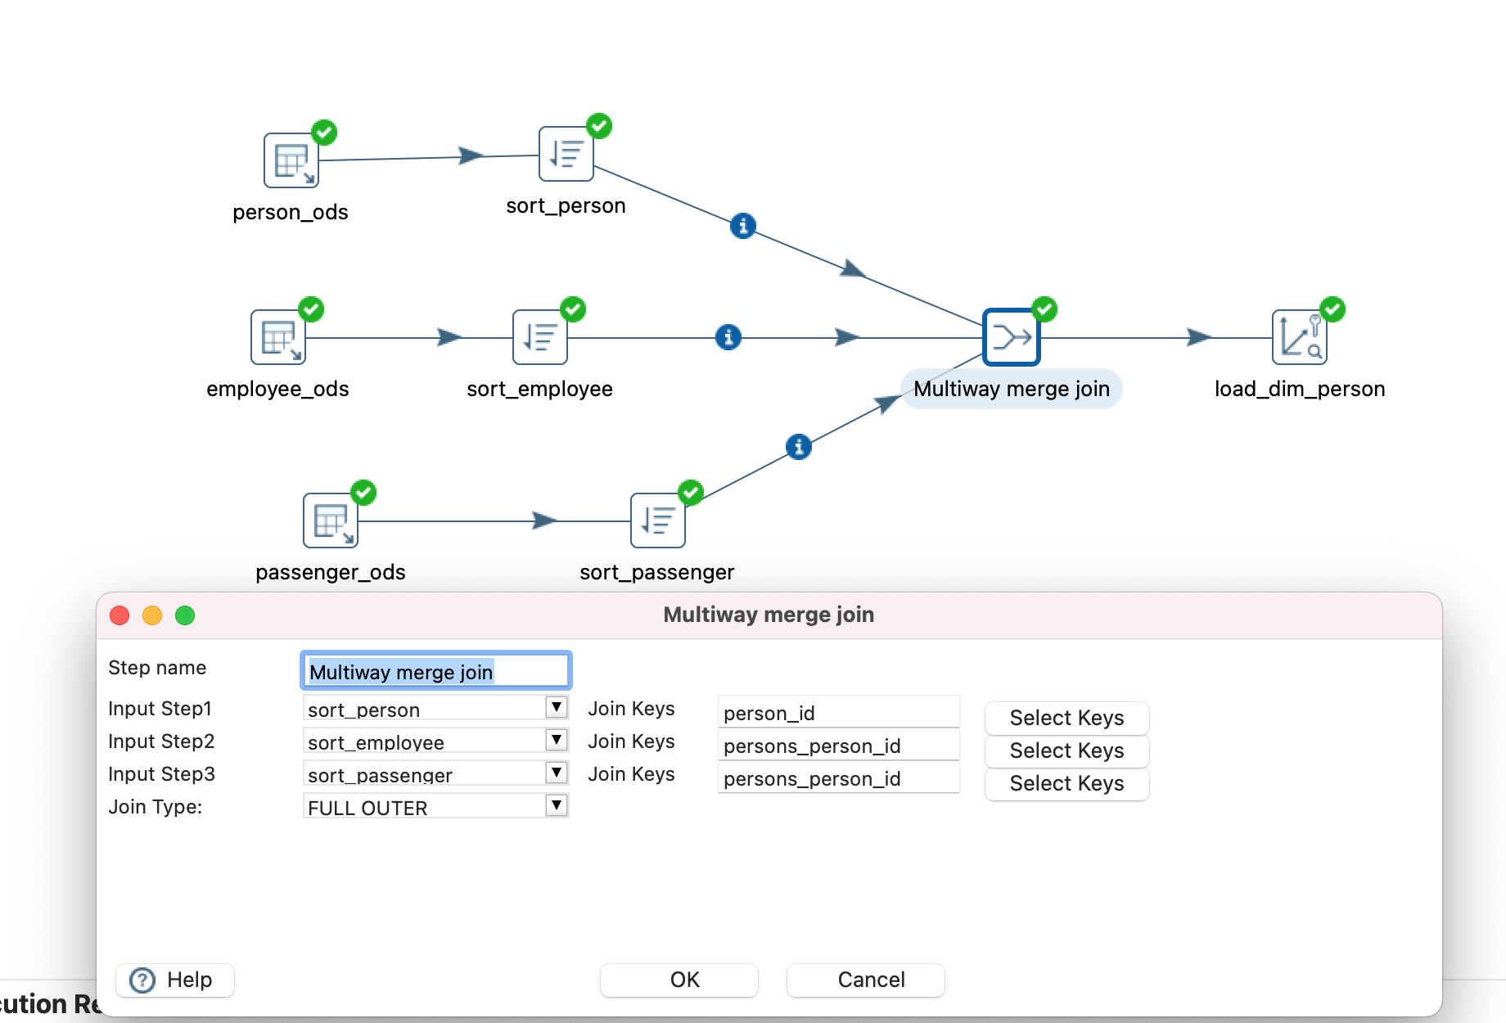
ETL : Transform & Load
Ods to WH

Slide 14
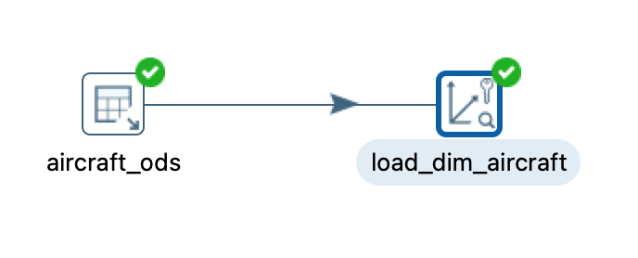
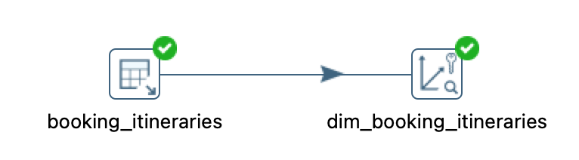
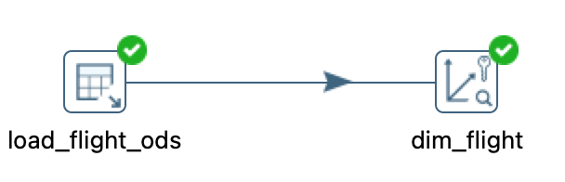
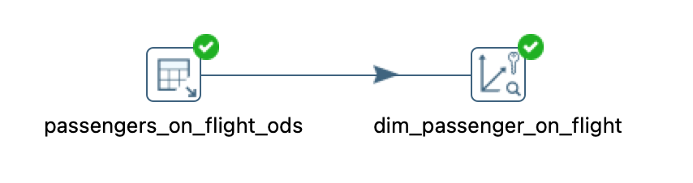
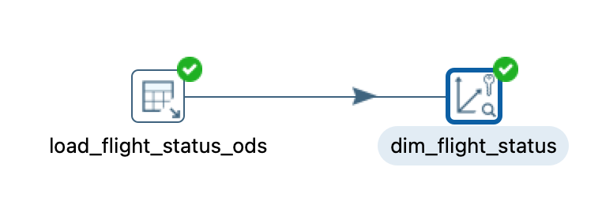
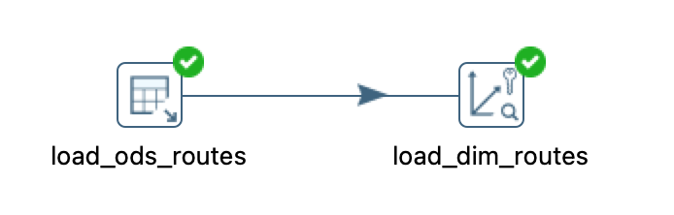
ETL : Transform & Load

Slide 15
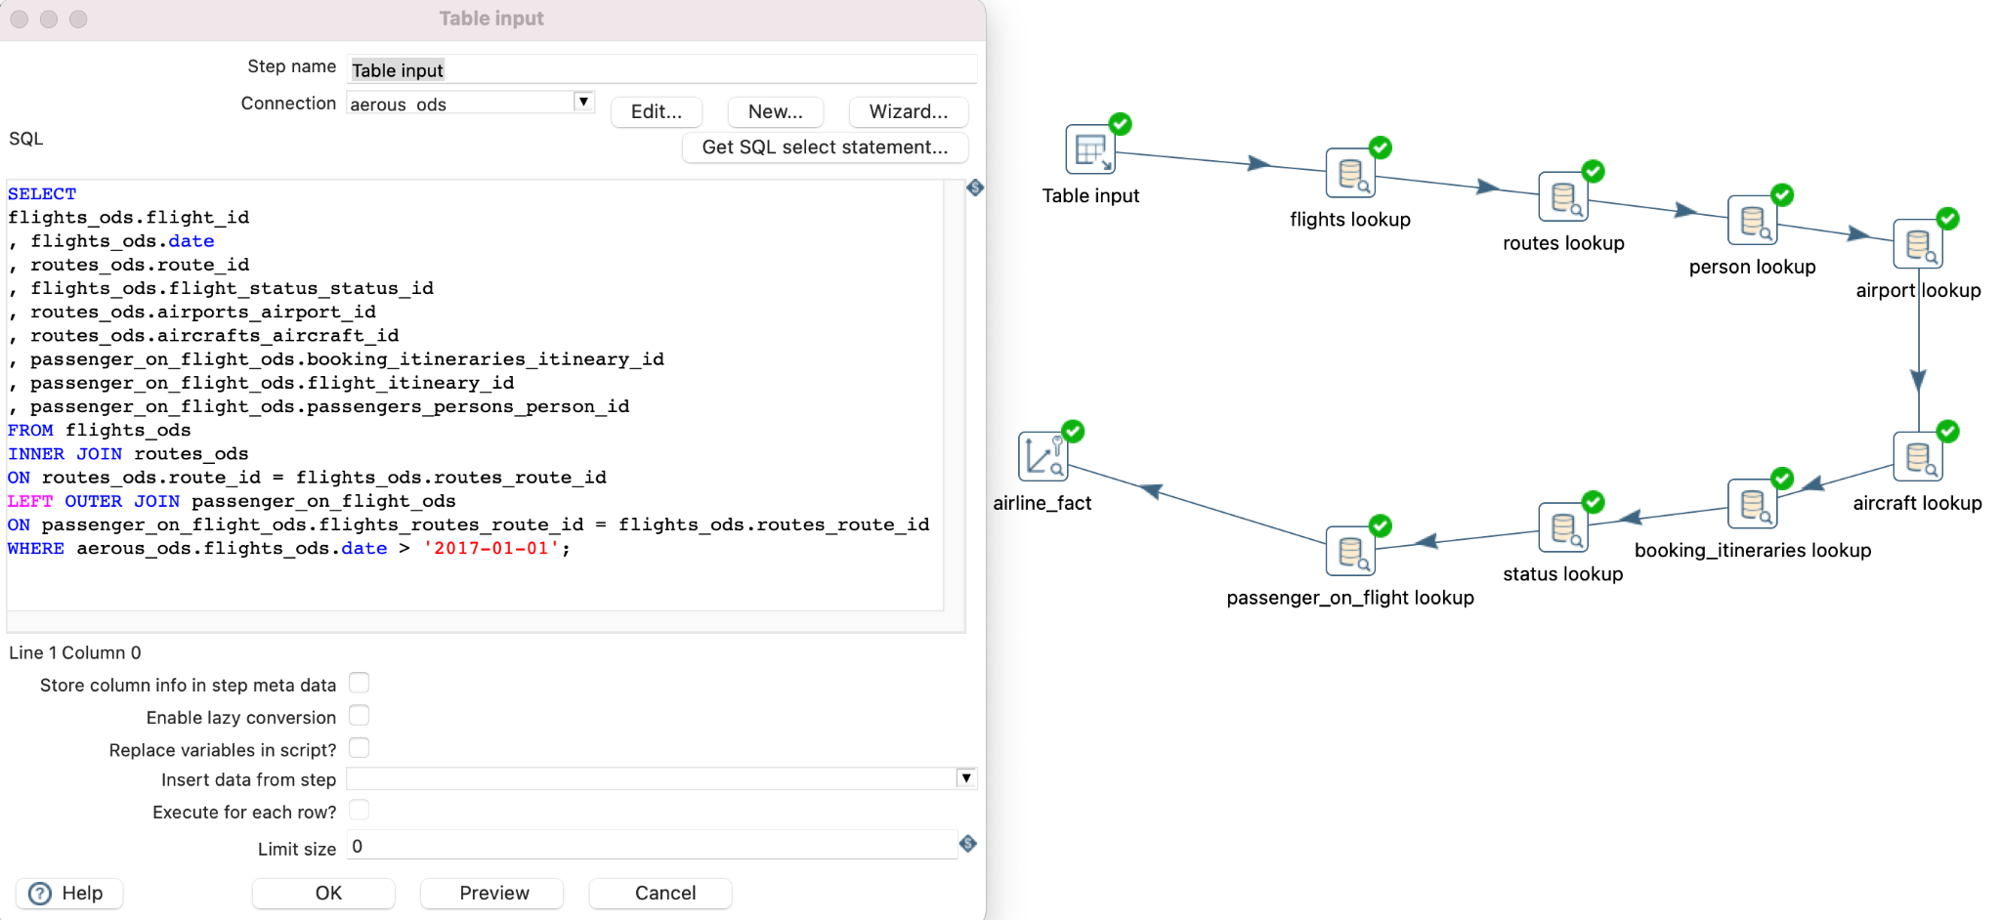
ETL : Transform & Load

Slide 16
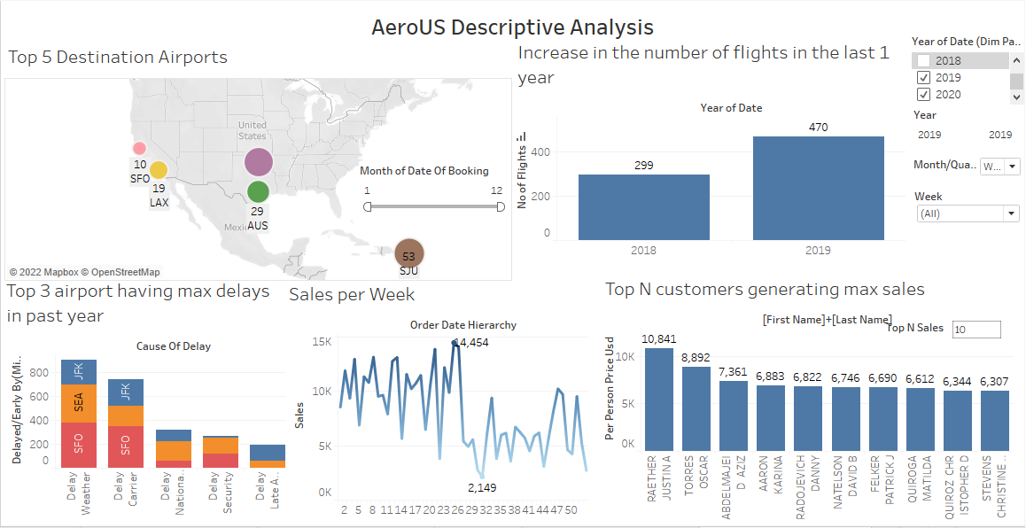
Tableau Demo - Descriptive Analysis

Slide 17
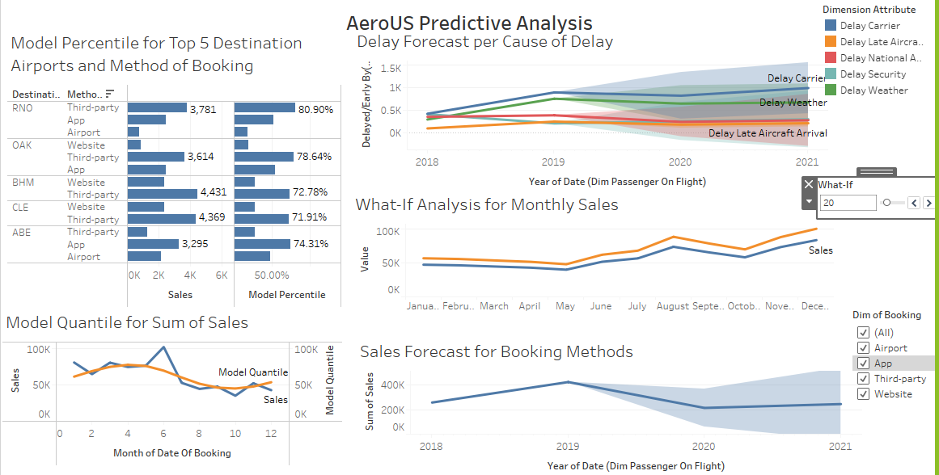
Tableau Demo - Predictive Analysis
Notes:
RNO- Reno
OAK-Oakland
BHM - Birmingham
CLE - Cleveland
ABE - Allentown
The MODEL_QUANTILE function takes a given quantile and predicts values based on the predictors you input. In this case, the quantile = 0.5, which predicts the median. We want to predict profit, so the target expression is SUM([Profit]). And since we want to base the prediction on past performance, we need to include date as a predictor.

Slide 18
Key Learnings & Future Scope
Key Learnings:
Importance of good (clean, consistent) data
Ease that Data Transformation tools like Pentaho and Tableau have brought
Data Visualization helps in comprehending data at a glance and also brings focus to the quality of data
Future Scope:
More data would help us answer the following business questions:
Number of booking cancellations 24 hrs before departure (Lead Measure)
Customer/Employee Satisfaction (Lag Measure)
Offers or upgrades based on customer history (Predictive)
Top 5 fully-booked flight routes in the last year (Descriptive)
Notes:
Most important learning was to have good(clean, consistent) data.

Slide 19
THANK YOU

