Slide 1
Introduction to Web-Based Java Applications (PRJ301)
Lecturer : Hồ Hoàn Kiếm (KiemHH)
Pass enroll LMS : SE1843_SU24

Slide 2
Prerequisites
Completed:
DBI202 (Database Systems)
PRO192 (Object Oriented Programming)

Slide 3
Course Objectives
This course explores the features of JavaEE (J2EE)
Understand the core technologies of Java web programming (Servlets, JSP, JavaBeans, Custom Tags, Filtering)
Understand and be able to apply MVC architecture for the web combining with framework (Struts 2)
Develop a Web Application (Servlets, JSP)

Slide 4




MVC Design Pattern Model – View – Controller
Sees
User
Uses
Updates
Manipulates
View
Controller
Model
This is a MVC Model

Slide 5
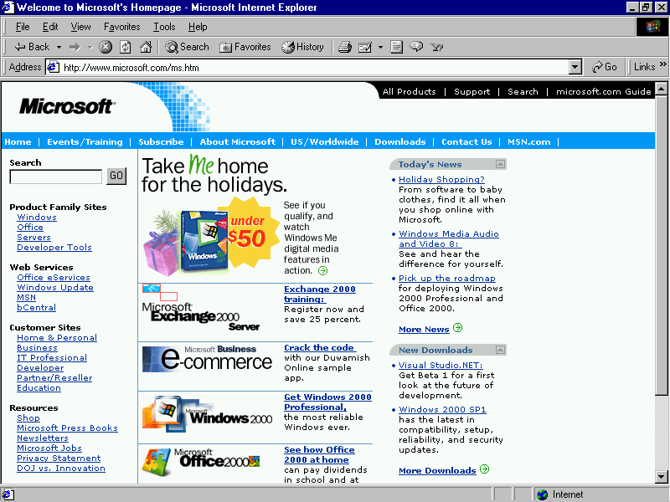
Course Objectives
The MVC architecture is applied in web application

Slide 6
Course Objectives
The MVC architecture is applied in web application
Web Server
Container

Slide 7
Course Objectives
The MVC architecture is applied in web application
Web Server
Container
C
M
V

Slide 8
Course Objectives
The MVC architecture is applied in web application
Web Server
Container
C
DB
M
V

Slide 9
Course Objectives
The MVC architecture is applied in web application
Web Server
Container
C
DB
1
M
V

Slide 10
Course Objectives
The MVC architecture is applied in web application
Web Server
Container
C
DB
1
2
M
V

Slide 11
Course Objectives
The MVC architecture is applied in web application
Web Server
Container
C
DB
1
2
3
M
V

Slide 12
Course Objectives
The MVC architecture is applied in web application
Web Server
Container
C
DB
1
2
3
M
V

Slide 13
Course Objectives
The MVC architecture is applied in web application
Web Server
Container
C
DB
1
2
3
M
V

Slide 14
Course Objectives
The MVC architecture is applied in web application
Web Server
Container
C
DB
1
2
3
4
M
V

Slide 15
Course Objectives
The MVC architecture is applied in web application
Web Server
Container
C
DB
1
2
3
5
4
M
V

Slide 16
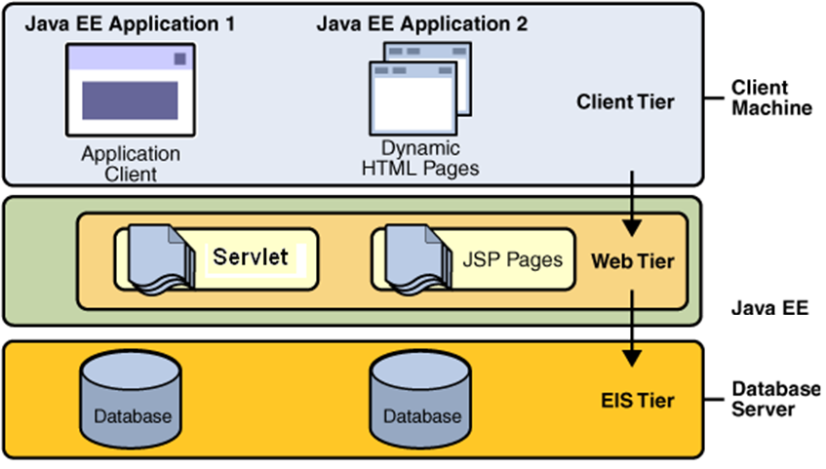
Course Objectives

Slide 17
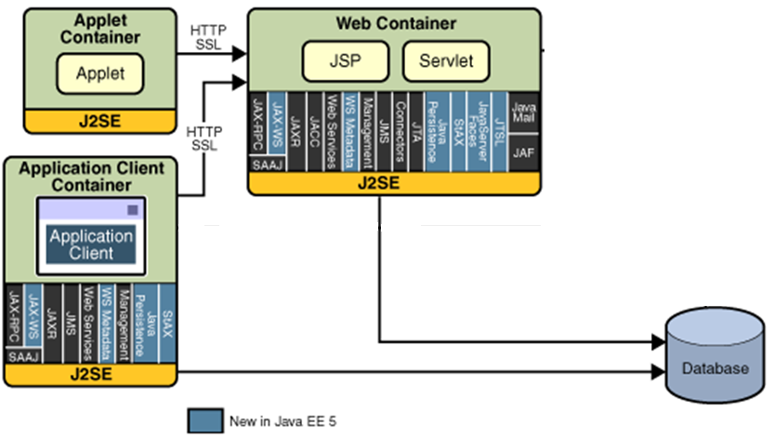
Course Objectives
J2EE 1.4/ JavaEE5/ JavaEE6 Platform API

Slide 18
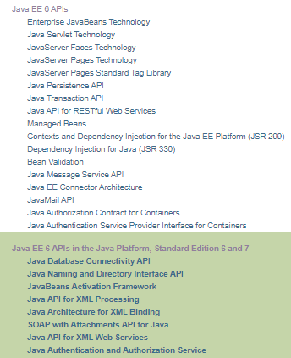
Course Objectives
J2EE/JavaEE Technologies

Slide 19
Course Description
Servlets Model
Web Application Interacting with Database
Web Application & Web Container
Java Server Pages (JSP)
Session Management
JavaBeans
JSP Tag Libraries – Custom Tags
Filters

Slide 20
Course Plan
Web based App - PBL
Web
Day 1, 2, 3, 4, 5, 6 – Login
Servlet, JDBC
Day 7, 8, 9 – Search
Break Down
Day 10, 11 – MVC2
JSP
Day 12, 13, 14, 15 – CUD, Shopping Carts
Sessions
Day 16, 17 – Login
JavaBeans
Day 18, 19, 20 – CRUD
MVC 2 Complete - JSTL - Taglib
Day 21, 22, 23 – Filter
MVC2 Using Filter as Controller

Slide 21
Course Plan
See material of the course on LMS (link shared by Google Drive)
Agenda
The Servlet Model
Web Application Interacting with Database
Web Application & Web Container
Java Server Pages (JSP)
Session Management, Session & Listener (self-study)
JavaBeans
JSP Tag Libraries – Custom Tags
Filters
Practical test
Project Presentation

Slide 22
Materials/ References
Required Textbook
Online Text book: Nicholas S. Williams, 2014, Professional Java® for Web Applications, Wrox Press
http://library.books24x7.com/toc.aspx?bookid=62587
Required References
http://java.sun.com/docs/books/tutorial/jdbc/
https://docs.oracle.com/cd/B14099_19/web.1012/b14017/filters.htm
References
http://java.sun.com/
Fan Page: https://www.facebook.com/TrongKhanh.Kieu/

Slide 23
Learning Environments
JDK 8 (https://www.oracle.com/java/technologies/downloads/)
Recommend: JDK 8 Update 172/321
(https://www.oracle.com/java/technologies/javase/javase8u211-later-archive-downloads.html)
JDK 8 Documentation
J2EE 1.4/JavaEE7 Core Patterns
NetBeans IDE 8.2/13 with supporting JavaEE (https://netbeans.apache.org/ )
Bundle Tomcat 8.0 / 8.5 (http://tomcat.apache.org/ )
DBMS: MS. SQL Server 2017/2019 (http://www.microsoft.com/sqlserver)
Browser: Internet Explorer ≥ 8.x
Driver Type 4/6 for MS. SQL Server:
sqlserver4.jar/sqlserver42.jar (http://lms-undergrad.fpt.edu.vn/mod/resource/view.php?id=4566 )

Slide 24
Course Rules
How to conduct
Prepare contents of the next session/ topic at home
Following lessons in classrooms (take note yourself to understand) and review previous session in lecture on class every day (penalty marks on workshops)
Completing chapter assessments in time and Quizzes (via LMS)
Communication
Class
Interchange by FU-HCM LMS, Forum
Discussing actively in your teams and in classrooms
Free to question and answer
Others
Off phone
Use laptops under teacher’s instruction (No game, no chat in class)

Slide 25
Evaluation Strategy
Must attend more than 80% of contact hours (if not, not allow to take exam).
Evaluating
02 Progress Test (Q) 10 %
02 Workshop (Lab) 10 %
01 Assignment (Prj) 40 %
01 Practical Exam (P) 20 %
Final Exam (FE) 20 %
Total score
10% (Q) + 10% (Lab) + 40% (Prj) + 20% (P) + 20% (FE)
Pass
Total score ≥ 5 and Final Examination ≥ 4 (of 10)
Every components > 0
Retake only the Final Exam when not passed
Learning Coursera ( 20% of ASM)
https://www.coursera.org/specializations/java-database-connectivity

Slide 26
How to study
This course is complex knowledge (however, it’s attractive and exciting), so you need to keep tight grip on it
Read
On the books to get the general concept
Reference, study, collection from internet, your classmates, forum …
Attend lectures
Listens, understand, then make your own notes
Give your explanation about some topic in lectures
Ask questions
Give some examples that are not existed in your book
Practice all the exercises, demo to make your sense
After classes
Discuss your classmate in directly, on forum
Do the lab, assignments to submit via LMS, and do more exercises
Build your teams in yourselves to support together in studying

Slide 27
How to exam/test
This course is required following rules, so you need to focus and practice your exercises and homework in try your best everyday (meet deadline and submit on LMS)
Progress Tests (if students violate, they take 0 marks)
No books and No conversations
Practical Exam (if students violate, they take 0 marks)
Obey requirements and lecturer’s recommended in his lecture
No internets, No emails, No chats, No conversation
Not copy or paste from available/previous code.
All are try it yourselves manually
… Nothing else
You do only work with Netbeans IDE tools and DBMS. (without configuring svn)
Workshop/Assignment (if students violate, they take 0 marks)
Obey requirements and lecturer’s recommended in his lecture
Not copy (copy code, contents, style)
Submission of all source code does not delete anything

Slide 28
Academic policy
Cheating, plagiarism and breach of copyright are serious offenses under this Policy.
Cheating
Cheating during a test, making a project, or an exam is construed as talking, peeking at another student’s paper, or any other clandestine method of transmitting information.
Cheating during in making lab and assignment as copy source code, copy style, same meaning in progress, …
To verify, student’s code in project can be deleted, then he/she must be retyped to make the program running correctly. Or/And make new required functions (Otherwise, he/she takes 0 marks for his/her project/quiz)
Plagiarism
Plagiarism is using the work of others without citing it; that is, holding the work of others out as your own work.
To verify, student must be described functionality dataflow and how it work (Otherwise, he/she takes 0 marks for his/her project)
Breach of Copyright
If you photocopy a textbook without the copyright holder's permission, you violate copyright law.

Slide 29
Enjoy the Course
Be enthusiastic about the material because it is interesting, useful and an important part of your training as a software engineer.
Our job is to help you learn and enjoy the experience.
We will do our best but we need your help.
So, let’s all have fun together with Web-Based Java Applications!!!

Slide 30
Q & A

