Slide 1
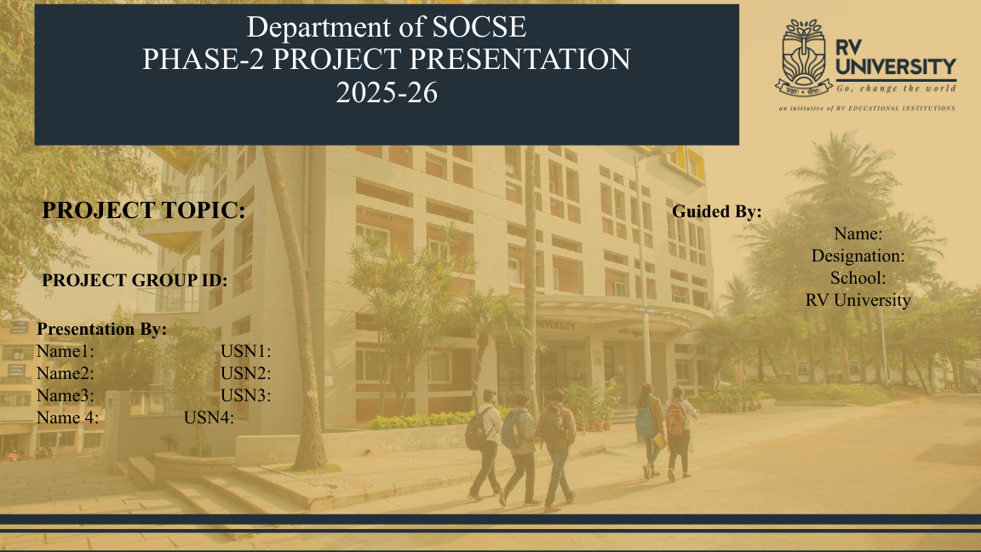
“What We Become” – A Choices Based RPG Game
PROJECT GROUP ID: __________________
Name1: NT Aravind USN1: 1RVU23BSC094
Name2: Sharanya R USN2: 1RVU23BSC133
Guided By: S Aruna Designation: Assistant Professor
School of Computer Science and Engineering (SoCSE), RV University

Slide 2
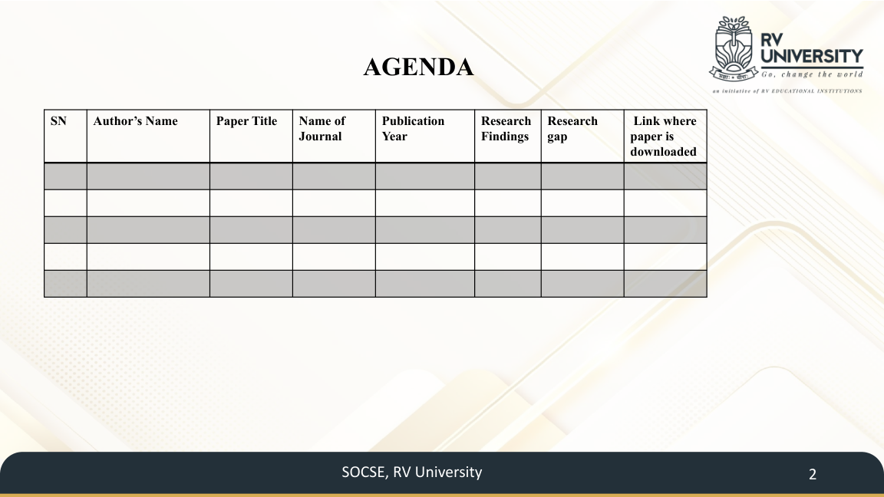
LITERATURE SURVEY
SN | Author(s) | Paper Title | Journal | Year | Research Findings | Research Gap | Download
1 | Ferreira et al. | Exploring empathy in cyberbullying with serious games | Computers & Education | 2021 | Game play was associated with higher cognitive empathy, empathic concern and affective empathy. | Focused on adolescent bystanders and one multiplayer scenario. | doi.org/10.1016/j.compedu.2021.104155
2 | Calvo-Morata et al. | Serious games to prevent and detect bullying and cyberbullying | Computers & Education | 2020 | Review found 33 games with varied mechanics; serious games can support awareness, empathy and coping strategies. | Only 8 reviewed games were available; evidence of effectiveness was uneven. | doi.org/10.1016/j.compedu.2020.103958
3 | DeSmet et al. | Friendly Attac serious digital game for prosocial bystander behavior | Computers in Human Behavior | 2018 | Positive effects were found for predictors of prosocial behavior and quality of life. | No significant effect was found on actual bystander behavior or bullying prevalence. | doi.org/10.1016/j.chb.2017.11.040
4 | Wei et al. | Amplifying Player Experience to Facilitate Prosocial Outcomes in a Narrative-Based Serious Game | Media and Communication | 2025 | Player-avatar similarity and in-game control were tested; effects varied by player perspective. | Need to integrate effective game features into richer, choice-driven narratives. | doi.org/10.17645/mac.8637
RESEARCH GAP:
Existing games show empathy/prosocial potential; our project links player choices to relationships, reputation and multiple long-term outcomes.

Slide 3

VIVA-VOCE PREPARATION
1. What problem does your project address?
Cyberbullying, online harassment, social-media validation, peer pressure and the resulting effects on relationships, academics, self-esteem and digital citizenship.
2. Why use an RPG instead of a conventional awareness program?
The player experiences situations and consequences through choices, making the learning interactive rather than purely instructional.
3. What is innovative about the project?
Hidden choices, branching narrative, dynamic hometown effects, realistic motivations for bullying, a cycle-breaking scenario and multiple endings.
4. What are the main outcomes affected by player choices?
Confidence, empathy, reputation, academic focus, digital influence and hometown prosperity.
5. What did the literature survey show?
Serious games can support awareness, empathy and prosocial outcomes, while studies also show limits in translating game effects into sustained real-world behavior.
6. What is your research gap?
Our project focuses on combining these findings into a choice-driven RPG where consequences propagate across the protagonist, relationships, online reputation and hometown.
7. What technologies are used?
Unity 3D, C#, XR Interaction Toolkit, Blender, Visual Studio/VS Code, and Git/GitHub; compatible VR hardware is targeted.
Be prepared to explain your individual contribution, gameplay flow, branching logic, implementation status and how the project differs from existing serious games.

