Slide 1
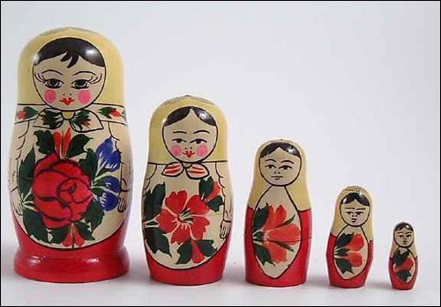
Behaviour Chains ** Russian Doll Model ** BMVC

Slide 2
Intentionally Different
Behaviour Chains are pipelines
You go from start to end of the pipeline. Each behaviour invoking itself and controlling invocation of the next.
Then you come back up – optionally executing different parts of those behaviours again
Start unit of work
Commit unit of work
Update entities

Slide 3
Configuration model....
Behaviour chains - metadata/blueprints for the runtime behaviours
Separate configuration permits conventions and manipulation of chains
Behaviour Node
+Type
Apply Conventions
Behaviour Node
Convert to Runtime Model
Behaviour Node
Apply Transformations

Slide 4
...Runtime Model
Convert the chains into sequences of linked behaviours (think CoR)
Begin execution of the chain by invoking the first behaviour
Behaviour
Invoke()
public void Invoke()
{
BeforeInnerBehaviour();
if (!IsEndOfChain()) Inner.Invoke();
AfterInnerBehaviour();
}
Behaviour
Behaviour

Slide 5
Links
http://lostechies.com/chadmyers/2011/06/23/cool-stuff-in-fubumvc-no-1-behaviors
http://lostechies.com/josharnold/2011/02/01/fubumvc-primer-configuration-vs-runtime/

