Slide 1

Erlang
??????

Slide 2
Erlang
Functional programming language
Created by Ericsson for telecom systems
Needed distributed, ALWAYS available systems
No downtime when faults occur
No downtime for adding new features
Proven over years of usage

Slide 3
Concurrency is it’s middle name
No threads – lightweight processes
No shared state
Processes communicate information by messaging
Process monitoring – when a process blows up, the system can handle it without going down
Hot code loading – no need to take the system down to add new features

Slide 4
Modules
Akin to classes in C#
Write it
Compile it from the shell
Call functions from the shell
Or…. use Make

Slide 5

Sending and Receiving Messages
Every process has it’s own mailbox
To send a process a message, you need it’s process id followed by “!” and then the message
A process takes messages out of its mailbox using the receive keyword

Slide 6


Real Messaging Patterns
Sending messages is a bit pointless if you can’t get a reply
Leave a message with a return address
Wait patiently for a response

Slide 7
Process Monitoring
One process watches another
When an error occurs it can immediately restart it or spin up another process on another machine for example
Monitoring process and monitored process can live on separate machines in a cluster

Slide 8
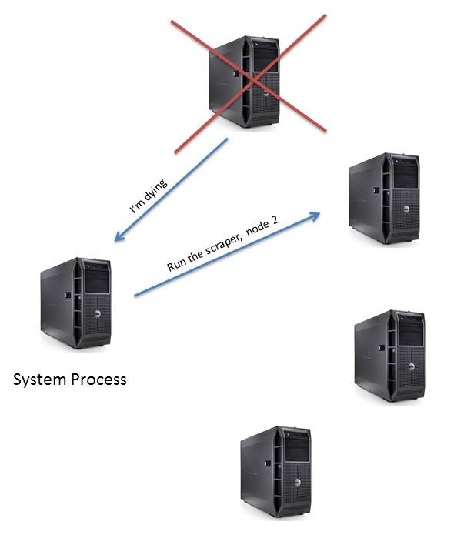
Attempt to restart on same machine
Or… use another node in the cluster
Don’t confuse with load balancing over http….
The exit message can contain information about the state of the current process. So when the supervisor re-assigns the work it can continue from where it left off

Slide 9

Coming Soon…..
A more in-depth project
OTP libraries
Hot code loading – upgrade the system and fix bugs without ANY disruption to end users

