Slide 1
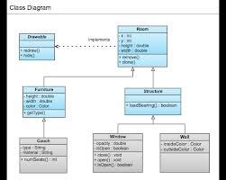
Effective Sketches
(Architectural Diagrams)
Inspired by @simonbrown’s architecture 4 devs workshop and book

Slide 2
Deliver better-designed applications faster
Immediately understand what the system does and where your work fits in
When someone leaves the team, the knowledge of how it works remains
Get new starters up to speed quicker
You can spot risks a lot easier
When things go wrong, easier to identify problems

Slide 3

Think you’re smart?
Take a look at the hand-out…..
Now design the system – at least 1 diagram

Slide 4

An effective sketch is worth 1000 lines of code
3 good things about another team’s diagram
3 things that weren’t so good

Slide 5
Sound familiar?
Too much information – hard to understand
Not enough information – what is going on?
What does that symbol mean?
Why are the different colours?
I just don’t geddit

Slide 6
A conceptual framework for effective sketches
Different diagrams for different types of information
… at different levels of detail
… with judicious use of colour and symbols
… and a nice little key

Slide 7
Learn more…
Follow @simonbrown
Go to his @skillsmatter workshop
Get his architecture 4 devs book
Read his blog: coding the architecture

Slide 8
8 dizzle website
Customer db
Payment System

