Slide 1
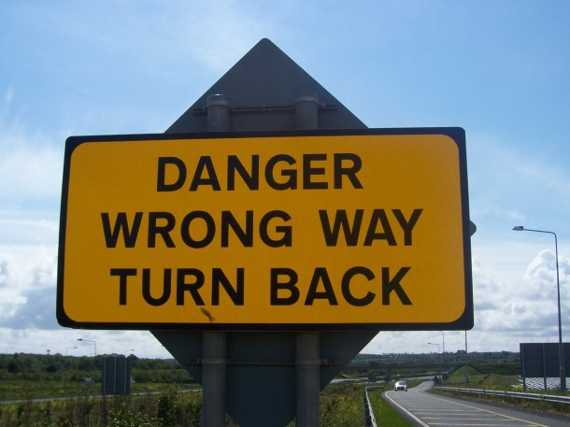
SOLID is just a guideline… It’s not the goal
Don’t let principles and best practices take you down the wrong path

Slide 2
Do you care about?.....
Improving the quality of your code?
Creating simpler code bases for you and your team to maintain?
Learning new metrics for improving code readability?
Adding new analytical thinking techniques to your skillset?

Slide 3
Delivering business value
We are usually writing code to deliver business value
Customers do not download MP3s because our code is SOLID
Record labels to not sign deals with us because our code is SOLID
Whilst it can help, SOLID does not guarantee business value

Slide 4
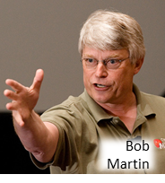

What SOLID does guarantee…
Uncle Bob (and others) will get three nice holidays this year

Slide 5
There are no “best practices”
SOLID is just an example – don’t blindly follow any principle or best practice
All “best practices” were conceived in a specific context
Without understanding how an idea came about – how can you know if it applies to you?

Slide 6
But let’s not hate
People follow best practices with the best of intentions
We as devs are constantly told our code must be SOLID - we think we are doing right by our peers and employers
A lot of time we are – because best practices and principles can help us when used correctly
We just need to think for ourselves a bit more….

Slide 7
Context is nearly always king
What are the business requirements?
Is it better to model business abstractions?
Will the time it takes to be SOLID increase time to market?.. and is that important to the business?
Look at the code: has making it SOLID reduced readability?
To be able to maintain, you need to understand it, right?

Slide 8
A world before SRP
Massive, monolithic c++ classes (100s of lines if you’re lucky)
One small change could take out 5 business use cases
Pace of adding new features rapidly decelerates

Slide 9
SRP Rationale….
“If a class has more than one responsibility, then the responsibilities become coupled.
Changes to one responsibility may impair or inhibit the class’ ability to meet the others.
This kind of coupling leads to fragile designs that break in unexpected ways when
changed.”
Therefore… we need the potential of fragile designs to be a problem

Slide 10
Subjective SRP…
“Should these two responsibilities be separated? That depends upon how the application is changing.”
“…what a responsibility is, and how it relates to the users of the system and the roles that they play”
What’s that I said about context earlier?
Responsibilities are subjective - based on your specific context

Slide 11
Please don’t do this…
If you have a class… with one method…. containing 5 lines of code…
Don’t refactor the logic into 3 classes, each with 1 method unless you really have to
There’s a good chance you just don’t have the concern of “fragile designs that break in unexpected ways”

Slide 12
What’s the problem?
Probably harder to understand with an illusion of complexity…. **class explosion**
Likely to have greater refactoring friction
You can obscure design opportunities
Increased potential for unwanted coupling
Might be just wasting time unnecessarily

Slide 13
We need OCP because….
“When a single change to a program results in a cascade of changes to dependent modules,
that program exhibits the undesirable attributes that we have come to associate with “bad”
design. The program becomes fragile, rigid, unpredictable and unreusable.”
Pre-requisite for OCP: “a cascade of changes to dependent modules”

Slide 14
Open for thinking, closed for blind faith
“It should be clear that no signiﬁcant program can be 100% closed.”
“Since closure cannot be complete, it must be strategic. That is, the designer must
choose the kinds of changes against which to close his design. This takes a certain amount
of prescience derived from experience.”
“He then makes sure that the open-closed principle is invoked for the most probable changes.”

Slide 15

OCP is as old as the dinosaurs
“In my understanding, OCP reflects the reality of the 80's and early 90's, where projects often did not even use version control, much less had automated regression tests or the benefit of sophisticated refactoring tools. OCP was an attempt to avoid the risk of breaking code that had been manually tested and put into production. Today, we have better ways to manage the risk of breaking working software (namely, version control systems, TDD and automated testing, and refactoring tools).”

Slide 16
OCP and Business Value
If you close parts of the system where there are lots of business changes – you might add value
But you can lose buckets of business value by:
  Spending drastically too long
  Adding way too many abstractions…
  ..thus lots of indirection
  Introducing a readability nightmare
  Slew of un-needed tests that take time to create, maintain and run

Slide 17
ISP saves the day
“the original Door abstraction had nothing whatever to do with timing. If timing-
free derivatives of Door are created, those derivatives will have to provide nil implementa-
tions for the TimeOut method. Moreover, the applications that use those derivatives will
have to #include the deﬁnition of the TimerClient class, even though it is not used.”
Pre-requisite: abstract base class that depends on an interface that only some subclasses will need

Slide 18
ISP won’t hurt you..
It probably won’t hurt you too much if you adhere to or ignore ISP
Just don’t go getting all dogmatic and forgetting the important goals…
… such as delivering business value

Slide 19
What about L and D
Common sense principles
If you have crazy sub-classes
Or tight-coupling
Make sure you have a good reason

Slide 20
If not SOLID, then..
Look at the code – is it easier to read?
How many classes to step through to work out what is going on
Do you have the potential for the problem the “best practice” was created to solve?
Is the time it takes worth the payback?
If it was my own company would I do it?

