Slide 1
Training Course Amazon Web Service

Slide 2
AWS Module Overview
Deploying, administering, and monitoring AWS system and network resources in an automatable and reusable manner
Prerequisites
Some Linux or Windows system administration experience
Basic familiarity with Linux command line or Windows PowerShell
Knowledge of popular development and scripting languages (e.g., Python) a plus, but not required

Slide 3
AWS Module Schedule
Day | Presentations
Day 07 | AWS Introduction & IAM Service
Day 08 | Computing on AWS: EC2
Day 09 | Networking on AWS: VPC
Day 10 | Storage on AWS: EBS, S3
Day 11 | Load Balancing & AutoScaling
Day 12 | Database on AWS: RDS

Slide 4
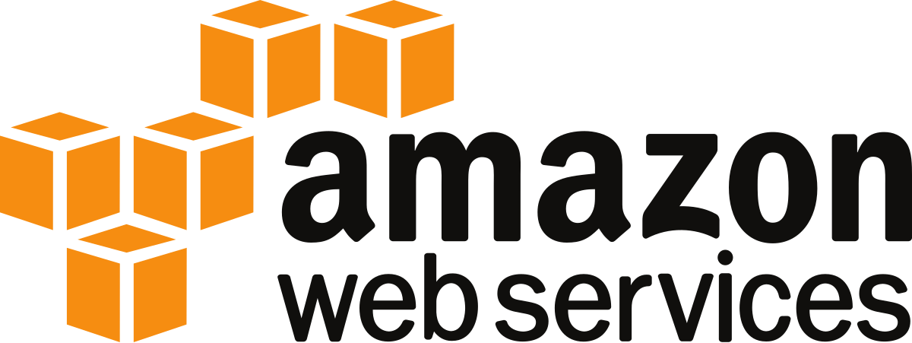
Day 07: AWS Introduction & IAM Service

Slide 5
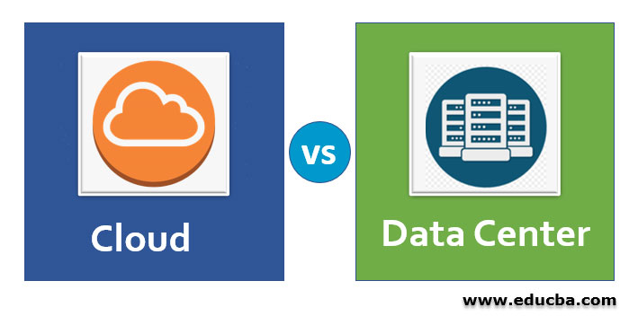

Cloud Computing Concept
Cloud or Data Center?
Brain Storming!!
Notes:
Begin with defining what is System Operations

Slide 6
Cloud Computing Concept
System Operations in Data Center and The Cloud
Data Center
Upfront capital expense
Provision hardware and staff for normal operations and disaster recovery (DR)
Limited experimentation and reusability
The Cloud
Available when needed
Build up, tear down and reuse with ease
Reduced cost and planning for DR, storage redundancy
More independence innovation within the company
Hybrid Model
Connect data center and cloud resources
Notes:
Benefits:
Fast scale-out, on demand. You can request the resources you need
Replicate, scale quickly
Tear up and tear down easily

Slide 7
Cloud Computing Concept
System Operations in the Cloud
Cloud computing enables automated and repeatable deployment of infrastructure on demand.
Systems can become self-describing.
Script, program, or template
DEV
TEST
PRODUCTION

Slide 8
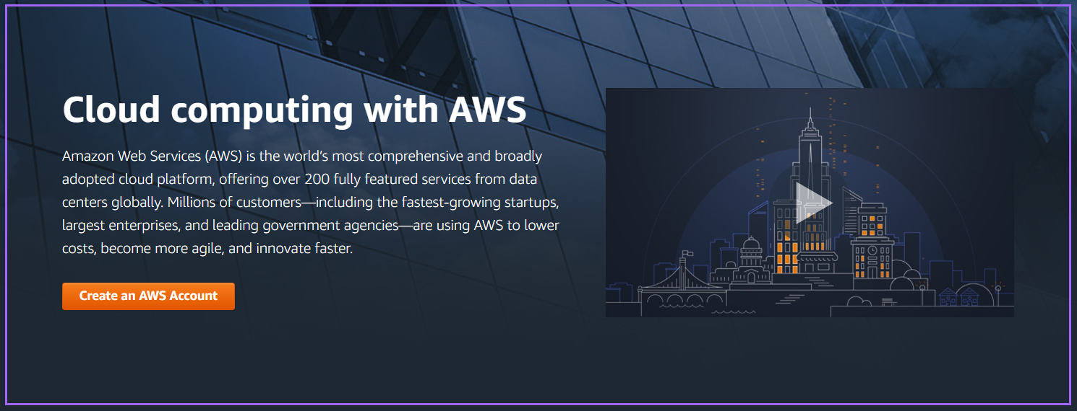
AWS Introduction
What is AWS?

Slide 9
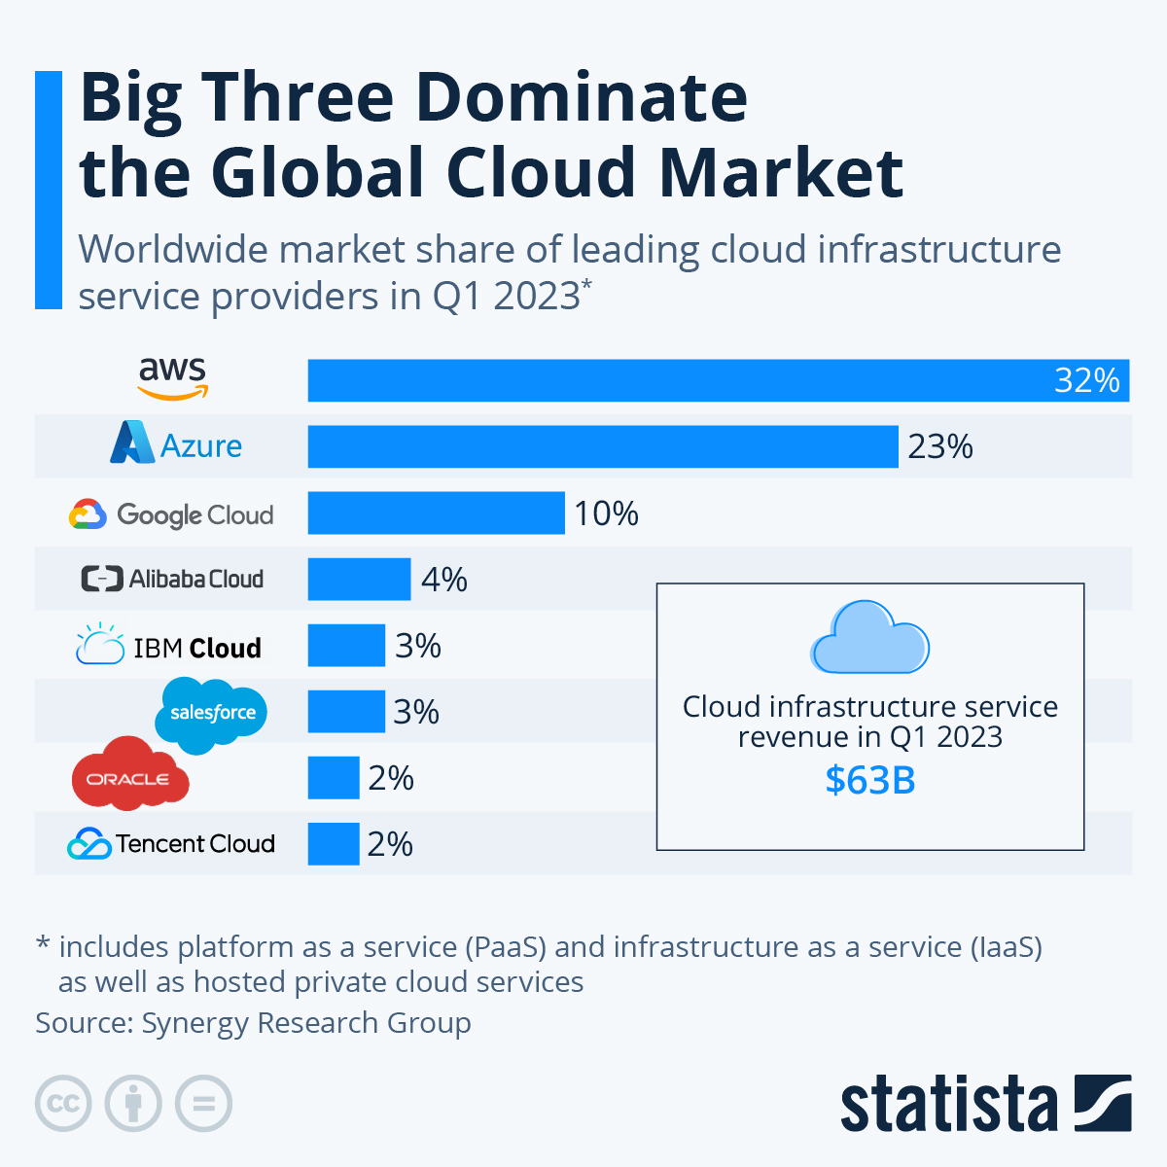
AWS Introduction
AWS Market Share

Slide 10
AWS Introduction
Global Infrastructure: AWS Regions, AZs, and Edge Locations
AWS achieves this by supporting a secure, redundant, and global infrastructure, which divided into regions, Availability Zones, and edge locations.
A region is a collection of two or more Availability Zones in a specific geographic area.
An Availability Zone is an isolated collection of AWS resources. Availability Zones within a region are connected through low-latency links.
An edge location is A site that CloudFront uses to cache copies of your content for faster delivery to users at any location.
AWS Global Infrastructure

Slide 11
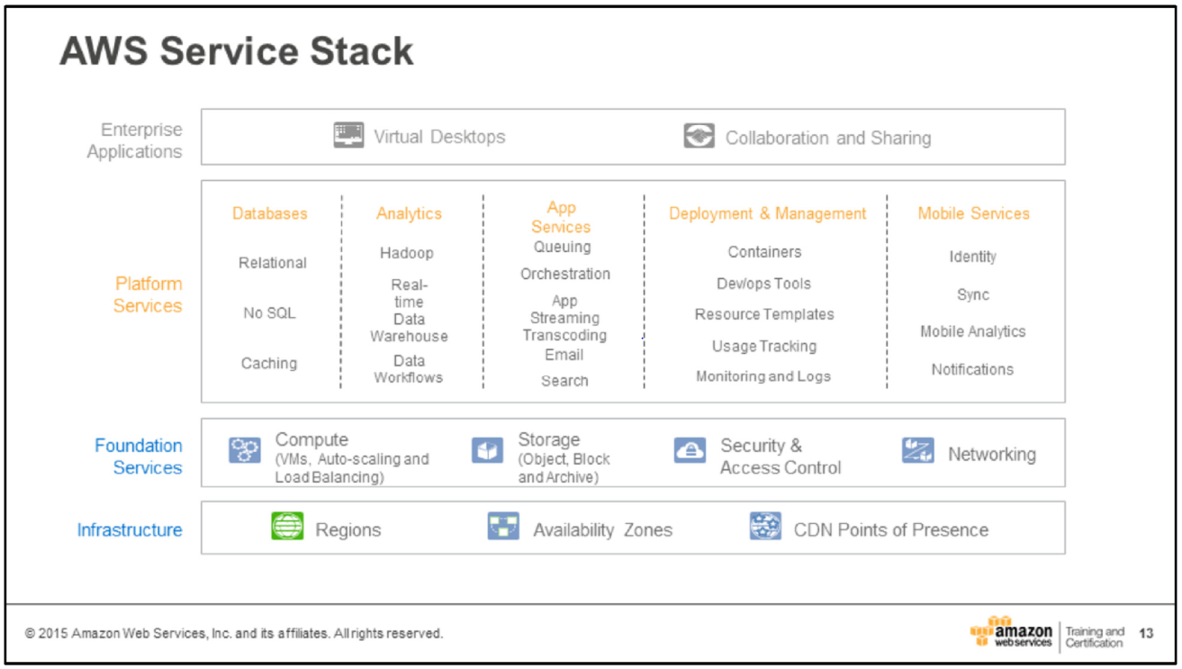
AWS Introduction
AWS provides a highly reliable, scalable, low-cost infrastructure platform in the cloud that powers hundreds of thousands of businesses all over the world.
At the core is the compute, storage and data services that are the heart of AWS’s offering.

Slide 12
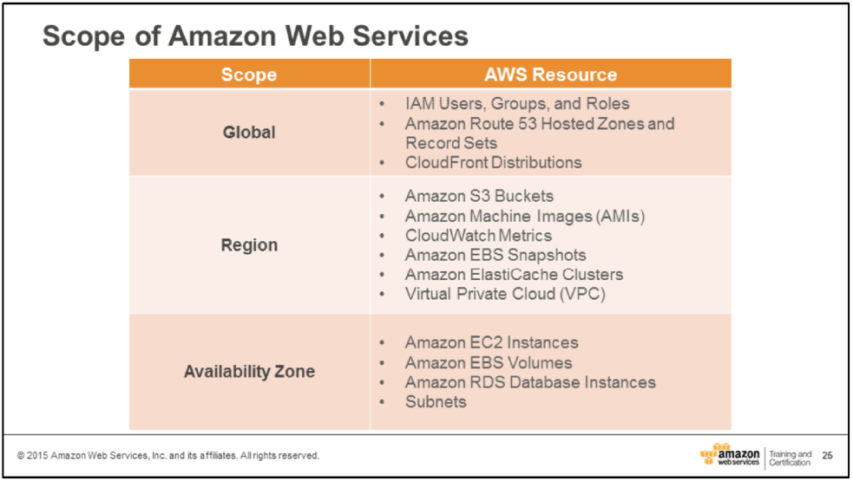
AWS Introduction
When create AWS resources, those resources exist at a scope which varies depending on the service – either global, region, or Availability Zone. Resources with global and regional scope are automatically distributed across multiple Availability Zones by AWS.

Slide 14
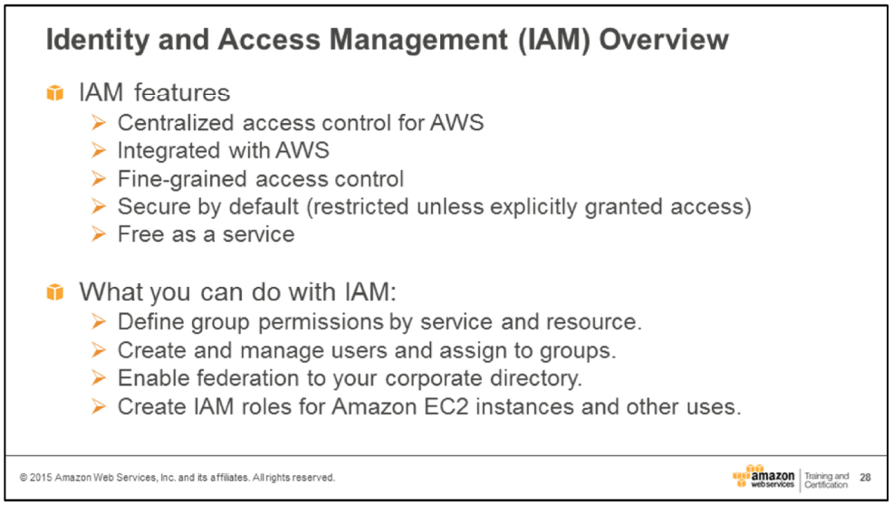
IAM Service
AWS Identity and Access Management (IAM) provides a centralized environment in which to administer users, groups, roles and permissions.

Slide 15
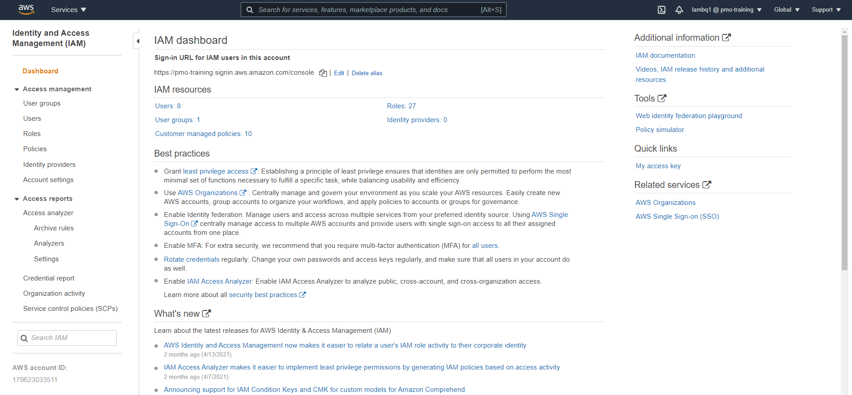
Module 1: Understand System Operations in AWS
Access to IAM services > Login AWS account >> Service > IAM (Manage access to AWS resources)

Slide 16
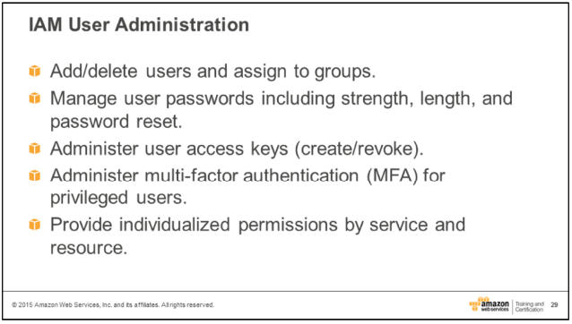
Module 1: Understand System Operations in AWS
IAM enables a customer to create multiple users and manage the permissions for each of these users within their AWS account.

Slide 17
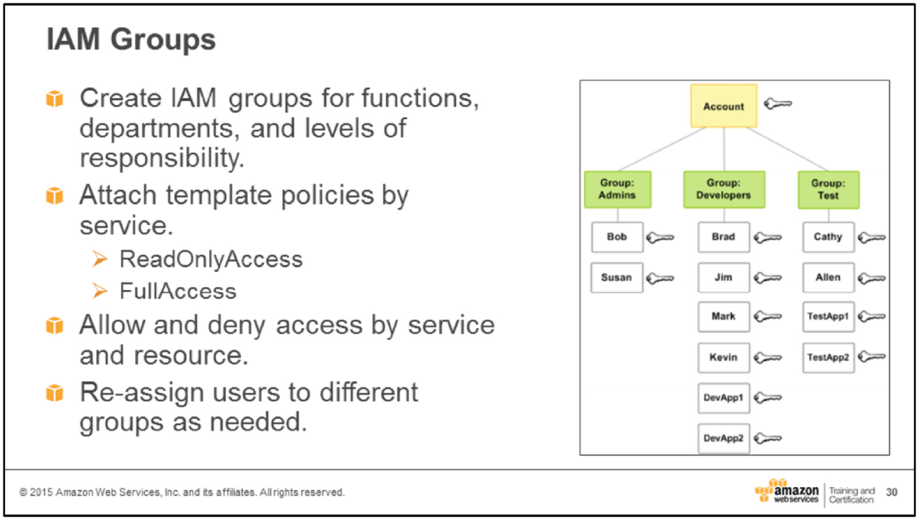
Module 1: Understand System Operations in AWS
To provide added security to AWS account, it is strongly encouraged that create a set of groups corresponding to the “least privilege” principle.

Slide 18
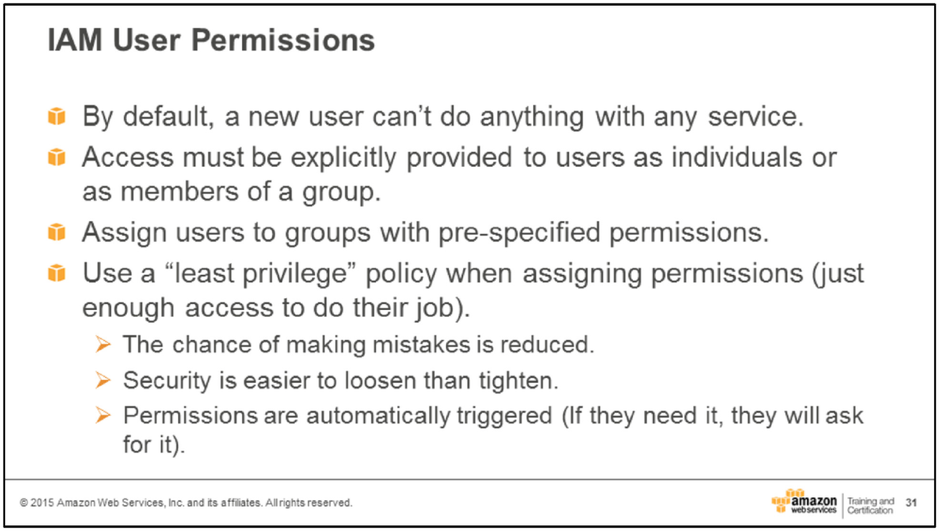
Module 1: Understand System Operations in AWS
Using group simplifies the task of adding or removing permissions to a large number of users simultaneously.

Slide 19
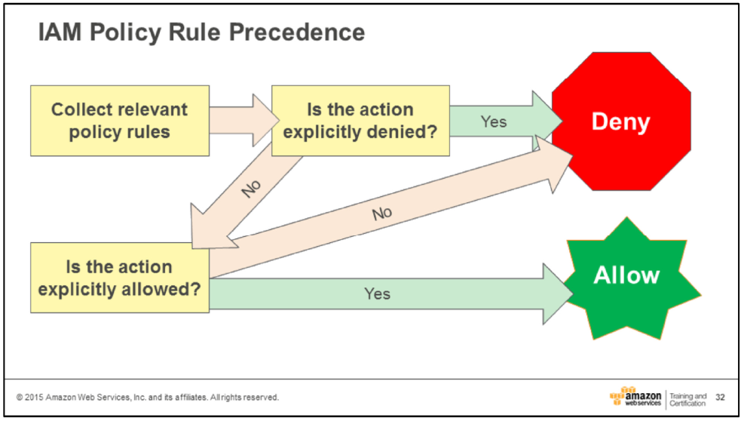
Module 1: Understand System Operations in AWS
To determine whether the request should be allowed or denied, these rules are followed:
By default, all requests are denied
An explicit allow overrides this default
An explicit deny overrides any allows

Slide 20
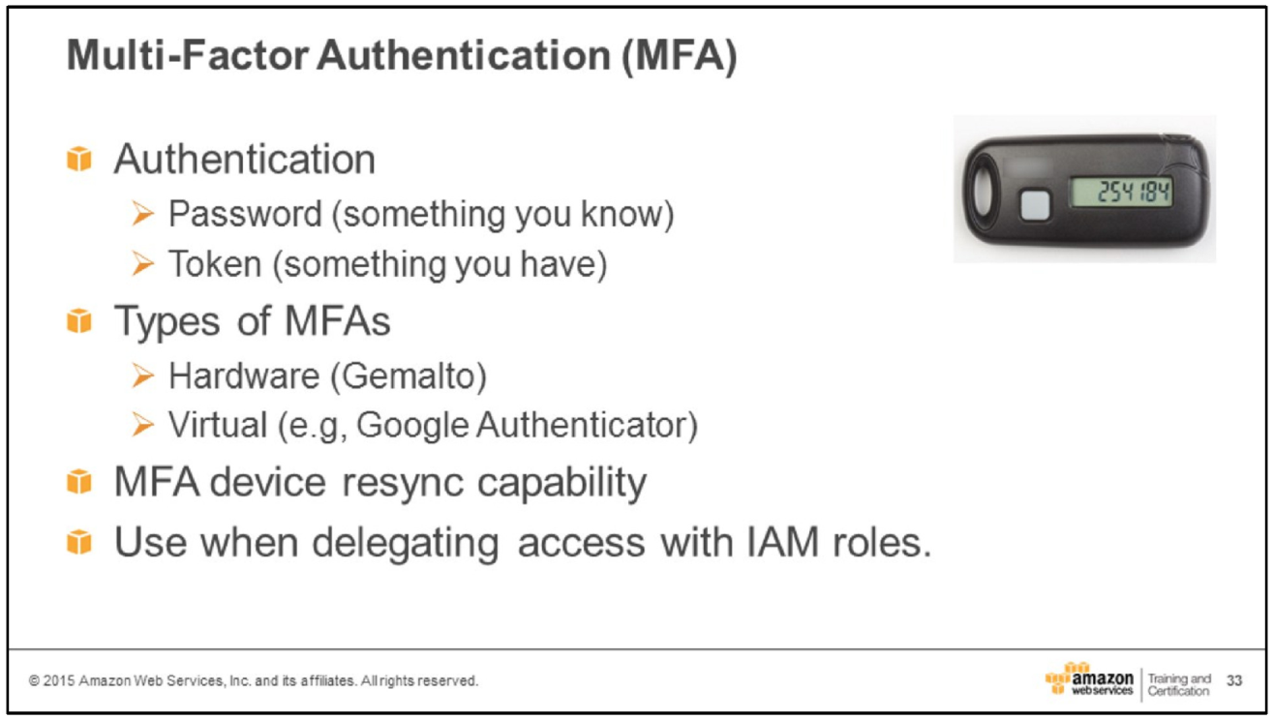
Module 1: Understand System Operations in AWS
These days, password-only security is not enough. Should enable multi-factor authentication (MFA). With MFA, users must supply both a password and a one-time challenge/response token.

Slide 21
Module 1: Understand System Operations in AWS
Securing your AWS Account
Delegate system administration functions to least-privilege IAM admin groups
Require multi-factor authentication for root-level access
Physically secure hardware MFA devices in a secure place such as a vault
Do not share root credentials with anyone other than the account holder
Use IAM roles to provide cross-account access

Slide 22
IAM Service
IAM: User & Groups
IAM = Identity and Access Management, Global service
Root account create by default, shouldn’t be used or shared
User are people within your organization, and can be grouped
Groups only contain users, not other groups
User don’t have to belong to a group, and user can belong to multi group

Slide 23
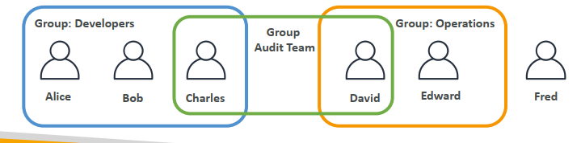
IAM Service
IAM: User & Groups

Slide 24
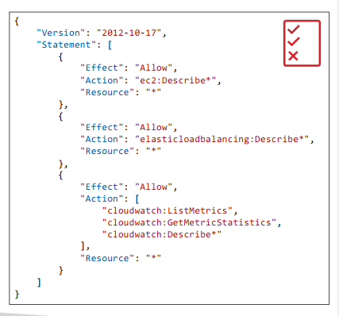
IAM Service
IAM: User & Groups
Users or Groups can be assigned JSON documents called policies
These policies define the permissions of the user
In AWS you apply the least privilege principle: don’t give more permission than user need

Slide 25
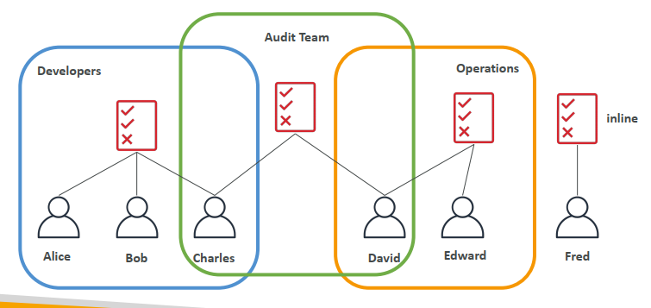
IAM Service
IAM Policies inheritance

Slide 26
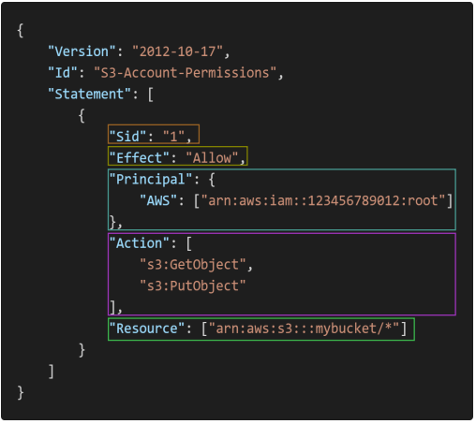
IAM Service
IAM Policies Structure
Consist of
Version: policy language version, always include “2012-10-17”
Id: an indentifer for the policy (optional)
Statement: one or more individual statements (required)
Statement consist of
Sid: an indentifer for the statement (optional)
Effect: whether the statement allows or denies access (allow, deny)
Principal: account/user/role which this policy applied to
Action: list of actions this policy allows or denies
Resource: list of resources to which the actions applied to
Condition: conditions for when this policy is in effect (optional)

Slide 27
IAM Service
IAM – Password Policy
Strong passwords = higher security for your account
In AWS, you can setup a password policy
Set a minimum password lengh
Require specific character types
Including uppercase letters
Lowercase letters
Number
Non-alphanumeric characters
Allow all IAM users to change their own passwords
Require users to change their password after some time (password expiration)
Prevent password re-use

Slide 28
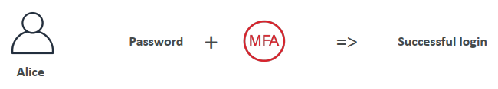
IAM Service
Multi Factor Authentication - MFA
Users have access to your account and can possibly change configurations or delete resources in your AWS account
You want to protect your Root Accounts and IAM users
MFA = password you know + security device you own
Main benefit of MFA:
If a password is stolen or hacked, the account is not compromised

Slide 29
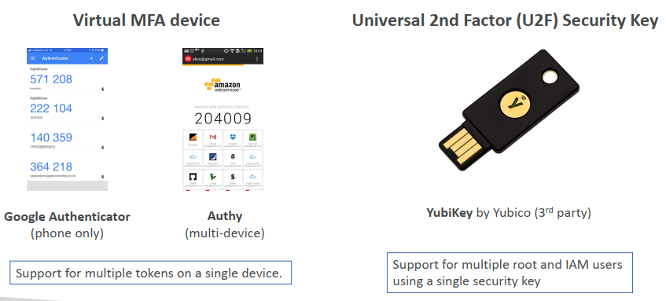
IAM Service
MFA devices options in AWS

Slide 30
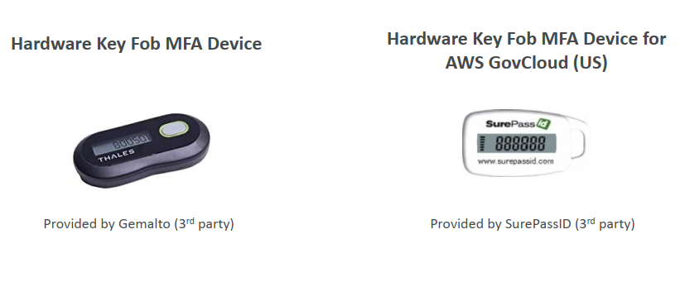
IAM Service
MFA devices options in AWS

Slide 31
IAM Service
How can users access AWS?
To access AWS, you have three options:
AWS Management Console (protected by password + MFA)
AWS Command Line Interface (CLI): protect by access keys
AWS Software Developer Kit (SDK) – for code: protected by accese keys
Access Keys are generated through the AWS Console
Users manage their own access keys
Access Keys are secret, just like a password. Don’t share them
Access Key ID ~= username
Secret Access Key ~= password

Slide 32
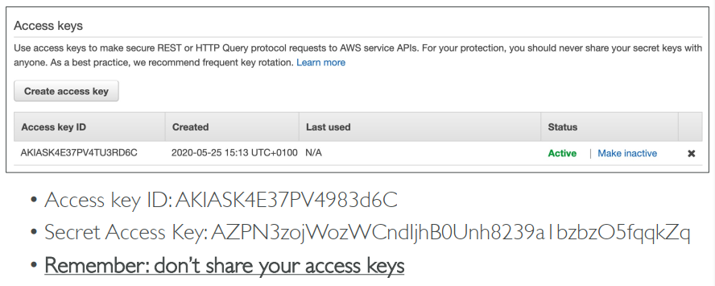
IAM Service
Example (Fake) Access Keys

Slide 33
IAM Service
What’s the AWS CLI?
A tool that enables you to interact with AWS services using commands in your command-line shell
Direct access to the public APIs of AWS services
You can develop scripts to manage your resources
It’s open-source https://github.com/aws/aws-cli
Alternative to using AWS Management Console

Slide 34
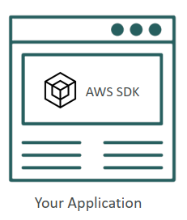
IAM Service
What’s the AWS SDK?
AWS Software Development Kit (AWS SDK)
Language-specific APIs (set of libraries)
Enables you to access and manage AWS services programmatically
Embedded within your application
Supports
SDKs (JavaScript, Python, PHP, .NET. Ruby, Java, Go, Node.js, C++)
Mobile SDKs (Android, iOS, …)
IoT Device SDKs (Embedded C, Arduino, …)
Example: AWS CLI is built on AWS SDK for Python

Slide 35
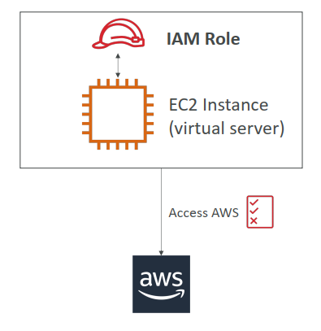
IAM Service
IAM Roles for Services
Some AWS service will need to perform actions on your behalf
To do so, we will assign permissions to AWS services with IAM Roles
Common roles:
EC2 Instance Roles
Lambda Function Roles
Roles for CloudFormation

Slide 36
IAM Service
IAM Security Tools
IAM Credentials Report (account-level)
A report that lists all your account’s users and the status of their various credential
IAM Access Advisor (user-level)
Access advisor shows the service permission granted to a user and when those services were last accessed
You can use this information to revise your policies

Slide 37
IAM Service
IAM Guidelines & Best Practices
Don’t use the root account except for AWS account setup
One physical user = One AWS user
Assign users to groups and assign permissions to groups
Create a strong password policy
Use and enforce the use of Multi Factor Authentication (MFA)
Create and user Roles for giving permissions to AWS services
Use Access Keys for Programmatic Access (CLI/SDK)
Audit permissions of your account with the IAM Credentials Report
Never share IAM users & Access Keys

Slide 38
IAM Service
IAM Section - Summary
Users: mapped to a physical user, has a password for AWS Console
Groups: contains users only
Policies: JSON document that outlines permissions for users or groups
Roles: for EC2 instances or AWS services
Security: MFA + Password Policy
Access Keys: access AWS using the CLI or SDK
Audit: IAM Credential Reports & IAM Access Advisor

Slide 39

Thank you

