Slide 1
Training Course Amazon Web Service

Slide 2
AWS Module Schedule
Day | Presentations
Day 07 | AWS Introduction & IAM Service
Day 08 | Computing on AWS: EC2
Day 09 | Networking on AWS: VPC
Day 10 | Storage on AWS: EBS, S3
Day 11 | Load Balancing & AutoScaling
Day 12 | Database on AWS: RDS

Slide 3
Day 08: Computing on AWS EC2 service

Slide 4
Computing on AWS - Overall
Compute Category | AWS service
Instances (virtual machines) | Amazon Elastic Compute Cloud (Amazon EC2)
Containers | Amazon Elastic Container Service (Amazon ECS) Amazon Elastic Kubernetes Service (Amazon EKS) AWS Fargate
Serverless | AWS Lambda

Slide 5
Computing on AWS – EC2
Goal: Understand how to deploy instances and maintain instance health
Creating instances
Type of instance
Instance security
Pricing
Troubleshooting

Slide 6
Computing on AWS – EC2
Architecture of Cloud Computing
Amazon EC2 instances run as virtual machines on host computers located in each Availability Zone
Each Amazone EC2 instance receives a particular number of virtual CPUs and an amount of RAM
Instance Store is physically attached to the host computer and provides temporary block-level storage for use with an instance, data in the instance store does not persist

Slide 7
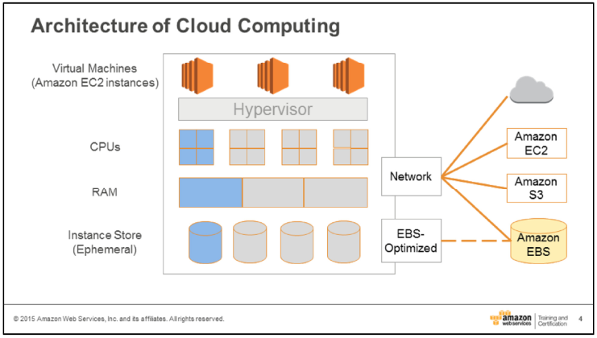
Computing on AWS – EC2
Architecture of Cloud Computing

Slide 8
Computing on AWS – EC2
Instance Types
Instance types differ in CPU, memory, storage, and network capacity
Instances are described by family (T2, M3, etc,..) and size (small, medium, large, xlarge, 2xlarge, etc,…)
Each instance type family is optimized for a specific type of workload
Monitor CPU usage of instances to determine whether you are using the right instance type

Slide 9
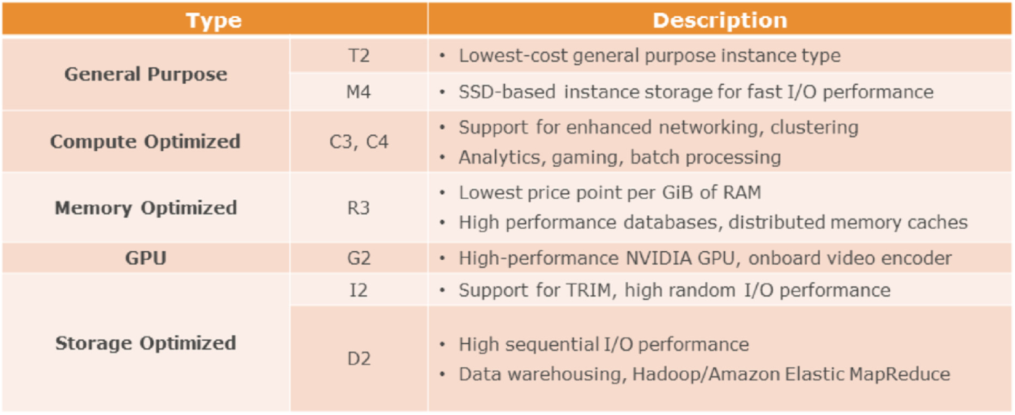
Computing on AWS – EC2
Instance Types
Notes:
https://instances.vantage.sh/

Slide 10
Computing on AWS – EC2
Creating Instances in AWS

Slide 11
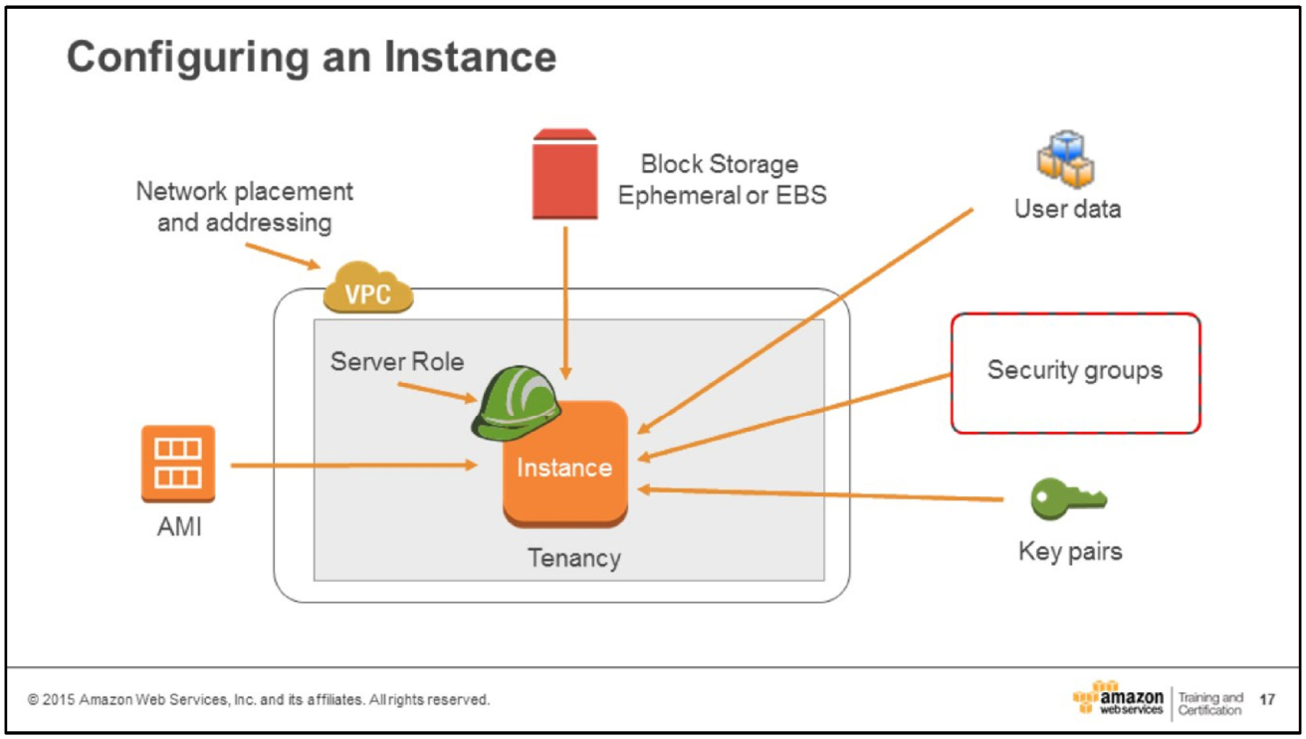
Computing on AWS – EC2
Create An Instance
Instance
AMI
Storage
Network placement and addressing
User data
Key pairs
Security groups

Slide 12
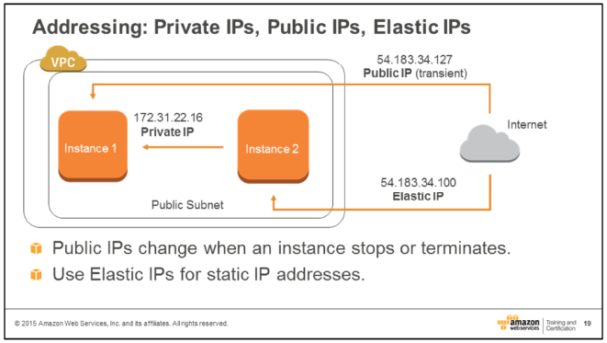
Computing on AWS – EC2
Create An Instance
Internet Protocol
Private IPs
Public IPs
Elastic IPs

Slide 13
Computing on AWS – EC2
Create An Instance
Amazon Elastic Block Store (EBS)
Network-attached disk storage
Types of EBS volumes
General Purpose (SSD)
Provisioned IOPS (SSD)
Magnetic options
Data persist when instance is stopped
Data persist when instance is terminated, provided the DeleteOnTermination attribute is false

Slide 14
Computing on AWS – EC2
Create An Instance
Instance Store (Ephemeral)
Instance store volumes are directly attached to a host computer
Instance Store SSD volumes have fast disk access suitable for swap files, caches, buffers, and highly replicated data
Instance store volume contents are lost when an instance is stopped or terminated
Instance store volumes can offer up to 100,000 IOPS for some instance types

Slide 15
Computing on AWS – EC2
Create An Instance
User Data
User data scripts supplied to initialize instances automatically
Linux script
Window batch or PowerShell scripts
User data scripts can install any software package
Web server
Database server
Configuration management tools
User data scripts are executed by
Cloud-init on Linux
EC2 config service on Window
User data scripts run once per instance-id default

Slide 16
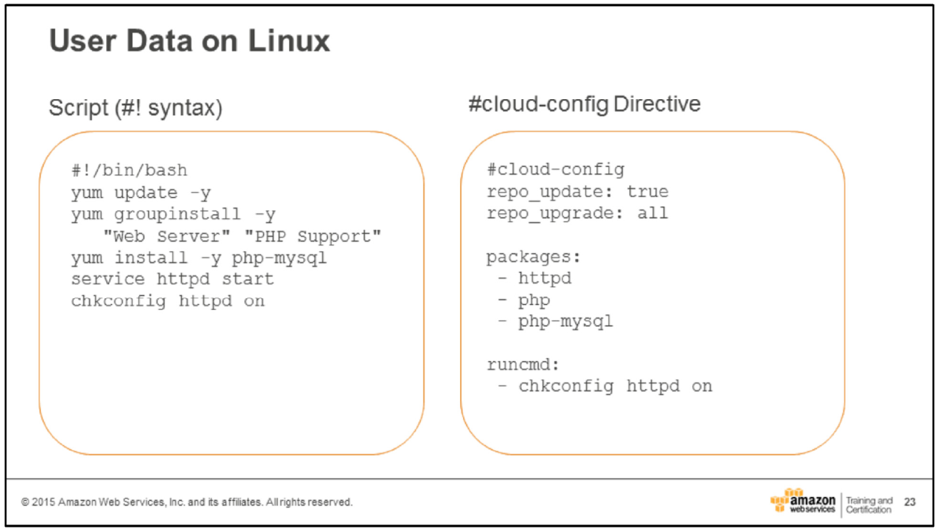
Computing on AWS – EC2
Create An Instance
User Data

Slide 17
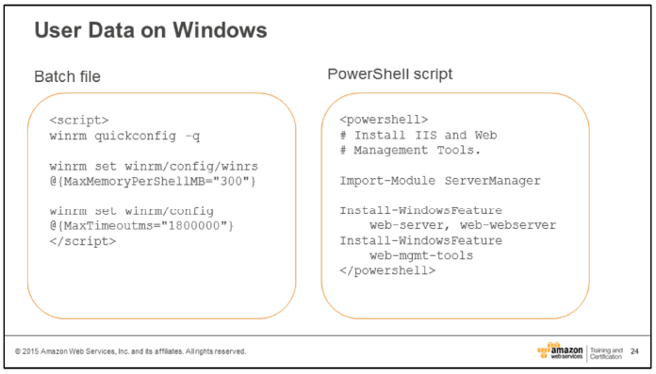
Computing on AWS – EC2
Create An Instance
User Data

Slide 18
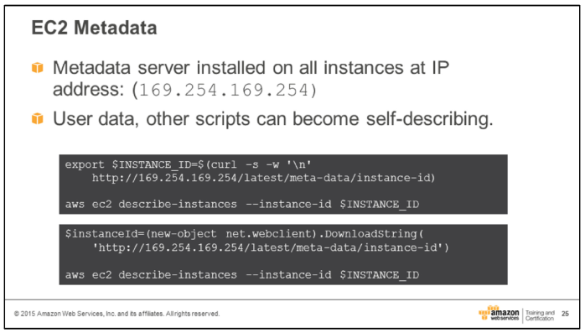
Computing on AWS – EC2
Create An Instance
Meta Data

Slide 19
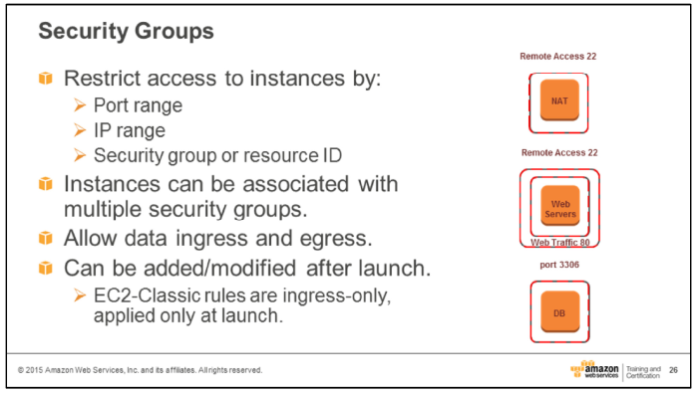
Computing on AWS – EC2
Create An Instance
Security Groups

Slide 20
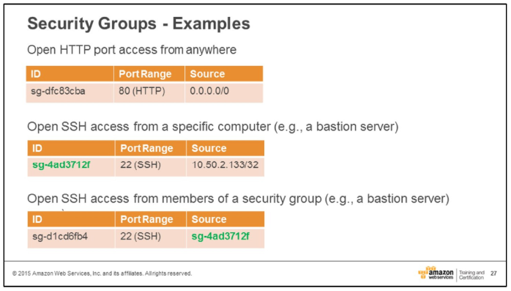
Computing on AWS – EC2
Create An Instance
Security Groups

Slide 21
Computing on AWS – EC2
Create An Instance
Key Pairs
Remote Access
Linux – Use SSH to log into an instance since password-only authentication is disabled on Linux by default
Windows – Use RDP to log in to instances using an encrypted random password that can only be decrypted using a private secret access key
Public key cryptographic keys
Only the Public Access key ID needs to be uploaded to server (in ~/.ssh/authorized_keys on Linux)
Private secret access keys can be generated locally and must be saved when created

Slide 22
Computing on AWS – EC2
Managing Instances in AWS

Slide 23
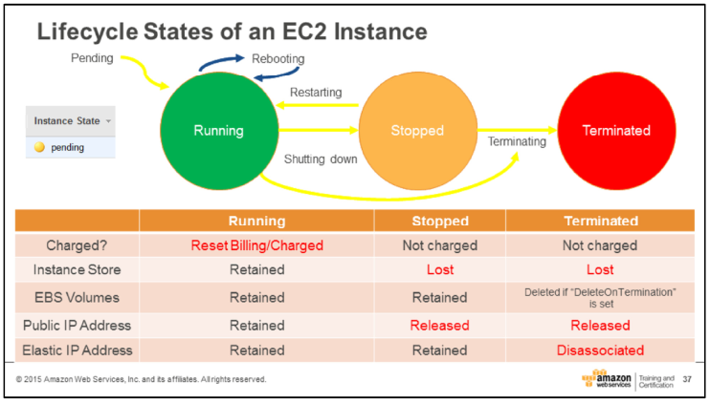
Computing on AWS – EC2
An instance enters the Pending state when it is first started. As soon as it is started, we will be charged for that instance’s first hour

Slide 24
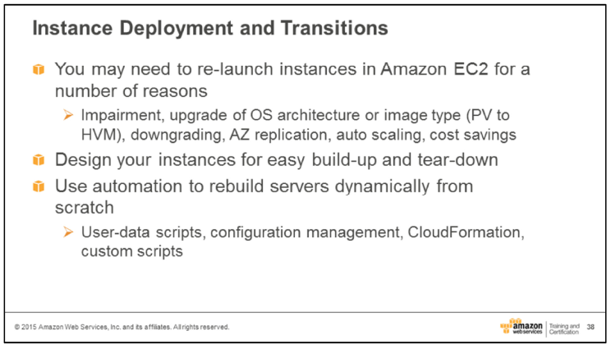
Computing on AWS – EC2
Scale: Vertical or Horizontal
Vertical: scale up/down
Horizontal: scale out/in
Notes:
Upgrade/ change instance type

Slide 25
Computing on AWS – EC2
Securing Your AWS Instances

Slide 26
Computing on AWS – EC2
EC2 Instance Security Summary
Should:
Use IAM roles when launching instances
Use least privilege access policies
Guard and manage access/secret keys
Keep security patches up to date
Use a NAT and Bastion host or similar solutions
Shoud Not:
Use root level access/secret keys
Embed access/secret keys in code or commit to Git
Notes:
Upgrade/ change instance type

Slide 27
Computing on AWS – EC2
Troubleshooting AWS Instance Issues

Slide 28
Computing on AWS – EC2
Troubleshooting Common EC2 Issues
Can’t connect to the instance
Check security groups
Automated Windows Updates sometimes a culprit
Instance is marked “Impaired” (fail status check)
Reboot
Get System Log command in console for additional troubleshooting
(Windows) attaching a second Elastic Network Interface (ENI) may enable connecting to the instance
Log issue with AWS support

Slide 29
Computing on AWS – EC2
Understanding EC2 Instance Pricing

Slide 30
Computing on AWS – EC2
Mix of Pricing Type
On-Demand Instances | Reserved Instances | Spot Instances
Pay as you go for compute power Benefit: On-demand availability Pay only for what you use, no up-front commitments or long-term contracts | 1- or 3- year terms Choose zero/partial/full up-front payment Receive significant hourly discount Benetfit: Cost/Predictability Helps ensure that compute capacity is available when needed | Bid on unused EC2 capacity Spot Price based on supply/demand, determined automatically, up to 90% off on-demand price Benefit: Cost/Large Scale, dynamic workload handling Spot price below bid, instances start Spot price above bid, instances terminate after a 2- minute warning

Slide 31
Thank you

