Slide 1
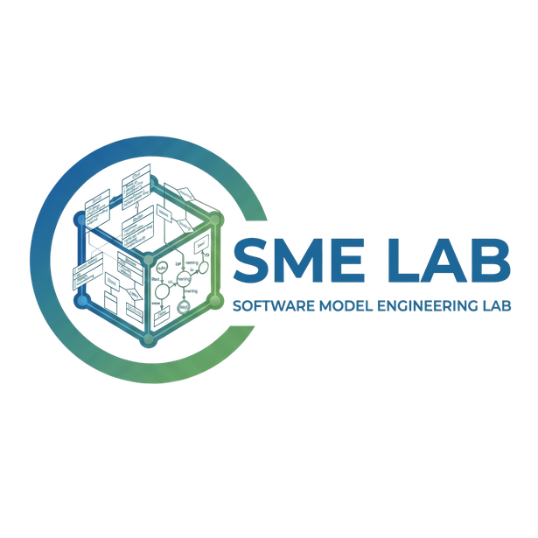

Agentic Repository-level Code Translation
Agentic
Repository-level
Code Translation

Slide 2
Agentic Repository-level Code Translation
Software Modernization
“Software modernization attempts to evolve
a legacy system, or elements of the system,
when conventionally evolutionary practices,
such as maintenance and enhancement,
can no longer achieve the desired system properties.”
Seacord, R. C., Plakosh, D., & Lewis, G. A. (2003). Modernizing legacy systems: Software technologies, engineering processes, and business practices. Addison-Wesley Professional.
02

Slide 3
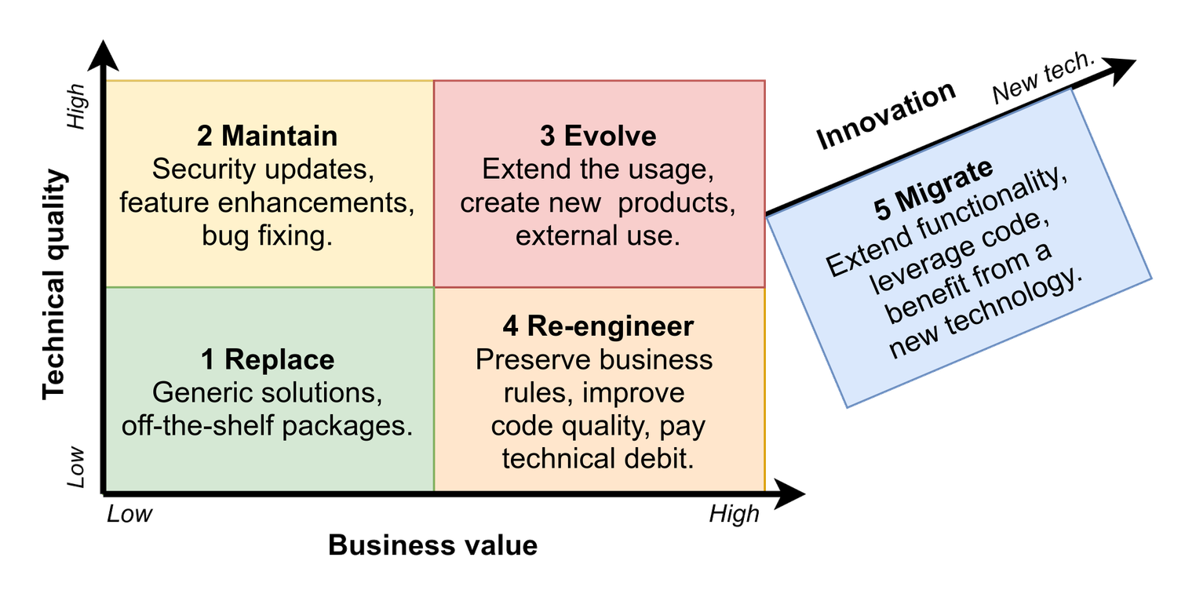
Agentic Repository-level Code Translation
Software Modernization, categorized
Assunção, W. K. G., Marchezan, L., Egyed, A., & Ramler, R. (2024). Contemporary software modernization: Perspectives and challenges to deal with legacy systems. arXiv. https://doi.org/10.48550/arXiv.2407.04017
03

Slide 4
Agentic Repository-level Code Translation
Repository-level Code Translation
“Repository-level code translation refers to translating an entire code repository from one programming language to another while preserving the functionality of the source repository.”
Wang, Y., Wang, Y., Wang, S., Guo, D., Chen, J., Grundy, J., Liu, X., Ma, Y., Mao, M., Zhang, H., & Zheng, Z. (2024). RepoTransBench: A real-world benchmark for repository-level code translation. arXiv. https://doi.org/10.48550/arXiv.2412.17744
04

Slide 5
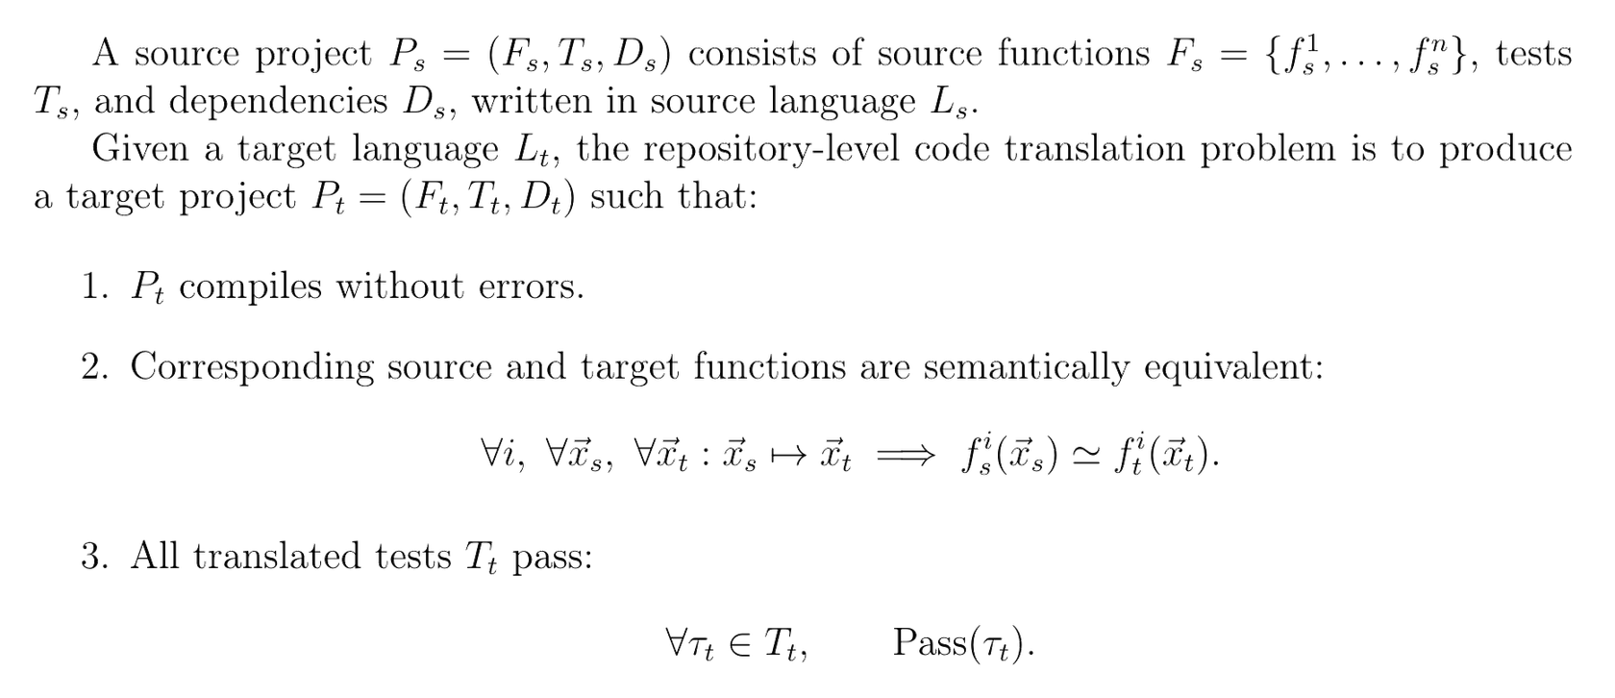
Agentic Repository-level Code Translation
Repository-level Code Translation, formalized
Ibrahimzada, A. R., Paulsen, B., Kroening, D., & Jabbarvand, R. (2026). ReCodeAgent: A multi-agent workflow for language-agnostic translation and validation of large-scale repositories. arXiv. https://doi.org/10.48550/arXiv.2604.07341
05

Slide 6



Agentic Repository-level Code Translation
Repository-level Code Translation, categorized
Rule-based Translation
Neuro-symbolic Translation
Agentic Translation
“[...] rely on predefined patterns to guide the translation process.”
“[...] combine large language models (LLMs) with (symbolic) program analysis and testing.”
“[...] one or more LLM agents work together to translate code between specific source-target PLs.”
“[...] all translation rules
are written by hand.”
Luo, F., Ji, K., Gao, C., Gao, S., Feng, J., Liu, K., Xia, X., & Lyu, M. R. (2025). Integrating rules and semantics for LLM-based C-to-Rust translation. In 2025 IEEE International Conference on Software Maintenance and Evolution (ICSME) (pp. 685–696). IEEE. https://doi.org/10.1109/ICSME64153.2025.00069
Ibrahimzada, A. R., Paulsen, B., Kroening, D., & Jabbarvand, R. (2026). ReCodeAgent: A multi-agent workflow for language-
agnostic translation and validation of large-scale repositories. arXiv. https://doi.org/10.48550/arXiv.2604.07341
06

Slide 7
Agentic Repository-level Code Translation
Agentic Repository-level Code Translation, [...]
<PENDING>
<PENDING>
07

Slide 8
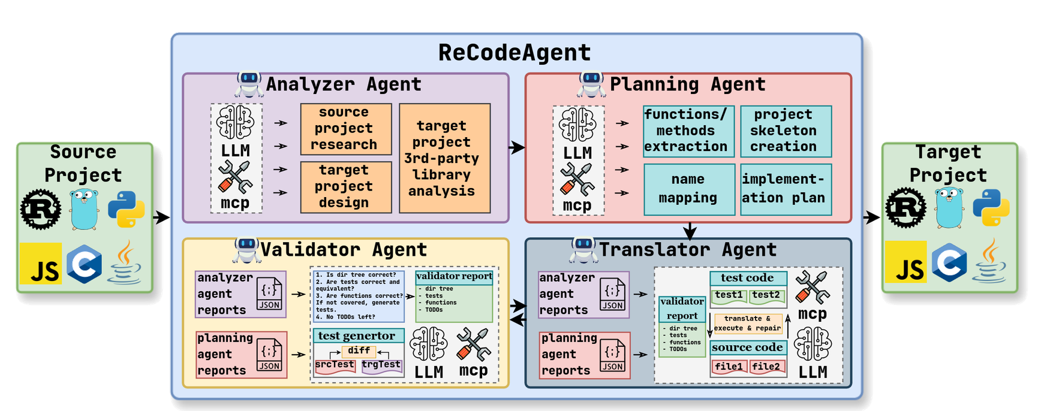
Agentic Repository-level Code Translation
Agentic Repository-level Code Translation, exemplified:
ReCodeAgent’s implementation
Ibrahimzada, A. R., Paulsen, B., Kroening, D., & Jabbarvand, R. (2026). ReCodeAgent: A multi-agent workflow for language-agnostic translation and validation of large-scale repositories. arXiv. https://doi.org/10.48550/arXiv.2604.07341
08

Slide 9
Agentic Repository-level Code Translation
Research Direction, summarized
Software Modernization
Migration
Repository-level
Code Translation
Agentic
Repository-level
Code Translation
09

Slide 10
Agentic Repository-level Code Translation
Prerequisites
1
2
3
Agentic Harness Engineering
Program Analysis
Software Archaeology
how to design an E2E workflow
leveraging LLM agents
how to provide LLM agents
with structured understanding
of a repository
how to do repository-level
code translation by hand
10

Slide 11
Agentic Repository-level Code Translation
References
Prerequisites
GDS K S. (2026, May 17). How to read any legacy codebase: The archaeology playbook. DEV Community. https://dev.to/thegdsks/how-to-read-any-legacy-codebase-the-archaeology-playbook-19bh
11

Slide 12
Agentic Repository-level Code Translation
References
Related works
Shetty, M., Jain, N., Godbole, A., Seshia, S. A., & Sen, K. (2024). Syzygy: Dual code-test C to (safe) Rust translation using LLMs and dynamic analysis. arXiv preprint arXiv:2412.14234. https://arxiv.org/abs/2412.14234
Li, T., Li, R., Wang, B., Paulsen, B., Mathur, U., & Saxena, P. (2025). Adversarial agent collaboration for C to Rust translation. arXiv preprint arXiv:2510.03879. https://arxiv.org/abs/2510.03879
Ibrahimzada, A. R., Ke, K., Pawagi, M., Abid, M. S., Pan, R., Sinha, S., & Jabbarvand, R. (2025). AlphaTrans: A neuro-symbolic compositional approach for repository-level code translation and validation. Proceedings of the ACM on Software Engineering, 2(FSE), Article FSE109. https://doi.org/10.1145/3729379
Nitin, V., Krishna, R., do Valle, L. L., & Ray, B. (2025). C2SaferRust: Transforming C projects into safer Rust with neurosymbolic techniques. arXiv preprint arXiv:2501.14257. https://arxiv.org/abs/2501.14257
Khatry, A., Zhang, R., Pan, J., Wang, Z., Chen, Q., Durrett, G., & Dillig, I. (2025). CRUST-Bench: A comprehensive benchmark for C-to-safe-Rust transpilation. arXiv preprint arXiv:2504.15254. https://arxiv.org/abs/2504.15254
Yang, J., Jimenez, C. E., Wettig, A., Lieret, K., Yao, S., Narasimhan, K. R., & Press, O. (2024). SWE-agent: Agent-computer interfaces enable automated software engineering. Advances in Neural Information Processing Systems, 37, 50528–50652. https://proceedings.neurips.cc/paper_files/paper/2024/hash/5a7c947568c1b1328ccc5230172e1e7c-Abstract-Conference.html
12

Slide 13
Agentic Repository-level Code Translation
References
Related works
Wang, Y., Ou, R., Wang, Y., Liu, M., Chen, J., Shi, E., . . . Zheng, Z. (2025). EffiReasonTrans: RL-optimized reasoning for code translation. arXiv preprint arXiv:2510.18863. https://arxiv.org/abs/2510.18863
Wang, C., Yu, T., Wang, J., Chen, D., Zhang, W., Shi, Y., . . . Shen, B. (2025). EvoC2Rust: A skeleton-guided framework for project-level C-to-Rust translation. arXiv preprint arXiv:2508.04295. https://arxiv.org/abs/2508.04295
Luo, F., Ji, K., Gao, C., Gao, S., Feng, J., Liu, K., . . . Lyu, M. R. (2025). Integrating rules and semantics for LLM-based C-to-Rust translation. arXiv preprint arXiv:2508.06926. https://arxiv.org/abs/2508.06926
Yuan, Z., Mao, W., Chen, Z., Shang, X., Wang, C., Lou, Y., & Peng, X. (2025). Project-level C-to-Rust translation via pointer knowledge graphs. arXiv preprint arXiv:2510.10956. https://arxiv.org/abs/2510.10956
Sim, H., Cho, H., Go, Y., Fu, Z., Shokri, A., & Ravindran, B. (2025). Large language model-powered agent for C to Rust code translation. arXiv preprint arXiv:2505.15858. https://arxiv.org/abs/2505.15858
Zhang, H., David, C., Wang, M., Paulsen, B., & Kroening, D. (2025). Scalable, validated code translation of entire projects using large language models. Proceedings of the ACM on Programming Languages, 9(PLDI), Article 212. https://doi.org/10.1145/3729315
Guan, Z., Yin, X., Peng, Z., & Ni, C. (2025). RepoTransAgent: Multi-agent LLM framework for repository-aware code translation. arXiv preprint arXiv:2508.17720. https://arxiv.org/abs/2508.17720
13

Slide 14
Agentic Repository-level Code Translation
References
Related works
Dehghan, S., Sun, T., Wu, T., Li, Z., & Jabbarvand, R. (2025). Translating large-scale C repositories to idiomatic Rust. arXiv preprint arXiv:2511.20617. https://arxiv.org/abs/2511.20617
Cai, X., Liu, J., Huang, X., Yu, Y., Wu, H., Li, C., . . . Jiang, L. (2025). RustMap: Towards project-scale C-to-Rust migration via program analysis and LLM. In International Conference on Engineering of Complex Computer Systems (pp. 283–302). Cham, Switzerland: Springer. https://doi.org/10.1007/978-981-96-5491-2_16
Zhou, T., Zhang, Z., Lin, H., Jha, S., Christodorescu, M., Levchenko, K., & Chandrasekaran, V. (2025). SACTOR: LLM-driven correct and idiomatic C to Rust translation with static analysis and FFI-based verification. arXiv preprint arXiv:2503.12511. https://arxiv.org/abs/2503.12511
Wang, B., Li, T., Li, R., Mathur, U., & Saxena, P. (2025). Program skeletons for automated program translation. Proceedings of the ACM on Programming Languages, 9(PLDI), Article 184. https://doi.org/10.1145/3729287
Ibrahimzada, A. R., Paulsen, B., Kroening, D., & Jabbarvand, R. (2026). ReCodeAgent: A multi-agent workflow for language-agnostic translation and validation of large-scale repositories. arXiv preprint arXiv:2604.07341. https://arxiv.org/abs/2604.07341
14

Slide 15
Agentic Repository-level Code Translation
The End

