Slide 1
工业组建模型技术研究
朱罡

Slide 2
组件模型
RTE
C
A
A
B
B
C
D
B
B
B
C
C
C
D
F
A
B
D
E
F
C
A
repository
composition
& deposition
E
deployment

Slide 3
Component
A unit of independent deployment
A unit of third-party composition
no persistent state
Reusability
Configurability
Extendibility
composition
configuration & reconfiguration
IDL

Slide 4
重用性
函数
对象
组件
服务
功能粒度越来越粗
抽象层次越来越高
层级关系原来越扁平
Components capture the deployment nature of software; object capture its run-time nature.

Slide 5
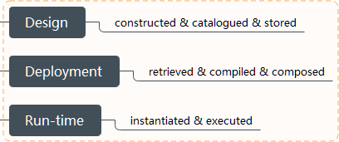
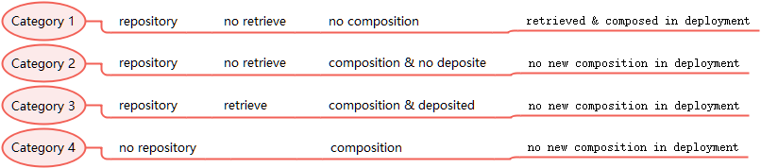
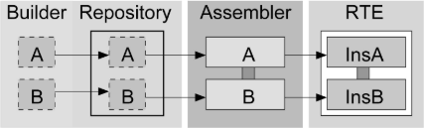
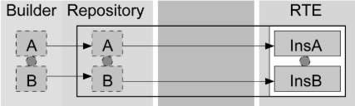
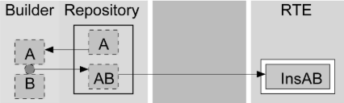
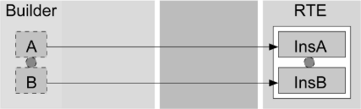
Lifecycle
Category 1
JavaBean
Category 2
EJB,COM,.NET
Category 3
Koala, SOFA
Category 4
PECO,UML,ADL-like

Slide 6

Academic vs Industry
Hierarchical model
Formal design
Model checking & behavior protocol
mature RTE
muti communication style
usability
PECOS
EJB
Fractcal
AutoSAR
UML
CCM
SOFA
Corba

Slide 7
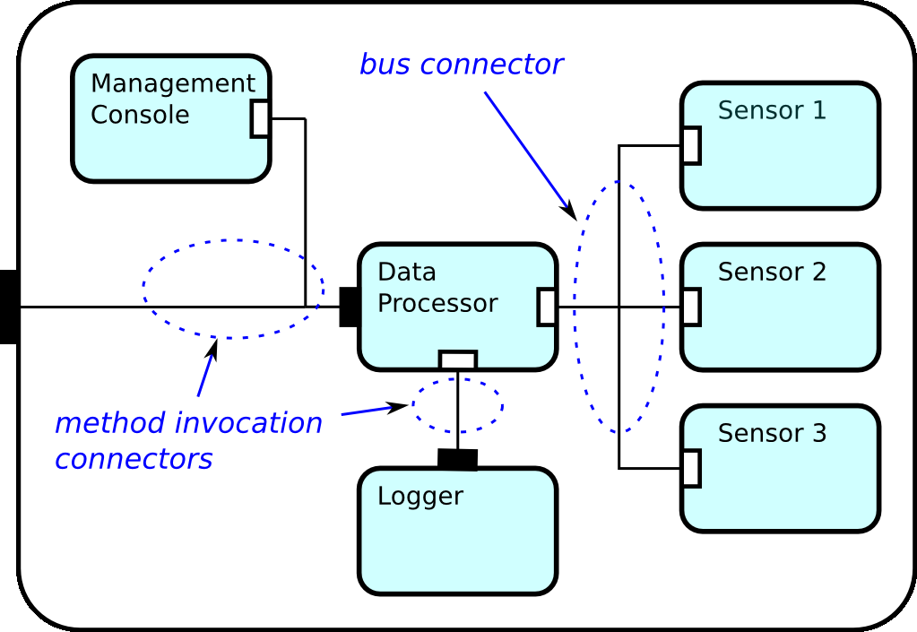
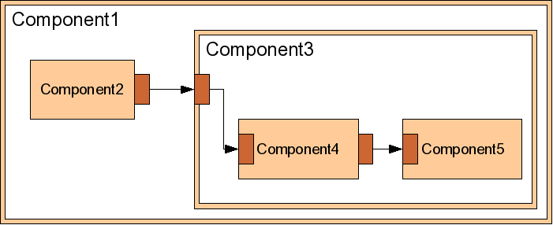
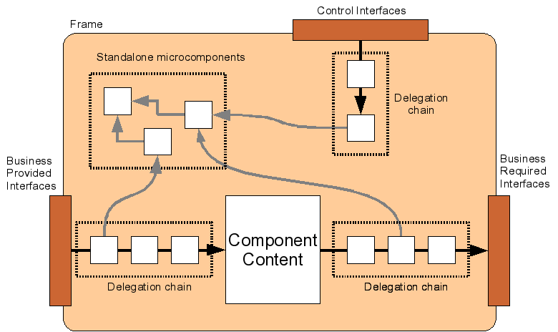
SOFA 2
frame &
architecture
communication
control part
dynamic reconfiguration

Slide 8
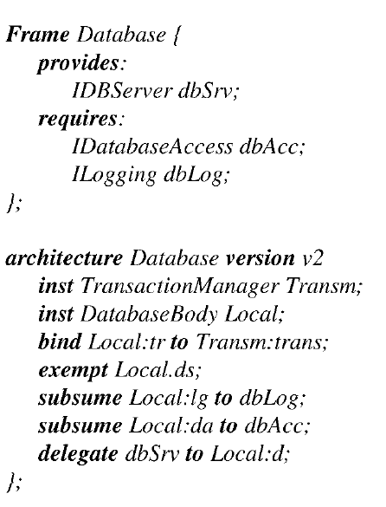
Architecture
& Frame
3
4
1
4
5
2
1
1
2
3
4
5
CDL

Slide 9
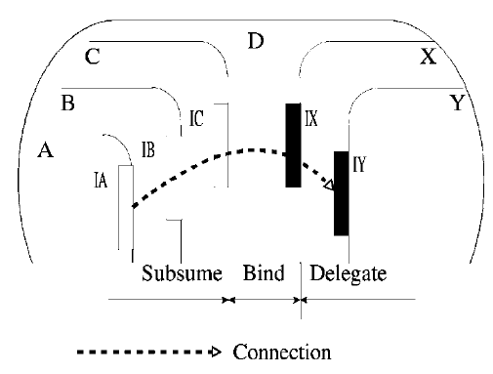
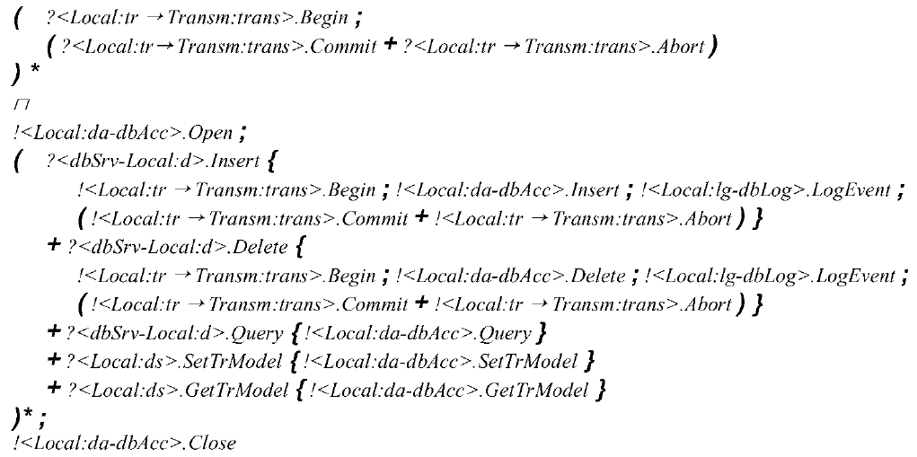
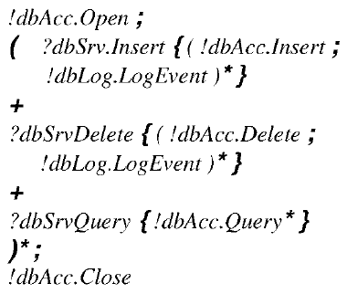
Behavior protocol
conformance
接口-接口
接口- Frame
Frame – Architecture
;
序列
+
或
*
重复
{}
嵌套
！
调用
?
被调用
-
subsume
delegate
→
bind
Frame protocol
Π
组合
Architecture protocol

Slide 10
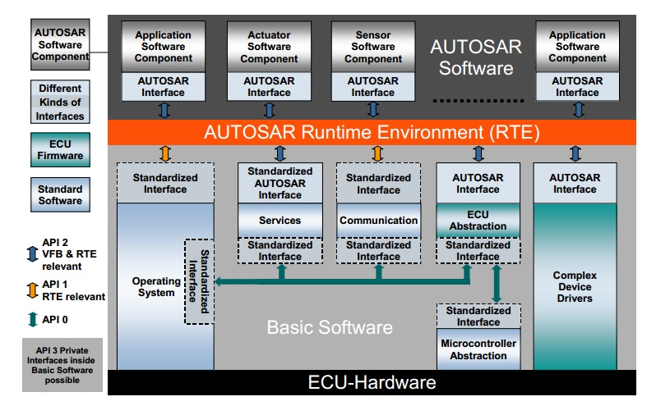
AutoSAR

Slide 11
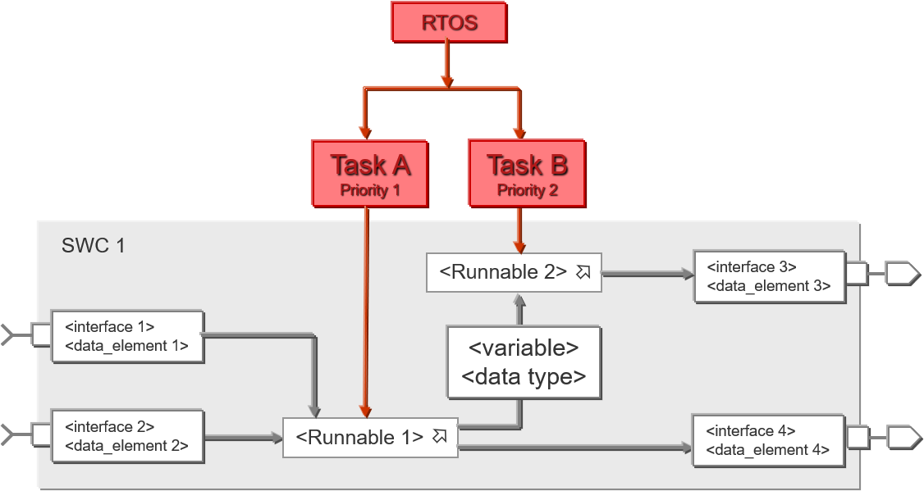
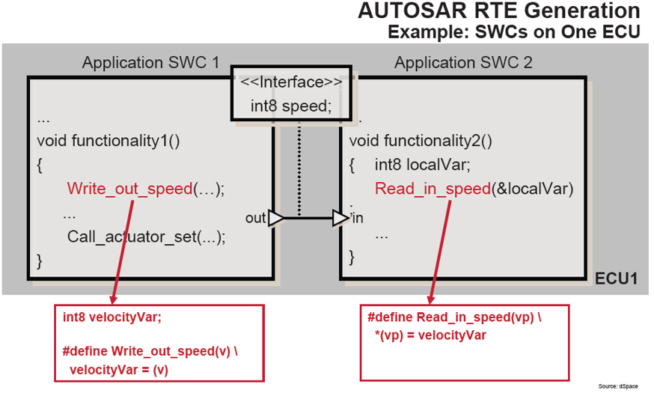
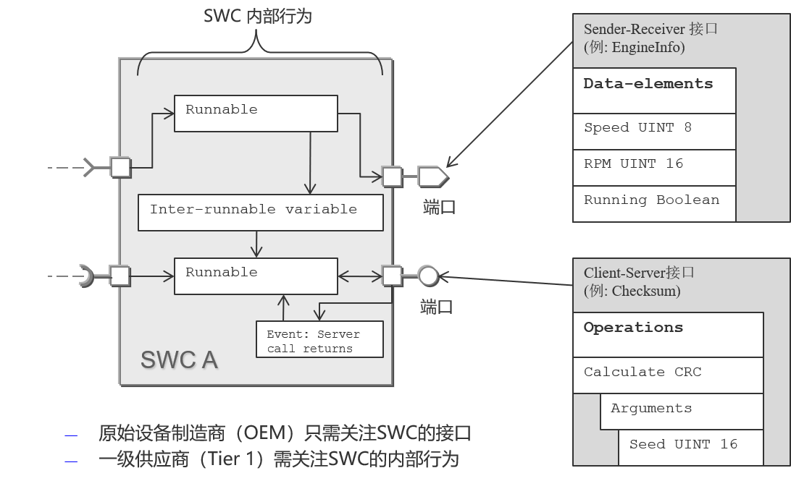
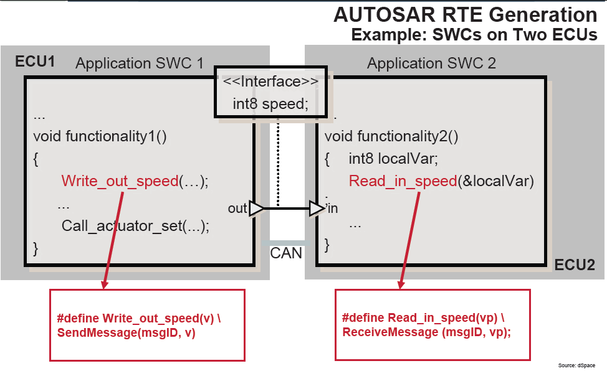

Slide 12
异步
同步

