Slide 1
工业组件模型技术研究

Slide 2
组件模型
RTE
C
A
A
B
B
C
D
B
B
B
C
C
C
D
F
A
B
D
E
F
C
A
repository
composition
& deposition
E
deployment

Slide 3
Component
A unit of independent deployment
A unit of third-party composition
no persistent state
Reusability
Configurability
Extendibility
composition
configuration & reconfiguration
IDL

Slide 4
复用性
函数
对象
组件
服务
功能粒度越来越粗
抽象层次越来越高
层级关系原来越扁平
Components capture the deployment nature of software; object capture its run-time nature.

Slide 5
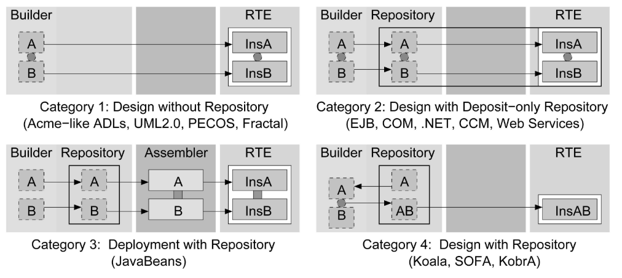
Life Cycle
Design Phase
Deployment Phase
Run-time Phase
Object−oriented Programming Languages
Programming Languages with IDL mappings
Architecture Description Languages
Syntax
Classes
Objects
Architectural Units
Semantics
Taxonomy
Composition

Slide 6
Idealized Life Cycle
Design
Deployment
Run-time
Builder
Repository
Assembler
Distributed RTE
deposit
compile
instantiate
A
A
A
insA
A
component
B
B
insB
A
component(binary)
retrieve
insA
component
instance
C
C
B
insB
A
D
D
D
insD
component container
B
deposit
CD
CD
insCD
design phase composition operator
(composite)
deployment phase composition operator
(intra-container assemble)
run-time phase composition operator
(inter-container/run-time assemble)

Slide 7
Academic vs Industry
PECOS
EJB
Fractcal
AutoSAR
UML
CCM
SOFA 2
Corba
Hierarchical model
Formal design
Model checking & behavior protocol
mature RTE
muti communication style
usability

Slide 8
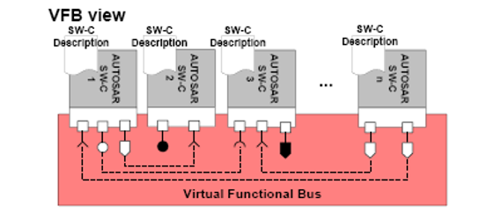
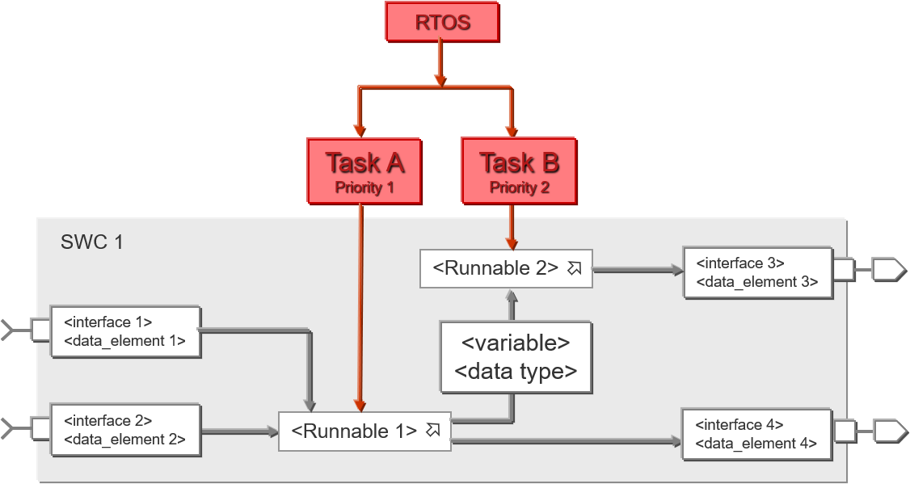
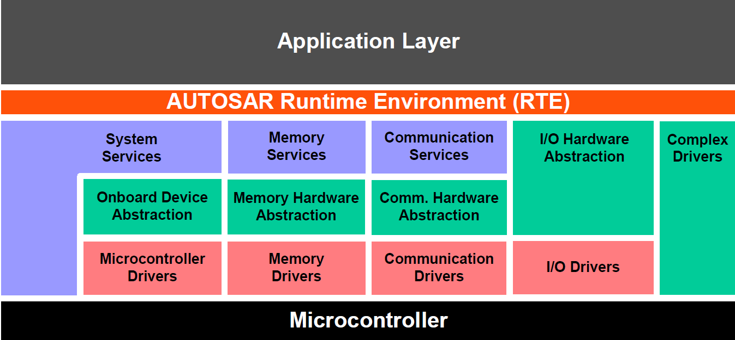
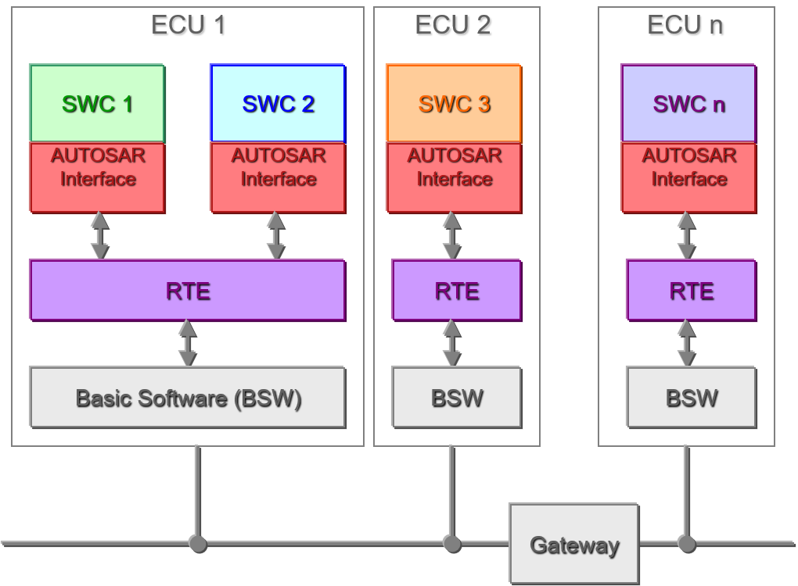
AUTOSAR
AUTOSAR利用了组件模型的重用性，更强调组件的可移植可扩展，软硬件协同设计等特性，目的是为OEM和供应商提供标准化的协同开发和系统整合能力。

Slide 9
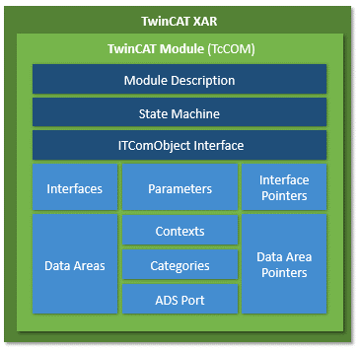
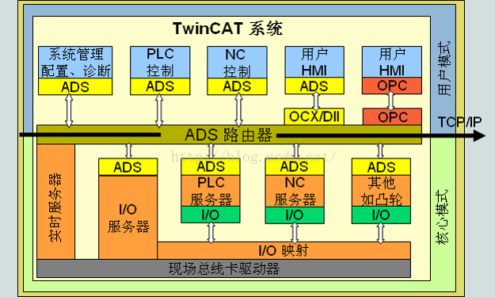
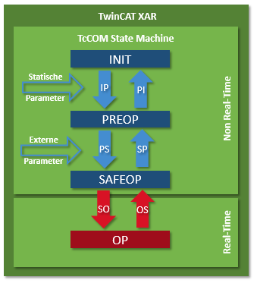
TWINCAT
TwinCAT runtime提供了一个RTE用以加载实现和管理各个模块，使得控制系统的开发可以由多个制造商协同开发。

Slide 10
Component Model
Node 1
Node 2
Container A
Container B
Container C
method invocation
CM
BC
AC
CM
BC
AC
CM
BC
AC
intra-node communication
handled by middleware
(shared memory)
inter-node communication
handled by middleware
(UDP over field bus e.g.)
OS
OS
Hardware
Hardware

Slide 11
Node A
Node B
Node C
Topic 3-A
Data writer
Topic 3-B
Topic 2-A
Topic 3-A
Topic 2-A
Topic 3-A
Topic 3-B
Data reader
Topic 1-A
Topic 3-B
Topic 2-A
Topic 3-B
Topic 3-A
Topic 1-A
Topic 1-B
Topic 1-B
DCPS Manager(Basic Component)
DCPS Manager
DCPS Manager
Subscriber
Subscriber
Subscriber
Subscriber
Subscriber
Subscriber
Subscriber
Publisher
Publisher
Publisher
Publisher
Publisher
Publisher
Publisher
Domain 1 (Topic:1-A,1-B)
Domain 2 (Topic:2-A)
Domain 3 (Topic:3-A,3-B)
虚拟总线

Slide 12
Communication Pattern
Request
Topic
Input Area
Topic
input
input
Cyclic
Task
Cyclic
Task
output
Output Area
Topic
output
Reply
Topic
Component A
filter
Component B
Component A
Component B
requester
replier
Component B
Data Flow
Topic
Event Trigger
Topic
filter
Component A
Component B
Component A
listener
Component C
sender
receiver
trigger
listener

