Slide 3

Group 6: Apartment Price Prediction in Hanoi
Trinh Giang Nam – 20215229
Nguyen Trong Huy – 20210451
Nguyen Chinh Minh – 20215224

Slide 4
Introduction
Objective
Develop an application to predict the price of an apartment with input from user
Input
Price
Area
Location
Amenities
Output
Price of the given apartment

Slide 5
Pipeline
bds68
json
extract
homedy
json
csv
processing
training
deploy
extract
alonhadat
json
extract
Crawling and extracting tools: requests and BeautifulSoup library

Slide 6
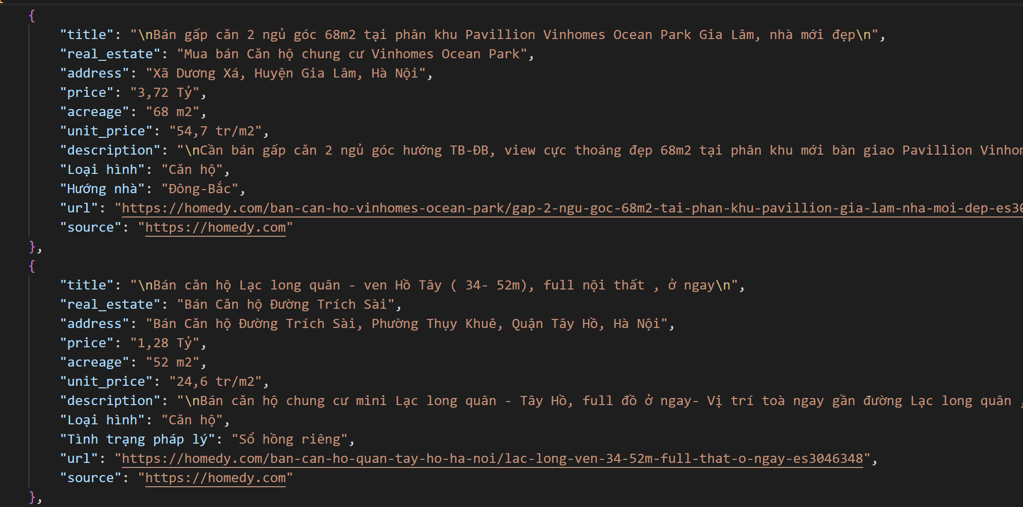
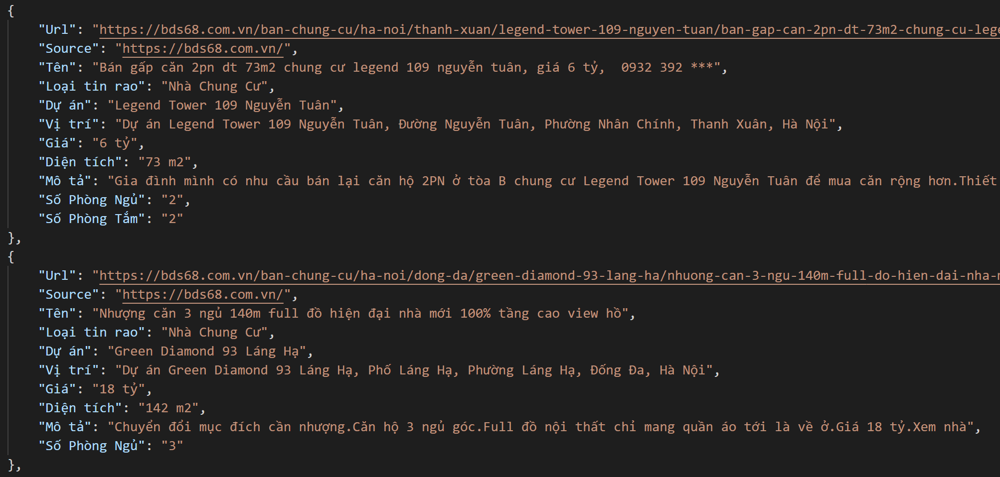
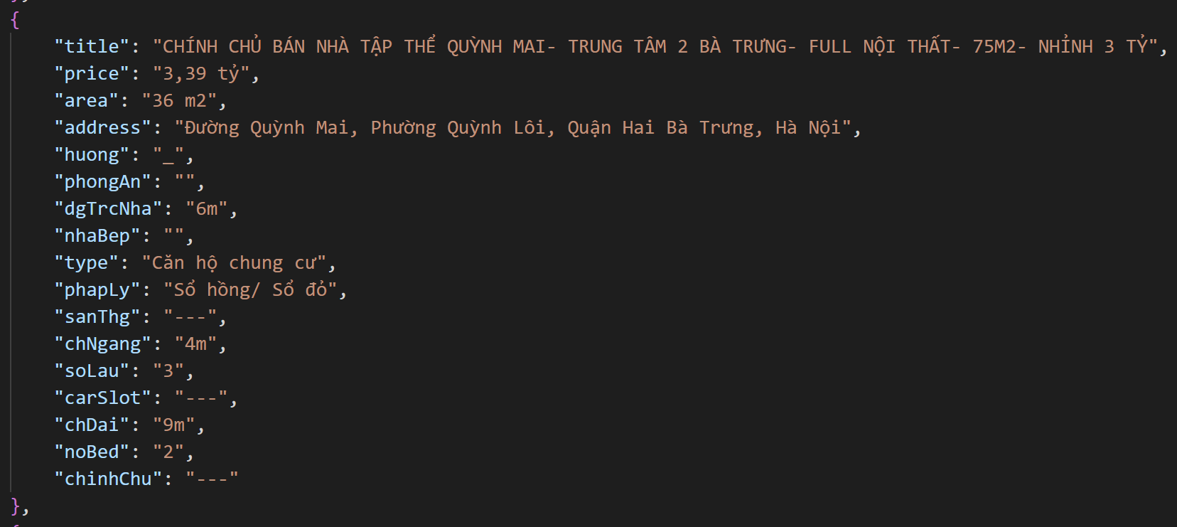
Data raw
homedy.com: 3614 samples
bds68.com.vn: 15338 samples
alonhadat.com.vn:
5980 samples

Slide 7
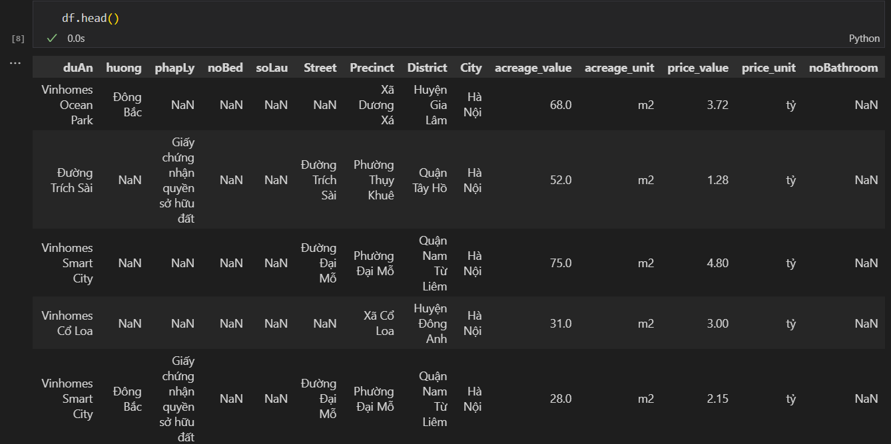
Data normalized
Number of features: 14 (5 numerical features, 9 categorical features)

Slide 8
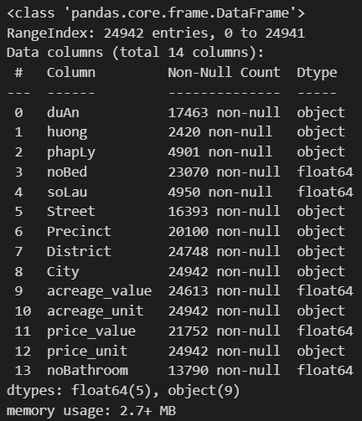
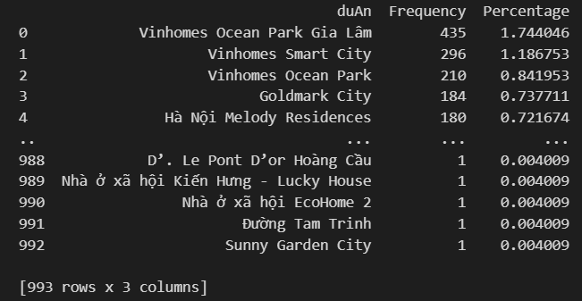
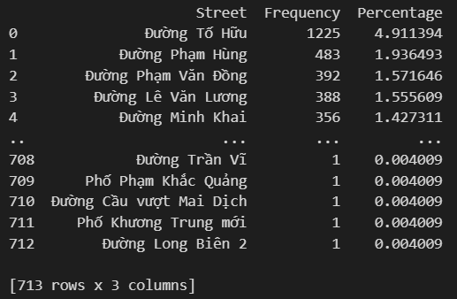
Data normalized

Slide 9
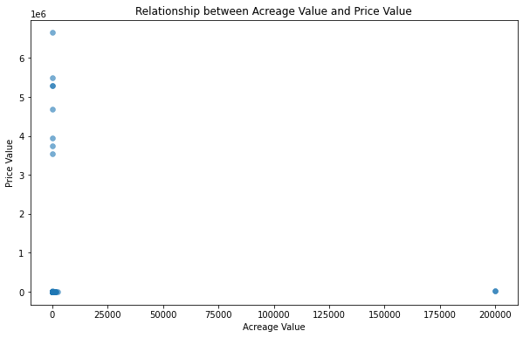
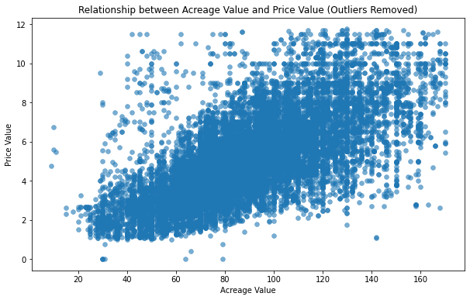
Data normalized

Slide 10
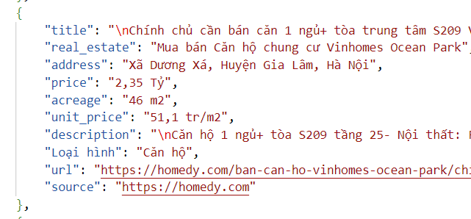
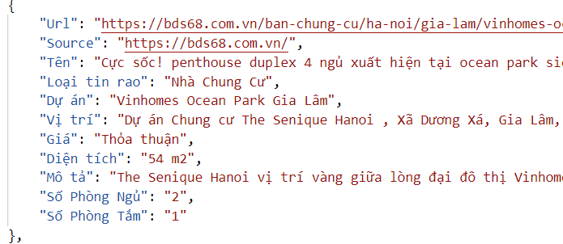
Data cleaning
- Remove samples with no target feature
- Group similar values
- Extract values from text: Precinct, District, price_value, acreage_value

Slide 11
Data processing
- Check for unique values in price_value and acreage_value then convert to drop redundant features
- Combine existing features into new features to get better insight of the dataset
Remove outliers using IQR: IQR = Q3 – Q1
Q1: The first quartile, the value below which 25% of the data falls.
Q3: The third quartile, the value below which 75% of the data falls

Slide 12
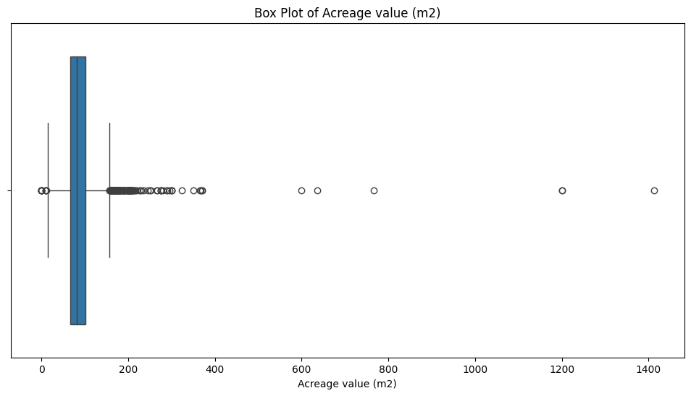
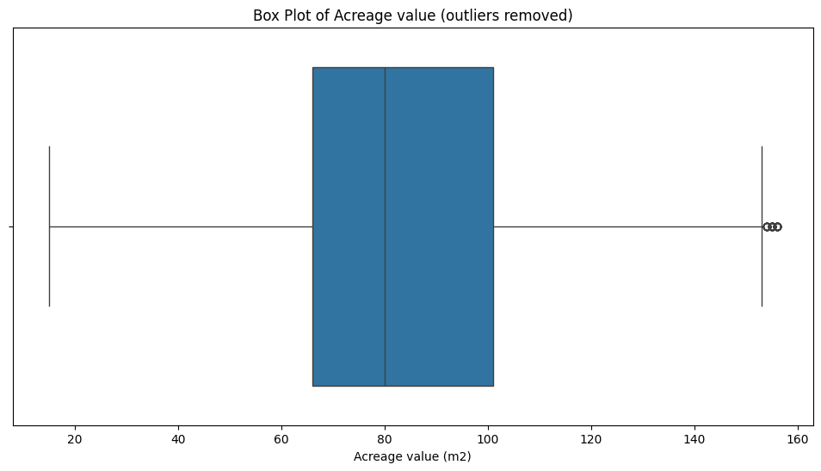
Data processing
Using box plot to remove outliers

Slide 13
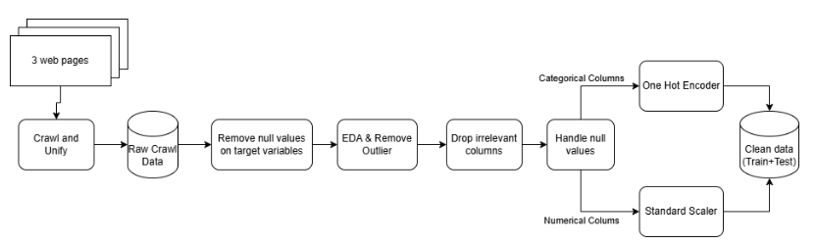
Feature Engineering
The dataset was prepared for machine learning training through feature engineering. Key steps included:
Removing duplicates for data integrity.
Handling missing values:
Numerical features (noBed, noBathroom, soLau): Replaced with -1.
Categorical features (District, phapLy, huong, Precinct, duAn): Filled with "NO INFO".
Using pipelines for preprocessing:
Categorical data: Imputation with SimpleImputer and encoding with OneHotEncoder.
Numerical data: Median imputation and scaling with StandardScaler.
The two pipelines were then integrated into a Column Transformer, which allowed for the simultaneous transformation of categorical and numerical features.

Slide 14
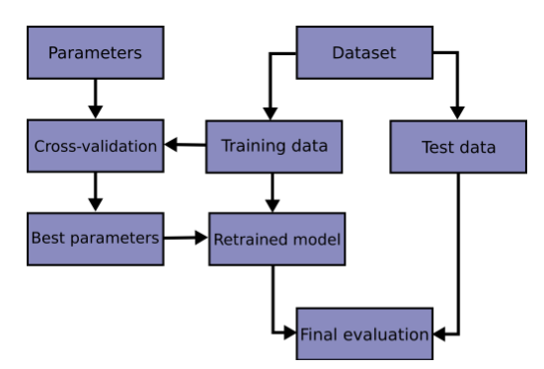
Training Regressor Models
Data Preparation
Model Selection and Tuning
Model Evaluation
Model Saving
Training model with Grid Search workflow

Slide 15
Training Regressor Models
Data Preparation | Model Selection and Tuning | Model Evaluation | Model Saving
The dataset was split into features (X) and the target variable (price_value), excluding irrelevant columns (street, price_per_area) Data was divided into training and testing sets (80-20 split) for fair evaluation. | 4 models were employed: • Linear Regression: baseline model without hyperparameter tuning. • Support Vector Regressor (SVR): a non-linear model tuned using grid search over the regularization parameter (C)). • XGBoost Regressor: A gradient boosting algorithm, tuned for n_estimators, max_depth, learning_rate. • LSTM Hyperparameter tuning for SVR and XGBoost was conducted using Grid-SearchCV with 5-fold cross-validation. Optimization criterion was the negative mean absolute error (MAE) | Evaluation metrics included: • Mean Absolute Error (MAE) • Root Mean Squared Error (RMSE) | The trained models, including the tuned SVR and XGBoost, were serialized and saved as .pkl files. → ensured that the models could be reused for predictions or further evaluation in subsequent stages.

Slide 16
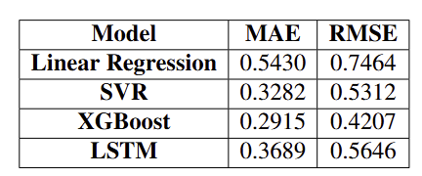
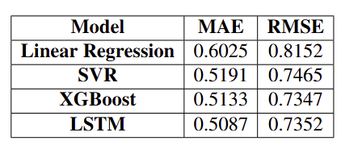
Experimental Results
Model training results on train set
Model training results on test set
Results indicate non-linear patterns effectively captured by advanced models like XGBoost and SVR.
Overfitting observed in these models suggests possible noise or insufficient training data.
Recommendations: improve preprocessing, apply regularization, or increase data volume to enhance generalization.
XGBoost showed the best performance, with potential for further improvement by addressing overfitting.

Slide 17
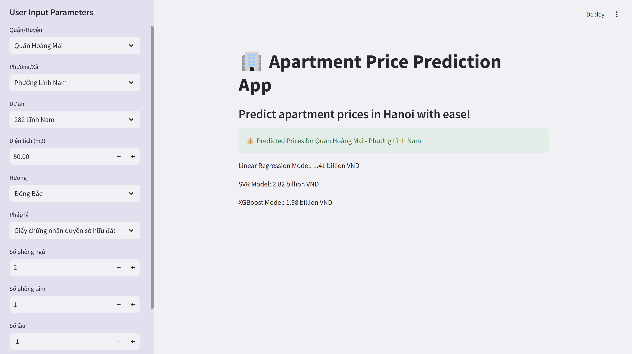
Demo Interface

Slide 18
Conclusions
Project Summary:
Developed a data science pipeline to address real-world problems, specifically predicting apartment prices in Hanoi.
Key steps: data preprocessing, exploratory analysis, feature engineering, and hyperparameter tuning.
Best-performing models:
XGBoost: Achieved RMSE of 0.7347 with Grid Search tuning.
LSTM: Scored best on MAE with 0.5087.
Integrated predictive models into a user-friendly application:
Enables real estate agents, buyers, and investors to input parameters and receive instant price predictions.
Democratizes data-driven insights, improving efficiency in the real estate market.
Future Work:
Explore advanced methods:
Expand data sources through web crawling.
Implement deep learning models tailored for regression tasks to enhance accuracy.
Improve data handling:
Better manage outliers and anomalies for more generalized results.
Use advanced feature selection and dimensionality reduction techniques to reduce computational complexity and costs.

