Slide 1
NIST/NTIA Spectrum Monitoring Project System Requirements
CTL / Wireless Networks Division
December 15, 2014

Slide 2


Spectrum Monitoring Pilot Program A Collaboration between NIST and NTIA
Goals:
Evaluate benefits of automated and continuous spectrum measurements for analysis of spectrum usage
Evaluate use of measurements for dynamic spectrum sharing
Spectrum Sensor
Modes of sensor measurement acquisition:
Periodic post
Continuous stream
Spectrum Occupancy Database
Incumbent RF System
Client w/ GUI

Slide 3
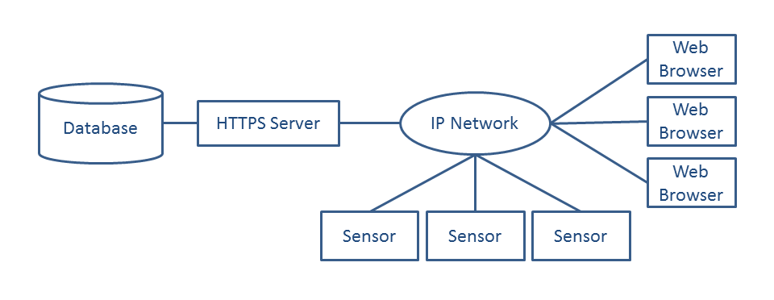
System Overview
Firewall

Slide 4
Web Server Detail
Browser
Ff
HTTPS/
WebSocket
Python/
Flask
NGNIX
HTTPS
Sensor
Mongodb
SSL
Sensor
Sensor

Slide 5
Network Security
All network traffic over encrypted connections.
Server will deploy with a verified certificate.
Sensors will have passwords for identification.
Web browser access does not need Identification (no passwords).

Slide 6
Processing For Inbound Data From Sensor
Static Periodic Data
Streamed (live) Data
Sensor POSTS data using HTTPS POST.
JSON header includes a registered Sensor Name/Password:
- Web Service Authenticates the POST
Binary attachment contains actual data.
Sensor establishes an authenticated
encrypted socket connection to the web service.
Streams data as a continuous stream of bytes
Web service extracts the data and
puts into the database.
Web service buffers the data in a fixed size buffer and makes it available to web clients via a web socket.
Periodically samples data stream and puts into the database.

Slide 7
Web Browser Client
Static Data Display
Live Data Display
Web application runs in browser and issues
queries via a web service with a defined API.
Web Browser establishes a HTTPS
Web Socket Connection with web service.
Web server renders relevant data – consisting of images and charts and sends back identifying information to the clients.
Web Service Streams data
continuously to the browser
Client fetches generated images and displays in browser window.
Browser generates a near-realtime
Spectrogram

Slide 8
Networking Load Estimate
Networking load for sensors:
Each sensor can generate 560 kBytes for every POST.
POST occurs once every 15 minutes.
Streaming Load:
Each sensor generates a load of 56 kBytes/sec.
Will need a dedicated server for processing (not a virtual machine).
Estimated 10 sensors for first year of deployment. Ideally want to support 100 sensors on a single server (need load measurements to see if that is feasible).
CPU Load and memory measurements are TBD

Slide 9
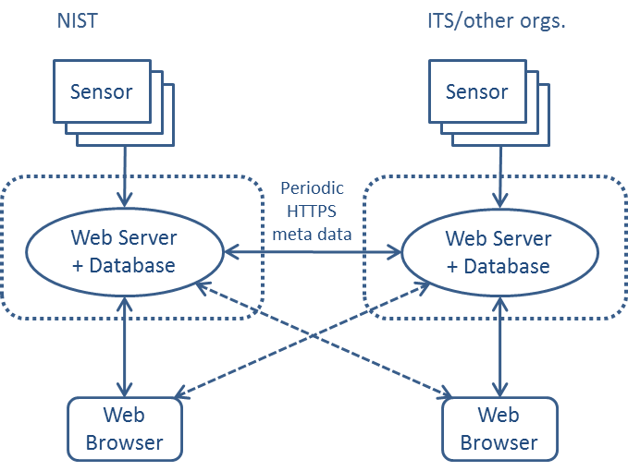
Federated operation

Slide 10
Firewall Requirements
Server will accept TCP connections at the following ports public ports (outbound traffic will flow from the server over established connections):
443 / HTTPS For Web Server Access.
9000-9008 / SSL For Streaming sensor.
Connections can be long lived.
Outbound traffic initiated from inside the firewall:
The web server will initiate outbound connections to peer web servers for federated operation and send HTTPS traffic over those connections.
The deployment does not need to access any resources inside NIST (can have its own firewall).

