Slide 1
An Overview of the NTIA/NIST Spectrum Monitoring Pilot Program
M. Cotton, J. Wepman, J. Kub, S. Engelking, Y. Lo, H. Ottke, R. Kaiser, D. Anderson
National Telecommunications and Information Administration
Institute for Telecommunication Sciences
Boulder, Colorado
M. Souryal, M. Ranganathan
National Institute of Standards and Technology
Communications Technology Laboratory
Gaithersburg, Maryland
Center for Advanced Communications
U.S. Department of Commerce
International Workshop on Smart Spectrum − March 9, 2015

Slide 2
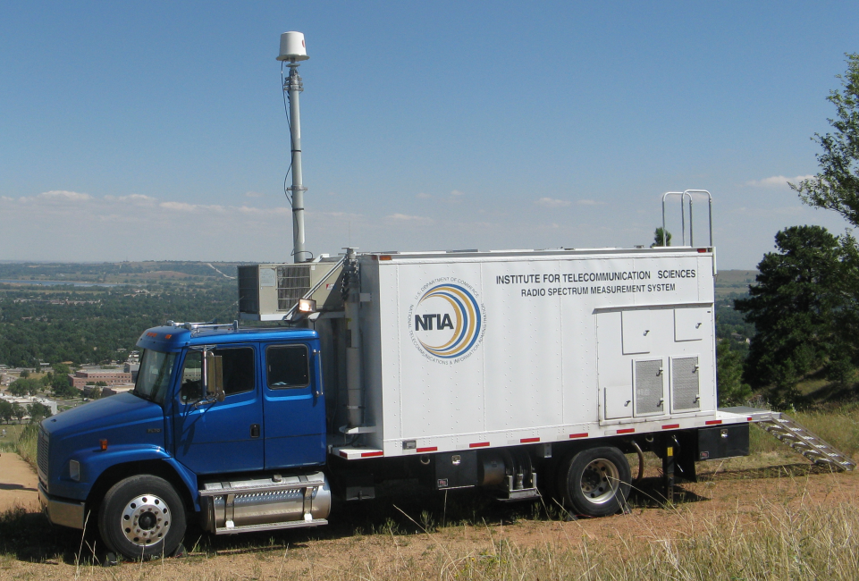
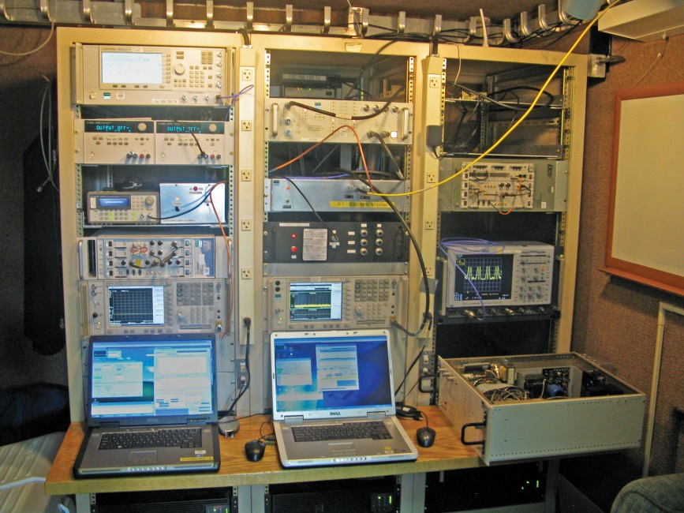

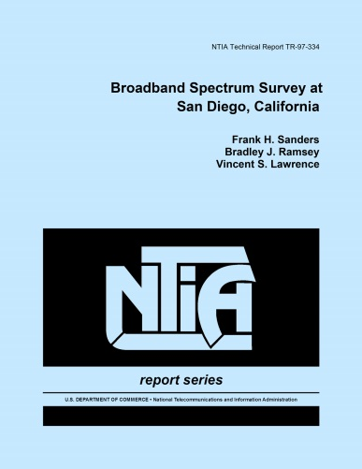
Background: Spectrum Surveys Today

Slide 3
Outline
Background and Motivation
Goals
Spectrum Occupancy Sensor
General requirements
Sensor evaluation
3.5 GHz radar sensor and comm sensor implementations
Spectrum Occupancy Database
Architecture and functionality
Data visualization
Ongoing work

Slide 4

Goals of Pilot Program
To develop and test an infrastructure for automated and continuous spectrum measurements made available in near real time
To establish best practices for the acquisition of spectrum occupancy measurements
Web Browser
Database
IP Network
Web Browser
HTTPS Server
Web Browser
Applications
Spectrum Sensor
Spectrum Sensor
Spectrum Sensor
Informing Spectrum Policy − Historical amplitude data, course metrics (e.g., daily mean band occupancy), confidence limits
Coordinating Spectrum Usage – Low latency amplitude data, temporal statistics of channel usage
Enforcement – Low latency amplitude and phase data, Signal ID, Location/direction finding

Slide 5
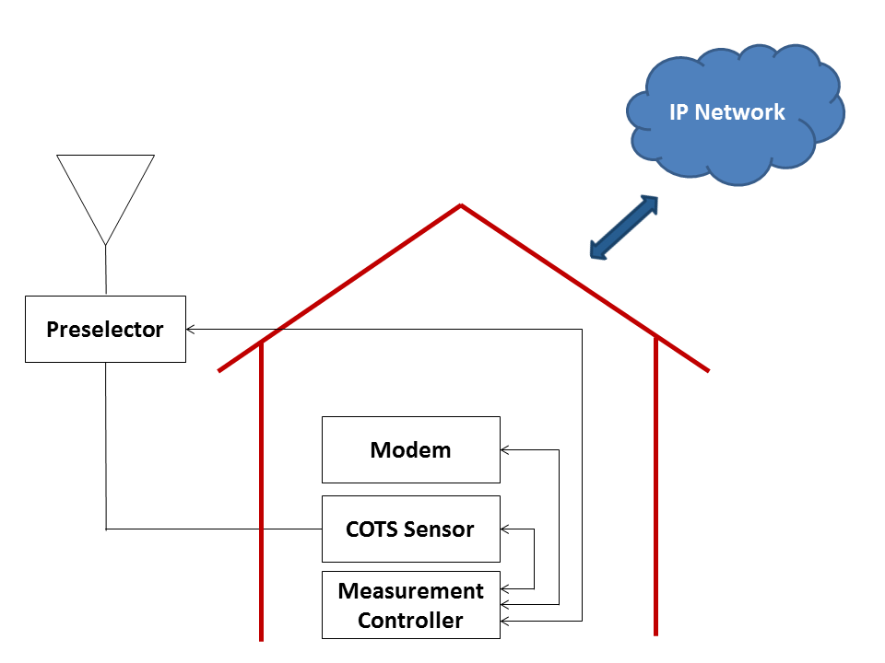
Spectrum Sensor General Requirements
Preselection: attenuates unwanted out-of-band signals
PS ruggedized and weatherproof for outdoor operation
Calibration: references power spectral measurements to a known source and measures system noise level
Remote logging: formats measurements to a predefined transfer specification and transmits them to the database over an IP network

Slide 6
Sensor Evaluation
Tiers
High − traditional spectrum analyzer, swept-frequency meas., large spurious-free dynamic range (~$50K)
Mid − spectrum sensor, FFT-based meas. (~$15K)
Low − software-defined receiver: RF front-end, ADC, DDC (<$3K + cost of GPP)
Ultra-Low − e.g., RTL-SDR USB stick, <3 MS/s (~$20 + cost of GPP)
Evaluation Metrics
Noise figure, dynamic range, spurious response, intermodulation distortion, frequency/amplitude stability and accuracy, …

Slide 7

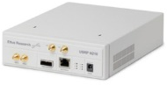
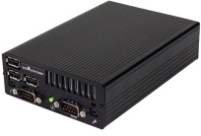
Sensor Development
Radar Sensor
Sensing high-power pulsed radar signals
High and mid tier sensor implementations with preselector
First sensor deployed at Virginia Beach in August 2014 to monitor the 3.5 GHz maritime radar band
Comm Sensor
Sensing broadband communication signals (e.g., LTE)
Low tier SDR hardware plus GPP streaming in real time
GPP running custom GNU Radio application
Database
IP Network
IQ @ 12.5 MS/s
power spectra @ 450 kb/s
6 in
4 in

Slide 8
How Measurements are Logged to the Database
Three message types
System: RF specs, sensor ID, calibration data
Location: geolocation data, time
Data: detection scheme, frequency range, power spectra, …
Modes
Acquisition: periodically posts finite block of data
Streaming: continuously transmits measurements over a persistent, secure socket
{
"Ver": "1.0.12",
"Type": "Loc",
"SensorID": "101010101",
"SensorKey": 846859034,
"t": 987654321,
"Mobility": "Stationary",
"Lat": 40.0,
"Lon": -105.26,
"Alt": 1655,
"TimeZone": "America\Denver"
}
sample Location message

Slide 9
Spectrum Occupancy Database
Repository of power spectral measurements (currently)
Threshold-based calculation of band occupancy
Access via web-based services
Distributed architecture: multi-site, multi-org
Open source
Organization A
Organization B
Sensor
Sensor
Sensor
Sensor
Sensor
Sensor
Periodic public meta data
Web Server + Database
Web Server + Database
Web Browser
Web Browser

Slide 10
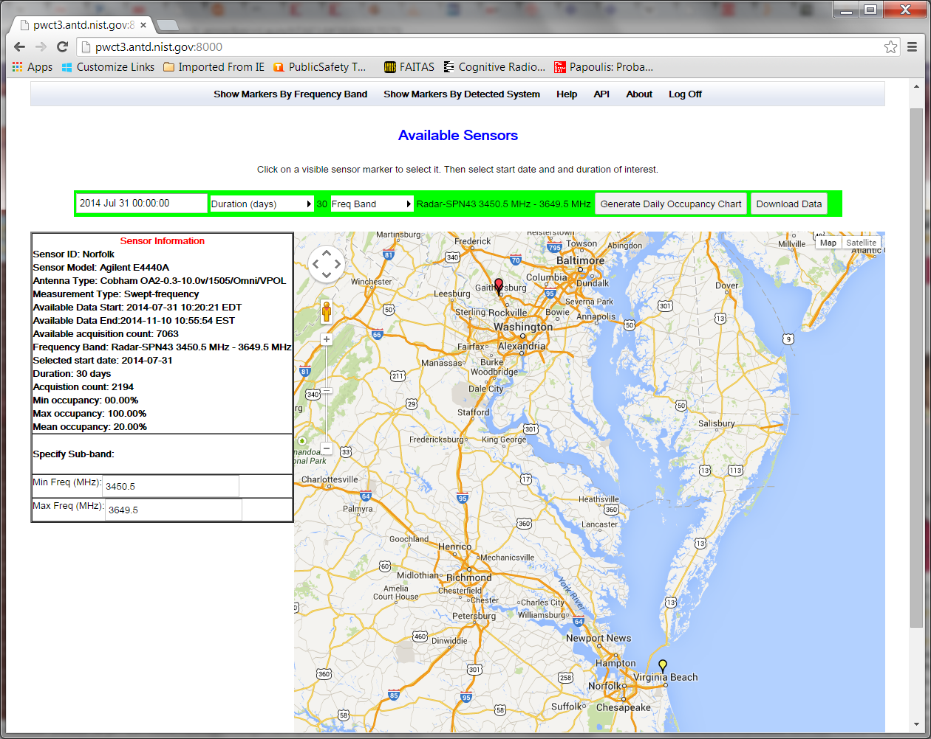

Slide 11
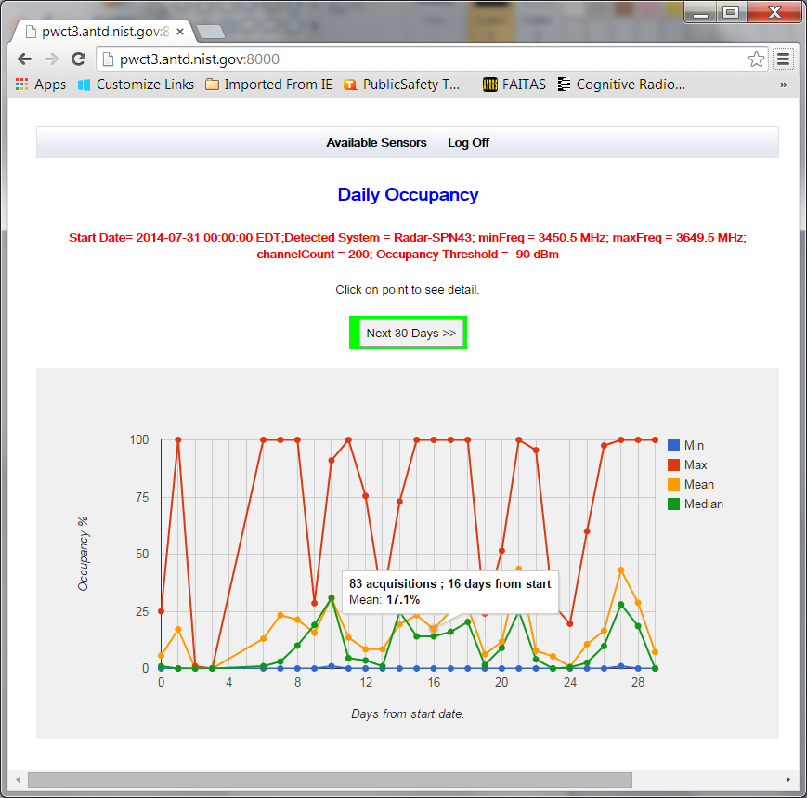

Slide 12
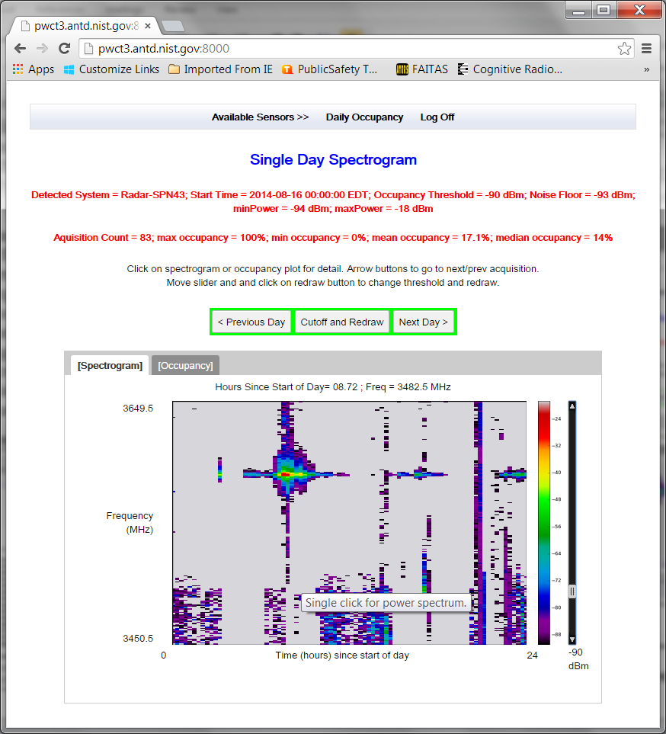

Slide 13
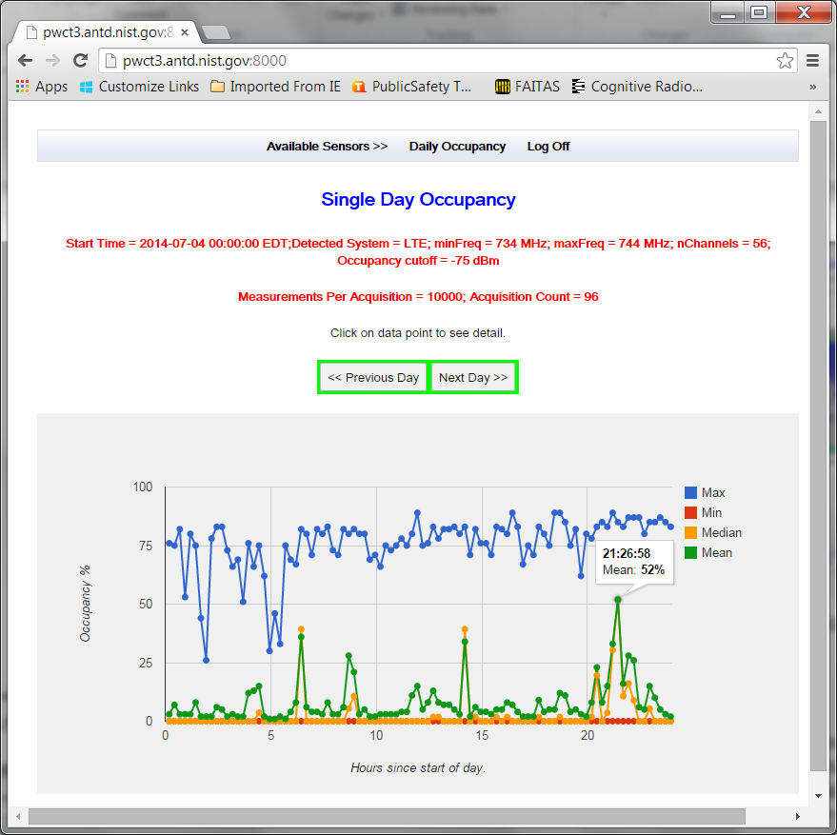

Slide 14
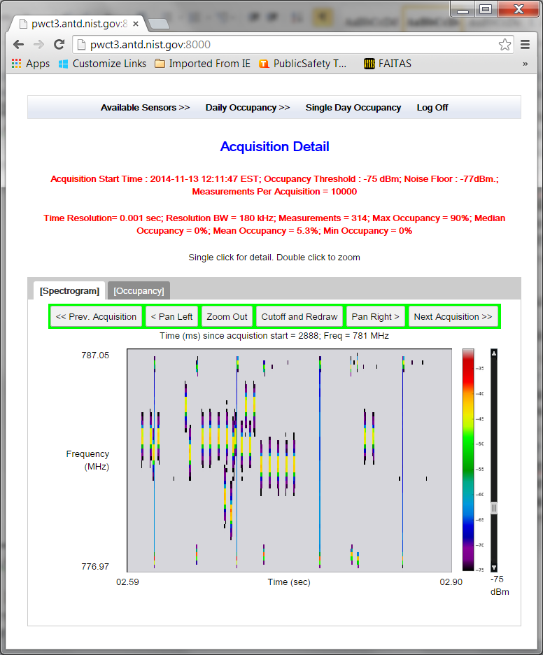

Slide 15
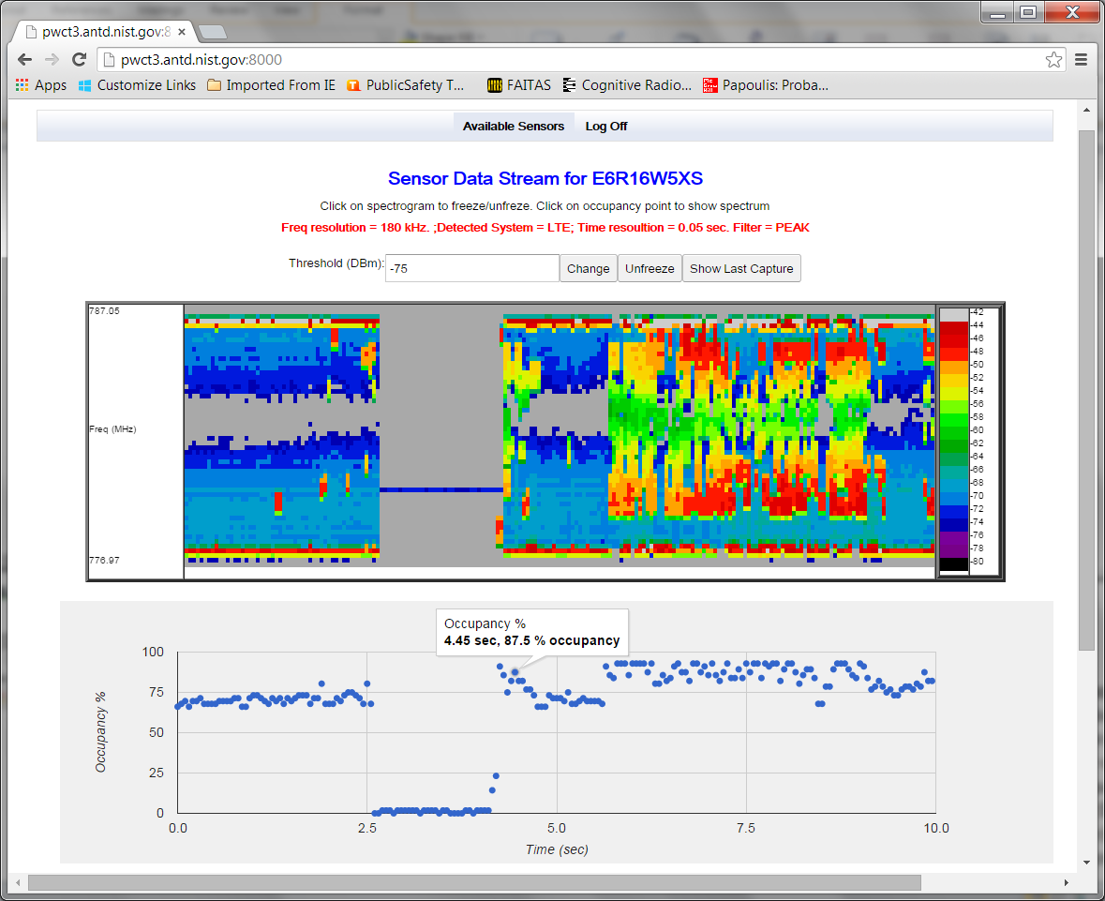

Slide 16

Ongoing Work
Deploy five more 3.5 GHz sensors along U.S. coastlines
Develop field-ready comm sensor prototype
Deploy Internet- accessible database
Spectrum coordination API
Sensor cost-capability matrix
Uncertainty analysis
Additional applications: 2.9 GHz − 3.1 GHz radionavigation band, 1695 MHz − 1710 MHz meteorological satellite band, spectrum sharing “model city”

Slide 17
Summary: What Makes This “Spectrum Observatory” Different?
Band-specific detection schemes employed
Preselection and calibration of sensors
Low latency logging and live streaming
Evolution of power spectra / occupancy over time
Multi-organization distributed database (source code to be made available)
Uncertainty of spectrum measurements to be quantified

