Slide 1


Slide 2
Content:
01
02
03
04
Our team
Our goal
Stages of Realization
Used Technologies

Slide 3

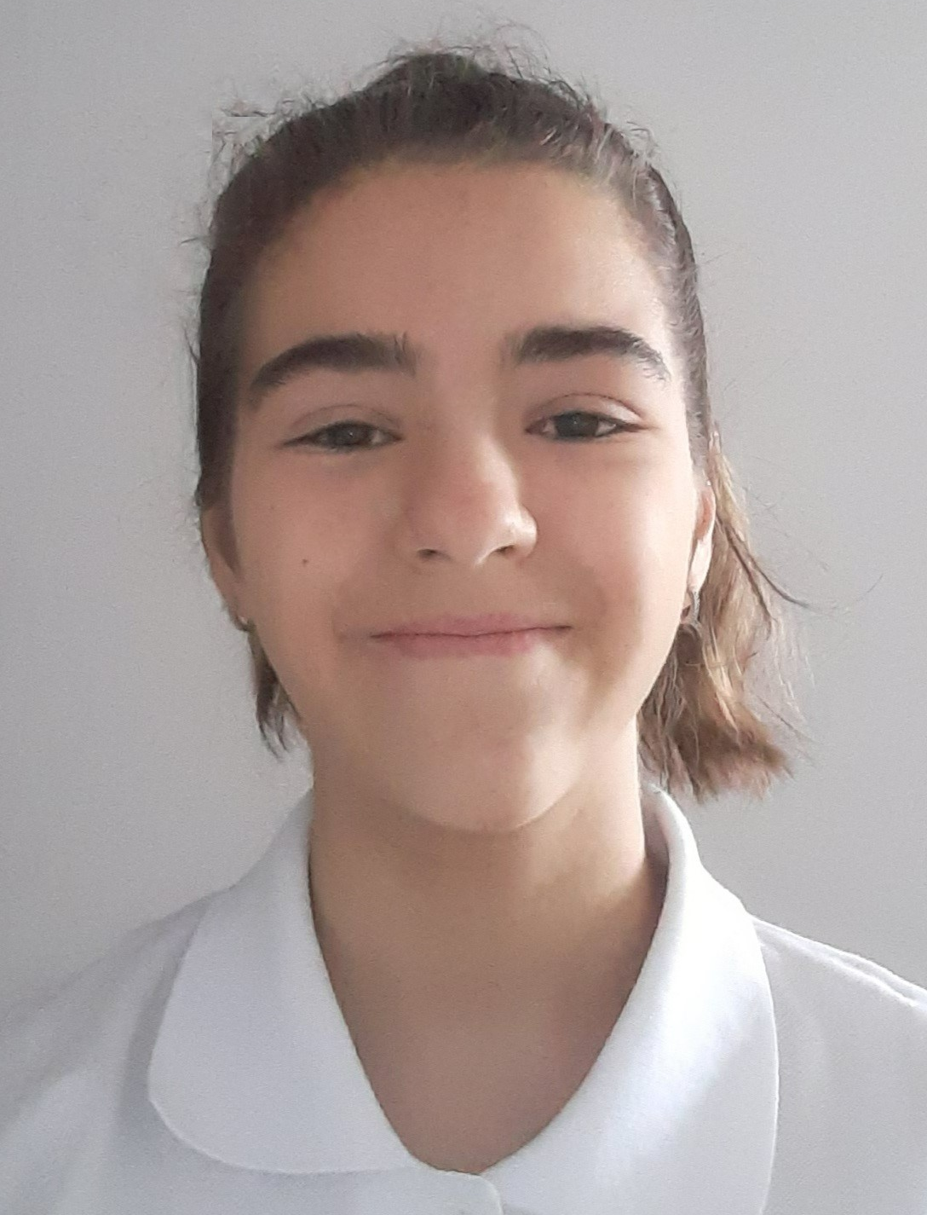
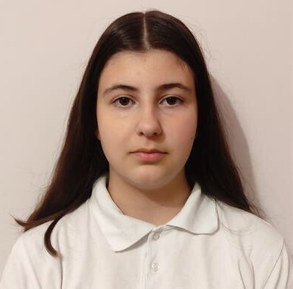
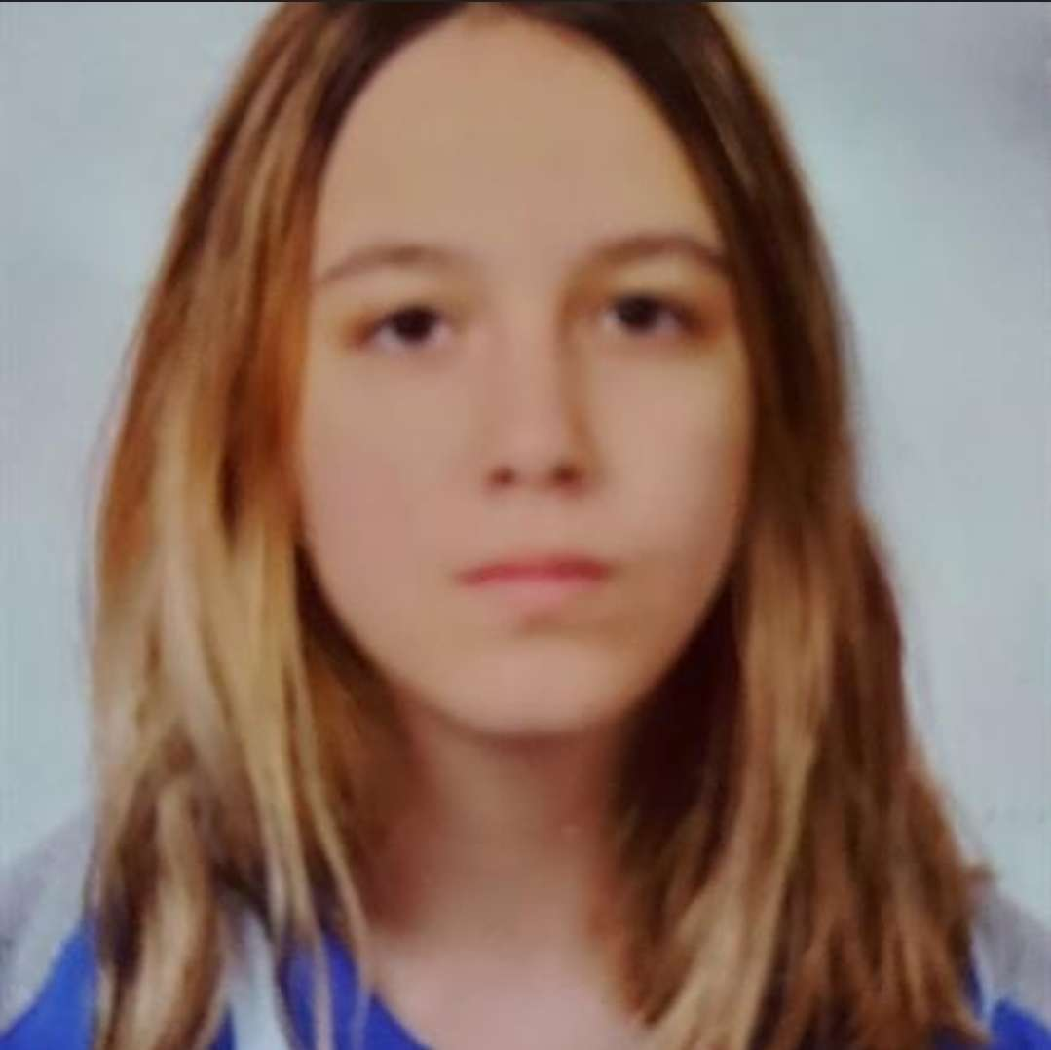
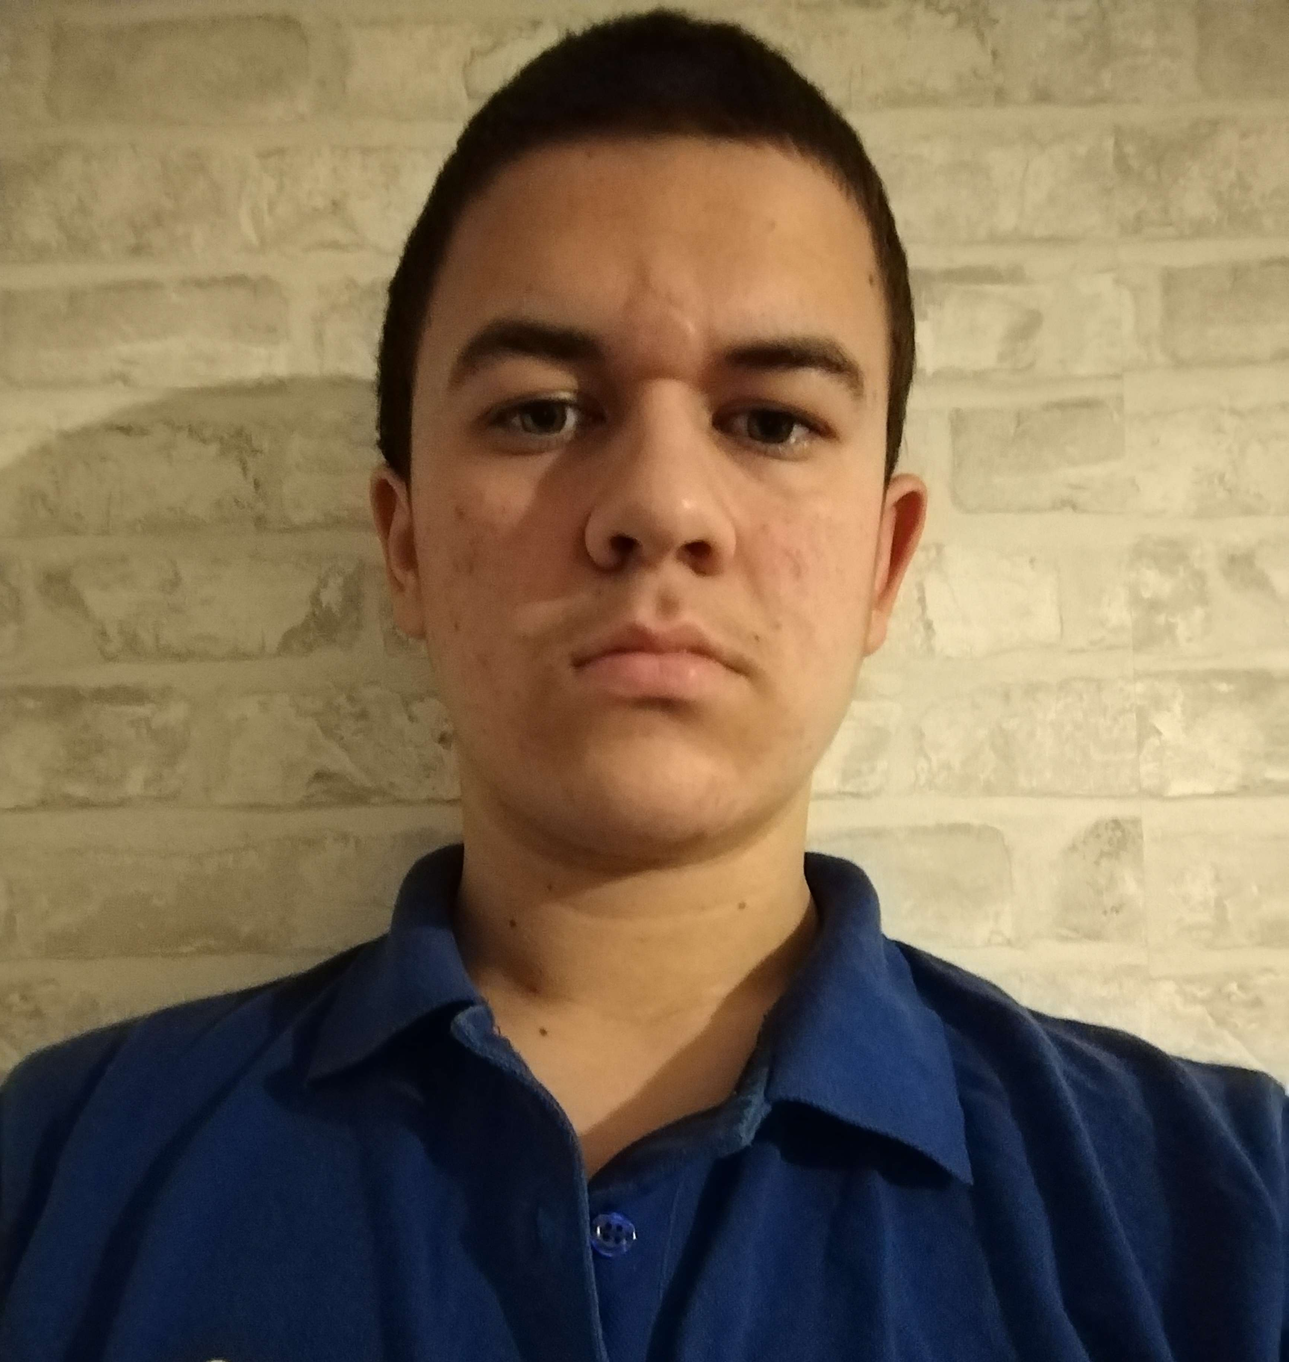

The team
Antonia
Taneva
Valeria
Chavdarova
Atanas Atanasov
Nadezhda
Ivanova
Scrum Trainer
Back-end
developer
Front-end
developer
QA engineer

Slide 4


Our goal
Our goal is to make the player use logic and mathematics while they are enjoying their game.

Slide 5

Stages of Realization
Organization
Development
Presentation
Decide on the idea

Slide 6







Used Technologies

Slide 7
Let’s Continue With a Demonstration

Slide 8
Thank you for the attention!

