Slide 1


Slide 2
Content:
01
02
03
04
Our team
Our goal
Stages of Realization
Used Technologies

Slide 3

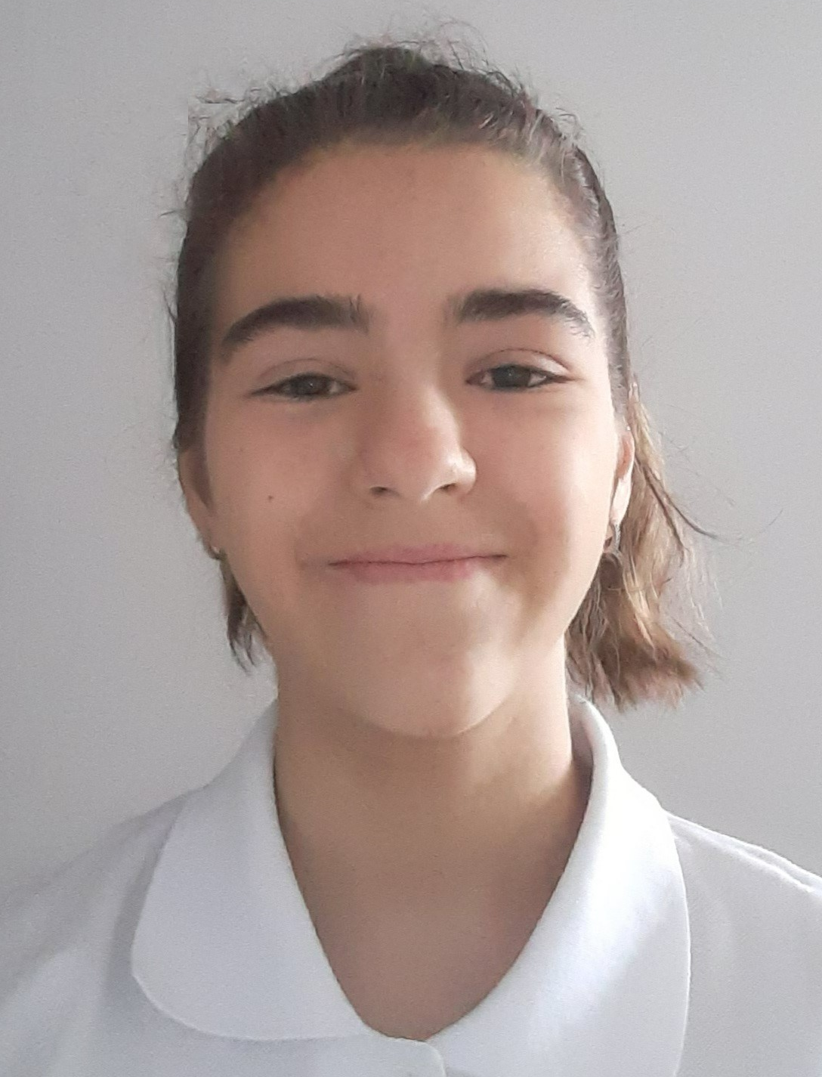
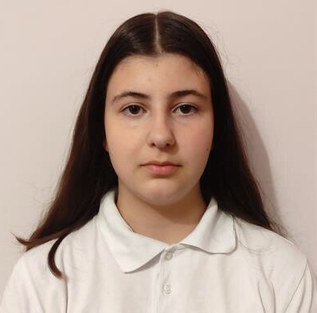
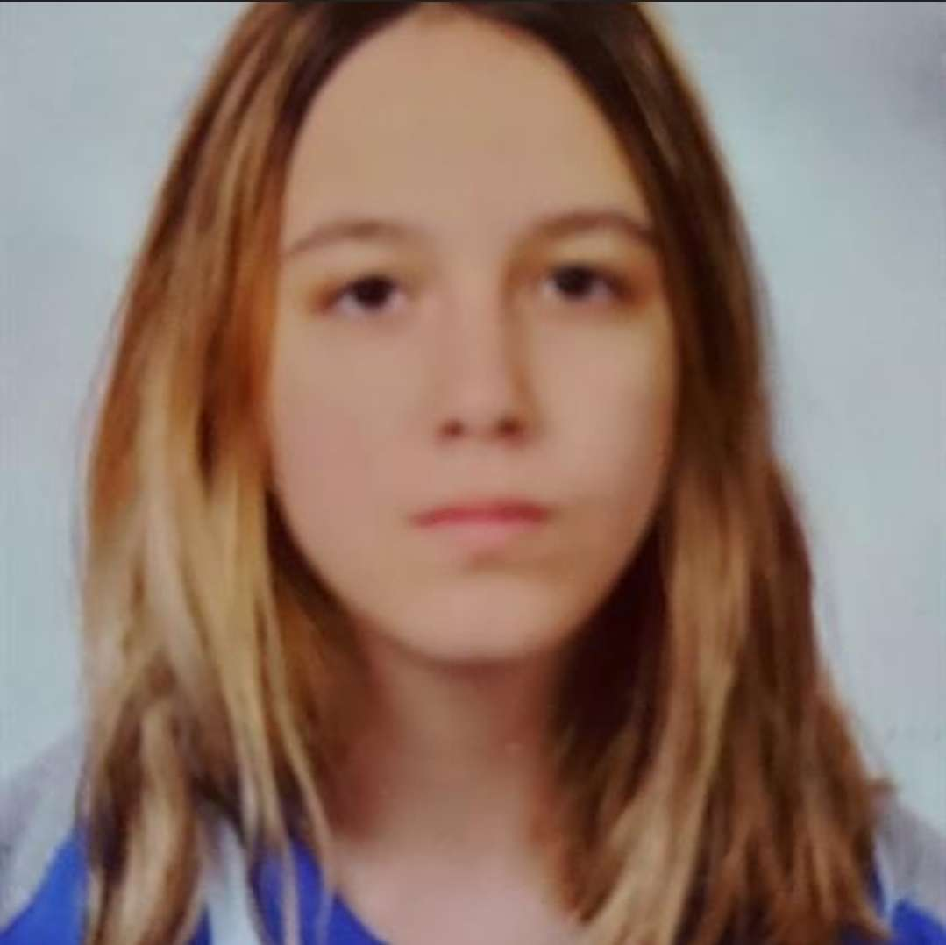
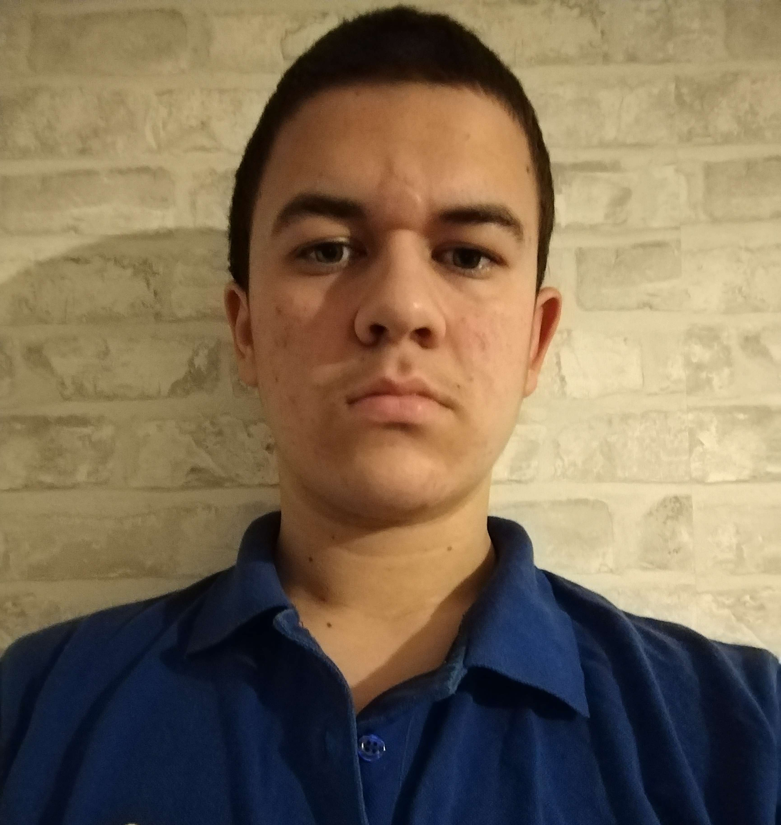

The team
Надежда Иванова
Scrum Trainer
Валерия Чавдарова
Антония Танева
Атанас Атанасов
QA engineer
Back-end
developer
Front-end
developer

Slide 4


Our goal
Our goal is to make the player use logic and mathematics while he/she is enjoying his/her game.

Slide 5

Stages of Realization
Organization
Development
Presentation
Decide on the idea

Slide 6







Used Technologies

Slide 7
Let’s Continue With a Demonstration
Please keep this slide for attribution

