Slide 1


Project presentation

Slide 2
TABLE OF CONTENTS
01
02
04
03
Our team
Our goal
Stages of realization
Used technologies

Slide 3
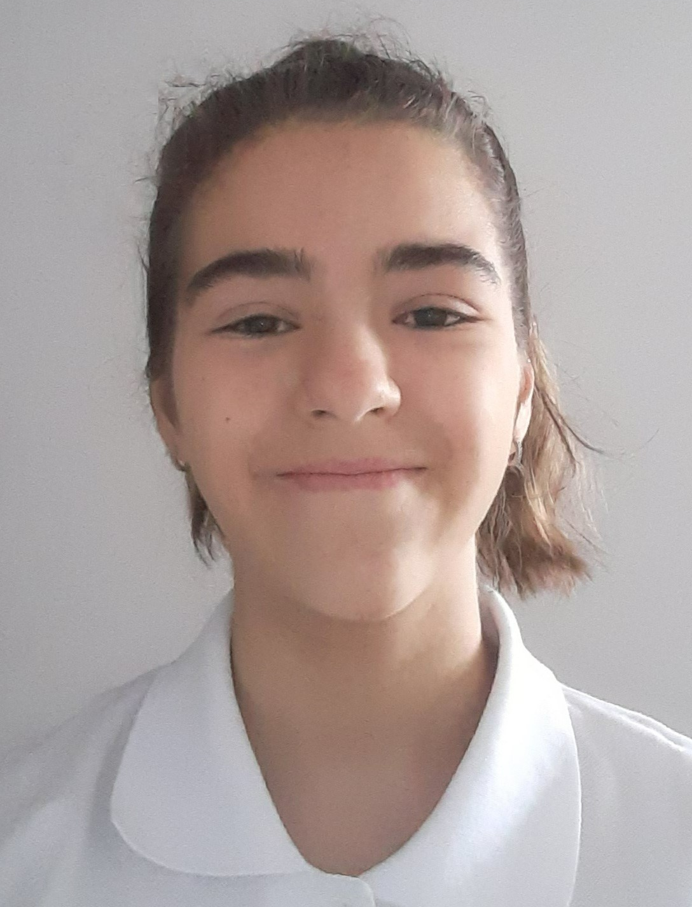
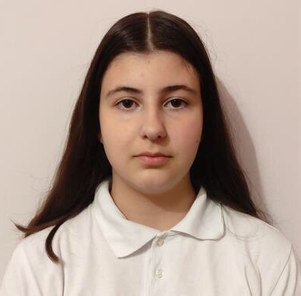
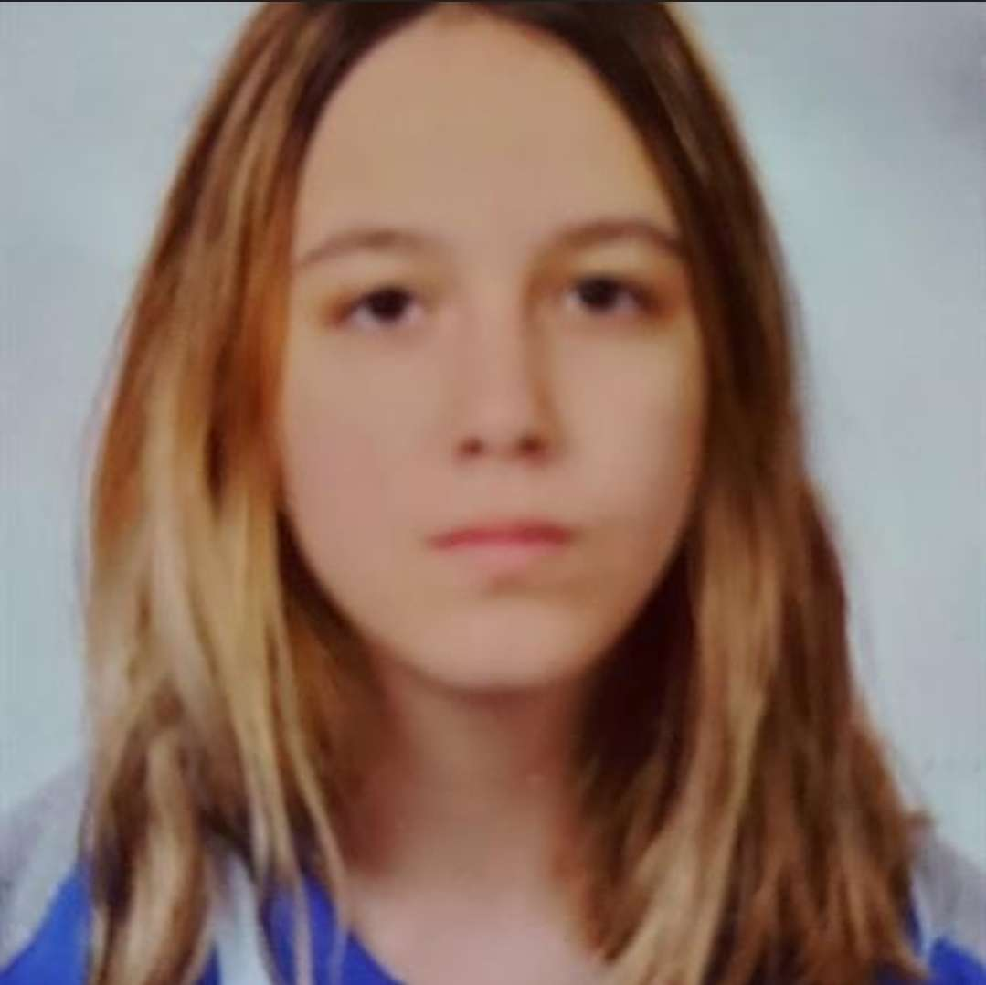
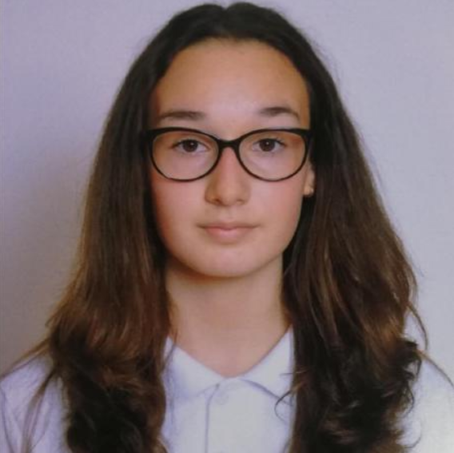
Our Team
Nadezhda Ivanova
Valeria Chavdarova
Antonia Taneva
Viktoria Kupenova
Scrum Trainer
Back-End developer
Back-End developer
Front-End developer

Slide 4
Our Goal
Our goal is to make the player
understand how important is to keep our planet clean while enjoying their game.

Slide 5

Stages of realisation
Organization
Decide on the idea
Development
Presentation

Slide 6









Used Technologies

Slide 7
LET’S CONTINUE WITH THE GAME!

Slide 8

Thank you for your attention!
Please keep this slide for attribution

