Slide 1

Lab 5

Slide 2
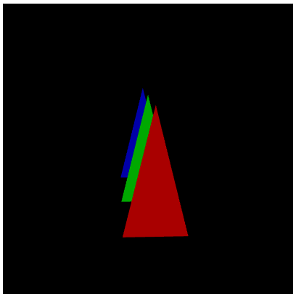
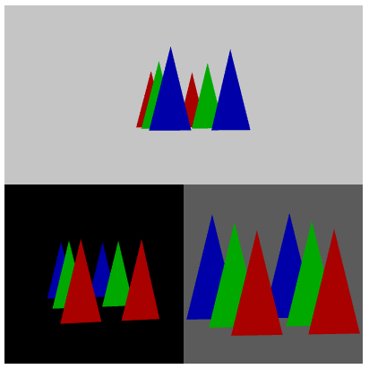
Download the lab5 template
You will subdivide the canvas into 3 regions (each ono has different background color)
One renders the scene from the front side with perspective camera model
Another one renders the scene from the front side with orthographic camera model
The last one renders the scene from the back side with perspective camera model
Make sure all results without distortion
User can drag to rotate the scene and the three sub views are linked
Or you can check this video
https://www.youtube.com/watch?v=xylPM9S5j2I&ab_channel=Ko-ChihWang
Look into the scene from back side
(perspective camera model)
Orthographic
camera model
(front side view)
Perspective camera model
(front side view)

Slide 3
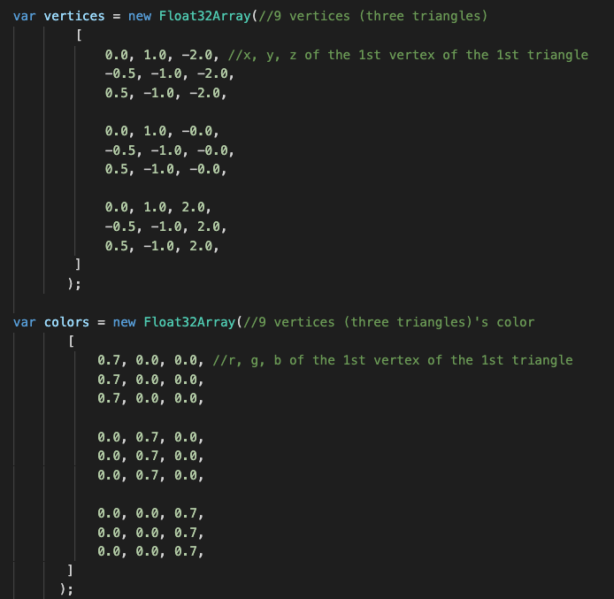
Triangles and Colors
Here are three triangles (a set)

Slide 4
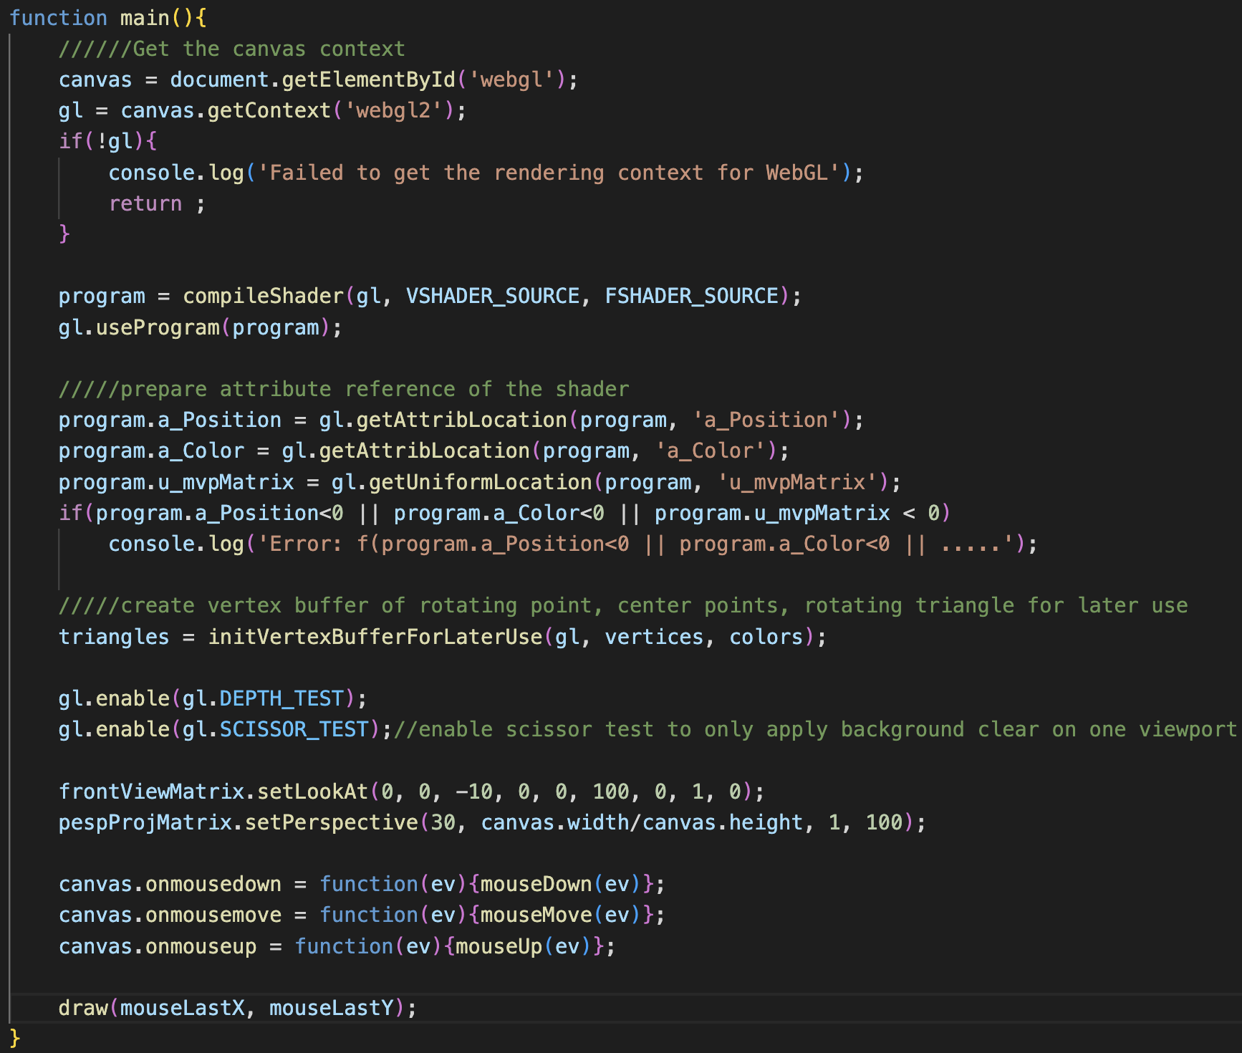
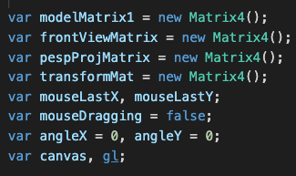
Viewpoint Change (Rotation)
The idea here is to rotate the whole scene instead of moving the camera
After we know how much we should rotate the scene from mouse information, we multiply this information into ”modelMatrix”

Slide 5
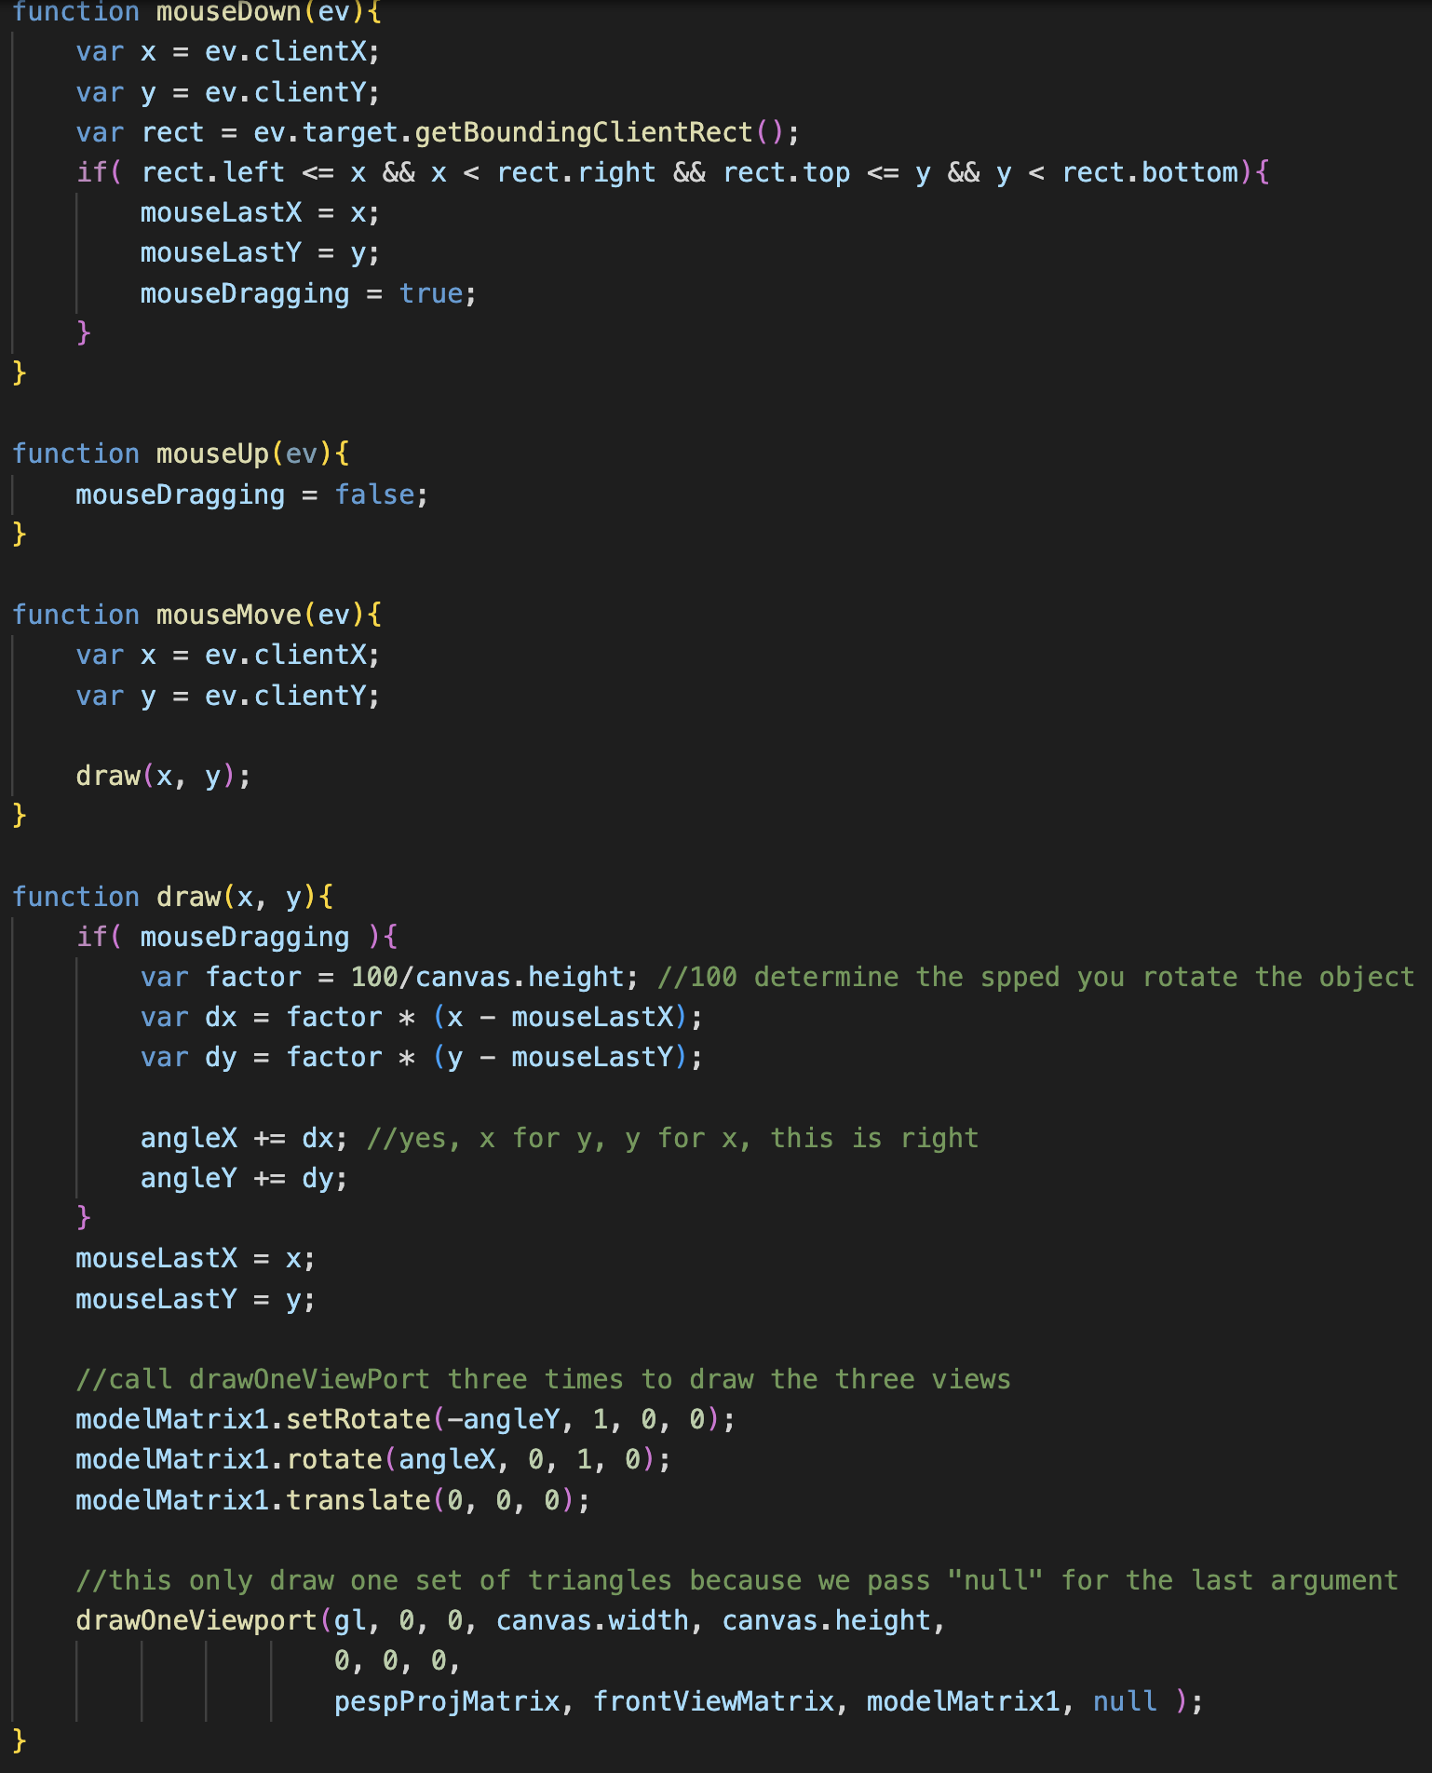
Viewpoint Change (Rotation)
Enable mouse dragging
and calculate where user presses the mouse
What does “rotate the scene” mean?
Disable mouse dragging
When user starts to drag, get where the mouse cursor is now
If you have multiple objects in the scene and the red dot is where your camera looks at,
all objects should rotate around the red dot.
calculate how much we should rotate the scene
along the X-axis and Y-axis
Set the rotation matrix to rotate scene
draw

Slide 6
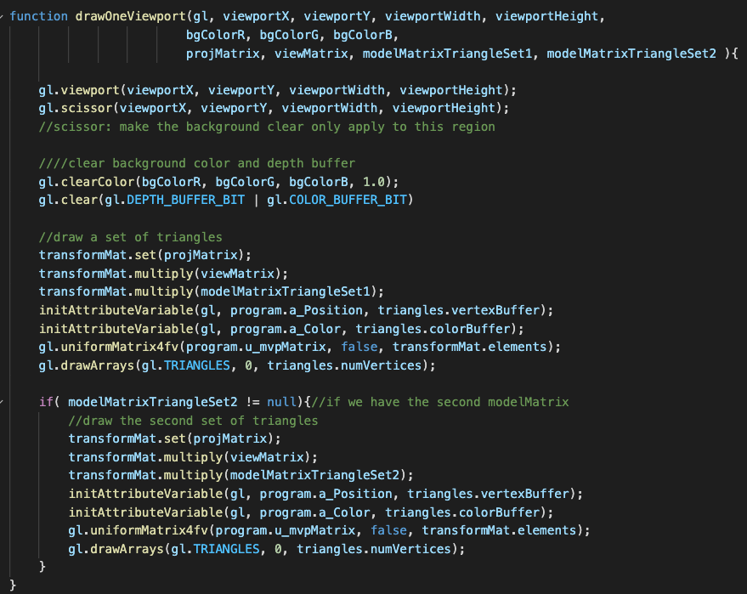
Viewport info.
drawOneViewport() draws “one” viewport for you
Projection matrix of the camera of this viewport
Background color of the viewport
view matrix of the camera of this viewport
modelMatrix (include scene rotation info.) for the first set of triangles
modelMatrix (include scene rotation info.) for the second set of triangles
Where to draw the first set of triangles
Where to draw the second set of triangles

Slide 7
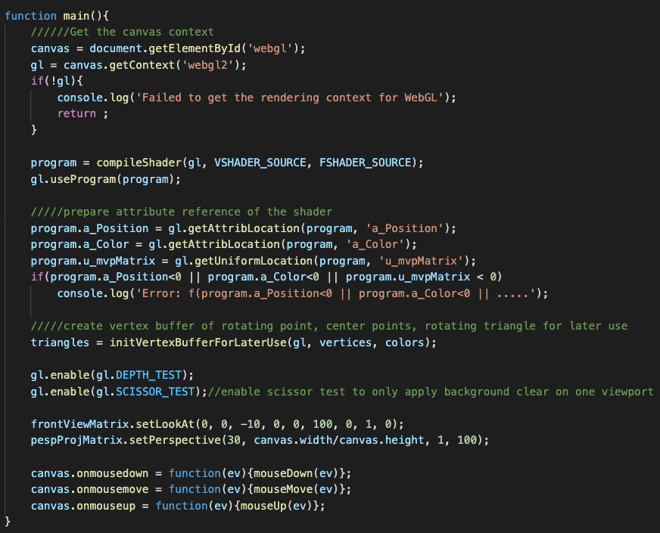
Scissor Test
Without enabling scissor test and set scissor region, gl.clear() will clear whole canvas

Slide 8
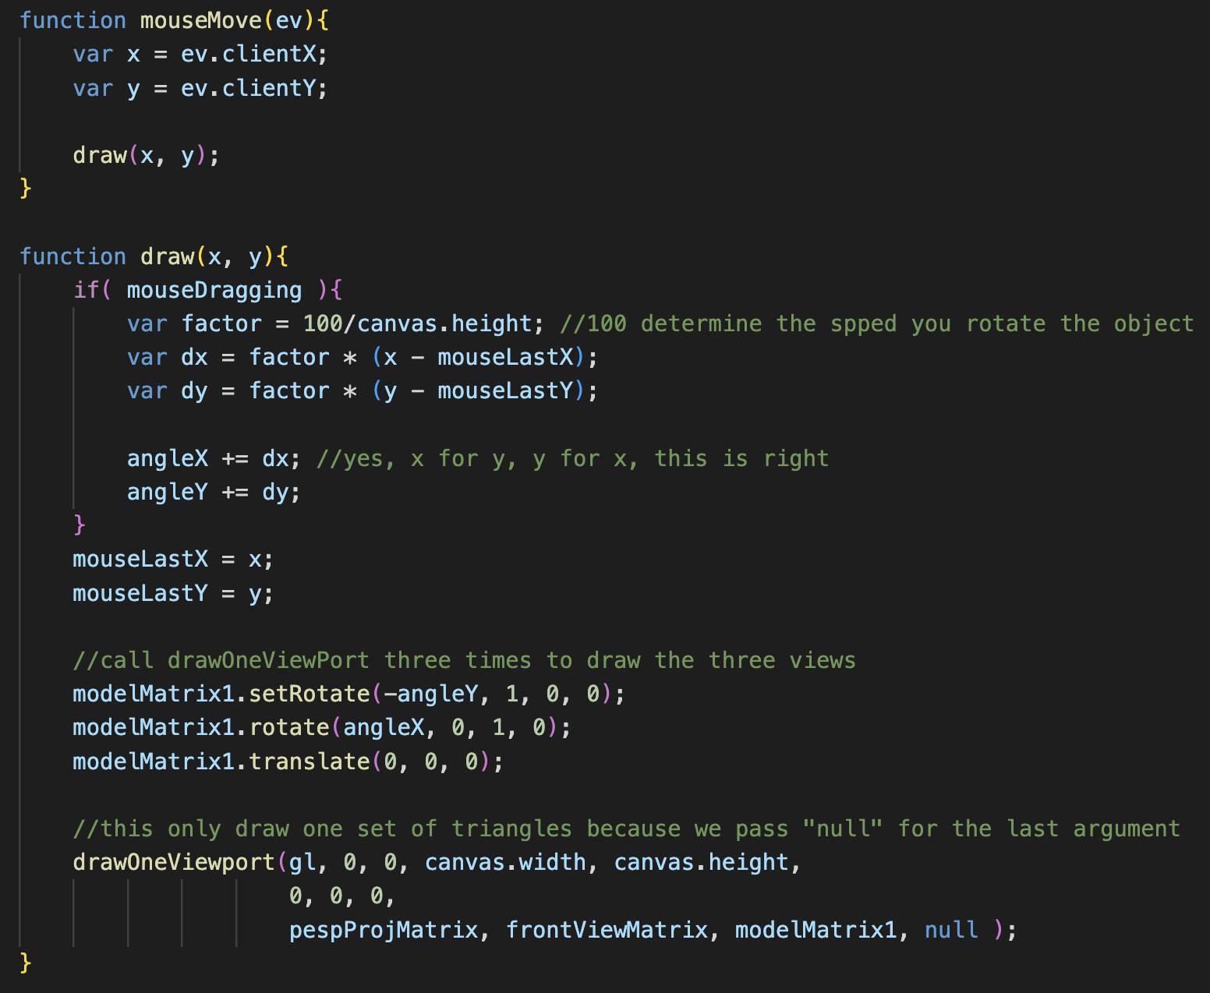
Hints
What you should do is just call drawOneViewport() 3 times (because you are going to draw three viewport)
And, give each call proper ”viewport”, “background”, “projectionMatrix”, “viewMatrix” and “modelMatrix” information

Slide 9
What You Should Do for “Submission”

Slide 10
Submission Instruction
Create a folder
Put the html and js files in the folder
Zip the folder
Rename the zip file to your student ID
For example, if your student ID is “40312345s”, rename the zip file to “40312345s.zip”
Submit the renamed zip file to Moodle
Make sure
you put all files in the folder to zip
You submit the zip file with correct name
You won’t get any point if
the submitted file does not follow the naming rule,
TA cannot run your code,
or cannot unzip your zip file.

