Slide 1

Lab 6

Slide 2
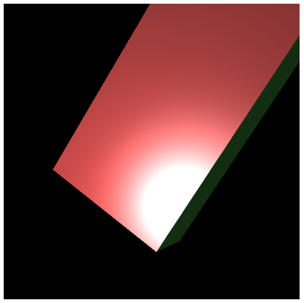
Download the lab6 template
You will implement phong shading (per-fragment illumination)
A much better illumination than Ex06-3 and Ex06-4
You can use mouse to rotate the objects and check the result
Please this video, this is the result you should have
https://www.youtube.com/watch?v=gRnnbXuSjfk&ab_channel=Ko-ChihWang

Slide 3
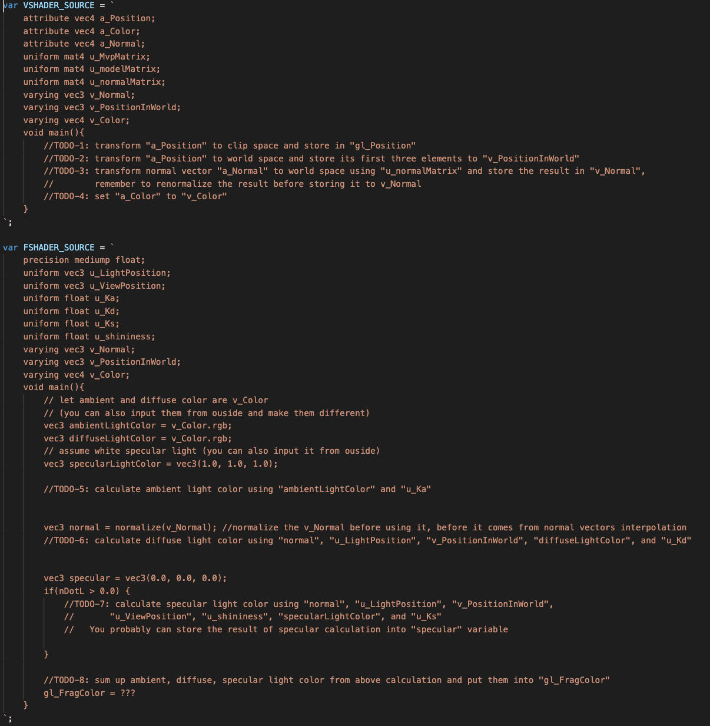
Please check “TODO” in the WebGL.js
You only need to add code in main functions of vertex and fragment shaders (do NOT change any code outside of main functions of the shaders)
Follow the TODOs and its explanation one by one to finish this practice
Hint:
the code you will write here is very similar to the shader code in ”Ex06-4”. The major difference is that most of the code in vertex shader in Ex06-4 is moved to fragment shader here.

Slide 4
What You Should Do for “Submission”

Slide 5
Submission Instruction
Create a folder
Put the html and js files in the folder
Zip the folder
Rename the zip file to your student ID
For example, if your student ID is “40312345s”, rename the zip file to “40312345s.zip”
Submit the renamed zip file to Moodle
Make sure
you put all files in the folder to zip
You submit the zip file with correct name
You won’t get any point if
the submitted file does not follow the naming rule,
TA cannot run your code,
or cannot unzip your zip file.

