Slide 1

Lab 3

Slide 2
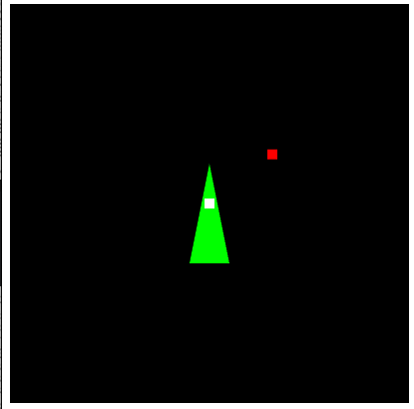
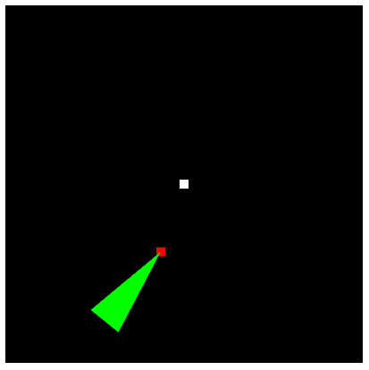
Download this lab and run it, you will see the left figure.
By adding some transformations on the triangle, make the triangle move with the red dot and also fix the tip point (triangle) to rotate around the red dot.
Check the video here: https://www.youtube.com/watch?v=SSud8JLqvU8&list=PLsId7efYPyAah0Z64j9DpedSVAcvzOSKb&index=2&t=0s&ab_channel=Ko-ChihWangKo-ChihWang
Check the video here
Transformations on the triangle

Slide 3
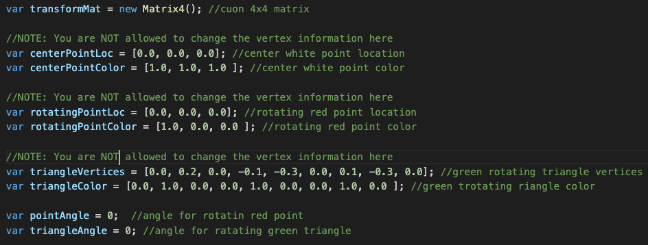
In WebGL.js, I set vertices information here (check the comment), do NOT change any information here

Slide 4
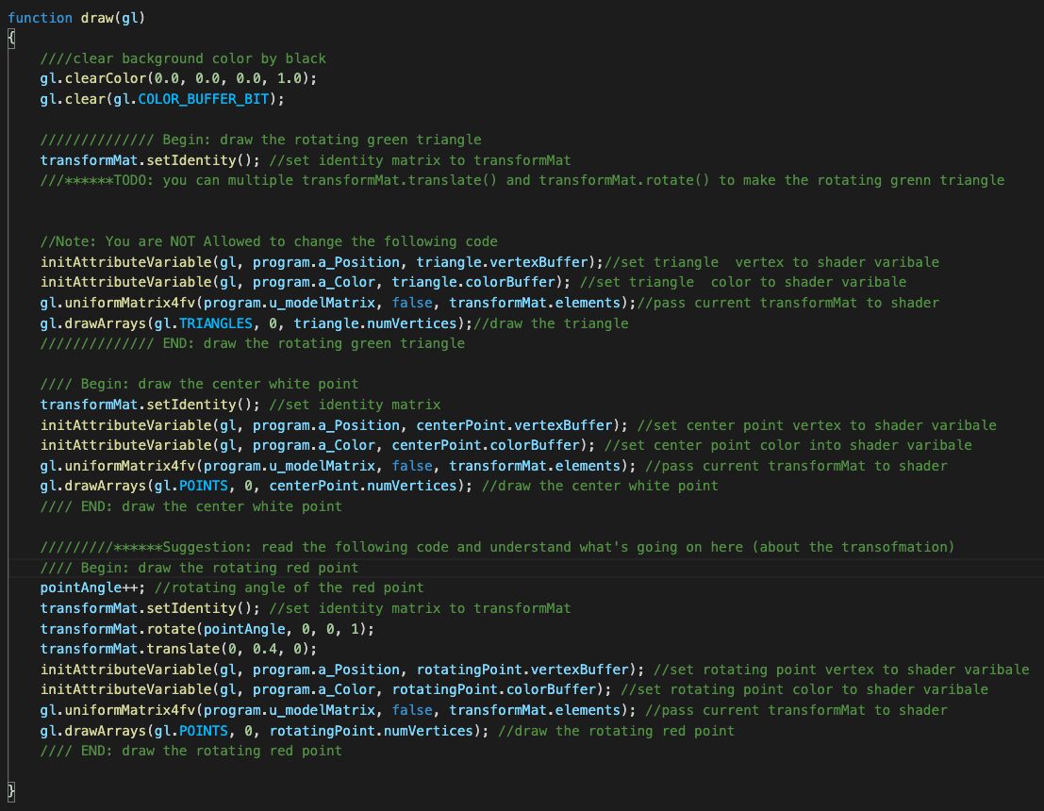
The only thing you can do is to add some transformations here
Firstly, try to understand how I make the red point rotate.

Slide 5
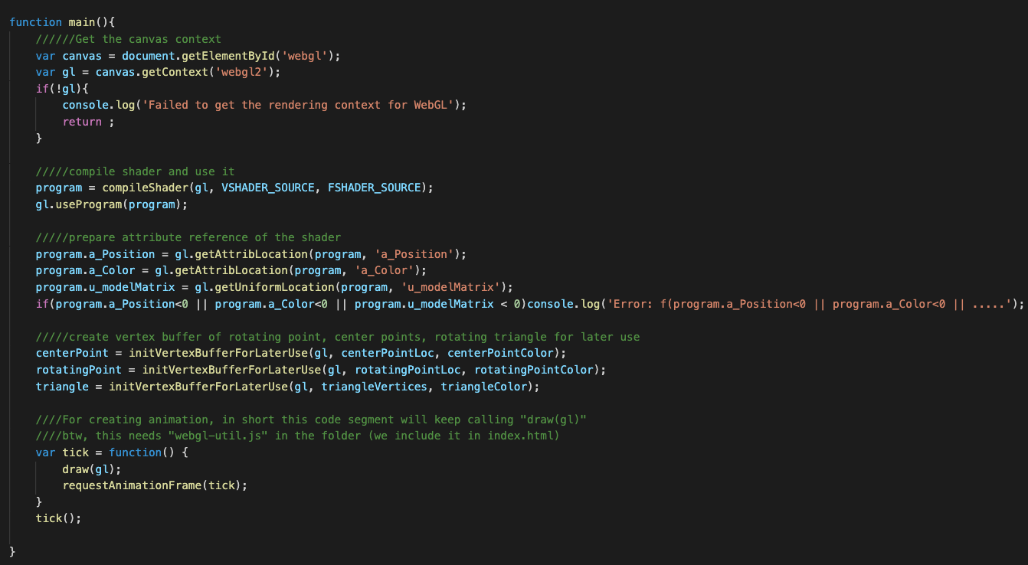
You may be confused about how I create and use the vertex buffer object. I will explain that next week. Just assume everything is alright. Just take care of the transformations in draw().
This is how we make the animation. In short, the function, draw(), is called repeatedly

Slide 6
What You Should Do for “Submission”

Slide 7
Submission Instruction
Create a folder
Put the html and js files in the folder
Zip the folder
Rename the zip file to your student ID
For example, if your student ID is “40312345s”, rename the zip file to “40312345s.zip”
Submit the renamed zip file to Moodle
Make sure
you put all files in the folder to zip
You submit the zip file with correct name
You won’t get any point if
the submitted file does not follow the naming rule,
TA cannot run your code,
or cannot unzip your zip file.

