Slide 1

Lab 4

Slide 2
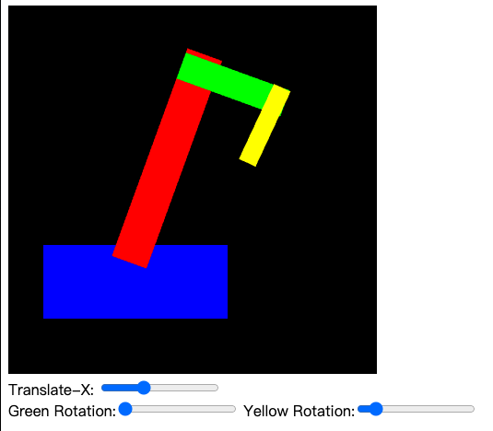
Download the lab4 template, you can see this figure
Goal
If you move the ”translate-x” slider, the robot will move left or right
If you move the ”green rotation” slider, the green arm will rotate
If you move the “yellow rotation” slider, the yellow arm will rotate
Or you can check this video
https://www.youtube.com/watch?v=mJn6BklPGmM&feature=youtu.be&ab_channel=Ko-ChihWang

Slide 3
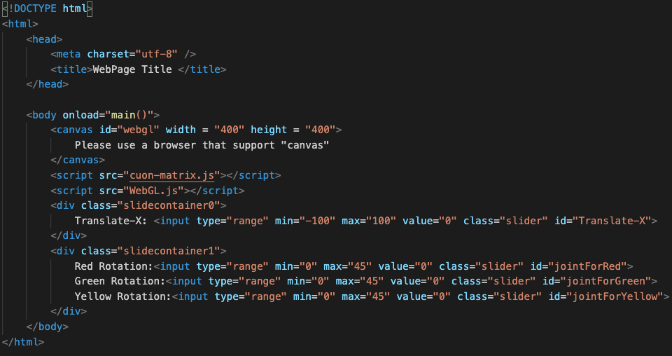
Index.html
sliders
Min, max and initial value

Slide 4
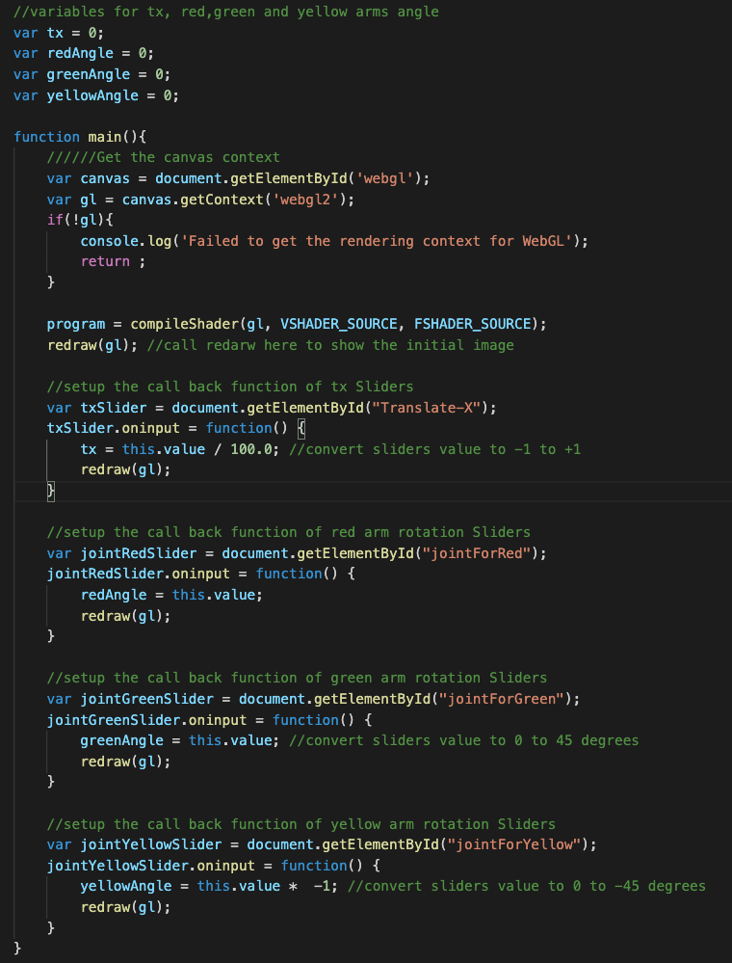
WebGL.js – main()
Store the input from sliders
Function to draw a frame
Register the call back function of sliders

Slide 5
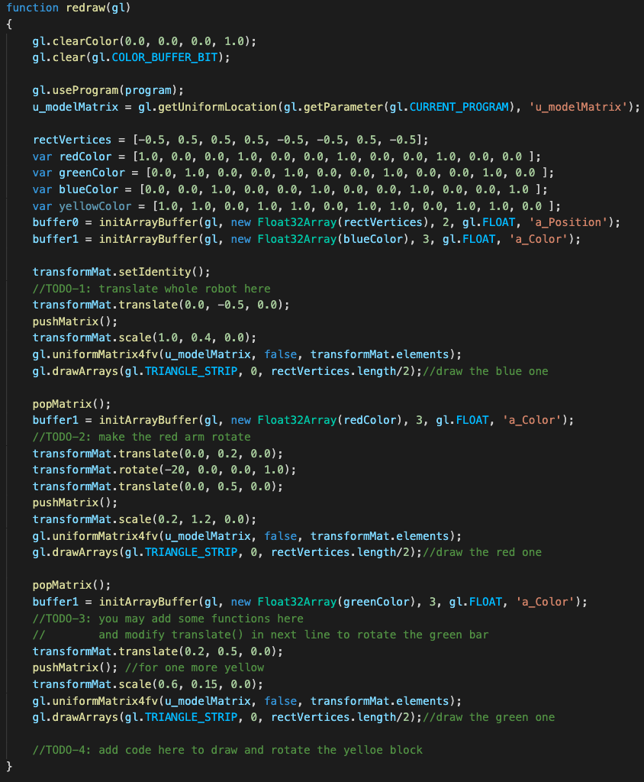
WebGL.js – redraw()
Check these TODO

Slide 6
What You Should Do for “Submission”

Slide 7
Submission Instruction
Create a folder
Put the html and js files in the folder
Zip the folder
Rename the zip file to your student ID
For example, if your student ID is “40312345s”, rename the zip file to “40312345s.zip”
Submit the renamed zip file to Moodle
Make sure
you put all files in the folder to zip
You submit the zip file with correct name
You won’t get any point if
the submitted file does not follow the naming rule,
TA cannot run your code,
or cannot unzip your zip file.

