Slide 1
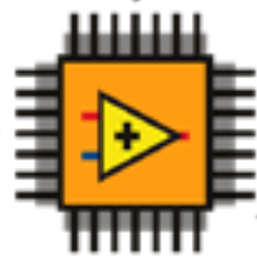
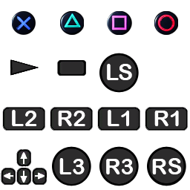
a_x
a_y
a_z
p
q
r
= Custom Device
IMU
= FPGA
ctrl_custom
X
Y
Psi
ctrl_TAPM
Oqus
u_1
u_2
u_3
u_4
u_5
u_6
alpha_1
alpha_2
alpha_3
alpha_4
alpha_5
alpha_6
PosXLeft
PosYLeft
PosXRight
PosYRight
ArrowUp
ArrowDown
Start
ctrl_sixaxis2thruster
u2pwm
PWM
WL_Joystick
STOP
Triangle
Square
Cross
Circle
Triangle
Square
Cross
Circle

