Slide 1
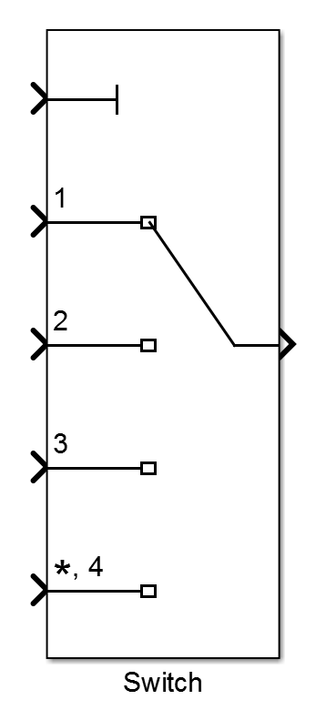
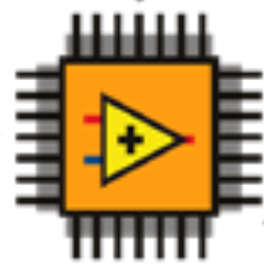
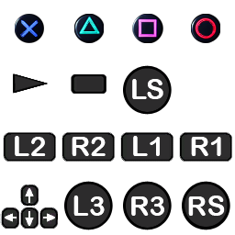
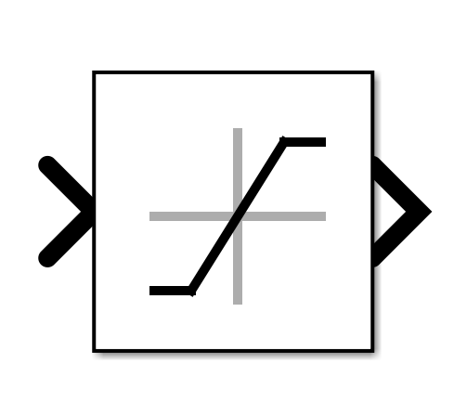
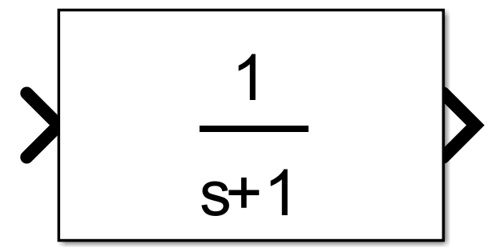

Switch
WL_Joystick
u
PWM
ctrl_custom
Saturation
Mech-el
ctrl_DP
Wrapping
STOP
PWM
α
ctrl_sixaxis2thruster

