Slide 1

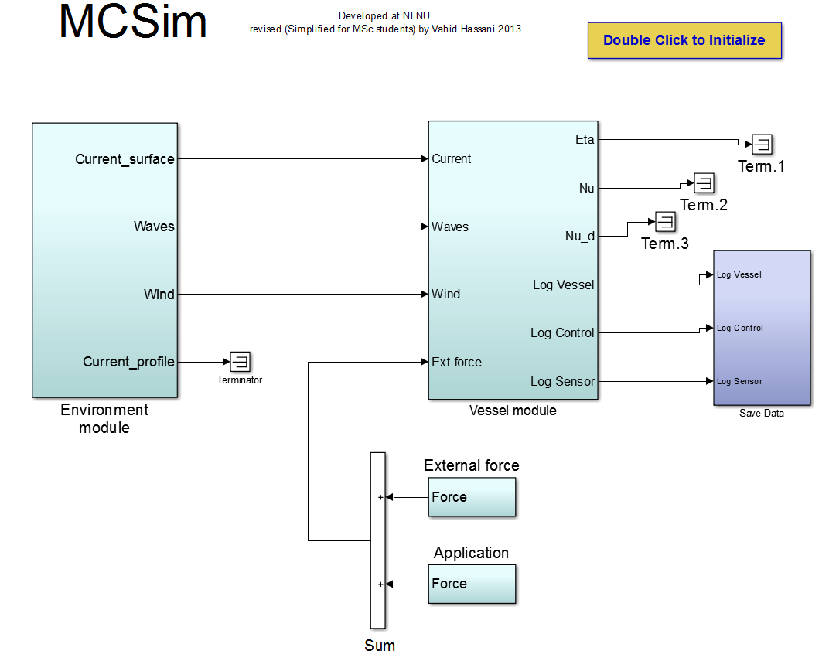

Version Management for MCSim
Marine Control Simulator Toolbox at AMOS

Slide 2
Content
Introduction to MCSim
Basics on Version Management
Using git
Master and Branches
Committing and Pulling
Creating Tags
Installation Guide
Wiki-Page
Conclusion

Slide 3
Introducing MCSim
AMOS owns a toolbox to simulate ships and test control systems in a simulation envoirnment
The toolbox contains a sophisticated environment module
The vessel module contains eight different models of ships

Slide 4

Idea of Version Management
The toolbox is being used in different research project
Power System Configuration
Thruster Allocation Problem
Stationkeeping (DP, TAPM, PM)
Arctic Operations
Each user indidually generates new functions in MCSim
The addition to MCSim can be of huge value to other users aswell
We need to find a way to distribute new features among users
Microsoft, 2014

Slide 5

Introducing git
git has been developed by Linus Torvald for the distributed development of the Linux kernel
It works as a distributed system, meaning every user has all data of the project available
It is open source and free to use
Each user maintains a local copy of the repository
All user repositories are mirrored on a server (backup)
GitHub, 2014

Slide 6
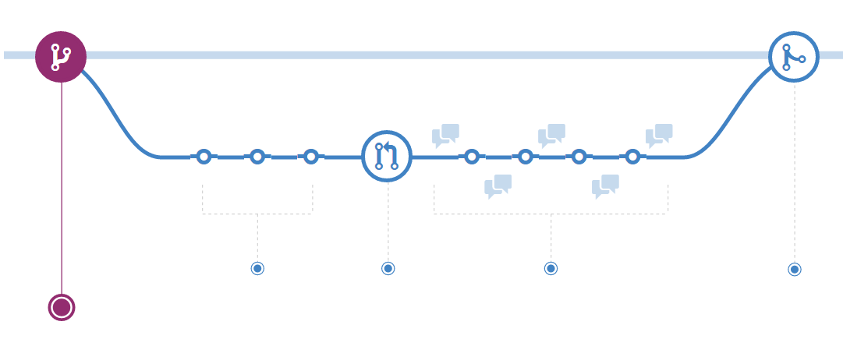
The Master and Branches
The Master contains the current version of the toolbox
For each project a branch from the master can be created allowing to make changes without the other users being effected
After the project is complete, the branch can be merged with the Master, making the changes available to all users
GitHub, 2014

Slide 7
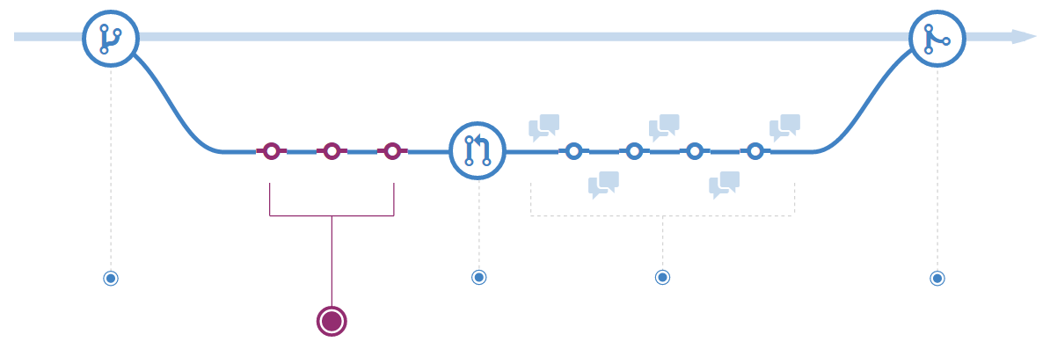
Committing and Pulling
A commit sends all changes you made on the project to your branch
It is always possible to reverse any commit you ever did, adding a nice backup and recovery functionality to your project
GitHub, 2014

Slide 8
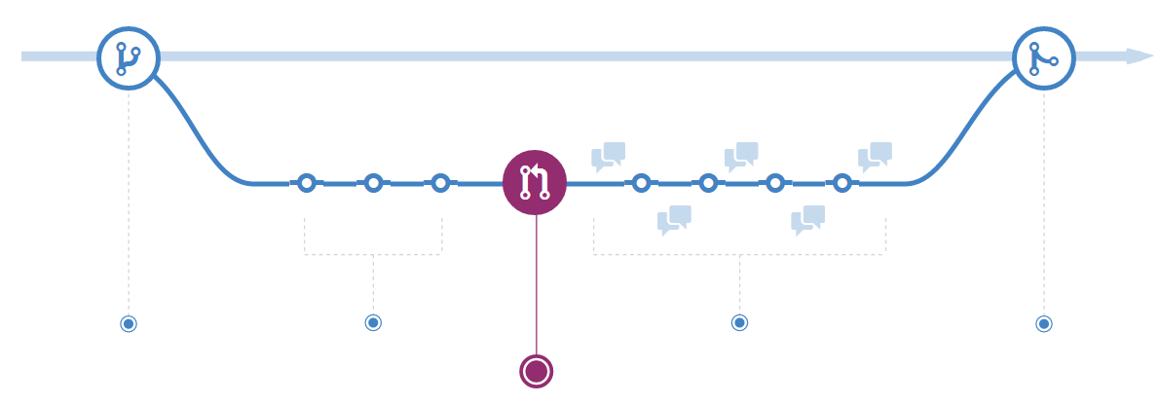
Committing and Pulling
If a functionality works, it can be merged with the Master by requesting a pull
GitHub, 2014

Slide 9
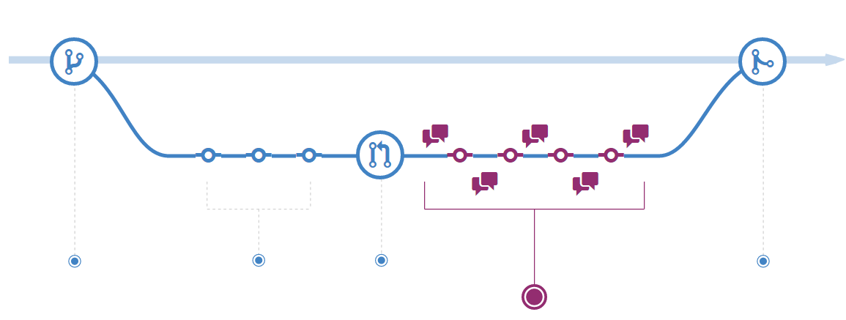
Committing and Pulling
After a pull-request has been submitted, the users or a suitable board can decide how it can be merged into the Master
The changes can be reviewed and questions or comments can be made
After everyone clears the changes your branch is merged with the Master
GitHub, 2014

Slide 10
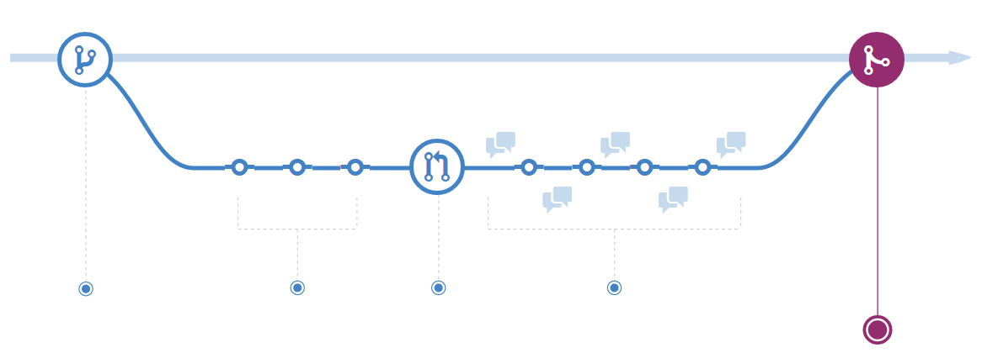
Creating Tags
If major changes to the Master are made, a tag of the software will be created
A tag is a stable version of the Master, that can serve as starting point for every new user
Allows a version control (Version 1.0, Version 2.0 , etc.) and an easy publication of the software
GitHub, 2014

Slide 11
Nice, how do I get it?
Three steps
Created a free account on github.com and send me your username
Install the GitHub Software (Windows, Mac or Linux)
Click on «+», select «Clone», pick «MCSim» and place it on a spot on your harddrive
GitHub, 2014

Slide 12
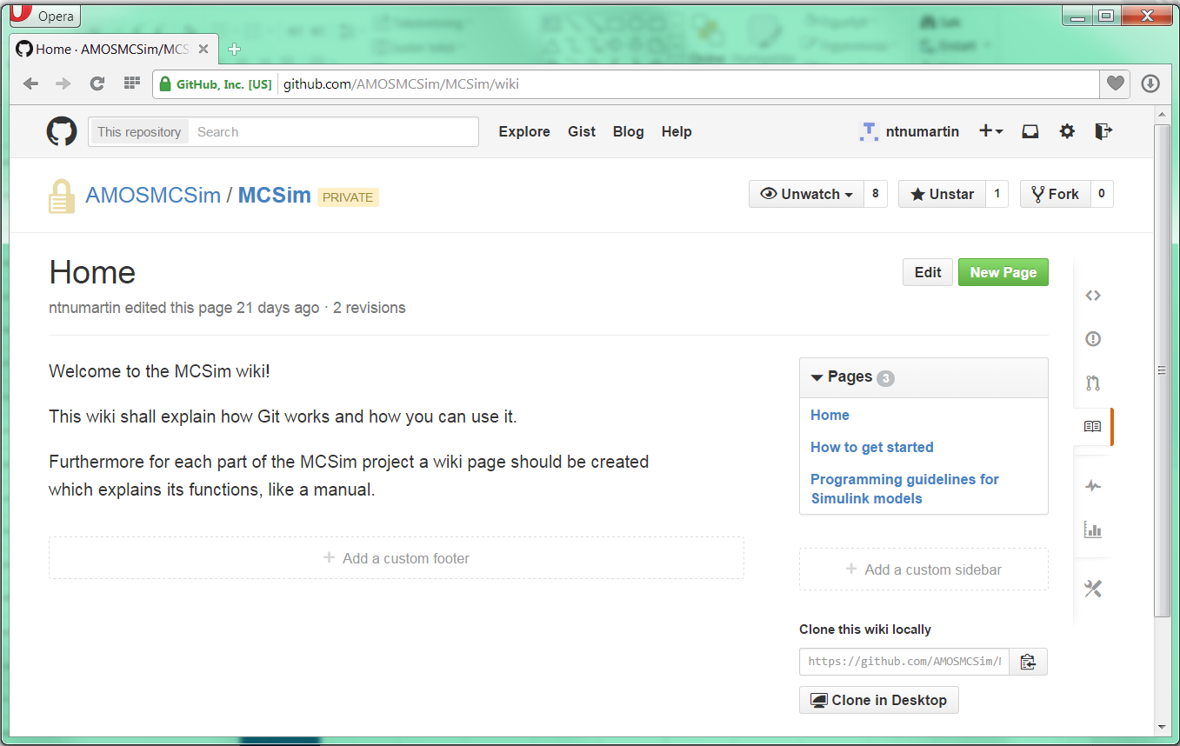
Wiki on GitHub for MCSim
A wiki can be accessed on the github project website
Feel free to use it for sharing your ideas on MCSim
Everyone can create pages in the wiki

Slide 13
Advantages and Disadvantages
Contra
You have to press the commit button
Keeping track of changes
Software can easily be published
Wiki-Page is included
Pro
Automatic Backup

Slide 14
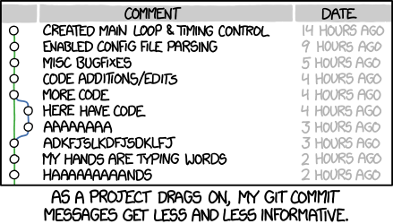
Questions?
xkcd, 2014

