Slide 1
Encapsulation

Slide 2
What we discuss
Object-Oriented Programming
Encapsulation
Principles and best practices supporting Encapsulation

Slide 3
Object-Oriented Programming
An engineering approach for building software systems
  based on the concepts of classes and objects that are used for modeling the real world entities
Object-oriented software systems
  Consist of a group of cooperating objects
  Objects exchange messages
    Sending messages
    Receiving messages
  Implemented in OO languages
    Smalltalk/C++/Java/C#/Scala, ..etc

Slide 4
What is an object?
An object represents an entity
  Physical entity
    A Car, a bird, ...
  Conceptual entity
    A baking account, a chemical reaction, ..
  Software entity
    A linked list, a database connection, ...

Slide 5
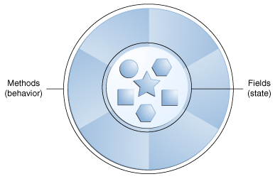
Formal definition
An entity with a well-defined boundary that encapsulates state and behavior
  State is represented by fields/attributes
  Behavior is represented by methods/operations

Slide 6
Fake Objects
Objects used only to hold data
  Fields and getters and setters
  Java Beans
  Data Transfer Object
  Anemic Domain Model http://www.martinfowler.com/bliki/AnemicDomainModel.html
No real and meaningful behavior

Slide 7
Object state
One of the possible conditions in which an object may exist
  An baking account may be active or inactive
  Best practices : these conditions should be as small as possible
The state of an object can changes over time
  State is changed by behavior

Slide 8
Object behavior
Behavior determines how an object acts and reacts
Behavior may or may not change state
  Calling a method to change a field
  Calling a method to read a field
Kinds of methods
  Query methods
  Command methods
  Query and command methods
=> Command Query Responsibility Segregation

Slide 9
What is a class?
A description of a set of objects that share the same attributes, operations
  A class defines the structure and behavior of each object in the class
  A class serves as template/blueprint (static) for creating object
  An object is an instance (dynamic) of a class
A class is not a collection of objects

Slide 10
Basic foundations of OOP
Abstraction
Encapsulation
Inheritance
Polymorphism

Slide 11
Abstraction
Presenting essential characteristics of an entity that distinguish it from all kinds of entities
  “When I see a bird that walks like a duck and swims like a duck and quacks like a duck, I call that bird a duck” - James Whitcomb Riley

Slide 12

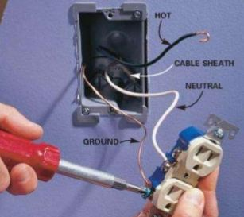
Encapsulation
Hide implementation from clients
  Hide internal state and behavior – information hiding
  Only expose several methods – called public interfaces

Slide 13
Property of software
One thing we always face in software development
  No matter what system we're building, what programing language we use, …
          CHANGE
Reasons for change
  Customers want new and different functionality
  Business rules change, ...

Slide 14
How OOP deals with change?
ENCAPSULATE IT!
Identify what varies and separate them from what stays the same (relatively, may not change)
Some Code

Slide 15
Single Responsibility Principle
A class should has only one reason for change
A class should do only one thing and do it well
Benefits
  Fine-grained (small) modules
  More chances for reusing code
  Easy to test, maintain

Slide 16
OOP vs Procedural Programming
Collaboration between objects
Functionality is grouped by object
Objects and their behavior can be reused
A series of functions
Functionality is grouped by task
Functions/tasks can be reused

Slide 17
Benefits of OOP
Objects are a natural way for representing real world
Encapsulated objects are more reusable and maintainable
Objects are more extensible

Slide 18
Bad OOP practices
Mix procedural programming with OOP
Program in an OO language in the PP style
Some code

Slide 19
Tell, Don't ask
The calling object should describe (send message/tell) what it wants the called object to do and let the called object decide how to make things happen
  The called object makes its decisions based on its internal information or information from the caller
The calling object shouldn't “ask” for information and decide what to do and call other objects to make things happen
  The caller knows a lot about other objects → high coupling

Slide 20
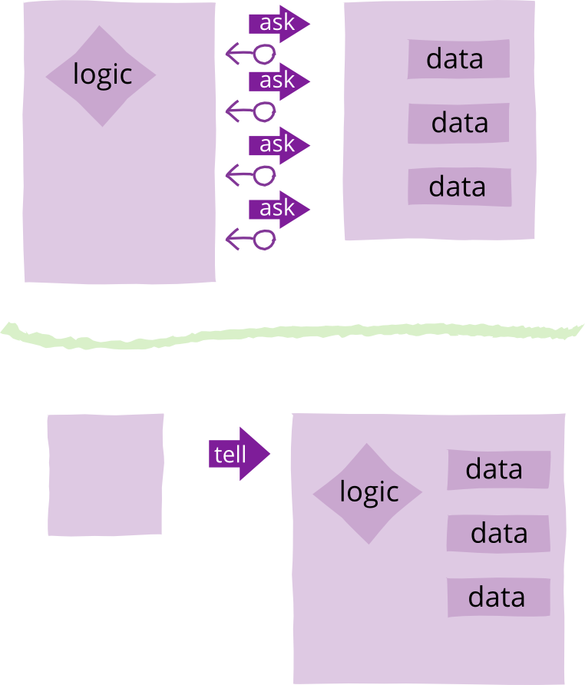
Tell, Don't ask

Slide 21
Law of Demeter or Principle of least knowledge
Each unit should have only limited knowledge about other related units
Each unit should only talk to its friends : don't ask to strangers
Some code

Slide 22
Practice Law of Demeter – loosely coupled programs
A method of an object may only call methods of
  The object itself
  An argument of the method
  Any object created within the method
  Any direct properties/fields of the object
Should not chain method calls
  Strictly : one dot per line
  Not applied to fluent interfaces (DSL), builder pattern, ...

Slide 23
Don't repeat yourself – DRY
Every piece of knowledge (logic) must have a single, unambiguous, authoritative representation within a system
Reduce code duplication
A modification of any single element of a system doesn't require a change in other unrelated elements

Slide 24
Design Patterns
Facade - provides simplified interfaces to clients
  SLF4J
Strategy - encapsulates algorithms
  Comparator interface
Command – encapsulates code to perform an action
  Runnable interface, task queue

Slide 25
Conclusion
Encapsulation is the heart of object-oriented software
  Flexible, easy to change
  Understandable, maintainable
The idea is simple, but hard to get it right
  Levels of encapsulation : method, class, component,..
  Many practice forms
Read and Practice/Code

Slide 26
Sources of knowledge
Agile Principles, Patterns, and Practices in C# - Martin C.Robert, Martin Micah
Head First Design Patterns – Eric Freeman and Elisabeth Freeman
Growing Object-Oriented Software, Guided By Tests – Steve Freeman and Nat Pryce
The Pragmatic Programmer: From Journeyman to Master – Andrew Hunt and David Thomas

Slide 27
Next session
Inheritance
Polymorphism

