Slide 1
Polymorphism

Slide 2
Basic foundations of OOP
Abstraction
Encapsulation
Inheritance
Polymorphism

Slide 3
Abstraction
Presenting essential characteristics of an entity that distinguish it from all kinds of entities
  “When I see a bird that walks like a duck and swims like a duck and quacks like a duck, I call that bird a duck” - James Whitcomb Riley

Slide 4


Encapsulation
Hide implementation from clients
  Hide internal state and behavior – information hiding
  Only expose several methods – called public interfaces

Slide 5
Polymorphism
The ability to appear in many forms
  Poly – “many”, morph - “form”
In Java
  The ability of a reference variable to change behavior according to what object instance it is holding
  Multiple objects of different sub-classes to be treated as objects of a single super class
  Automatically selecting the proper methods to apply to a particular object based on the subclass it belongs to – dynamic dispatch

Slide 6
Types of Polymorphism
Compile-time
Method overloading
Run-time
Method overriding
Parametric/Generic

Slide 7
Polymorphism supports in Java
Inheritance
Multiple sub-classes extend a base class
Interfaces
Classes implement an interface

Slide 8
Advantages of polymorphism
Polymorphism enables “Programming to General”
rather than “Programming to Specific”
Code Reusability
Reduction in Complexity = Simplicity
Extensibility
Maintainability

Slide 9
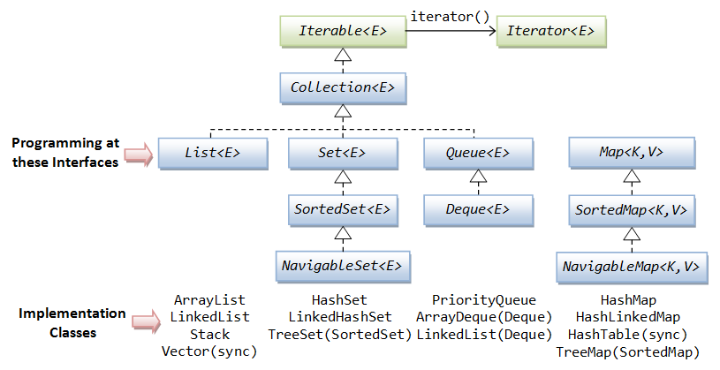
Java collection framework

Slide 10
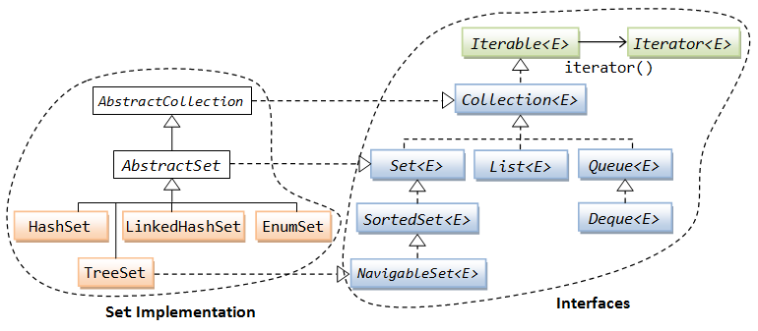
Java collection framework

Slide 11
Best Practices
Replace Conditional with Polymorphism
Program to an interface, not an implementation

Slide 12
Replace Conditional with Polymorphism
Direct code inside branches of if/switch statement
Procedural programming - code duplication, hard to read, maintain
Polymorphism to handle complex conditional cases
Encapsulate code of each branch into a (sub)class

Slide 13
Program to an interface, not an implementation
Interface are just contracts or signatures
what operations can be performed
not how they are performed
Easy to change behavior at run-time
multiple different implementations
loosely coupling

Slide 14
Disadvantages
More time spent on design
Harder to find expert programmers
Code harder to trace

Slide 15
Conclusion
Polymorphism is a powerful tool provided by object oriented programming
Polymorphism is closely combined with abstraction, encapsulation and inheritance
Build great and powerful OO software

