Slide 1
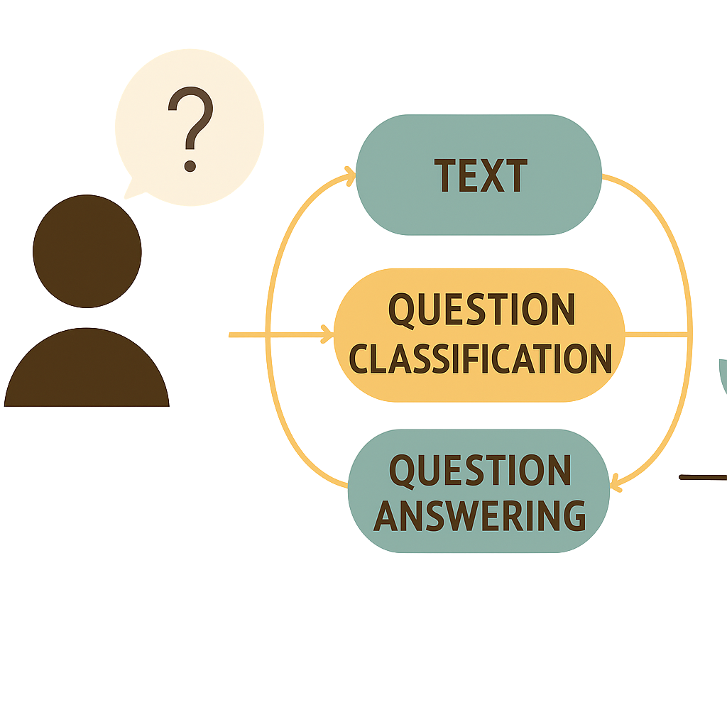
NLP Pipeline for Question Classification and Answering
A Technical Report by RKNT Rajapaksha and DMU Nimsara

Slide 2

Introduction: The Power of NLP
Natural Language Processing (NLP) is a critical field in AI, enabling machines to understand, interpret, and generate human language. Question answering systems are a challenging and valuable application, used in search engines, virtual assistants, and customer service.

Slide 3
Project Objectives
1
2
Question Type Classification
Question Answering
Categorize questions into semantic types (what, who, when, etc.).
Extract precise answers from text using ML and transformer models.
3
4
Feature Comparison
Out-of-Vocabulary Handling
Evaluate TF-IDF, Word2Vec, and FastText effectiveness.
Demonstrate capability for unseen words in real-world scenarios.

Slide 4
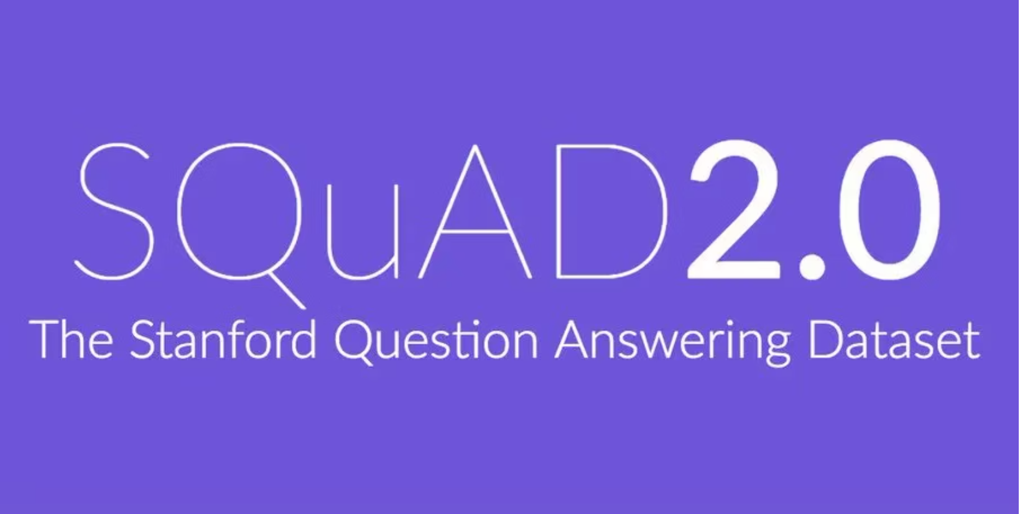
Dataset and Scope: SQuAD
The Stanford Question Answering Dataset (SQuAD) was chosen for its comprehensive collection of reading comprehension questions based on Wikipedia articles.
A subset of 20,000 samples was processed for computational efficiency, maintaining statistical representativeness.
The dataset exhibits natural class imbalance, with ~67% "what" questions and smaller percentages for other types.

Slide 5
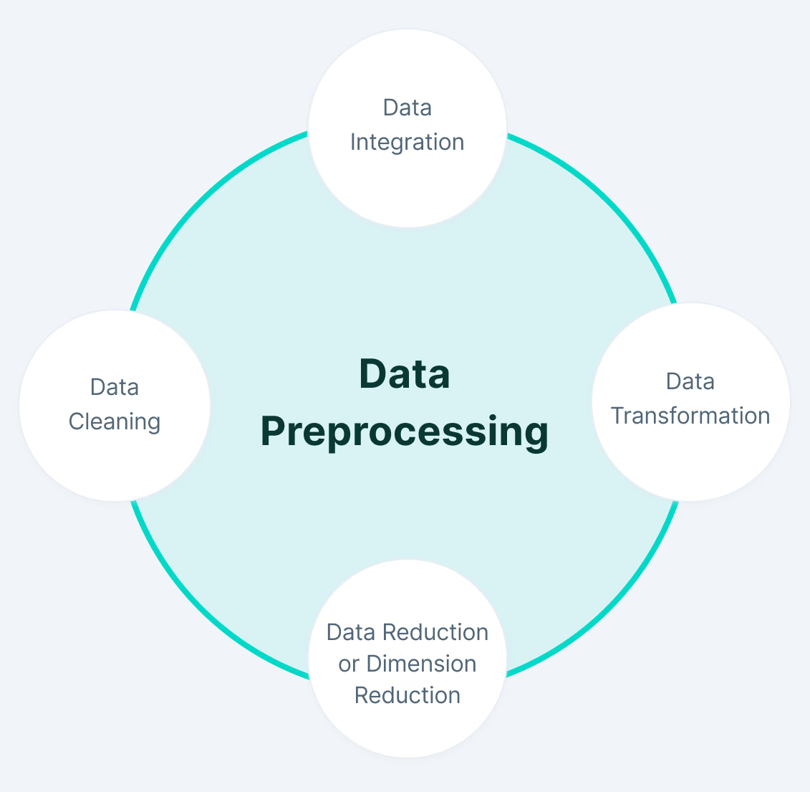
Methodology: Data Preprocessing
Text Normalization
Tokenization & Filtering
Lowercase conversion, contraction expansion, special character removal.
NLTK word tokenization, stopword removal, alphabetic validation.
Morphological Processing
Porter Stemming to reduce words to root forms for semantic matching.

Slide 6
Feature Extraction Techniques
TF-IDF Vectorization
Word2Vec Embeddings
FastText Embeddings
Captures term importance and contextual relationships using n-grams.
Skip-gram architecture for semantic relationships via contextual co-occurrence.
Extends Word2Vec with character-level n-grams for out-of-vocabulary words.

Slide 7
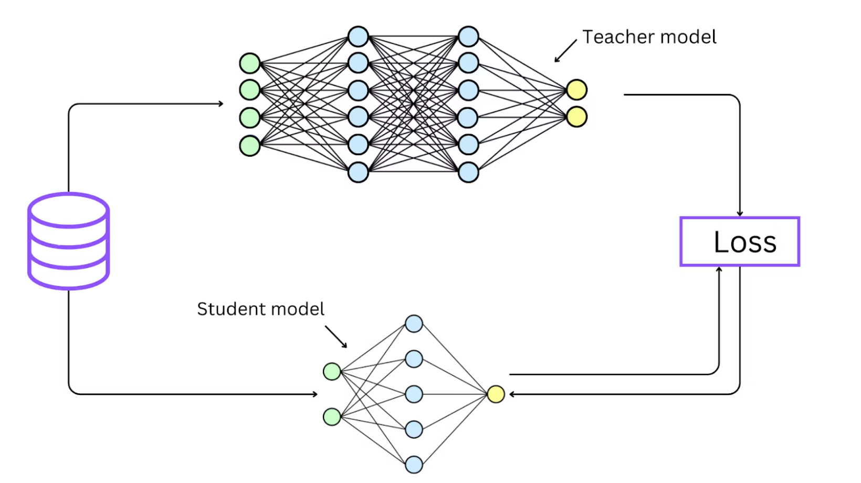
Model Implementation Strategy
Advanced Transformer Architecture
Baseline Models
DistilBERT for Question Answering: A knowledge-distilled BERT version, fine-tuned on SQuAD for state-of-the-art performance.
Keyword overlap analysis
Length-based classification
Traditional ML Models
Logistic Regression
Support Vector Machines (SVM)
Random Forest ensembles

Slide 8
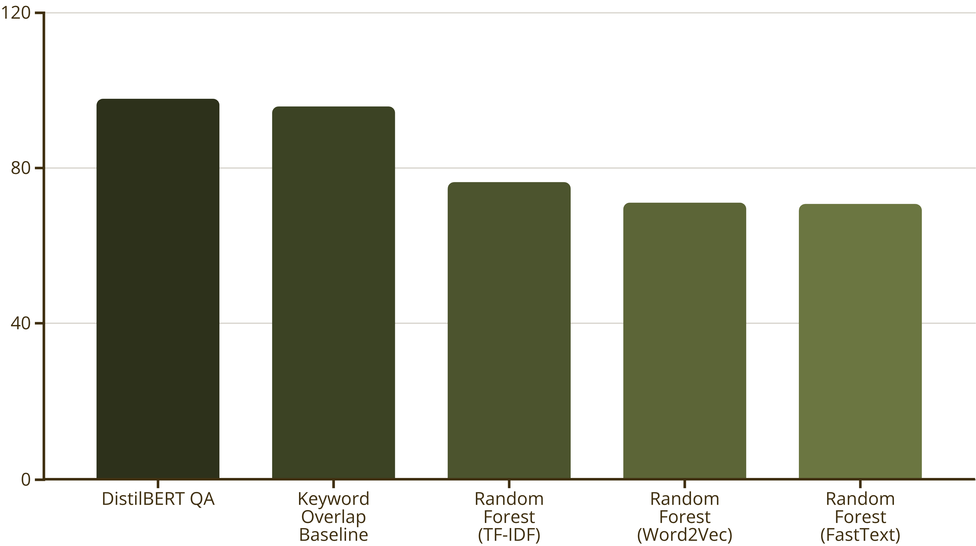
Performance Analysis: Key Findings
DistilBERT achieved exceptional 98.00% accuracy, demonstrating superiority. The keyword overlap baseline also performed remarkably well at 95.87%.

Slide 9
Challenges and Limitations
1
2
3
Dataset & Domain
Technical Implementation
Evaluation & Methodology
SQuAD's Wikipedia-centric content limits generalization. Class imbalance (67% "what" questions) creates bias.
GPU memory constraints limited sample sizes and embedding dimensions..
String-based answer matching (98% accuracy vs. 67.15% F1-score) suggests need for semantic metrics. Limited cross-validation due to computational constraints.

Slide 10

Conclusion
DistilBERT showed clear superiority for QA tasks
TF-IDF proved effective for traditional classification.
FastText's OOV handling is valuable for real-world deployment.
.

