Slide 1
Unit 3 Memory System
Basic memory circuits
Organization of the main memory
Memory technology
Cache memory, which reduces the effective memory access time
Virtual memory, which increases the apparent size of the main memory

Slide 2
Introduction
Execution speed of programs is highly dependent on the speed with which instructions and data can be transferred between the processor and the memory.
Ideally, the memory would be fast, large, and inexpensive.
Unfortunately, it is impossible to meet all three of these requirements simultaneously. Increased speed and size are achieved at increased cost.
Much work has gone into developing structures that improve the effective speed and size of the memory, yet keep the cost reasonable.

Slide 3
Basic Concepts-1
The maximum size of the memory that can be used in any computer is determined by the addressing scheme.
For example, a computer that generates 16-bit addresses is capable of addressing up to
2¹⁶ = 64K (kilo) memory locations

Slide 4
Basic Concepts-2
The memory is usually designed to store and retrieve data in word-length quantities.
Consider, for example, a byte-addressable computer whose instructions generate 32-bit addresses.
When a 32-bit address is sent from the processor to the memory unit, the high order 30 bits determine which word will be accessed. If a byte quantity is specified, the low-order 2 bits of the address specify which byte location is involved.

Slide 5
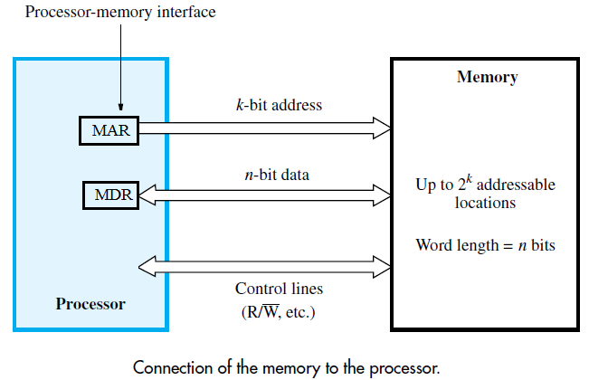
Basic Concepts-4
The connection between the processor and its memory consists of address, data, and control lines,

Slide 6
Basic Concepts-5
The processor uses the address lines to specify the memory location involved in a data transfer operation, and uses the data lines to transfer the data.
At the same time, the control lines carry the command indicating a Read or a Write operation and whether a byte or a word is to be transferred. The control lines also provide the necessary timing information and are used by the memory to indicate when it has completed the requested operation.
When the processor-memory interface receives the memory’s response, it asserts the MFC (Memory Function Complete) signal

Slide 7
Basic Concepts-6
A useful measure of the speed of memory units is the time that elapses between the initiation of an operation to transfer a word of data and the completion of that operation.
This is referred to as the memory access time.
Another important measure is the memory cycle time, which is the minimum time delay required between the initiation of two successive memory operations, for example, the time between two successive Read operations.
The cycle time is usually slightly longer than the access time.

Slide 8
Basic Concepts-7
A memory unit is called a random-access memory (RAM) if the access time to any location is the same, independent of the location’s address.
This distinguishes such memory units from serial, or partly serial, access storage devices such as magnetic and optical disks.
Access time of the latter devices depends on the address or position of the data.

Slide 9
Basic Concepts-8
Cache and Virtual Memory
The processor of a computer can usually process instructions and data faster than they can be fetched from the main memory. Hence, the memory access time is the bottleneck in the system.
One way to reduce the memory access time is to use a cache memory.
This is a small, fast memory inserted between the larger, slower main memory and the processor. It holds the currently active portions of a program and their data.
Virtual memory With this technique, only the active portions of a program are stored in the main memory, and the remainder is stored on the much larger secondary storage device. Sections of the program are transferred back and forth between the main memory and the secondary storage device in a manner that is transparent to the application program. As a result, the application program sees a memory that is much larger than the computer’s physical main memory.

Slide 10
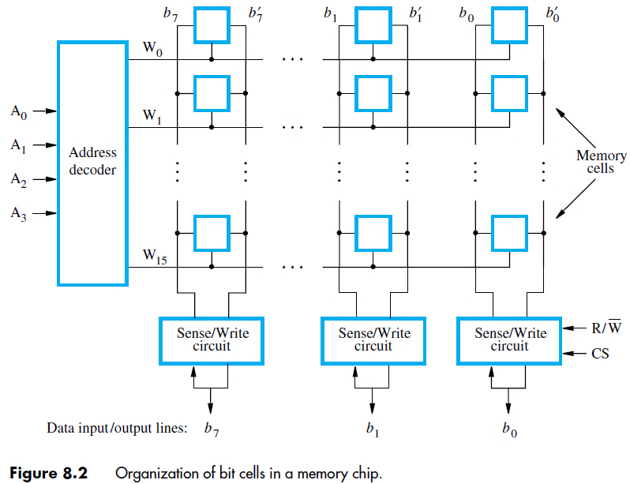
Semiconductor RAM Memories-1
Internal Organization of Memory Chips

Slide 11
Semiconductor RAM Memories-2
Memory cells are in the form of an array, in which each cell is capable of storing one bit of information.
Each row of cells constitutes a memory word, and all cells of a row are connected to a common line referred to as the word line, which is driven by the address decoder on the chip.
The cells in each column are connected to a Sense/Write circuit by two bit lines, and the Sense/Write circuits are connected to the data input/output lines of the chip.
During a Read operation, these circuits sense, or read, the information stored in the cells selected by a word line and place this information on the output data lines.
During a Write operation, the Sense/Write circuits receive input data and store them in the cells of the selected word.

Slide 12
Semiconductor RAM Memories-3
In above example of a very small memory circuit consisting of 16 words of 8 bits each.
This is referred to as a 16 × 8 organization.
The data input and the data output of each Sense/Write circuit are connected to a single bidirectional data line that can be connected to the data lines of a computer.
The R/W (Read/Write) input specifies the required operation, and the CS (Chip Select) input selects a given chip in a multichip memory system.

Slide 13
Semiconductor RAM Memories-4
Number of external connections required
The memory in above example stores 128 bits and requires 14 external connections for address (4), data(8), and control lines(2). It also needs two lines (2) for power supply and ground connections.
Now in case of 1K (1024) memory cells. This circuit can be organized as a 128 × 8 memory, requiring a total of 19 external connections. (7+8+2+2)
The same number of cells can be organized into a 1K×1 format. In this case, a 10-bit address is needed, but there is only one data line, resulting in 15 external connections. (10+1+2+2)
A 1G-bitchip may have a 256M × 4 organization, in which case a 28-bit address is needed and 4 bits are transferred to or from the chip. (28+4+2+2)

Slide 14
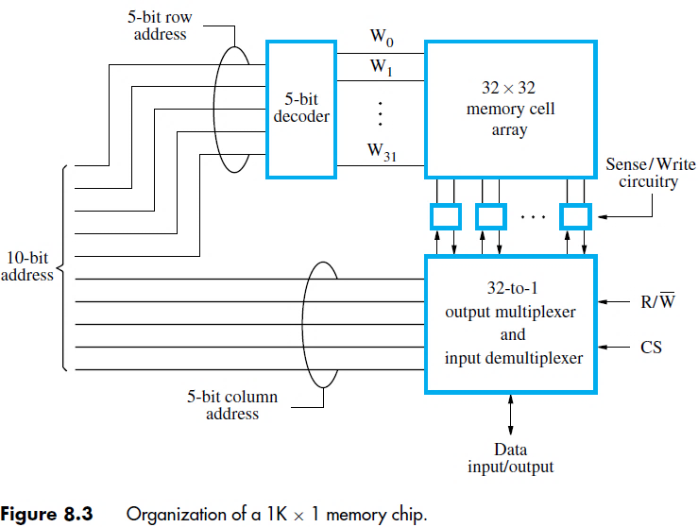
Semiconductor RAM Memories-5
Organization of a 1K × 1 memory chip.
10-bit address is divided into two groups of 5 bits each to form the row and column addresses for the cell array.
A row address selects a row of 32 cells, all of which are accessed in parallel.
But, only one of these cells is connected to the external data line, based on the column address

Slide 15
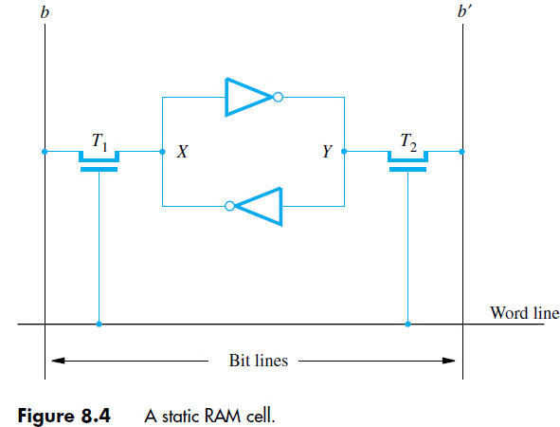
Semiconductor RAM Memories-6 Static Memories (SRAM)
Memories that consist of circuits capable of retaining their state as long as power is applied are known as static memories.

Slide 16
Semiconductor RAM Memories-7 Static Memories (SRAM)
Two inverters are cross-connected to form a latch. The latch is connected to two bit lines by transistors T1 and T2. These transistors act as switches that can be opened or closed under control of the word line.
When the word line is at ground level, the transistors are turned off and the latch retains its state.
For example, if the logic value at point X is 1 and at point Y is 0, this state is maintained as long as the signal on the word line is at ground level. Assume that this state represents the value 1.

Slide 17
Semiconductor RAM Memories-8 Static Memories (SRAM)
Read Operation
Assume cell is in state 1.
To read keep Word line to 1.
So signal on bit line b is high and the signal on bit line b` is low

Slide 18
Semiconductor RAM Memories-9 Static Memories (SRAM)
Write Operation
During a Write operation, the Sense/Write circuit drives bit lines b and b`.
It places the appropriate value on bit line b and its complement on b` and activates the word line.
This forces the cell into the corresponding state, which the cell retains when the word line is deactivated.

Slide 19
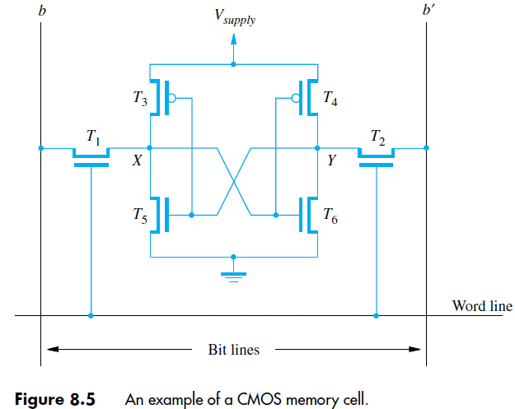
Semiconductor RAM Memories-10 Static Memories (SRAM)
CMOS Cell
Transistor pairs (T3, T5) and (T4, T6) form the inverters in the latch.
The state of the cell is read or written as just explained. For example, in state 1, the voltage at point X is maintained high by having transistors T3 and T6 on, while T4 and T5 are off.
If T1 and T2 are turned on, bit lines b and b` will have high and low signals, respectively.

Slide 20
Semiconductor RAM Memories-11 Static Memories (SRAM)
Continuous power is needed for the cell to retain its state. If power is interrupted, the cell’s contents are lost. When power is restored, the latch settles into a stable state, but not necessarily the same state the cell was in before the interruption. Hence, SRAMs are said to be volatile memories.
A major advantage of CMOS SRAMs is their very low power consumption, because current flows in the cell only when the cell is being accessed.
Static RAMs can be accessed very quickly. Access times on the order of a few nanoseconds are found in commercially available chips. SRAMs are used in applications where speed is of critical concern.

Slide 21
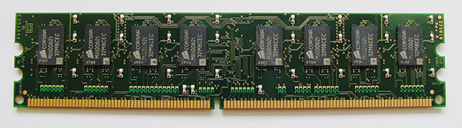
Semiconductor RAM Memories-12 Asynchronous Memories (DRAM)
Static RAMs are fast, but their cells require several transistors.
Less expensive and higher density RAMs can be implemented with simpler cells.
But, these simpler cells do not retain their state for a long period, unless they are accessed frequently (Refreshed) for Read or Write operations.
Memories that use such cells are called dynamic RAMs (DRAMs).

Slide 22
Semiconductor RAM Memories-13 Asynchronous Memories (DRAM)
Information is stored in a dynamic memory cell in the form of a charge on a capacitor, but this charge can be maintained for only tens of milliseconds.
Since the cell is required to store information for a much longer time, its contents must be periodically refreshed (read or write) by restoring the capacitor charge to its full value.

Slide 23
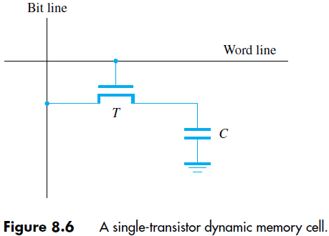
Semiconductor RAM Memories-14 Asynchronous Memories (DRAM)
A single-transistor dynamic memory cell.
To store information in this cell, transistor T is turned on and an appropriate voltage is applied to the bit line.
This causes a known amount of charge to be stored in the capacitor.
After the transistor is turned off, the charge remains stored in the capacitor, but not for long. The capacitor begins to discharge.

Slide 24
Semiconductor RAM Memories-15 Asynchronous Memories (DRAM)
This is because the transistor continues to conduct a tiny amount of current, after it is turned off.
Hence, the information stored in the cell can be retrieved correctly only if it is read before the charge in the capacitor drops below some threshold value.
During a Read operation, the transistor in a selected cell is turned on.
A sense amplifier connected to the bit line detects whether the charge stored in the capacitor is above or below the threshold value.
If the charge is above the threshold, the sense amplifier drives the bit line to the full voltage representing the logic value 1. As a result, the capacitor is recharged.
If the sense amplifier detects that the charge in the capacitor is below the threshold value, it pulls the bit line to ground level to discharge the capacitor fully.
Thus, reading the contents of a cell automatically refreshes its contents.
Since the word line is common to all cells in a row, all cells in a selected row are read and refreshed at the same time.

Slide 25
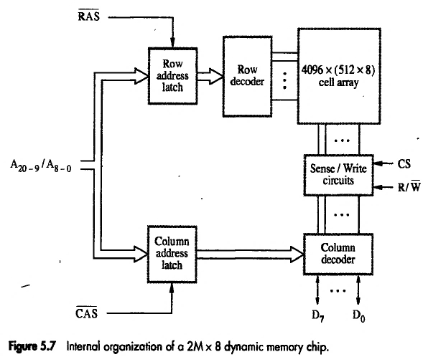
Semiconductor RAM Memories-16 Asynchronous Memories (DRAM)
Internal organization of a 2M × 8 dynamic memory chip.

Slide 26
Semiconductor RAM Memories-17 Asynchronous Memories (DRAM)
A 16-Megabit DRAM chip, configured as 2M × 8, is shown in above diagram.
The cells are organized in the form of a 4K × 4K array.
The 4096 cells in each row are divided into 512 groups of 8, forming 512 bytes of data.
Therefore, 12 address bits are needed to select a row, and another 9 bits are needed to specify a group of 8 bits in the selected row.
In total, a 21-bit address is needed to access a byte in this memory.
The high-order 12 bits and the low-order 9 bits of the address constitute the row and column addresses of a byte, respectively.
To reduce the number of pins needed for external connections, the row and column addresses are multiplexed on 12 pins.

Slide 27
Semiconductor RAM Memories-18 Asynchronous Memories (DRAM)
During a Read or a Write operation, the row address is applied first.
It is loaded into the row address latch in response to a signal pulse on an input control line called the Row Address Strobe (RAS).
This causes a Read operation to be initiated, in which all cells in the selected row are read and refreshed.

Slide 28
Semiconductor RAM Memories-19 Asynchronous Memories (DRAM)
Shortly after the row address is loaded, the column address is applied to the address pins and loaded into the column address latch under control of a second control line called the Column Address Strobe (CAS).
The information in this latch is decoded and the appropriate group of 8 Sense/Write circuits is selected.
If the R/W control signal indicates a Read operation, the output values of the selected circuits are transferred to the data lines, D7−D0.
For a Write operation, the information on the D7−D0 lines is transferred to the selected circuits, then used to overwrite the contents of the selected cells in the corresponding 8 columns.
We should note that in commercial DRAM chips, the RAS and CAS control signals are active when low.

Slide 29
Semiconductor RAM Memories-20 Asynchronous Memories (DRAM)
The timing of the operation of the DRAM described above is controlled by the RAS and CAS signals.
These signals are generated by a memory controller circuit external to the chip when the processor issues a Read or a Write command.
During a Read operation, the output data are transferred to the processor after a delay equivalent to the memory’s access time.
Such memories are referred to as asynchronous DRAMs.
The memory controller is also responsible for refreshing the data stored in the memory chips.

Slide 30
Semiconductor RAM Memories-21 Asynchronous Memories (DRAM)
Fast Page Mode
When the DRAM in above example is accessed, the contents of all 4096 cells in the selected row are sensed, but only 8 bits are placed on the data lines, D7−D0. This byte is selected by the column address, bits A8−0.
A simple addition to the circuit makes it possible to access the other bytes in the same row without having to reselect the row.
Each sense amplifier also acts as a latch.
When a row address is applied, the contents of all cells in the selected row are loaded into the corresponding latches.
Then, it is only necessary to apply different column addresses to place the different bytes on the data lines.

Slide 31
Semiconductor RAM Memories-22 Asynchronous Memories (DRAM)
This arrangement leads to a very useful feature. All bytes in the selected row can be transferred in sequential order by applying a consecutive sequence of column addresses under the control of successive CAS signals.
Thus, a block of data can be transferred at a much faster rate than can be achieved for transfers involving random addresses.
This feature is referred to as the fast page mode. (A large block of data is often called a page.)

Slide 32
Semiconductor RAM Memories-23 Synchronous DRAMs (SDRAM)
DRAMs whose operation is synchronized with a clock signal. Such memories are known as synchronous DRAMs (SDRAMs).
The cell array is the same as in asynchronous DRAMs.
SDRAMs have built-in refresh circuitry, with a refresh counter to provide the addresses of the rows to be selected for refreshing.
As a result, the dynamic nature of these memory chips is almost invisible to the user.

Slide 33
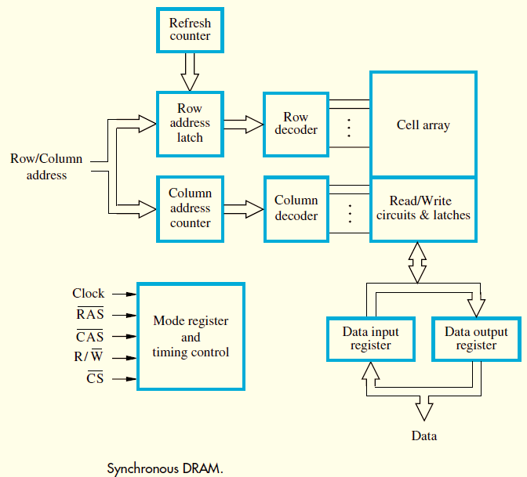
Semiconductor RAM Memories-24 Synchronous DRAMs(SDRAM)

Slide 34
Semiconductor RAM Memories-25 Synchronous DRAMs(SDRAM)
SDRAMs have several different modes of operation, which can be selected by writing control information into a mode register.
For example, in burst operations of different lengths can be specified.
It is not necessary to provide externally-generated pulses on the CAS line to select successive columns.
The necessary control signals are generated internally using a column counter and the clock signal.
New data are placed on the data lines at the rising edge of each clock pulse.

Slide 35
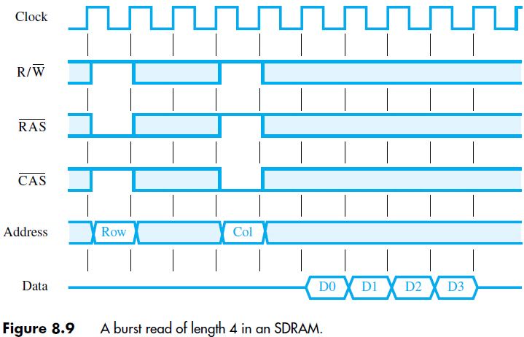
Semiconductor RAM Memories-26 Synchronous DRAMs(SDRAM)
Timing diagram for a typical burst read of length 4

Slide 36
Semiconductor RAM Memories-27 Synchronous DRAMs(SDRAM)
First, the row address is latched under control of the RAS signal. The memory typically takes 2 or 3 clock cycles (we use 2 in the figure for simplicity) to activate the selected row. Then, the column address is latched under control of the CAS signal.
After a delay of one clock cycle, the first set of data bits is placed on the data lines.
The SDRAM automatically increments the column address to access the next three sets of bits in the selected row, which are placed on the data lines in the next 3 clock cycles.

Slide 37
Semiconductor RAM Memories-28 Synchronous DRAMs(SDRAM)
Synchronous DRAM scan deliver data at a very high rate, because all the control signals needed are generated inside the chip.
The initial commercial SDRAMs designed for clock speeds of up to 133 MHz.
As technology evolved, much faster SDRAM chips were developed. Today’s SDRAMs operate with clock speeds that can exceed 1 GHz.

Slide 38
Semiconductor RAM Memories-28 Synchronous DRAMs(SDRAM)
Latency and Bandwidth
Data transfers to and from the main memory often involve blocks of data.
The memory access time defined earlier is not sufficient for describing the memory’s performance when transferring blocks of data. During block transfers, memory latency is the amount of time it takes to transfer the first word of a block.
The time required to transfer a complete block depends also on the rate at which successive words can be transferred and on the size of the block. The time between successive words of a block is much shorter than the time needed to transfer the first word.
For instance, as in the timing diagram, the access cycle begins with the assertion of the RAS signal. The first word of data is transferred five clock cycles later. Thus, the latency is five clock cycles. If the clock rate is 500 MHz, then the latency is 10 ns.
The remaining three words are transferred in consecutive clock cycles, at the rate of one word every 2 ns.

Slide 39
Semiconductor RAM Memories-29 Synchronous DRAMs(SDRAM)
A useful performance measure is the number of bits or bytes that can be transferred in one second. This measure is referred as the memory bandwidth.
It depends on the speed of access to the stored data and on the number of bits that can be accessed in parallel.
The rate at which data can be transferred to or from the memory depends on the bandwidth of the system interconnections.
For this reason, the interconnections used always ensure that the bandwidth available for data transfers between the processor and the memory is very high.

Slide 40
Semiconductor RAM Memories-30 Synchronous DRAMs
Double-Data-Rate SDRAM (DDR-RAM)
The key idea is to take advantage of the fact that a large number of bits are accessed at the same time inside the chip when a row address is applied.
To make the best use of the available clock speed, data are transferred externally on both the rising and falling edges of the clock.
For this reason, memories that use this technique are called double-data-rate SDRAMs (DDR SDRAMs).

Slide 41
Semiconductor RAM Memories-31 Synchronous DRAMs
Several versions of DDR chips have been developed. The earliest version is known as DDR. Later versions, called DDR2, DDR3, and DDR4, have enhanced capabilities.
They offer increased storage capacity, lower power, and faster clock speeds.
For example, DDR2 and DDR3 can operate at clock frequencies of 400 and 800 MHz, respectively. Therefore, they transfer data using the effective clock speeds of 800 and 1600 MHz, respectively.

Slide 42
Semiconductor RAM Memories-32 Structure of Larger Memories
The basic organization of memory circuits as they may be implemented on a single chip. Now examine how memory chips may be connected to form a much larger memory.

Slide 43
Semiconductor RAM Memories-33 Structure of Larger Memories
Static Memory Systems
Consider a memory consisting of 2M words of 32 bits each. Shown in next slide, how this memory can be implemented using 512K × 8 static memory chips.
Each column in the figure implements one byte position in a word, with four chips providing 2M bytes.
Four columns implement the required 2M × 32 memory.

Slide 44
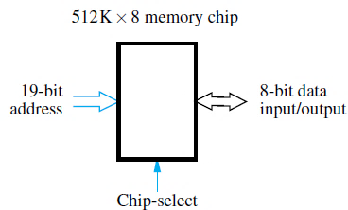
Semiconductor RAM Memories-34 Structure of Larger Memories
Each chip has a control input called Chip-select. When this input is set to 1, it enables the chip to accept data from or to place data on its data lines.

Slide 45
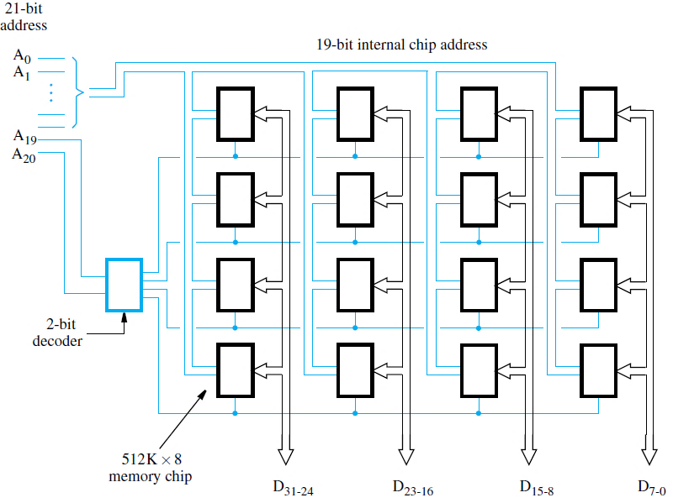
Semiconductor RAM Memories-35 Structure of Larger Memories
Organization of a 2M × 32 memory module using 512K × 8 static memory chips.

Slide 46
Semiconductor RAM Memories-36 Structure of Larger Memories
Only the selected chip places data on the data output line, while all other outputs are electrically disconnected from the data lines.
21 address bits are needed to select a 32-bit word in this memory.
The high-order two bits of the address are decoded to determine which of the four rows should be selected.
The remaining 19 address bits are used to access specific byte locations inside each chip in the selected row.
The R/W inputs of all chips are tied together to provide a common Read/Write control line (not shown in the figure).

Slide 47
Semiconductor RAM Memories-37 Structure of Larger Memories
Dynamic Memory Systems
Modern computers use very large memories. Even a small personal computer is likely to have at least 1G bytes of memory. Typical desktop computers may have 4G bytes or more of memory.
A large memory leads to better performance, because more of the programs and data used in processing can be held in the memory, thus reducing the frequency of access to secondary storage.

Slide 48
Semiconductor RAM Memories-38 Structure of Larger Memories
Because of their high bit density and low cost, dynamic RAMs, mostly of the synchronous type, are widely used in the memory units of computers.
They are slower than static RAMs, but they use less power and have considerably lower cost per bit.
Available chips have capacities as high as 2G bits, and even larger chips are being developed. To reduce the number of memory chips needed in a given computer, a memory chip may be organized to read or write a number of bits in parallel.
Chips are manufactured in different organizations, to provide flexibility in designing memory systems. For example, a 1-Gbit chip may be organized as 256M × 4, or 128M × 8.

Slide 49
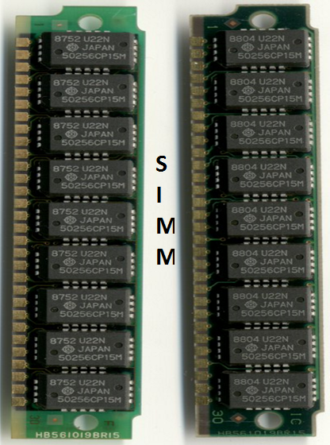
Semiconductor RAM Memories-39 Structure of Larger Memories
Packaging considerations have led to the development of assemblies known as memory modules. Each such module houses many memory chips, typically in the range 16 to 32, on a small board that plugs into a socket on the computer’s motherboard.
Memory modules are commonly called SIMMs (Single In-line Memory Modules) or DIMMs (Dual In-line Memory Modules), depending on the configuration of the pins.
Modules of different sizes are designed to use the same socket.
For example, 128M × 64, 256M × 64, and 512M × 64 bit DIMMs all use the same 240-pin socket.
Thus, total memory capacity is easily expanded by replacing a smaller module with a larger one, using the same socket.

Slide 50
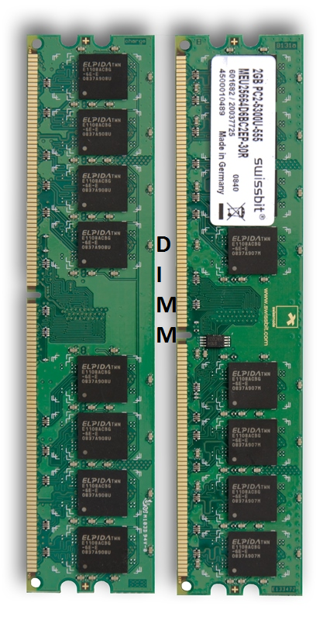
Semiconductor RAM Memories-39 Structure of Larger Memories
Packaging considerations have led to the development of assemblies known as memory modules. Each such module houses many memory chips, typically in the range 16 to 32, on a small board that plugs into a socket on the computer’s motherboard.
Memory modules are commonly called SIMMs (Single In-line Memory Modules) or DIMMs (Dual In-line Memory Modules), depending on the configuration of the pins.
Modules of different sizes are designed to use the same socket.
For example, 128M × 64, 256M × 64, and 512M × 64 bit DIMMs all use the same 240-pin socket.
Thus, total memory capacity is easily expanded by replacing a smaller module with a larger one, using the same socket.

Slide 51
Semiconductor RAM Memories-40 Structure of Larger Memories
Memory Controller
The address applied to dynamic RAM chips is divided into two parts , i.e. the high-order address bits, which select a row in the cell array by activating the RAS signal. Then, the low-order address bits, which select a column, are provided on the same address pins and latched under control of the CAS signal.
Since a typical processor issues all bits of an address at the same time, a multiplexer is required. This function is usually performed by a memory controller circuit.
The controller accepts a complete address and the R/W signal from the processor, under control of a Request signal which indicates that a memory access operation is needed.
It forwards the R/W signals and the row and column portions of the address to the memory and generates the RAS and CAS signals, with the appropriate timing.

Slide 52
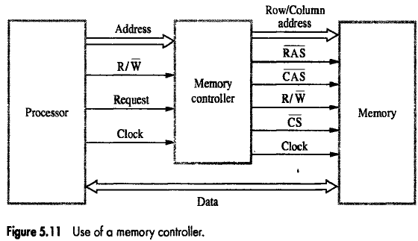
Semiconductor RAM Memories-41 Structure of Larger Memories

Slide 53
Semiconductor RAM Memories-42 Structure of Larger Memories
Memory Controller
When a memory includes multiple modules, one of these modules is selected based on the high-order bits of the address.
The memory controller decodes these high-order bits and generates the chip-select signal for the appropriate module.
Data lines are connected directly between the processor and the memory.

Slide 54
Semiconductor RAM Memories-43 Structure of Larger Memories
Memory Controller
Dynamic RAMs must be refreshed periodically. The circuitry required to initiate refresh cycles is included as part of the internal control circuitry of synchronous DRAMs.
However, a control circuit external to the chip is needed to initiate periodic Read cycles to refresh the cells of an asynchronous DRAM.
The memory controller provides this capability.

Slide 55
Semiconductor RAM Memories-44 Structure of Larger Memories
Refresh Overhead
A dynamic RAM cannot respond to read or write requests while an internal refresh operation is taking place.
Such requests are delayed until the refresh cycle is completed.
E.g. SDRAM of 8k (8192) rows, in which each all rows are refreshed in 64 ms, suppose it takes 4 cycles to access each row. So 8192 x 4 = 32768 cycles to refresh all rows.
At 133MHz clock rate the time needed to refresh all rows is 32786/(133x10⁶)=246µs. Thus refreshing takes 0.246ms in each 64ms.
So refreshed overhead is 0.246/64= 0.0038 which is less than 0.4% of the total time available for accessing the memory.

Slide 56
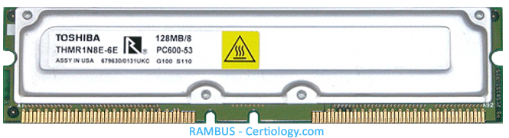
Semiconductor RAM Memories-45 Structure of Larger Memories
Rambus Memory
The rate of transferring data between the memory and the processor is a function of both the bandwidth of the memory and the bandwidth of its connection to the processor.
One way for increasing the bandwidth of this connection is to use a wider data path. However, this requires more space and more pins, increasing system cost.
The alternative is to use fewer wires with a higher clock speed. This is the approach taken by Rambus.

Slide 57
Semiconductor RAM Memories-46 Structure of Larger Memories
The key feature of Rambus technology is the use of a differential-signaling technique to transfer data to and from the memory chips.
Instead of using signal have logic voltage level of 0 or V _{supply} the signals consist of much smaller voltage swings around reference voltage V_{ref}. Two logic values represented by above and below V_{ref}.

Slide 58
Read-only Memories-1
Both static and dynamic RAM chips are volatile, which means that they retain information only while power is turned on.
There are many applications requiring memory devices that retain the stored information when power is turned off. For example, need to store a small program in such a memory, to be used to start the bootstrap process of loading the operating system from a hard disk into the main memory. The embedded applications are another important example.
Many embedded applications do not use a hard disk and require non-volatile memories to store their software.
Different types of non-volatile memories have been developed. But, a special writing process is needed to place the information into a non-volatile memory. Since its normal operation involves only reading the stored data, a memory of this type is called a read-only memory (ROM).

Slide 59
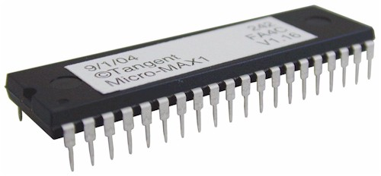
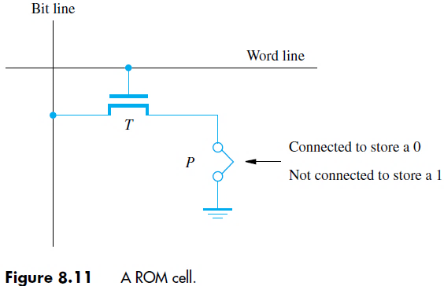
Read-only Memories-2 ROM
A memory is called a read-only memory, or ROM, when information can be written into it only once at the time of manufacture.

Slide 60
Read-only Memories-3 ROM
A logic value 0 is stored in the cell if the transistor is connected to ground at point P; otherwise, a 1 is stored.
The bit line is connected through a resistor to the power supply. To read the state of the cell, the word line is activated to close the transistor switch.
As a result, the voltage on the bit line drops to near zero if there is a connection between the transistor and ground.
If there is no connection to ground, the bit line remains at the high voltage level, indicating a 1.
A sense circuit at the end of the bit line generates the proper output value. The state of the connection to ground in each cell is determined when the chip is manufactured, using a mask with a pattern that represents the information to be stored.

Slide 61
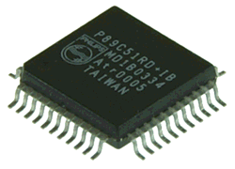
Read-only Memories-4 PROM
Some ROM designs allow the data to be loaded by the user, thus providing a programmable ROM (PROM).
Programmability is achieved by inserting a fuse at point P in a ROM cell.
Before it is programmed, the memory contains all 0s. The user can insert 1s at the required locations by burning out the fuses at these locations using high-current pulses. This process is irreversible.
PROMs provide flexibility and convenience not available with ROMs. The cost of preparing the masks needed for storing a particular information pattern makes ROMs cost effective only in large volumes.
The alternative technology of PROMs provides a more convenient and considerably less expensive approach, because memory chips can be programmed directly by the user.

Slide 62
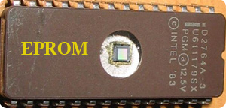
Read-only Memories-5 EPROM
It allows the stored data to be erased and new data to be written into it. Such an erasable, reprogrammable ROM is usually called an EPROM.
Since EPROMs are capable of retaining stored information for a long time, they can be used in place of ROMs or PROMs while software is being developed.
An EPROM cell has a structure similar to the ROM cell. However, the connection to ground at point P is made through a special transistor. The transistor is normally turned off, creating an open switch. It can be turned on by injecting charge into it that becomes trapped inside.
By injecting the charges into it that become trapped in the transistors that form the memory cells. This can be done by exposing the chip to ultraviolet light, which erases the entire contents of the chip. To make this possible, EPROM chips are mounted in packages that have transparent windows.

Slide 63
Read-only Memories-6 EEPROM
An EPROM must be physically removed from the circuit for reprogramming. Also, the stored information cannot be erased selectively. The entire contents of the chip are erased when exposed to ultraviolet light.
Another type of erasable PROM can be programmed, erased, and reprogrammed electrically. Such a chip is called an electrically erasable PROM, or EEPROM.
One disadvantage of EEPROMs is that different voltages are needed for erasing, writing, and reading the stored data, which increases circuit complexity.
However, this disadvantage is outweighed by the many advantages of EEPROMs. They have replaced EPROMs in practice.

Slide 64
Read-only Memories-7 Flash Memory
An approach similar to EEPROM technology has given rise to flash memory devices. A flash cell is based on a single transistor controlled by trapped charge, much like an EEPROM cell.
The key difference is that, in a flash device, it is only possible to write an entire block of cells. Prior to writing, the previous contents of the block are erased.
Flash devices have greater density, which leads to higher capacity and a lower cost per bit. They require a single power supply voltage, and consume less power in their operation.

Slide 65
Read-only Memories-8 Flash Memory
The low power consumption of flash memories makes them attractive for use in portable, battery-powered equipment.
Typical applications include hand-held computers, cell phones, digital cameras, and MP3 music players. A flash memory is used in digital cameras to store picture data. In MP3 players, flash memories store the data that represent sound.
Single flash chips may not provide sufficient storage capacity for the applications mentioned above. Larger memory modules consisting of a number of chips are used where needed.
There are two popular choices for the implementation of such modules: flash cards and flash drives.

Slide 66
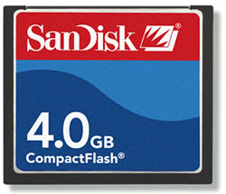
Read-only Memories-9 Flash Memory
Flash Cards
One way of constructing a larger module is to mount flash chips on a small card. Such flash cards have a standard interface that makes them usable in a variety of products.
A card is simply plugged into a conveniently accessible slot. Flash cards with a USB interface are widely used and are commonly known as memory keys.
They come in a variety of memory sizes. Larger cards may hold as much as 32 Gbytes. A minute of music can be stored in about 1 Mbyte of memory, using the MP3 encoding format.
Hence, a 32-Gbyte flash card can store approximately 500 hours of music.

Slide 67

Read-only Memories-10 Flash Memory
Flash Drives
Larger flash memory modules have been developed to replace hard disk drives, and hence are called flash drives.
They are designed to fully emulate hard disks, to the point that they can be fitted into standard disk drive bays. However, the storage capacity of flash drives is significantly lower.
Currently, the capacity of flash drives is on the order of 64 to 128 Gbytes. In contrast, hard disks have capacities exceeding a terabyte. Also, disk drives have a very low cost per bit.
The fact that flash drives are solid state electronic devices with no moving parts provides important advantages over disk drives. They have shorter access times, which result in a faster response. They are insensitive to vibration and they have lower power consumption, which makes them attractive for portable, battery-driven applications.

Slide 68
Speed, Size and Cost-1
A very fast memory can be implemented using static RAM chips. But, these chips are not suitable for implementing large memories, because their basic cells are larger, consume more power than dynamic RAM cells and not cost effective.

Slide 69
Speed, Size and Cost-2
Although dynamic memory units with gigabyte capacities can be implemented at a reasonable cost, the affordable size is still small compared to the demands of large programs with voluminous data.
A solution is provided by using secondary storage, mainly magnetic disks, to provide the required memory space. Disks are available at a reasonable cost, and they are used extensively in computer systems. However, they are much slower than semiconductor memory units.
So, a very large amount of cost-effective storage can be provided by magnetic disks, and a large and considerably faster, yet affordable, main memory can be built with dynamic RAM technology.
This leaves the more expensive and much faster static RAM technology to be used in smaller units where speed is of the essence, such as in cache memories.

Slide 70
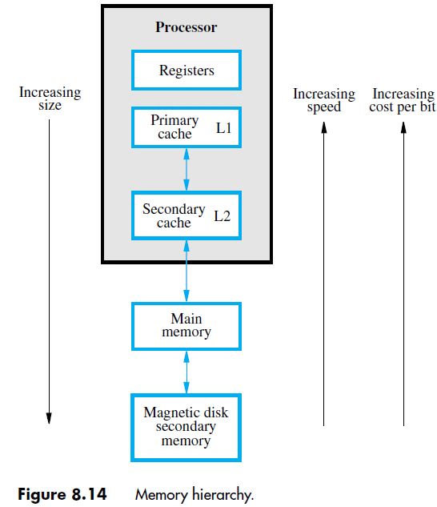
Speed, Size and Cost-3
Memory hierarchy
The fastest access is to data held in processor registers.
Processor cache, holds copies of the instructions and data stored in a much larger memory that is provided externally.
A primary cache is always located on the processor chip. This cache is small and its access time is comparable to that of processor registers. The primary cache is referred to as the level 1 (L1) cache.
A larger, and hence somewhat slower, secondary cache is placed between the primary cache and the rest of the memory. It is referred to as the level 2 (L2) cache.

Slide 71
Speed, Size and Cost-4
Some computers have a level 3 (L3) cache of even larger size, in addition to the L1and L2 caches. An L3 cache, also implemented in SRAM technology, may or may not be on the same chip with the processor and the L1 and L2 caches.
The main memory. This is a large memory implemented using dynamic memory components, typically assembled in memory modules such as DIMMs or SIMM or RIMM.
The main memory is much larger but significantly slower than cache memories.
Disk devices provide a very large amount of inexpensive memory, and they are widely used as secondary storage in computer systems. They are very slow compared to the main memory.
During program execution, the speed of memory access is of utmost importance.
The key to managing the operation of the hierarchical memory system is to bring the instructions and data that are about to be used as close to the processor as possible. This is the main purpose of using cache memories.

Slide 72
Direct Memory Access - 1
Data are transferred from an I/O device to the memory by first reading them from the I/O device using an instruction such as ,
Load R2,DATAIN
which loads the data into a processor register.
Then, the data read are stored into a memory location.
The reverse process takes place for transferring data from the memory to an I/O device.
An instruction to transfer input or output data is executed only after the processor determines that the I/O device is ready, either by polling its status register or by waiting for an interrupt request.
In either case, considerable overhead is incurred, because several program instructions must be executed involving many memory accesses for each dataword transferred.
When transferring a block of data, instructions are needed to increment the memoryaddress and keep track of the word count.
The use of interrupts involves operating system routines which incur additional overhead to save and restore processor registers, the program counter, and other state information.

Slide 73
Direct Memory Access - 2
An alternative approach is used to transfer blocks of data directly between the main memory and I/O devices, such as disks.
A special control unit is provided to manage the transfer, without continuous intervention by the processor. This approach is called direct memory access, or DMA.
The unit that controls DMA transfers is referred to as a DMA controller. It may be part of the I/O device interface, or it may be a separate unit shared by a number of I/O devices.
The DMA controller performs the functions that would normally be carried out by the processor when accessing the main memory.
For each word transferred, it provides the memory address and generates all the control signals needed. It increments the memory address for successive words and keeps track of the number of transfers.

Slide 74
Direct Memory Access - 3
Although a DMA controller transfers data without intervention by the processor, its operation must be under the control of a program executed by the processor, usually an operating system routine.
To initiate the transfer of a block of words, the processor sends to the DMA controller the starting address, the number of words in the block, and the direction of the transfer.
The DMA controller then proceeds to perform the requested operation. When the entire block has been transferred, it informs the processor by raising an interrupt.
Figure 8.12 shows an example of the DMAcontroller registers that are accessed by the processor to initiate data transfer operations.
Two registers are used for storing the starting address and the word count.
The third register contains status and control flags.
The R/W bit determines the direction of the transfer. When this bit is set to 1by a program instruction, the controller performs a Read operation, that is, it transfers data from the memory to theI/O device.
Otherwise, it performs a Write operation. Additional information is also transferred as may be required by the I/O device. For example, in the case of a disk, the processor provides the disk controller with information to identify where the data is located on the disk .

Slide 75
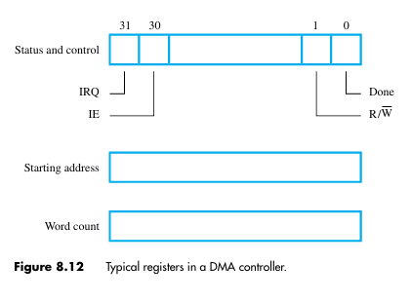
Direct Memory Access - 4
When the controller has completed transferring a block of data and is ready to receive anothercommand,it sets the Doneflag to1.
Bit30 is the Interrupt-enableflag,IE.
When this flag is set to 1, it causes the controller to raise an interrupt after it has completed transferring a block of data. Finally, the controller sets the IRQ bit to1when it has requested an interrupt.

Slide 76
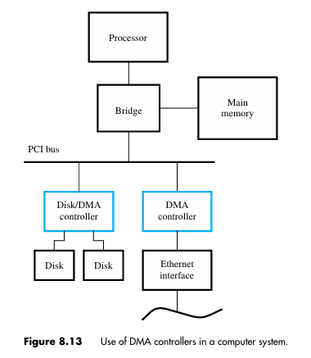
Direct Memory Access - 5
One DMA controller connects a high-speed Ethernet to the computer’s I/O bus.
The disk controller, which controls two disks, also has DMA capability and provides two DMA channels. It can perform two independent DMA operations, as if each disk had its own DMA controller. The registers needed to store the memory address, the word count, and so on, are duplicated, so that one set can be used with each disk.

Slide 77
Direct Memory Access - 6
To start a DMA transfer of a block of data from the main memory to one of the disks, an OS routine writes the address and word count information into the registers of the disk controller.
The DMA controller proceeds independently to implement the specified operation.
When the transfer is completed, this fact is recorded in the status and control register of the DMA channel by setting the Done bit.
At the same time, if the IE bit is set, the controller sends an interrupt request to the processor and sets the IRQ bit. The status register may also be used to record other information, such as whether the transfer took place correctly or errors occurred.

Slide 78
Cache Memories-1
The cache is a small and very fast memory, interposed between the processor and the main memory.
Its purpose is to make the main memory appear to the processor to be much faster than it actually is.
The effectiveness of this approach is based on a property of computer programs called locality of reference.

Slide 79
Cache Memories-2
Analysis of programs shows that most of their execution time is spent in routines in which many instructions are executed repeatedly.
The actual detailed pattern of instruction sequencing is not important—the point is that many instructions in localized areas of the program are executed repeatedly during some time period.
This behaviour manifests itself in two ways: temporal and spatial.
Temporal - recently executed instruction is likely to be executed again very soon.
The spatial- means that instructions close to a recently executed instruction are also likely to be executed soon.

Slide 80
Cache Memories-3
The memory control circuitry is designed to take advantage of the property of locality of reference.
Temporal locality suggests that whenever an information item, instruction or data, is first needed, this item should be brought into the cache, because it is likely to be needed again soon.
Spatial locality suggests that instead of fetching just one item from the main memory to the cache, it is useful to fetch several items that are located at adjacent addresses as well.
The term cache block or cache line refers to a set of contiguous address locations of some size.

Slide 81
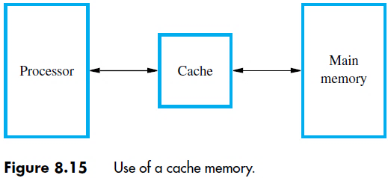
Cache Memories-4
Use of a cache memory.
When the processor issues a Read request, the contents of a block of memory words containing the location specified are transferred into the cache.

Slide 82
Cache Memories-5
Subsequently, when the program references any of the locations in this block, the desired contents are read directly from the cache.
Usually, the cache memory can store a reasonable number of blocks at any given time, but this number is small compared to the total number of blocks in the main memory.
The correspondence between the main memory blocks and those in the cache is specified by a mapping function.
When the cache is full and a memory word (instruction or data) that is not in the cache is referenced, the cache control hardware must decide which block should be removed to create space for the new block that contains the referenced word. The collection of rules for making this decision constitutes the cache’s replacement algorithm.

Slide 83
Cache Memories-6
Cache Hits
The processor does not need to know explicitly about the existence of the cache. It simply issues R/W requests using addresses that refer to locations in the memory.
The cache control circuitry determines whether the requested word currently exists in the cache. If it does, the R/W operation is performed on the appropriate cache location. In this case, a read or write hit is said to have occurred. The main memory is not involved when there is a cache hit in a Read/Write operation.

Slide 84
Cache Memories-7
For a Write operation, the system can proceed in one of two ways.
In the first technique, called the write-through protocol, both the cache location and the main memory location are updated.
The second technique is to update only the cache location and to mark the block containing it with an associated flag bit, often called the dirty or modified bit.
The main memory location of the word is updated later, when the block containing this marked word is removed from the cache to make room for a new block. This technique is known as the write-back, or copy-back, protocol.

Slide 85
Cache Memories-8
The write-through protocol is simpler than the write-back protocol, but it results in unnecessary Write operations in the main memory when a given cache word is updated several times during its cache residency.
The write-back protocol also involves unnecessary Write operations, because all words of the block are eventually written back, even if only a single word has been changed while the block was in the cache.
The write-back protocol is used most often, to take advantage of the high speed with which data blocks can be transferred to memory chips.

Slide 86
Cache Memories-9
Cache Misses
A Read operation for a word that is not in the cache constitutes a Read miss.
It causes the block of words containing the requested word to be copied from the main memory into the cache. After the entire block is loaded into the cache, the particular word requested is forwarded to the processor.
Alternatively, this word may be sent to the processor as soon as it is read from the main memory.
The latter approach, which is called load-through, or early restart, reduces the processor’s waiting time somewhat, at the expense of more complex circuitry.

Slide 87
Cache Memories-10
When a Write miss occurs in a computer that uses the write-through protocol, the information is written directly into the main memory.
For the write-back protocol, the block containing the addressed word is first brought into the cache, and then the desired word in the cache is overwritten with the new information.

Slide 88
Cache Memories-11
In a pipelined processor can cause instruction execution to stall for one or more cycles.
This can occur if a Load or Store instruction requests access to data in the memory at the same time that a subsequent instruction is being fetched. When this happens, instruction fetch is delayed until the data access operation is completed.
To avoid stalling the pipeline, many processors use separate caches for instructions and data, making it possible for the two operations to proceed in parallel.

Slide 89
Cache Memories-12 Mapping Functions
There are several possible methods for determining where memory blocks are placed in the cache.
Consider a example, cache consisting of 128 blocks of 16 words each, for a total of 2048 (2K) words, and assume that the main memory is addressable by a 16-bit address.
The main memory has 64K words, which will view as 4K blocks of 16 words each.
For simplicity, assume that consecutive addresses refer to consecutive words.

Slide 90
Cache Memories-13 Mapping Functions
Direct Mapping
The simplest way to determine cache locations in which to store memory blocks is the direct-mapping technique.
In this technique, block j of the main memory maps onto block j modulo 128 of the cache, as shown in next slide.
Thus, whenever one of the main memory blocks 0, 128, 256, . . . is loaded into the cache, it is stored in cache block 0. Blocks 1, 129, 257, . . . are stored in cache block 1, and so on.
Since more than one memory block is mapped onto a given cache block position, contention may arise for that position even when the cache is not full.
For example, instructions of a program may start in block 1 and continue in block 129, possibly after a branch. As this program is executed, both of these blocks must be transferred to the block-1 position in the cache. Contention is resolved by allowing the new block to overwrite the currently resident block.

Slide 91
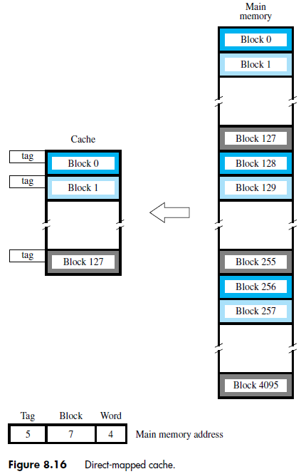
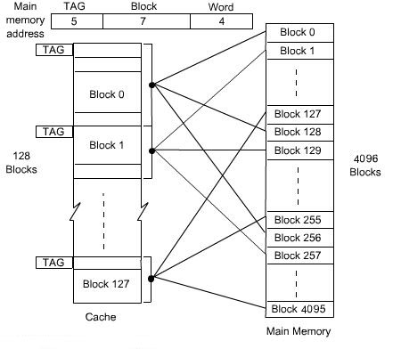
Cache Memories-14 Mapping Functions

Slide 92
Cache Memories-15 Mapping Functions
With direct mapping, the replacement algorithm is trivial. Placement of a block in the cache is determined by its memory address.
The memory address can be divided into three fields, as shown in previous slide.
The low-order 4 bits select one of 16 words in a block. When a new block enters the cache, the 7-bit cache block field determines the cache position in which this block must be stored.

Slide 93
Cache Memories-16 Mapping Functions
The high-order 5 bits of the memory address of the block are stored in 5 tag bits associated with its location in the cache.
The tag bits identify which of the 32 main memory blocks mapped into this cache position is currently resident in the cache.
As execution proceeds, the 7-bit cache block field of each address generated by the processor points to a particular block location in the cache.
The high-order 5 bits of the address are compared with the tag bits associated with that cache location. If they match, then the desired word is in that block of the cache. If there is no match, then the block containing the required word must first be read from the main memory and loaded into the cache.
The direct-mapping technique is easy to implement, but it is not very flexible.

Slide 94
Cache Memories-17 Mapping Functions
Associative Mapping
In which a main memory block can be placed into any cache block position.
In diagram (Next slide), 12 tag bits are required to identify a memory block when it is resident in the cache.
The tag bits of an address received from the processor are compared to the tag bits of each block of the cache to see if the desired block is present. This is called the associative-mapping technique.

Slide 95
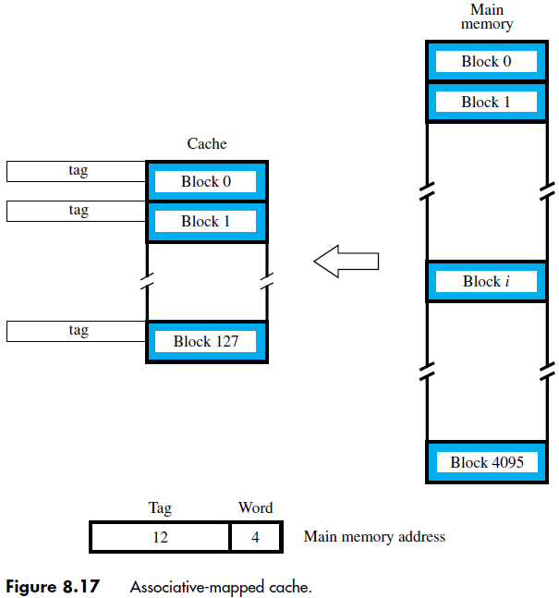
Cache Memories-18 Mapping Functions

Slide 96
Cache Memories-19 Mapping Functions
It gives complete freedom in choosing the cache location in which to place the memory block, resulting in a more efficient use of the space in the cache.
When a new block is brought into the cache, it replaces (ejects) an existing block only if the cache is full.
In this case, we need an algorithm to select the block to be replaced.
The complexity of an associative cache is higher than that of a direct-mapped cache, because of the need to search all 128 tag patterns to determine whether a given block is in the cache.
To avoid a long delay, the tags must be searched in parallel. A search of this kind is called an associative search.

Slide 97
Cache Memories-20 Mapping Functions
Set-Associative Mapping
Another approach is to use a combination of the direct- and associative-mapping techniques.
The blocks of the cache are grouped into sets, and the mapping allows a block of the main memory to reside in any block of a specific set.
Hence, the contention problem of the direct method is eased by having a few choices for block placement.
At the same time, the hardware cost is reduced by decreasing the size of the associative search.

Slide 98
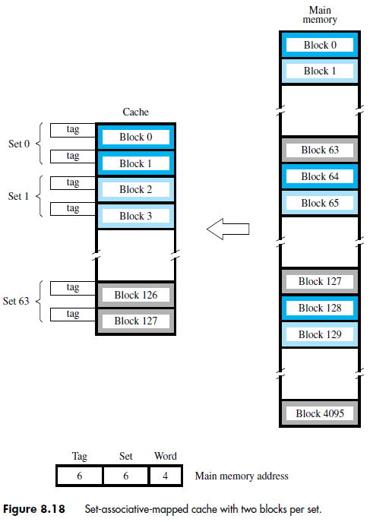
Cache Memories-21 Mapping Functions
Memory blocks 0, 64, 128, . . . , 4032 map into cache set 0, and they can occupy either of the two block positions within this set.
Having 64 sets means that the 6-bit set field of the address determines which set of the cache might contain the desired block.

Slide 99
Cache Memories-22 Mapping Functions
The tag field of the address must then be associatively compared to the tags of the two blocks of the set to check if the desired block is present. This two-way associative search is simple to implement.
The number of blocks per set is a parameter that can be selected to suit the requirements of a particular computer.
For the main memory and cache sizes in above example, four blocks per set can be accommodated by a 5-bit set field, eight blocks per set by a 4-bit set field, and so on.
The extreme condition of 128 blocks per set requires no set bits and corresponds to the fully-associative technique, with 12 tag bits. The other extreme of one block per set is the direct-mapping method.
A cache that has k blocks per set is referred to as a k-way set-associative cache.

Slide 100
Cache Memories-23
Stale Data
When power is first turned on, the cache contains no valid data. A control bit, usually called the valid bit, must be provided for each cache block to indicate whether the data in that block are valid.
The valid bits of all cache blocks are set to 0 when power is initially applied to the system. Some valid bits may also be set to 0 when new programs or data are loaded from the disk into the main memory.
Data transferred from the disk to the main memory using the DMA mechanism are usually loaded directly into the main memory, bypassing the cache.
If the memory blocks being updated are currently in the cache, the valid bits of the corresponding cache blocks are set to 0.
As program execution proceeds, the valid bit of a given cache block is set to 1 when a memory block is loaded into that location.
The processor fetches data from a cache block only if its valid bit is equal to 1. The use of the valid bit in this manner ensures that the processor will not fetch stale (old) data from the cache.

Slide 101
Cache Memories-24
A similar precaution is needed in a system that uses the write-back protocol. Under this protocol, new data written into the cache are not written to the memory at the same time.
Hence, data in the memory do not always reflect the changes that may have been made in the cached copy. It is important to ensure that such stale data in the memory are not transferred to the disk.
One solution is to flush the cache, by forcing all dirty blocks to be written back to the memory before performing the transfer. The operating system can do this by issuing a command to the cache before initiating the DMA operation that transfers the data to the disk.
Flushing the cache does not affect performance greatly, because such disk transfers do not occur often. The need to ensure that two different entities (the processor and the DMA subsystems in this case) use identical copies of the data is referred to as a cache-coherence problem.

Slide 102
Virtual Memory-1
Recall that an important challenge in the design of a computer system is to provide a large, fast memory system at an affordable cost.
Architectural solutions to increase the effective speed and size of the memory system.
Cache memories were developed to increase the effective speed of the memory system.
Virtual memory is an architectural solution to increase the effective size of the memory system.

Slide 103
Virtual Memory-2
Recall that the addressable memory space depends on the number of address bits in a computer.
For example, if a computer issues 32-bit addresses, the addressable memory space is 4G bytes.
Physical main memory in a computer is generally not as large as the entire possible addressable space.
Physical memory typically ranges from a few hundred megabytes to 1G bytes.
Large programs that cannot fit completely into the main memory have their parts stored on secondary storage devices such as magnetic disks.
Pieces of programs must be transferred to the main memory from secondary storage before they can be executed.

Slide 104
Virtual Memory-3
When a new piece of a program is to be transferred to the main memory, and the main memory is full, then some other piece in the main memory must be replaced.
Recall this is very similar to what we studied in case of cache memories.
Operating system automatically transfers data between the main memory and secondary storage.
Application programmer need not be concerned with this transfer.
Also, application programmer does not need to be aware of the limitations imposed by the available physical memory.

Slide 105
Virtual Memory-4
Techniques that automatically move program and data between main memory and secondary storage when they are required for execution are called virtual-memory techniques.
Programs and processors reference an instruction or data independent of the size of the main memory.
Processor issues binary addresses for instructions and data.
These binary addresses are called logical or virtual addresses.
Virtual addresses are translated into physical addresses by a combination of hardware and software subsystems.
If virtual address refers to a part of the program that is currently in the main memory, it is accessed immediately.
If the address refers to a part of the program that is not currently in the main memory, it is first transferred to the main memory before it can be used.

Slide 106
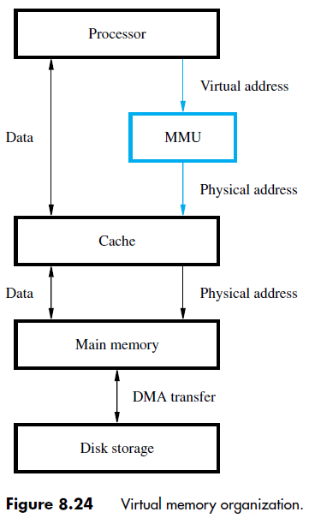
Virtual Memory-5
Memory management unit (MMU) translates virtual addresses into physical addresses.
If the desired data or instructions are in the main memory they are fetched as described previously.
If the desired data or instructions are not in the main memory, they must be transferred from secondary storage to the main memory.
MMU causes the operating system to bring the data from the secondary storage into the main memory.

Slide 107
Virtual Memory-6 Address Translation
Assume that program and data are composed of fixed-length units called pages.
A page consists of a block of words that occupy contiguous locations in the main memory.
Page is a basic unit of information that is transferred between secondary storage and main memory.
Size of a page commonly ranges from 2K to 16K bytes.
Pages should not be too small, because the access time of a secondary storage device is much larger than the main memory.
Pages should not be too large, else a large portion of the page may not be used, and it will occupy valuable space in the main memory.

Slide 108
Virtual Memory-7 Address Translation
Concepts of virtual memory are similar to the concepts of cache memory.
Cache memory:
Introduced to bridge the speed gap between the processor and the main memory.
Implemented in hardware.
Virtual memory:
Introduced to bridge the speed gap between the main memory and secondary storage.
Implemented in part by software.

Slide 109
Virtual Memory-8 Address Translation
Each virtual or logical address generated by a processor is interpreted as a virtual page number (high-order bits) plus an offset (low-order bits) that specifies the location of a particular byte within that page.
Information about the main memory location of each page is kept in the page table.
Main memory address where the page is stored.
Current status of the page.
Area of the main memory that can hold a page is called as page frame.
Starting address of the page table is kept in a page table base register.

Slide 110
Virtual Memory-9 Address Translation
Virtual page number generated by the processor is added to the contents of the page table base register.
This provides the address of the corresponding entry in the page table.
The contents of this location in the page table give the starting address of the page if the page is currently in the main memory.

Slide 111
Virtual Memory-10 Address Translation
PTBR holds
the address of
the page table.
Virtual address from processor
Page table base register
Page table address
Virtual page number
Offset
Virtual address is
interpreted as page
number and offset.
+
PTBR + virtual
page number provide
the entry of the page
in the page table.
PAGE TABLE
This entry has the starting location
of the page.
Page table holds information
about each page. This includes
the starting address of the page
in the main memory.
Control
Page frame
bits
in memory
Page frame
Offset
Physical address in main memory`

Slide 112
Virtual Memory-11 Address Translation
Page table entry for a page also includes some control bits which describe the status of the page while it is in the main memory.
One bit indicates the validity of the page.
Indicates whether the page is actually loaded into the main memory.
Allows the operating system to invalidate the page without actually removing it.
One bit indicates whether the page has been modified during its residency in the main memory.
This bit determines whether the page should be written back to the disk when it is removed from the main memory.
Similar to the dirty or modified bit in case of cache memory.
Other control bits for various other types of restrictions that may be imposed.
For example, a program may only have read permission for a page, but not write or modify permissions.

Slide 113
Virtual Memory-12 Address Translation
Where should the page table be located?
Recall that the page table is used by the MMU for every read and write access to the memory.
Ideal location for the page table is within the MMU.
Page table is quite large.
MMU is implemented as part of the processor chip.
Impossible to include a complete page table on the chip.
Page table is kept in the main memory.
A copy of a small portion of the page table can be accommodated within the MMU.
Portion consists of page table entries that correspond to the most recently accessed pages.

Slide 114
Virtual Memory-13 Translation Lookaside Buffer
A small cache called as Translation Lookaside Buffer (TLB) is included in the MMU.
TLB holds page table entries of the most recently accessed pages.
Recall that cache memory holds most recently accessed blocks from the main memory.
Operation of the TLB and page table in the main memory is similar to the operation of the cache and main memory.
Page table entry for a page includes:
Address of the page frame where the page resides in the main memory.
Some control bits.
In addition to the above for each page, TLB must hold the virtual page number for each page.

Slide 115
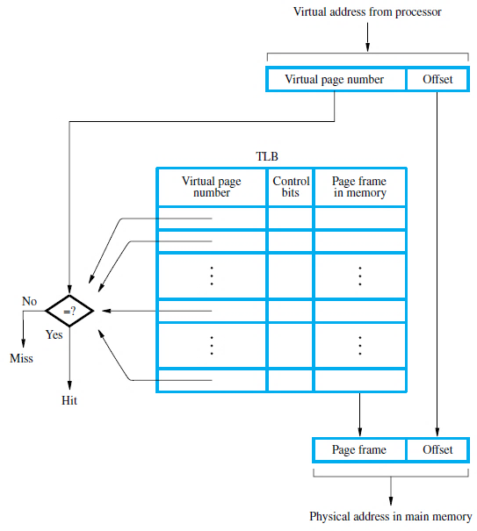
Virtual Memory-14 Translation Lookaside Buffer
Associative-mapped TLB
High-order bits of the virtual address generated by the processor select the virtual page.
These bits are compared to the virtual page numbers in the TLB.
If there is a match, a hit occurs and the corresponding address of the age frame is read.
If there is no match, a miss occurs and the page table within the main memory must be consulted.
Set-associative mapped TLBs are found in commercial processors.

Slide 116
Virtual Memory-15 Translation Lookaside Buffer
How to keep the entries of the TLB coherent with the contents of the page table in the main memory?
Operating system may change the contents of the page table in the main memory.
Simultaneously it must also invalidate the corresponding entries in the TLB.
A control bit is provided in the TLB to invalidate an entry.
If an entry is invalidated, then the TLB gets the information for that entry from the page table.
Follows the same process that it would follow if the entry is not found in the TLB or if a “miss” occurs.

Slide 117
Virtual Memory-16 Page Faults
What happens if a program generates an access to a page that is not in the main memory?
In this case, a page fault is said to occur.
Whole page must be brought into the main memory from the disk, before the execution can proceed.
Upon detecting a page fault by the MMU, following actions occur:
MMU asks the operating system to intervene by raising an exception.
Processing of the active task which caused the page fault is interrupted.
Control is transferred to the operating system.
Operating system copies the requested page from secondary storage to the main memory.
Once the page is copied, control is returned to the task which was interrupted.

Slide 118
Virtual Memory-17 Page Faults
Servicing of a page fault requires transferring the requested page from secondary storage to the main memory.
This transfer may incur a long delay.
While the page is being transferred the operating system may:
Suspend the execution of the task that caused the page fault.
Begin execution of another task whose pages are in the main memory.
Enables efficient use of the processor.

Slide 119
Virtual Memory-18 Page Faults
How to ensure that the interrupted task can continue correctly when it resumes execution?
There are two possibilities:
Execution of the interrupted task must continue from the point where it was interrupted.
The instruction must be restarted.
Which specific option is followed depends on the design of the processor.

Slide 120
Virtual Memory-19 Page Faults
When a new page is to be brought into the main memory from secondary storage, the main memory may be full.
Some page from the main memory must be replaced with this new page.
How to choose which page to replace?
This is similar to the replacement that occurs when the cache is full.
The principle of locality of reference can also be applied here.
A replacement strategy similar to LRU can be applied.
Since the size of the main memory is relatively larger compared to cache, a relatively large amount of programs and data can be held in the main memory.
Minimizes the frequency of transfers between secondary storage and main memory.

Slide 121
Virtual Memory-20 Page Faults
A page may be modified during its residency in the main memory.
When should the page be written back to the secondary storage?
Recall that we encountered a similar problem in the context of cache and main memory:
Write-through protocol(?)
Write-back protocol(?)
Write-through protocol cannot be used, since it will incur a long delay each time a small amount of data is written to the disk.

Slide 122
Thank You

