Slide 1

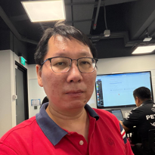

TEAM 6
EasyInvoice
React learning project
for B2B e-invoicing
Ralph Koh
Kwan Liang
Ang Jenn
Fang
John
Phang
NTU AI Engineering, Module 2
Live demo follows this short overview
Notes:
Timing: 25 seconds. Introduce EasyInvoice as the team's React learning project. The slides take about four minutes, followed by the working demo. Sources: README.md and docs/planning/presentation-outline.md.

Slide 2
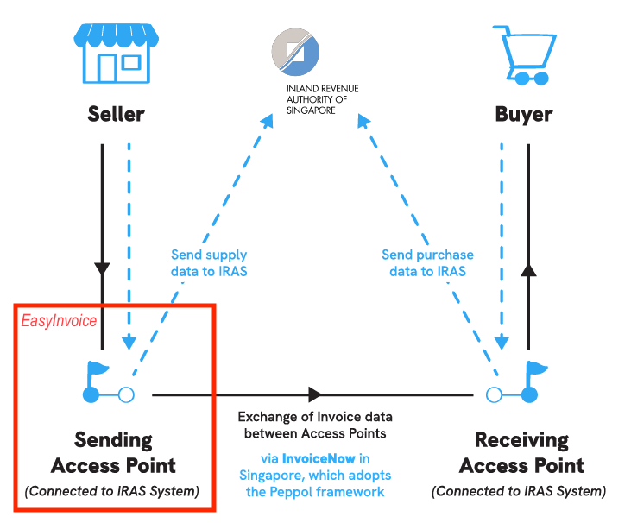
Problem and audience
Invoice work spans creation,
transmission and payment status
Audience
Small business finance and accounts receivable teams
EasyInvoice
A browser demo of the invoice lifecycle using Singapore InvoiceNow concepts
Simulated network. Synthetic data only.
Notes:
Timing: 40 seconds. Explain that small finance teams need one view of invoice creation, transmission and collection status. EasyInvoice demonstrates that workflow but does not connect to the real InvoiceNow network. Sources: README.md and docs/images/Peppol-InvoiceNow.png.

Slide 3
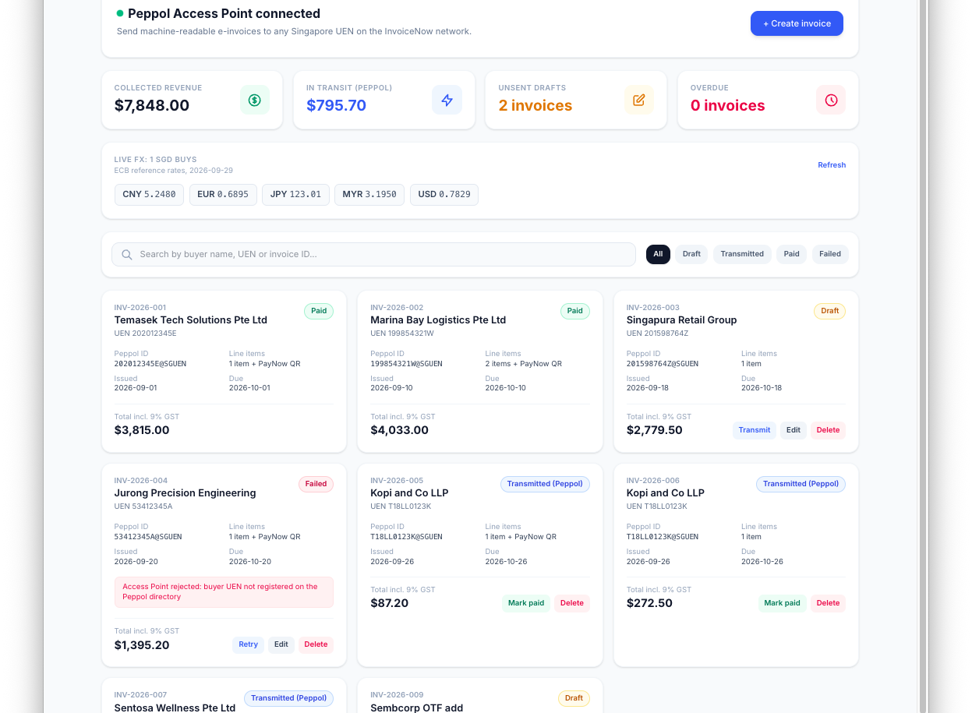
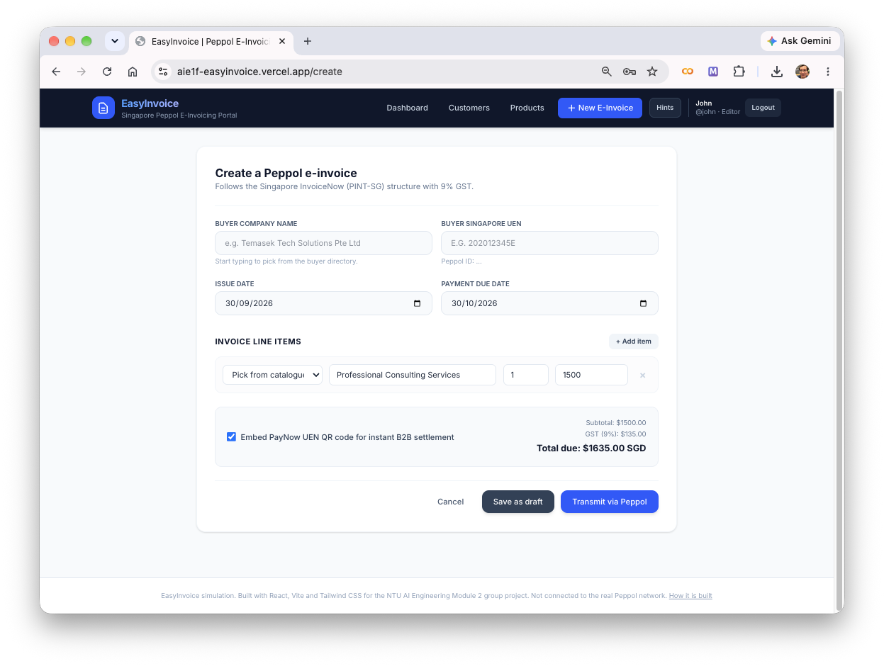
Working application
Dashboard
Create invoice
Search, filter, status and actions
Controlled form, catalogue items and GST
Notes:
Timing: 40 seconds. Point out the dashboard's operational view and the controlled create form. The live demo will show search, invoice creation, simulated transmission and status changes. Sources: docs/images/dashboard.png and docs/images/create-invoice.png.

Slide 4
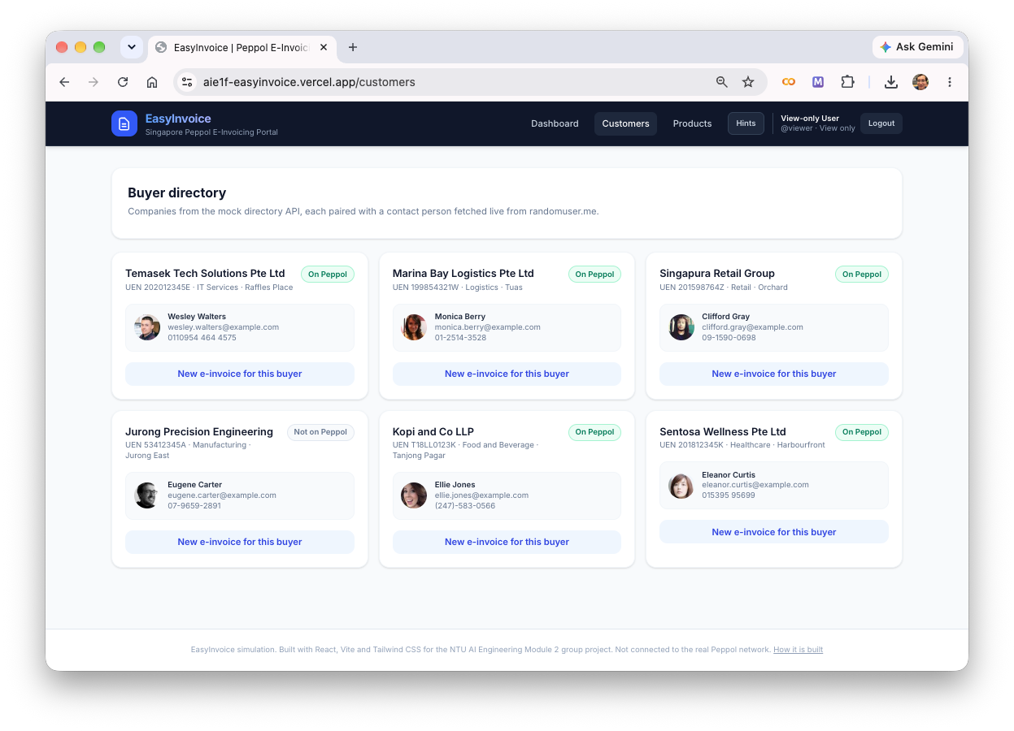
Technology and data
React 19 + Vite 8
MockAPI reference data
Components, hooks and fast local builds
React Router 7
Public login/tour and protected app routes
MockAPI
Shared CRUD persistence, no custom server
Vitest + React Testing Library
37 behaviour tests in GitHub Actions
Public APIs
FX rates and illustrative customer contacts
Notes:
Timing: 50 seconds. Explain why each technology was chosen. MockAPI provides shared persistence without a custom backend. The free tier allowed two resources, so customers and products share referenceData. Sources: README.md, docs/engineering/architecture-design.md and docs/images/referenceData-customers.png.

Slide 5
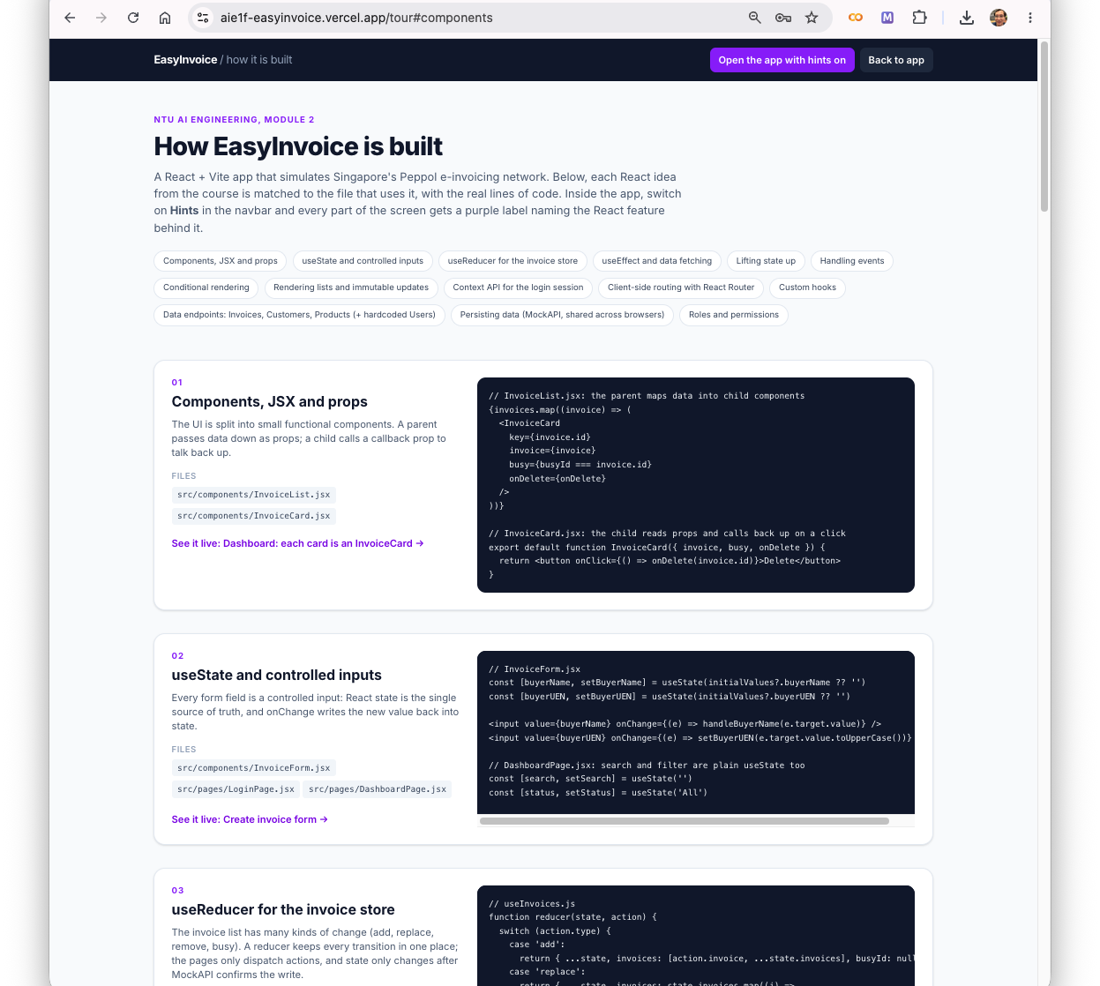
Team learnings
Ralph Koh
Structured a complete React app with reusable components, routes and shared state
Ang Jenn Fang
Tested user behaviour with Vitest, React Testing Library and mocks
John Phang
Integrated hosted persistence, role checks and CI across parallel branches
Notes:
Timing: 45 seconds. Summarise each member's learning focus. Ralph built the initial React application, Jenn established behavioural testing, and John integrated persistence, permissions and repository automation. Sources: docs/planning/presentation-outline.md, README.md and docs/images/Full_tour_with_code.png.

Slide 6
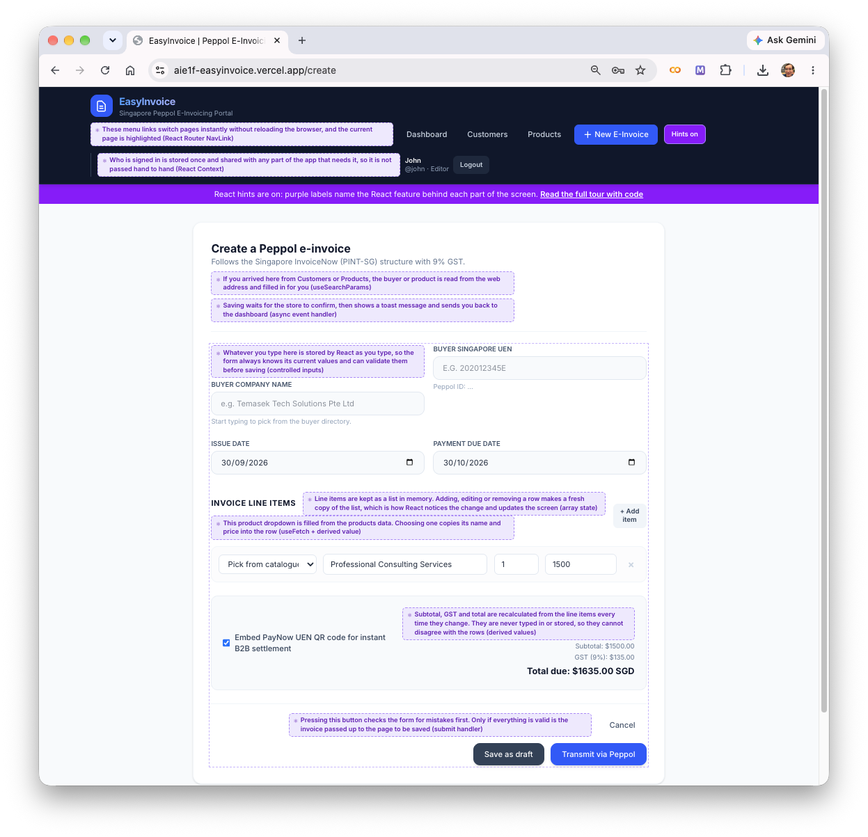
Challenges and responses
MockAPI allowed two resources
Customers and products share a typed referenceData resource
The schema editor could erase records
The team documented the risk and added repeatable seed data
Session-key mismatch after integration
Tests caught the regression before release
Live demo next: viewer permissions, create and transmit, mark paid
Notes:
Timing: 50 seconds. Describe the resource-limit decision, the destructive schema-editor risk and the integration bug found by tests. Then move directly to the live demo: compare viewer and editor access, create and transmit an invoice, and mark a transmitted invoice paid. Sources: docs/planning/presentation-outline.md, docs/decisions/decisions-log.md and docs/images/Hints-ON.png.

