Slide 1


Quantifier Elimination via Functional Composition
Jie-Hong Roland Jiang
Dept. of Electrical Eng. / Grad. Inst. of Electronics Eng.
National Taiwan University
Taipei 10617, Taiwan

Slide 2
Outline
Motivations
Prior work
Quantifier elimination by functional composition
  Propositional logic
  Predicate logic
Experimental results
Conclusions

Slide 3
Introduction
Quantifier elimination transforms a quantified formula, e.g., ∃x₁∀x₂∃x₃ ⋅⋅⋅ ∀x_{n} ϕ, into an equivalent quantifier-free formula ψ
  ψ can be preferable to ∃x₁∀x₂∃x₃ ⋅⋅⋅ ∀x_{n} ϕ
    E.g.,
    Properties of ψ can be reasoned more easily
    ψ can be treated as a synthesis result for implementation

Slide 4
Introduction
QE examples
  Gauss elimination for systems of linear equalities
  Fourier-Motzkin elimination for systems of linear inequalities
  Cylindrical algebraic decomposition for systems of polynomial inequalities

Slide 5
Motivations
QE arises in many contexts, including computation theory, mathematical logic, optimization, …
  Constraint reduction
  Quantified Boolean Formula (QBF) solving

Slide 6
Main focus
Propositional logic
  Quantifier elimination for QBFs

Slide 7
Prior work
Formula expansion
  ∃y ϕ(x,y) = ϕ(x,0) ∨ ϕ(x,1)
  BDD, AIG based image-computation [Coudert90][Pigorsch06]
Normal-form conversion
  Existential (universal) quantification is computationally trivial for disjunctive (conjunctive) normal form formulas
    Simply remove from the formula the literals of variables to be quantified
    E.g., ∀x₁[(x₁ ∨ x₂ ∨ x₃)(¬x₁ ∨ x₃)(x₂ ∨ x₄)] = (x₂ ∨ x₃)(x₃)(x₂ ∨ x₄)
  Formula conversion between CNF and DNF [McMillan02]
Solution enumeration
  Compute ψ(x) = ∃y ϕ(x,y) by enumerating all satisfiable assignments on x
  SAT-based image computation, e.g., [Ganai04]
Yet another way?

Slide 8
Question
Given a quantified formula ∃y ϕ(x,y), what should a function f be such that ϕ(x,f(x)) = ∃y ϕ(x,y)?
I.e., QE by functional composition

Slide 9
Answer
ϕ(x,f(x)) = ∃y ϕ(x,y) if and only if
  f has
  care onset ϕ(x,1) ∧ ¬ϕ(x,0)
  care offset ϕ(x,0) ∧ ¬ϕ(x,1)
  don’t care set ϕ(x,1) ≡ ϕ(x,0)
  In other words,
  (ϕ(x,1) ∧ ¬ϕ(x,0)) ≤ f ≤ ¬(ϕ(x,0) ∧ ¬ϕ(x,1))
  Such f always exists

Slide 10
Problem formulation
For universal quantification
∀y ϕ(x,y) = ¬∃y ¬ϕ(x,y) = ¬¬ϕ(x,f(x)) = ϕ(x,f(x))
  f has
  care onset ¬ϕ(x,1) ∧ ϕ(x,0)
  care offset ¬ϕ(x,0) ∧ ϕ(x,1)
  don’t care set ϕ(x,1) ≡ ϕ(x,0)
So by computing composite functions f, one can iteratively eliminate the quantifiers of any QBF

Slide 11
Computation
f can be computed by
  Binary decision diagrams (BDDs)
    Not scalable for large ϕ
  Craig interpolation

Slide 12
Craig interpolation
(Propositional logic)
For ϕ_{A} ∧ ϕ_{B} unsatisfiable, there exists an interpolant ι of ϕ_{A} w.r.t. ϕ_{B} such that
1. ϕ_{A} ⇒ ι
2. ι ∧ ϕ_{B} is unsatisfiable
3. ι refers only to the common variables of ϕ_{A} and ϕ_{B}

Slide 13
Computation
  care onset ϕ(x,1) ∧ ¬ϕ(x,0)
  care offset ϕ(x,0) ∧ ¬ϕ(x,1)
  don’t care set ϕ(x,1) ≡ ϕ(x,0)
ι
interpolant
ϕ_{A}
care onset
ϕ_{B}
care offset
The interpolant is a valid implementation of f, which can be obtained from the refutation of ϕ_{A} ∧ ϕ_{B} in SAT solving and can be naturally represented in And-Inverter Graphs (AIGs)

Slide 14
Composition vs. expansion
Is ϕ(x,f(x)) better than ϕ(x,0) ∨ ϕ(x,1) ?
f
x
x
in terms of AIGs, where structurally identical nodes are merged

Slide 15
Composition vs. expansion
[∃] Consider simplifying ϕ(x,1) in ϕ(x,0) ∨ ϕ(x,1) using ϕ(x,0) as don’t care
care onset ϕ(x,1) ∧ ¬ϕ(x,0)
care offset ¬ϕ(x,1) ∧ ¬ϕ(x,0)
In contrast to f with
care onset ϕ(x,1) ∧ ¬ϕ(x,0)
care offset ϕ(x,0) ∧ ¬ϕ(x,1)
For existential quantification, composition can be much better than expansion for sparse ϕ (due to simple interpolants)

Slide 16
Composition vs. expansion
[∀] Consider simplifying ϕ(x,1) in ϕ(x,0) ∧ ϕ(x,1) using ¬ϕ(x,0) as don’t care
care onset ϕ(x,1) ∧ ϕ(x,0)
care offset ¬ϕ(x,1) ∧ ϕ(x,0)
In contrast to f with
care onset ¬ϕ(x,1) ∧ ϕ(x,0)
care offset ¬ϕ(x,0) ∧ ϕ(x,1)
For universal quantification, composition can be much better than expansion for dense ϕ (due to simple interpolants)

Slide 17
Generalization to predicate logic
For a language L in predicate logic under structure (interpretation) I,
|=_{I} ∀x(∃y ϕ(x,y) = ∃F ϕ(x,Fx))
  QE is possible if such function F is finitely expressible in the language
    If ∃y ϕ(x,y) = ϕ(x,fx), then ϕ(a,b)∨¬∃y ϕ(a,y) is satisfied for any a, b with f(a)=b
    If for any a, b with f(a)=b satisfies ϕ(a,b)∨¬∃y ϕ(a,y), then
    ∃y ϕ(x,y) = ∨ (γ_{i} ∧ ϕ(x,f_{i}x)), where f = f_{i} if γ_{i} holds
    {(a,b) | ϕ(a,b)∨¬∃y ϕ(a,y)} characterizes the flexibility of f, which can be exploited to simplify QE

Slide 18
Generalization to predicate logic
Example
∃x(a⋅x²+c=0) over the real number
f(a,c) = (–c/a)^{1/2} if c/a ≤ 0
– if c/a > 0
Taking f(a,c) = (((–c/a)²)^{1/2})^{1/2}, this quantified formula is equivalent to
a⋅((((–c/a)²)^{1/2})^{1/2})²+c=0

Slide 19
Experiments
Given a sequential circuit, we compute its transition relation with input variables being quantified out, i.e.,
∃x [∧_{i} (s_{i}' ≡ δ_{i}(x,s))]
  Simple quantification scheduling applied
  AIG minimization applied

Slide 20
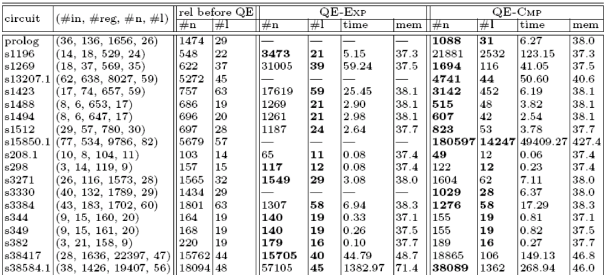
Experimental results

Slide 21
Discussion
Expansion vs. composition based QE
  Analogy with two-level vs. multi-level circuit minimization
    Relaxing level constraints admits more compact circuit representation
Sparsity may play an essential role in the effectiveness of composition-based QE

Slide 22
Conclusions
Quantifier elimination with functional composition can be effective at least for some applications (where the sparsity condition holds)
Future work
  Find more applications
  QE in predicate logic

Slide 23
Thanks for your attention!

Slide 24
Questions?

