Slide 1



BooM: A Decision Procedure for Boolean Matching with Abstraction & Dynamic Learning
Chih-Fan Lai¹, J.-H. Roland Jiang¹, and
Kuo-Hua Wang²
¹National Taiwan University
²Fu Jen Catholic University

Slide 2
Outline
Introduction to Boolean matching
Our formulation and solution
Experimental evaluation
Conclusions and future work

Slide 3
Introduction
Combinational equivalence checking (CEC)
  Known input correspondence
  coNP-complete
  Well solved in practical applications
f
g
x₁
x₂
x_{n}
y₁
y₂
y_{n}
…
…

Slide 4
Introduction
Boolean matching
  P-equivalence
    Unknown input permutation
    O(n!) CEC iterations
  NP-equivalence
    Unknown input negation and permutation
    O(2^{n}n!) CEC iterations
  NPN-equivalence
    Unknown input negation, input permutation, and output negation
    O(2^{n+1}n!) CEC iterations
N
f
g
x₁
x₂
x_{n}
y₁
y₂
y_{n}
…
…
P
N
π
ν

Slide 5
Introduction
Example
=
g
f
x₁
x₂
x₃
y₁
y₂
y₃
x₁
x₂
x₃

Slide 6
Introduction
Motivations
  Theoretically
    Complexity in between
    coNP (for all …) and
    ∑₂ (there exists … for all …)
    in the Polynomial Hierarchy (PH)
      Special candidate to test PH collapse
    Known as Boolean congruence/isomorphism dating back to the 19th century
  Practically
    Broad applications
      Library binding
      FPGA technology mapping
      Detection of generalized symmetry
      Logic verification
      Design debugging/rectification
      Functional engineering change order
    Intensively studied over the last two decades
PSPACE
Π₂
∑₂
coNP
NP
P

Slide 7
Introduction
Prior methods
 | Complete ? | Function type | Equivalence type | Solution type | Scalability
Spectral methods | yes | CS | mostly P | one | – –
Signature based methods | no | mostly CS | P/NP | N/A | – ~ ++
Canonical-form based methods | yes | CS | mostly P | one | +
SAT based methods | yes | CS | mostly P | one/all | +
BooM (QBF/SAT-like) | yes | CS / IS | NPN | one/all | ++
CS: completely specified
IS: incompletely specified

Slide 8
Main Results
Features of BooM
  General computation framework
  Effective search space reduction techniques
    Dynamic learning and abstraction
  Theoretical SAT-iteration upper-bound:
O(2^{n}n!)
O(2^{2n})

Slide 9
Formulation
Reduce NPN-equiv to 2 NP-equiv checks
  Matching f and g; matching f and ¬g
2nd order formula of NP-equivalence
  f_{c} and g_{c} are the care conditions of f and g, respectively
Need 1st order formula instead for SAT solving
∃ν。π,∀x ((f_{c}(x) ∧ g_{c}(ν。π(x))) ⇒ (f(x) ≡ g(ν。π(x))))

Slide 10
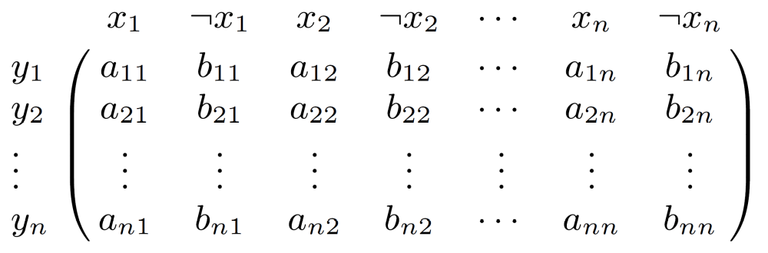
Formulation
0-1 matrix representation of ν。π
∑ =1
∑ =1
a_{ij} ⇒ (x_{j} ≡ y_{i})
b_{ij} ⇒ (¬x_{j} ≡ y_{i})

Slide 11
Formulation
Quantified Boolean formula (QBF) for NP-equivalence
  ϕ_{C}: cardinality constraint
  ϕ_{A}: /\_{i,j} (a_{ij} ⇒ (y_{i} ≡ x_{j})) (b_{ij} ⇒ (y_{i} ≡ ¬x_{j}))
Look for an assignment to a- and b-variables that satisfies ϕ_{C} and makes the miter constraint
Ψ = ϕ_{A} ∧ (f ≠ g) ∧ f_{c} ∧ g_{c}
unsatisfiable
Refine ϕ_{C} iteratively in a sequence Φ^{⟨0⟩}, Φ^{⟨1⟩}, …, Φ^{⟨k⟩}, for Φ^{⟨i+1⟩} ⇒ Φ^{⟨i⟩} through conflict-based learning
∃a,∃b,∀x,∀y (ϕ_{C} ∧ ϕ_{A} ∧((f_{c} ∧ g_{c}) ⇒ (f ≡ g))

Slide 12
BooM Flow
f (and f_{c})
g (and g_{c})
Preprocess
(sig., abs.)
How to compute all matches?
i=0
Solve mapping Φ^{⟨i⟩}
i=i+1
Solve Φ^{⟨i⟩} ∧ Ψ
no
SAT?
No match
Add learned clause to Φ^{⟨i⟩}
yes
Solve miter Ψ
Ψ
Φ^{⟨i⟩} characterizes all matches
no
SAT?
yes
Match found

Slide 13
NP-Equivalence
Conflict-based Learning
Observation
≠
How to avoid these 6 mappings at once?
1
0
f
g
1 0 1
0 1 1
ν。π
From SAT 1
1 0 1

Slide 14
NP-Equivalence
Conflict-based Learning
Learnt clause generation
( a₁₁ ∨ b₁₂ ∨ a₁₃ ∨ b₂₁ ∨ a₂₂ ∨ b₂₃ ∨ b₃₁ ∨ a₃₂ ∨ b₃₃ )
a₁₁
b₁₂
a₁₃
b₂₁
a₂₂
b₂₃
b₃₁
a₃₂
b₃₃
1
0
f
g
1
0
1
0
1
1
ν。π
1
0
1

Slide 15
NP-Equivalence
Conflict-based Learning
Proposition:
If f(u) ≠ g(v) with v = ν。π(u) for some ν。π satisfying Φ^{⟨i⟩}, then the learned clause \/_{ij} l_{ij} for literals
l_{ij} = (v_{i} ≠ u_{j}) ? a_{ij} : b_{ij}
excludes from Φ^{⟨i⟩} the mappings {ν′。π′ | ν′。π′(u) = ν。π(u)}
Proposition:
The learned clause prunes n! infeasible mappings
Proposition:
The refinement process Φ^{⟨0⟩}, Φ^{⟨1⟩}, …, Φ^{⟨k⟩} is bounded by 2^{2n} iterations

Slide 16
NP-Equivalence
Abstraction
Abstract Boolean matching
  Abstract f(x₁,…,x_{k},x_{k+1},…,x_{n}) to f(x₁,…,x_{k},z,…,z) = f*(x₁,…,x_{k},z)
  Match g(y₁,…,y_{n}) against f*(x₁,…,x_{k},z)
  Infeasible matching solutions of f* and g are also infeasible for f and g
f
f
g
f*
x_{k}
x_{k+1}
x_{n}
x_{k}
x_{k}
x₁
z
z
z
y_{k}
y_{k+1}
y_{n}
x₁
y₁
x₁
…
…
…
…
…
…
…
P
N

Slide 17
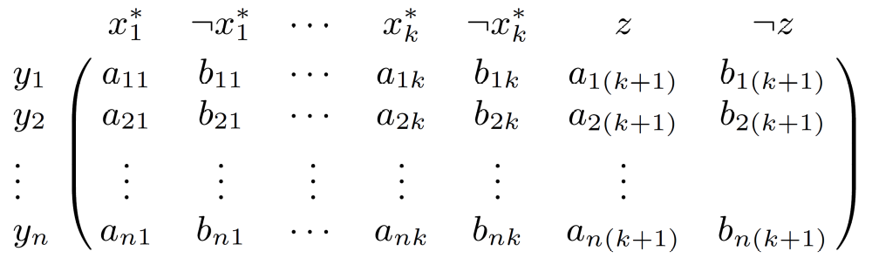
NP-Equivalence
Abstraction
Abstract Boolean matching
  Similar matrix representation of negation/permutation
    Similar cardinality constraints, except for allowing multiple y-variables mapped to z
∑ =1
∑ =1

Slide 18
NP-Equivalence
Abstraction
Used for preprocessing
Information learned for abstract model is valid for concrete model
Simplified matching in reduced Boolean space

Slide 19
P-Equivalence
Conflict-based Learning
Proposition:
If f(u) ≠ g(v) with v = π(u) for some π satisfying Φ^{⟨i⟩}, then the learned clause \/_{ij} l_{ij} for literals
l_{ij} = (v_{i}=0 and u_{j}=1) ? a_{ij} : ∅
excludes from Φ^{⟨i⟩} the mappings {π′ | π′(u) = π(u)}

Slide 20
P-Equivalence
Abstraction
Abstraction enforces search in biased truth assignments and makes learning strong
  For f* having k support variables, a learned clause converted back to the concrete model consists of at most (k–1)(n–k+1) literals

Slide 21
Experimental Setup
BooM implemented in ABC using MiniSAT
A function is matched against its synthesized, and input-permuted/negated version
  Match individual output functions of MCNC, ISCAS, ITC benchmark circuits
    717 functions with 10~39 support variables and 15~2160 AIG nodes
  Time-limit 600 seconds
  Baseline preprocessing exploits symmetry, unateness, and simulation for initial matching

Slide 22
Experimental Results
Learning
Abstraction
(P-equivalence; find all matches)

Slide 23
Experimental Results
P-equivalence
NP-equivalence

Slide 24
Experimental Results
BooM vs. DepQBF
(runtime after same preprocessing;
P-equivalence; find one match)

Slide 25
Conclusions
Proposed BooM, a dedicated decision procedure for Boolean matching
  Effective learning and abstraction
    Far faster than state-of-the-art QBF solver
    Theoretical upper bound reduced from O(2^{n}n!) to O(2^{2n})
      Empirically exponent ~7 times less for P, ~3 times less for NP
  General computation framework
    Handles NPN-equivalence, incompletely specified functions
    Allows easy integration with signature based methods
Anticipate BooM to be a common platform for other Boolean matching developments and to facilitate practical applications

Slide 26
Ongoing and Future Work
Generalize to multiple-output functions
Strengthen learning
Customize decision procedures for more computation problems

Slide 27
Thanks for Your Attention
Questions?

