Slide 1

To SAT or Not to SAT:
Ashenhurst Decomposition in a Large Scale
Hsuan-Po Lin, Jie-Hong Roland Jiang, and Ruei-Rung Lee
Graduate Institute of Electronics Engineering / Department of Electrical Engineering,
National Taiwan University
ICCAD 2008

Slide 2
Outline
1
Introduction
2
Prior Work
3
Our Approach
4
Experimental Results
5
Conclusions
ICCAD 2008

Slide 3
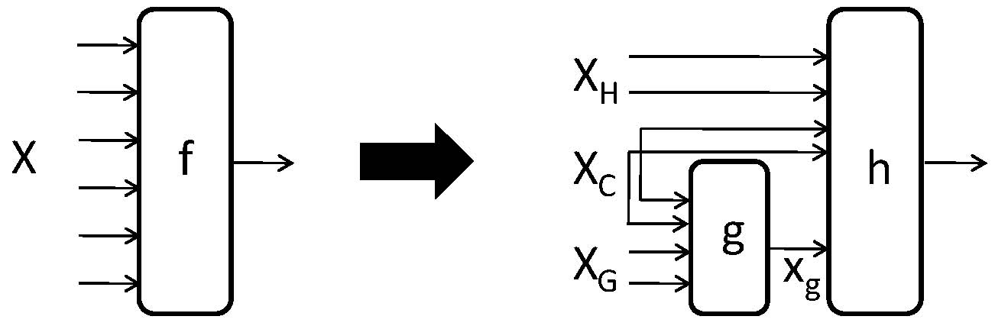
Introduction
Ashenhurst decomposition
  f(X) = h(X_{H},X_{C},g(X_{G},X_{C}))
  When can f be decomposed as the composition of some g and h?
  Comprehensible using decomposition chart
ICCAD 2008

Slide 4







Decomposition Chart
  f(a,b,c,d) = h(c,d,g(a,b,d))
X_{H} : {c}
X_{G} : {a,b}
X_{C} : {d}
f
a,b,d
X_{G} X_{C}
 | 000 | 010 | 100 | 110 | 001 | 011 | 101 | 111
00 | 0 | 0 | 0 | 0
10 | 0 | 1 | 1 | 0
01 |  |  |  |  | 0 | 0 | 1 | 1
11 |  |  |  |  | 1 | 1 | 0 | 0
 | 000 | 010 | 100 | 110 | 001 | 011 | 101 | 111
00 | 0 | 0 | 0 | 0
10 | 0 | 1 | 1 | 0
01 |  |  |  |  | 0 | 0 | 1 | 1
11 |  |  |  |  | 1 | 1 | 0 | 0
X_{H} X_{C}
c,d
h
g
 | 0 | 1 | 1 | 0 | 0 | 0 | 1 | 1
00 | 0 | 0 | 0 | 0
10 | 0 | 1 | 1 | 0
01 |  |  |  |  | 0 | 0 | 1 | 1
11 |  |  |  |  | 1 | 1 | 0 | 0
 | 0 | 1 | 1 | 0 | 0 | 0 | 1 | 1
00 | 0 | 0 | 0 | 0
10 | 0 | 1 | 1 | 0
01 |  |  |  |  | 0 | 0 | 1 | 1
11 |  |  |  |  | 1 | 1 | 0 | 0
X_{H} X_{C}
c,d
ICCAD 2008

Slide 5
Prior Work
BDD-based functional decomposition
  Memory explosion problem
  Variable partition cannot be automated
  Hard to handle non-disjoint decomposition
  Multiple-output decomposition cannot be handled naturally
ICCAD 2008

Slide 6
Our Approach
SAT-based computation
  Interpolation → get g
  Functional dependency → get h
With/without pre-specified variable partition
Single-/multiple-output decomposition
ICCAD 2008

Slide 7
Single-Output Decomposition
Problem formulation
  Given a function f(X) with variable partition X={X_{G}|X_{H}|X_{C}}, find g and h such that f(X) = h(X_{H},X_{C},g(X_{G},X_{C}))
ICCAD 2008

Slide 8
Decomposability as SAT
Functions g and h exists iff
(f(X_{H}¹, X_{G}¹, X_{C})≠ f(X_{H}¹, X_{G}², X_{C}))Λ
(f(X_{H}², X_{G}², X_{C})≠ f(X_{H}², X_{G}³, X_{C}))Λ
(f(X_{H}³, X_{G}³, X_{C})≠ f(X_{H}³, X_{G}¹, X_{C})) is UNSAT
1
1
1
x_{c}∈[[X_{C}]]
f
 | x_{g}¹∈[[X_{G}¹]] |  | x_{g}²∈[[X_{G}²]] |  | x_{g}³∈[[X_{G}³]]
x_{h}¹∈[[X_{H}¹]] | 1 |  | 0
x_{h}²∈[[X_{H}²]] |  |  | 0 |  | 1
x_{h}³∈[[X_{H}³]] | 1 |  |  |  | 0
f
f
f
f
f
f
X_{H}¹
X_{G}¹
X_{C}
X_{H}¹
X_{G}²
X_{C}
X_{H}²
X_{G}²
X_{C}
X_{H}²
X_{G}³
X_{C}
X_{H}³
X_{G}³
X_{C}
X_{H}³
X_{G}¹
X_{C}
ICCAD 2008

Slide 9
Craig Interpolation
For formulas φ_{A} and φ_{B} with φ_{A} Λ φ_{B} UNSAT, then there exists an interpolant P of φ_{A} such that
1. φ_{A} ⇒ P
2. P Λ φ_{B} is UNSAT
3. P refers only to the
common variables of
φ_{A} and φ_{B}
We show the connection between P and g
P
φ_{A}
φ_{B}
ICCAD 2008

Slide 10
Interpolating g-function
P: refer to the common variables X_{G}¹, X_{G}², X_{C}
φ_{A}: CP(X_{G}¹)≠CP(X_{G}²)
φ_{B}: CP(X_{G}²)≠CP(X_{G}³),CP(X_{G}¹)≠CP(X_{G}³), i.e., CP(X_{G}¹)=CP(X_{G}²)
f(X_{H}¹, X_{G}¹, X_{C})≠ f(X_{H}¹, X_{G}², X_{C})
(f(X_{H}², X_{G}², X_{C})≠ f(X_{H}², X_{G}³, X_{C}))Λ
(f(X_{H}³, X_{G}³, X_{C})≠ f(X_{H}³, X_{G}¹, X_{C}))
φ_{A}
φ_{B}
1
1
1
f
f
f
f
f
f
X_{H}¹
X_{G}¹
X_{C}
X_{H}¹
X_{G}²
X_{C}
X_{H}²
X_{G}²
X_{C}
X_{H}²
X_{G}³
X_{C}
X_{H}³
X_{G}³
X_{C}
X_{H}³
X_{G}¹
X_{C}
ICCAD 2008

Slide 11
Interpolating g-function (cont’d)
X_{G}¹
X_{G}²
X_{G}¹
X_{G}²
p
p
a
offset
q
q
r
r
s
s
onset
…
…
…
…
Relation characterized by
P(X_{G}¹, X_{G}²,c) for some c ∈ [[Xc]]
Relation after cofactoring
P(X_{G}¹=a, X_{G}²,c) w.r.t. some a ∈ [[X_{G}¹]]
P(X_{G}¹=a, X_{G}², X_{C}) is a feasible implementation of g(X_{G}, X_{C}) !
ICCAD 2008

Slide 12
Computing h-function
A naïve approach
  For X_{C} = ∅, function h can be derived using Shannon expansion
  h(X_{H},x_{g})=(¬x_{g} Λ h_{¬xg}) v (x_{g} Λ h_{xg})
  Non-scalable(w.r.t. X_{C} size)
  where
  h_{¬xg}(X_{H}) = h(X_{H},0) = h(X_{H},g(X_{G}=a)) = f(X_{H},X_{G}=a) and
  h_{xg}(X_{H}) = h(X_{H},1) = h(X_{H},g(X_{G}=b)) = f(X_{H},X_{G}=b)
  for a,b∈[[X_{G}]] with g(a)=0 and g(b)=1
ICCAD 2008

Slide 13
Computing h-function (cont’d)
A scalable approach
  Function h can be obtained with functional dependency formulation
    f(X) = h(φ₁(X), φ₂(X),…, φ_{m}(X)), where h is the unknown to be computed
    Let the above g_{i} be such that
    φ_{i} = x_{i} with x_{i} ∈ X_{H}∪X_{C} for i = 1,…,m-1
    φ_{m} = g(X_{G},X_{C})
    So-derived h is what we want
    Computation can be done with pure SAT solving [Lee et al.07]
ICCAD 2008

Slide 14
Overall Flow
AshenhurstDecomposition(f, X_{H}, X_{G}, X_{C}):
F ←CircuitInstantiation(f )
(φ_{A}, φ_{B}) ←CircuitPartition(F)
P(X_{G}¹,X_{G}²,X_{C}) ←Interpolation(φ_{A}, φ_{B})
g(X_{G},X_{C}) ←Cofactor(P, a∈[[X_{G}¹]])
h ←FunctionalDependency(f, g)
return(g, h)
ICCAD 2008

Slide 15
Automating Variable Partition
For each x_{i} ∈ X, add
  conditional clauses for X_{G}: ((x_{i}²≡x_{i}³)Λ(x_{i}⁴≡x_{i}⁵)Λ(x_{i}⁶≡x_{i}¹)) V α_{i}
  conditional clauses for X_{H}: ((x_{i}¹≡x_{i}²)Λ(x_{i}³≡x_{i}⁴)Λ(x_{i}⁵≡x_{i}⁶)) V β_{i}
(α_{i},β_{i})
  (0,0)→ x_{i} ∈ X_{C}
  (0,1)→ x_{i} ∈ X_{G}
  (1,0)→ x_{i} ∈ X_{H}
  (1,1)→ x_{i} can
  be in either of
  X_{G} and X_{H}
1
1
1
f
f
f
f
f
f
X_{H}¹
X_{G}¹
X_{C}¹
X_{H}²
X_{G}²
X_{C}²
X_{H}³
X_{G}³
X_{C}³
X_{H}⁴
X_{G}⁴
X_{C}⁴
X_{H}⁵
X_{G}⁵
X_{C}⁵
X_{H}⁶
X_{G}⁶
X_{C}⁶
ICCAD 2008

Slide 16
Automating Variable Partition (cont’d)
Make “unit assumptions” on control variables α_{i}, β_{i} for each x_{i}
Avoid trivial partition
  Impose seed partition
    Enforce one variable in X_{H}
    Enforce two variables in X_{G}
Enumerate seed partitions
  Incremental SAT solving
Apply minimal UNSAT core refinement to reduce X_{C}
ICCAD 2008

Slide 17
Multi-Output Decomposition
New UNSAT condition:
V(f_{i}(X_{H}¹, X_{G}¹, X_{C})≠ f_{i}(X_{H}¹, X_{G}², X_{C}))Λ
V(f_{i}(X_{H}², X_{G}², X_{C})≠ f_{i}(X_{H}², X_{G}³, X_{C}))Λ
V(f_{i}(X_{H}³, X_{G}³, X_{C})≠ f_{i}(X_{H}³, X_{G}¹, X_{C}))
Computation is same as before
i
i
i
X_{H}
X
f
X_{C}
h
...
g
...
X_{G}
x_{g}
ICCAD 2008

Slide 18
Experimental Setup
Implemented in ABC using MiniSAT
Linux, Xeon 3.4GHz CPU, and 6Gb RAM
Decompose primary-output and transition functions
  Only functions with no less than 50 inputs are considered
  ISCAS, MCNC, and ITC
ICCAD 2008

Slide 19
Experimental Results
Single-output decomposition
Circuit | #func | #var | #fail | #SAT_TO | #succ | #var_succ | #VP_avg | rate_ valid_VP | time_avg (sec) | Mem (Mb)
b15 | 370 | 143—306 | 0 | 51 | 319 | 143—306 | 1519 | 0.917 | 96.62 | 107.20
b17 | 1009 | 76—308 | 0 | 148 | 861 | 76—308 | 1645 | 0.904 | 87.12 | 125.84
c7552 | 36 | 50—194 | 0 | 2 | 34 | 50—194 | 1350 | 0.455 | 64.38 | 36.65
s13207 | 3 | 212—212 | 0 | 0 | 3 | 212—212 | 569 | 0.908 | 70.26 | 50.62
s38417 | 256 | 53—99 | 6 | 72 | 178 | 53—99 | 1090 | 0.523 | 103.33 | 136.04
s38584 | 7 | 50—147 | 0 | 0 | 7 | 50—147 | 1120 | 0.924 | 47.13 | 51.56
Two-output decomposition
Circuit | #pair | #var | #fail | #SAT_TO | #succ | #var_succ | #VP_avg | rate_ valid_VP | time_avg (sec) | Mem (Mb)
b15 | 201 | 145--306 | 0 | 31 | 170 | 145--269 | 1176 | 0.845 | 113.86 | 224.07
b17 | 583 | 79--310 | 0 | 88 | 495 | 79--308 | 676 | 0.824 | 103.12 | 419.35
c7552 | 21 | 56--195 | 0 | 2 | 19 | 56--141 | 188 | 0.465 | 89.57 | 78.67
s13207 | 3 | 212--228 | 0 | 0 | 3 | 212--228 | 585 | 0.7 | 93.36 | 118.03
s38417 | 218 | 53--116 | 13 | 30 | 175 | 53--116 | 689 | 0.498 | 109.06 | 319.48
s38584 | 9 | 50--151 | 0 | 0 | 9 | 50--151 | 1656 | 0.713 | 46.17 | 207.78
ICCAD 2008

Slide 20
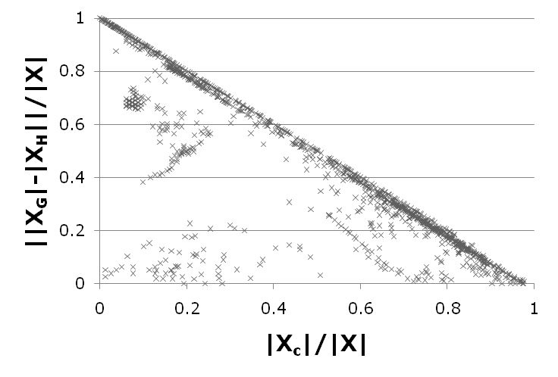
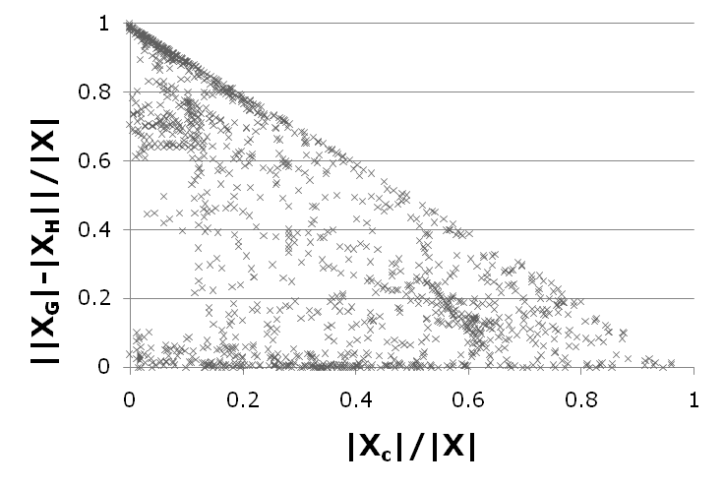
Experimental Results (cont’d)
Variable partition before / after UNSAT core refinement
ICCAD 2008

Slide 21
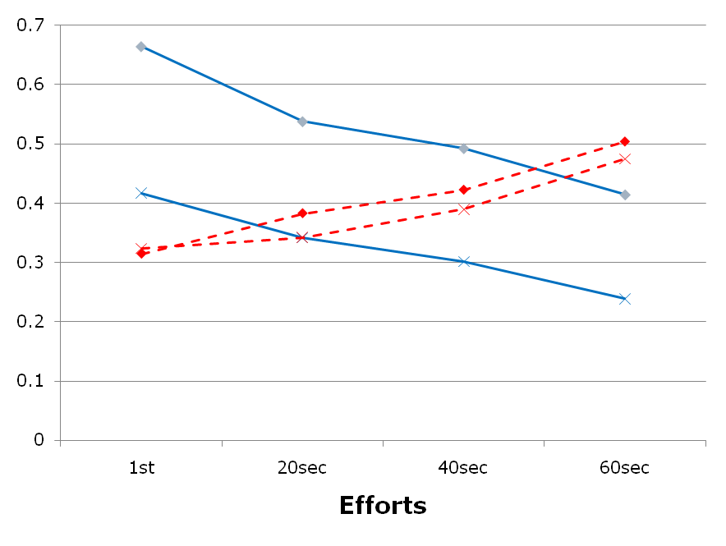
Experimental Results (cont’d)
Variable partition qualities resulted from different efforts
|X_{C}|/|X|
||X_{G}|-|X_{H}||/|X|
w/o mini
w/ mini
ICCAD 2008

Slide 22
Conclusions
Proposed pure SAT-based Ashenhurst decomposition
  Easily extendable to non-disjoint and multiple-output decompositions
  Scalable to functions with up to 300 input variables
Future work
  Functional decomposition beyond Ashenhurst
ICCAD 2008

Slide 23
Thanks for Your Attention!
ICCAD 2008

