Slide 1


Towards Completely Automatic Decoder Synthesis
Hsiou-Yuan Liu, Yen-Cheng Chou, Chen-Hsuan Lin, and Jie-Hong Roland Jiang
ALCom Lab
EE Dept/ Grad. Inst. of Electronics Eng.
National Taiwan University

Slide 2
Outline
Introduction
Decoder existence checking
Decoder synthesis
Experimental results
Conclusions

Slide 3

Introduction
Encoder
0,1,1,0,0,…
1,0,1,0,1,…
Decoder

Slide 4
Introduction
Decoding process under a bounded observation window
Encoder
…, o_{k}, o_{k+1}, o_{k+2}, o_{k+3}, o_{k+4}, o_{k+5}, …
Decoder
…
i_{j}
i_{j+1}
i_{j+1}
i_{j+2}
…

Slide 5


Introduction
Example
1/1
1/1
0/0
0/1
0/0
1/0
q₀
q₁
q₀
q₁
1/0
0/1
Output | Input
00... | ?0…
01… | ?1…
10… | ?1…
11… | ?0…
Output | Input
00... | 00... or 11…
01… | 01… or 10…
10… | 00… or 11…
11… | 01… or 10…

Slide 6
Introduction
Encoding/decoding scheme plays key roles in various applications, including
  Communication,
  Signal processing,
  Cryptography, …
Designing a decoder can be more difficult than designing an encoder
Automatic decoder synthesis helps a designer effectively and correctly implement his/her system

Slide 7
Introduction
Basic assumptions:
  Encoder can be sequential
    Combinational encoder is a special case
      Can be decoded with observation window of size 1
    Steady state behavior is of main concern
      Initial transient behavior is neglected
  Decoder has finite memory
    Bounded observation window

Slide 8
Prior Work
Decoder synthesis [Shen et al. ICCAD09]
  Bounded decoder existence checking
  Decoder generation using ALLSAT
Halting algorithm [Shen et al. FMCAD10]
  Unbounded decoder existence checking (with flaw)

Slide 9
Contributions
Theoretically, guaranteed decoder existence/inexistence checking with simplified formulation
Practically, fast computation
  Simplified CNF encoding
  Interpolation for decoder synthesis

Slide 10
Decoder Existence Checking
Notation
input
output
x
y
T
current state
s
s'
next state
transition relation

Slide 11
Decoder Existence Checking
Decoder exists under window (-n,p) iff
is UNSAT
T^{–n}
…
T^{–1}
T⁰
T¹
…
T^{p}
=
=
=
≠
=
=
=
T*^{–n}
…
T*^{–1}
T*⁰
T*¹
…
T*^{p}

Slide 12
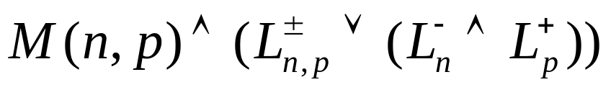
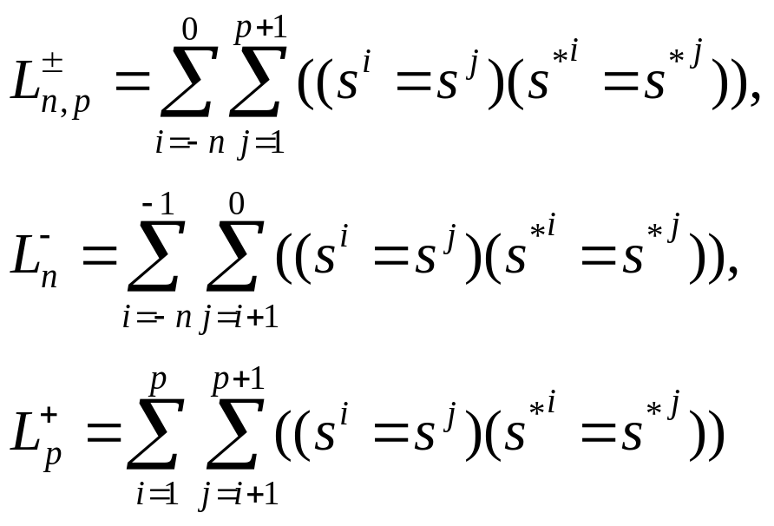
Decoder Existence Checking
Decoder does not exist iff
is SAT for some n and p, where

Slide 13
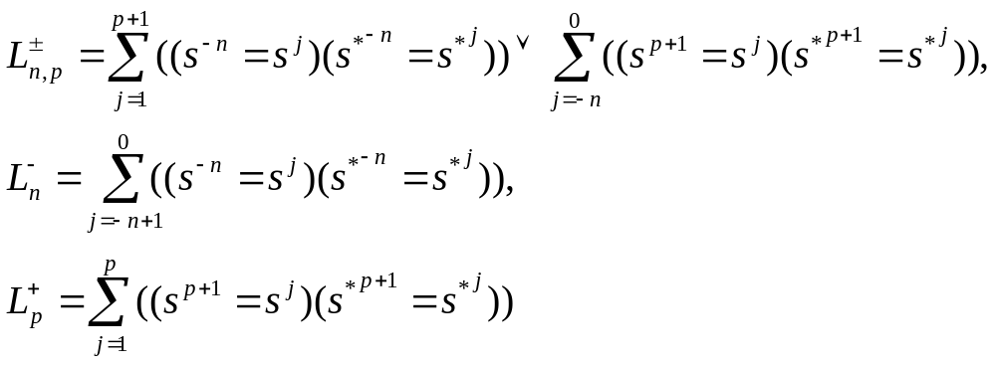
Decoder Existence Checking
Decoder does not exist iff
is SAT for some n and p, where

Slide 14
Decoder Existence Checking
T^{–n}
…
T^{–1}
T⁰
T¹
…
T^{p}
=
=
=
≠
=
=
=
T*^{–n}
…
T*^{–1}
T*⁰
T*¹
…
T*^{p}
=
L⁻
L⁺
=
=
=
=
L±
=
=
=
=
=
=
=
=

Slide 15
Decoder Existence Checking
solve M(n,p)
n := 0
p := 0
encoder
SAT?
no
decoder exists
return (n, p)
yes
solve M(n,p)∧(L±∨(L⁻∧L⁺))
n := n+1
p := p+1
SAT?
yes
no decoder
return counterexample
no

Slide 16
Decoder Existence Checking
Incremental timeframe expansion
  Expand from outside
T^{–3}
T^{–2}
T^{–1}
T⁰
…
=
=
=
=
=
≠
=
T*^{–3}
T*^{–2}
T*^{–1}
T*⁰
…
=
=
=
=
=

Slide 17
Decoder Existence Checking
Incremental timeframe expansion
  Expand from inside
T^{–3}
T^{–2}
T^{–2}
T^{–1}
T^{–1}
T⁰
…
=
=
=
=
=
=
=
≠
=
=
T*^{–3}
T*^{–2}
T*⁰
T*^{–2}
T*^{–1}
T*^{–1}
…
=
=
=
=
=

Slide 18
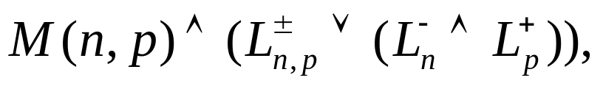
Decoder Existence Checking
Disjunctive conditions
Not good for CNF encoding

Slide 19
Decoder Existence Checking
CNF encoding of disjunctive conditions
  E.g.,
  Let Φ = Φ₁+Φ₂+Φ₃ = (C₁C₂C₃)+(C₄C₅)+(C₆C₇)
  Let Ψ = (C₁+¬α₁) (C₂+¬α₁) (C₃+¬α₁) (C₄+¬α₂) (C₅+¬α₂) (C₆+¬α₃) (C₇+¬α₃) (α₁+α₂+α₃)
  Φ and Ψ are equisatisfiable

Slide 20
Decoder Existence Checking
Incremental CNF encoding of disjunctive conditions
  E.g.,
  Let Φ = Φ₁+Φ₂+Φ₃ = (C₁C₂C₃)+(C₄C₅)+(C₆C₇)
  Suppose Φ_{i} are appended incrementally
  Let Ψ = (C₁+¬α₁) (C₂+¬α₁) (C₃+¬α₁) (β₀+α₁+¬β₁) (C₄+¬α₂) (C₅+¬α₂) (β₁+α₂+¬β₂) (C₆+¬α₃) (C₇+¬α₃) (β₂+α₃+¬β₃)
  Φ and (Ψ∧¬β₀∧β₃) are equisatisfiable

Slide 21
Decoder Existence Checking
solve M(n,p)
n := 0
p := 0
encoder
SAT?
no
decoder exists
return (n, p)
yes
solve M(n,p)∧(L±∨(L⁻∧L⁺))
n := n+1
p := p+1
SAT?
yes
no decoder
return counterexample
no

Slide 22
Decoder Synthesis
Craig interpolation theorem:
  For (A ∧ B) UNSAT, there exists an interpolant I such that
  1. A → I
  2. B ∧ I UNSAT
  3. I refers only to the common variables of A and B
I
B
A

Slide 23
Decoder Synthesis
The interpolant corresponds to the desired decoder
A
1
T^{–n}
…
T^{–1}
T⁰
T¹
…
T^{p}
=
=
=
=
=
=
0
T*^{–n}
…
T*^{–1}
T*⁰
T*¹
…
T*^{p}
B

Slide 24
Experimental Results
Our decoding system “Decosy” implemented in ABC using C language
Experiments conducted on Linux machine with Xeon 2.53 GHz CPU and 48GB RAM
Final circuits mapped into mcnc.genlib library

Slide 25
Experimental Results
Comparison on decoder generation time
circuit | [14]* |  | Decosy |  | area ratio | delay ratio
 | area/delay | time | area/delay | time
XGXS | 269/7.4 | 1.23 | 286/7.3 | 0.08 | 1.06 | 0.99
XFI | 5697/14.4 | 492.58 | 3978/14.3 | 4.02 | 0.70 | 0.99
Scrambler | 736/3.8 | 1.88 | 640/3.8 | 0.25 | 0.87 | 1
PCIE | 171/5.8 | 1.04 | 190/6.6 | 0.08 | 1.11 | 1.14
T2Ethernet | 299/7.5 | 22.67 | 583/9.0 | 1.47 | 1.95 | 1.20
HM(7,4) | 255§/7.3§ | 0.12 | 255/7.3 | 0.08 | 1 | 1
HM(15,11) | 4232§/13.8§ | 56.82 | 3279/13.2 | 1.33 | 0.77 | 0.96
*Prior work [14] implemented in OCaml.

Slide 26
Experimental Results
Comparison on decoder existence checking and decoder generation
circuit | [15]* |  | Decosy |  | area ratio | delay Ratio
 | area/delay | time | area/delay | time
XGXS | 293/7.5 | 2.70 | 295/7.1 | 0.10 | 1.01 | 0.95
XFI | 5697/14.4 | 1144.32 | 3913/12.5 | 7.52 | 0.69 | 0.87
Scrambler | 736/3.8 | 10.46 | 640/3.8 | 0.50 | 0.87 | 1
PCIE | 163/6.1 | 3.91 | 190/6.6 | 0.14 | 1.17 | 1.08
T2Ethernet | 269/6.9 | 113.89 | 526/9.7 | 12.38 | 1.96 | 1.41
HM(7,4) | 255§/7.3§ | 0.12§ | 255/7.3 | 0.08 | 1 | 1
HM(15,11) | 4232§/13.8§ | 56.92§ | 3279/13.2 | 1.94 | 0.77 | 0.96
*Prior work [14] implemented in OCaml.

Slide 27
Experimental Results
Comparison on decoder inexistence checking
circuit (w/o decoder) | [15]* time (s) | Decosy time (s)
XGXS_err | 2.17 | 0.01
XFI_err | 39.71 | 0.01
Scrambler_err | 3.96 | 0.08
PCIE_err | 2.94 | 0.01
T2Ethernet_err | 128.73 | 0.04
HM(7,4)_err | 1.35 | 0.01
HM(15,11)_err | 23.25 | 0.39
AD | >6000 | 0.01
*Prior work [14] implemented in OCaml.

Slide 28
Conclusions
We presented a sound and complete approach to decoder synthesis
An effective incremental SAT solving solution was proposed for decoder existence checking
Craig interpolation was used for effective decoder generation
Experiments showed robust and fast computation (with synthesis quality comparable to prior work)

Slide 29
Thank You for Your Attention
Questions?

