Slide 1


Studying

Slide 2



Exercise

Slide 3
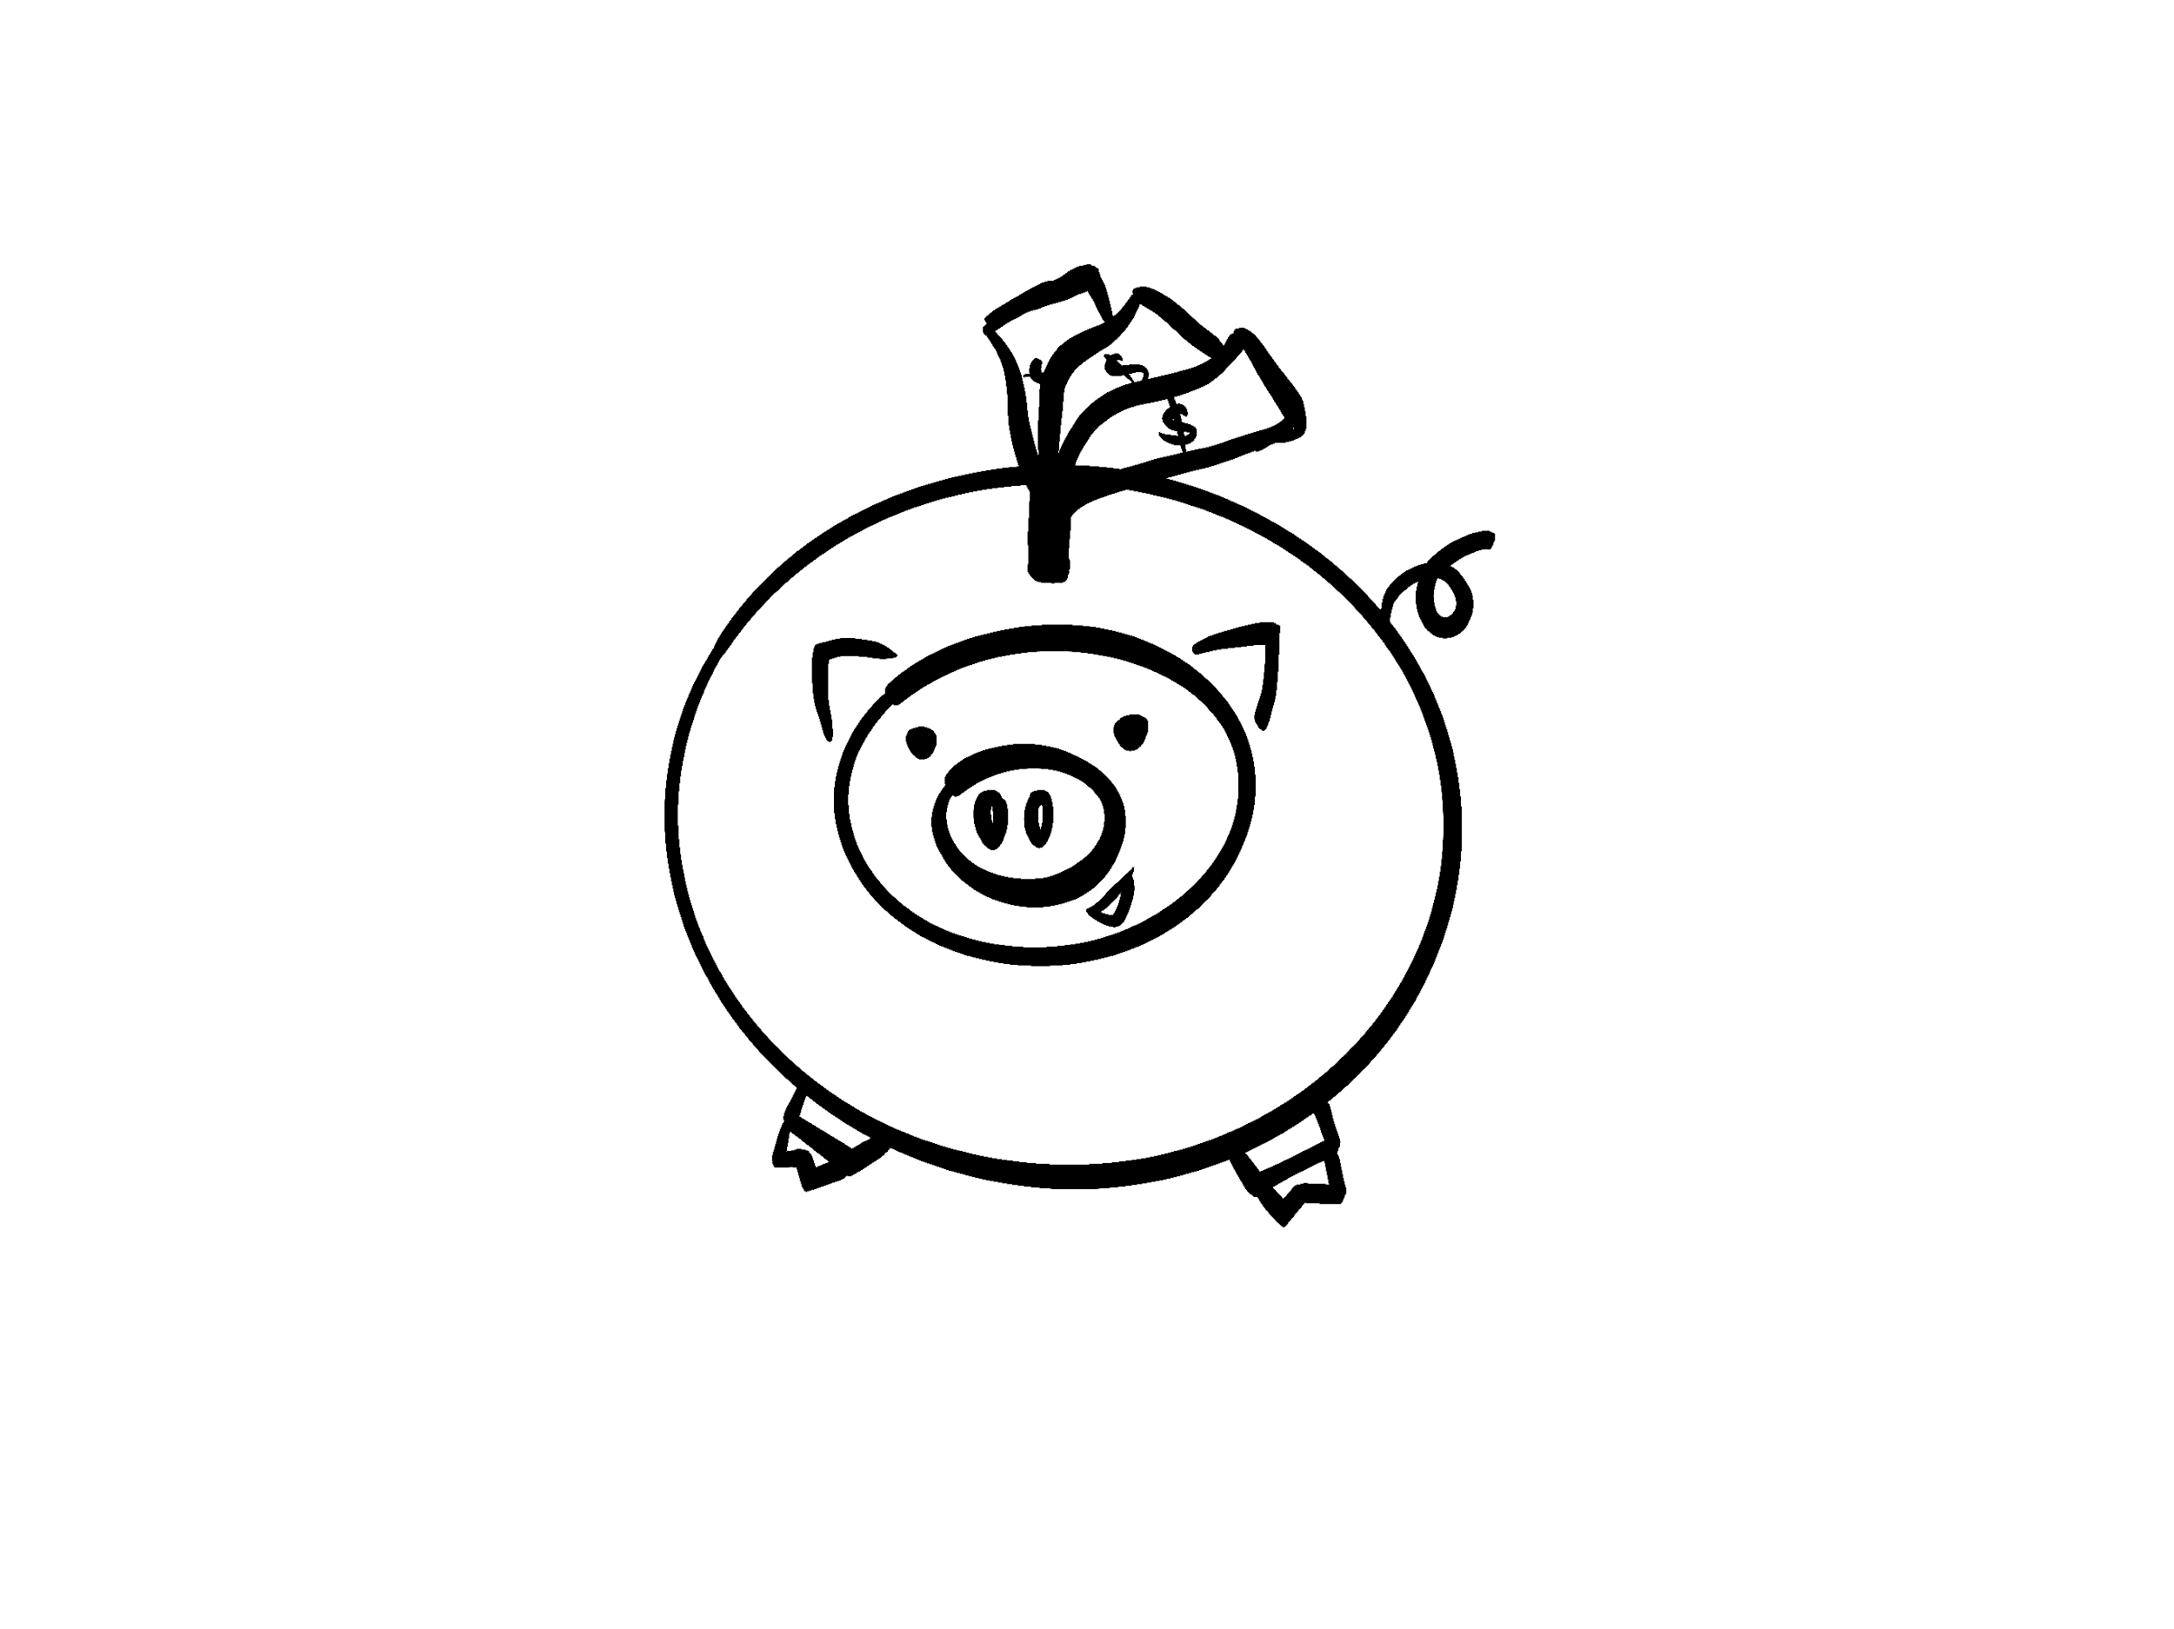
Save money

Slide 4


Drink water

Slide 5



Don’t smoke

Slide 6






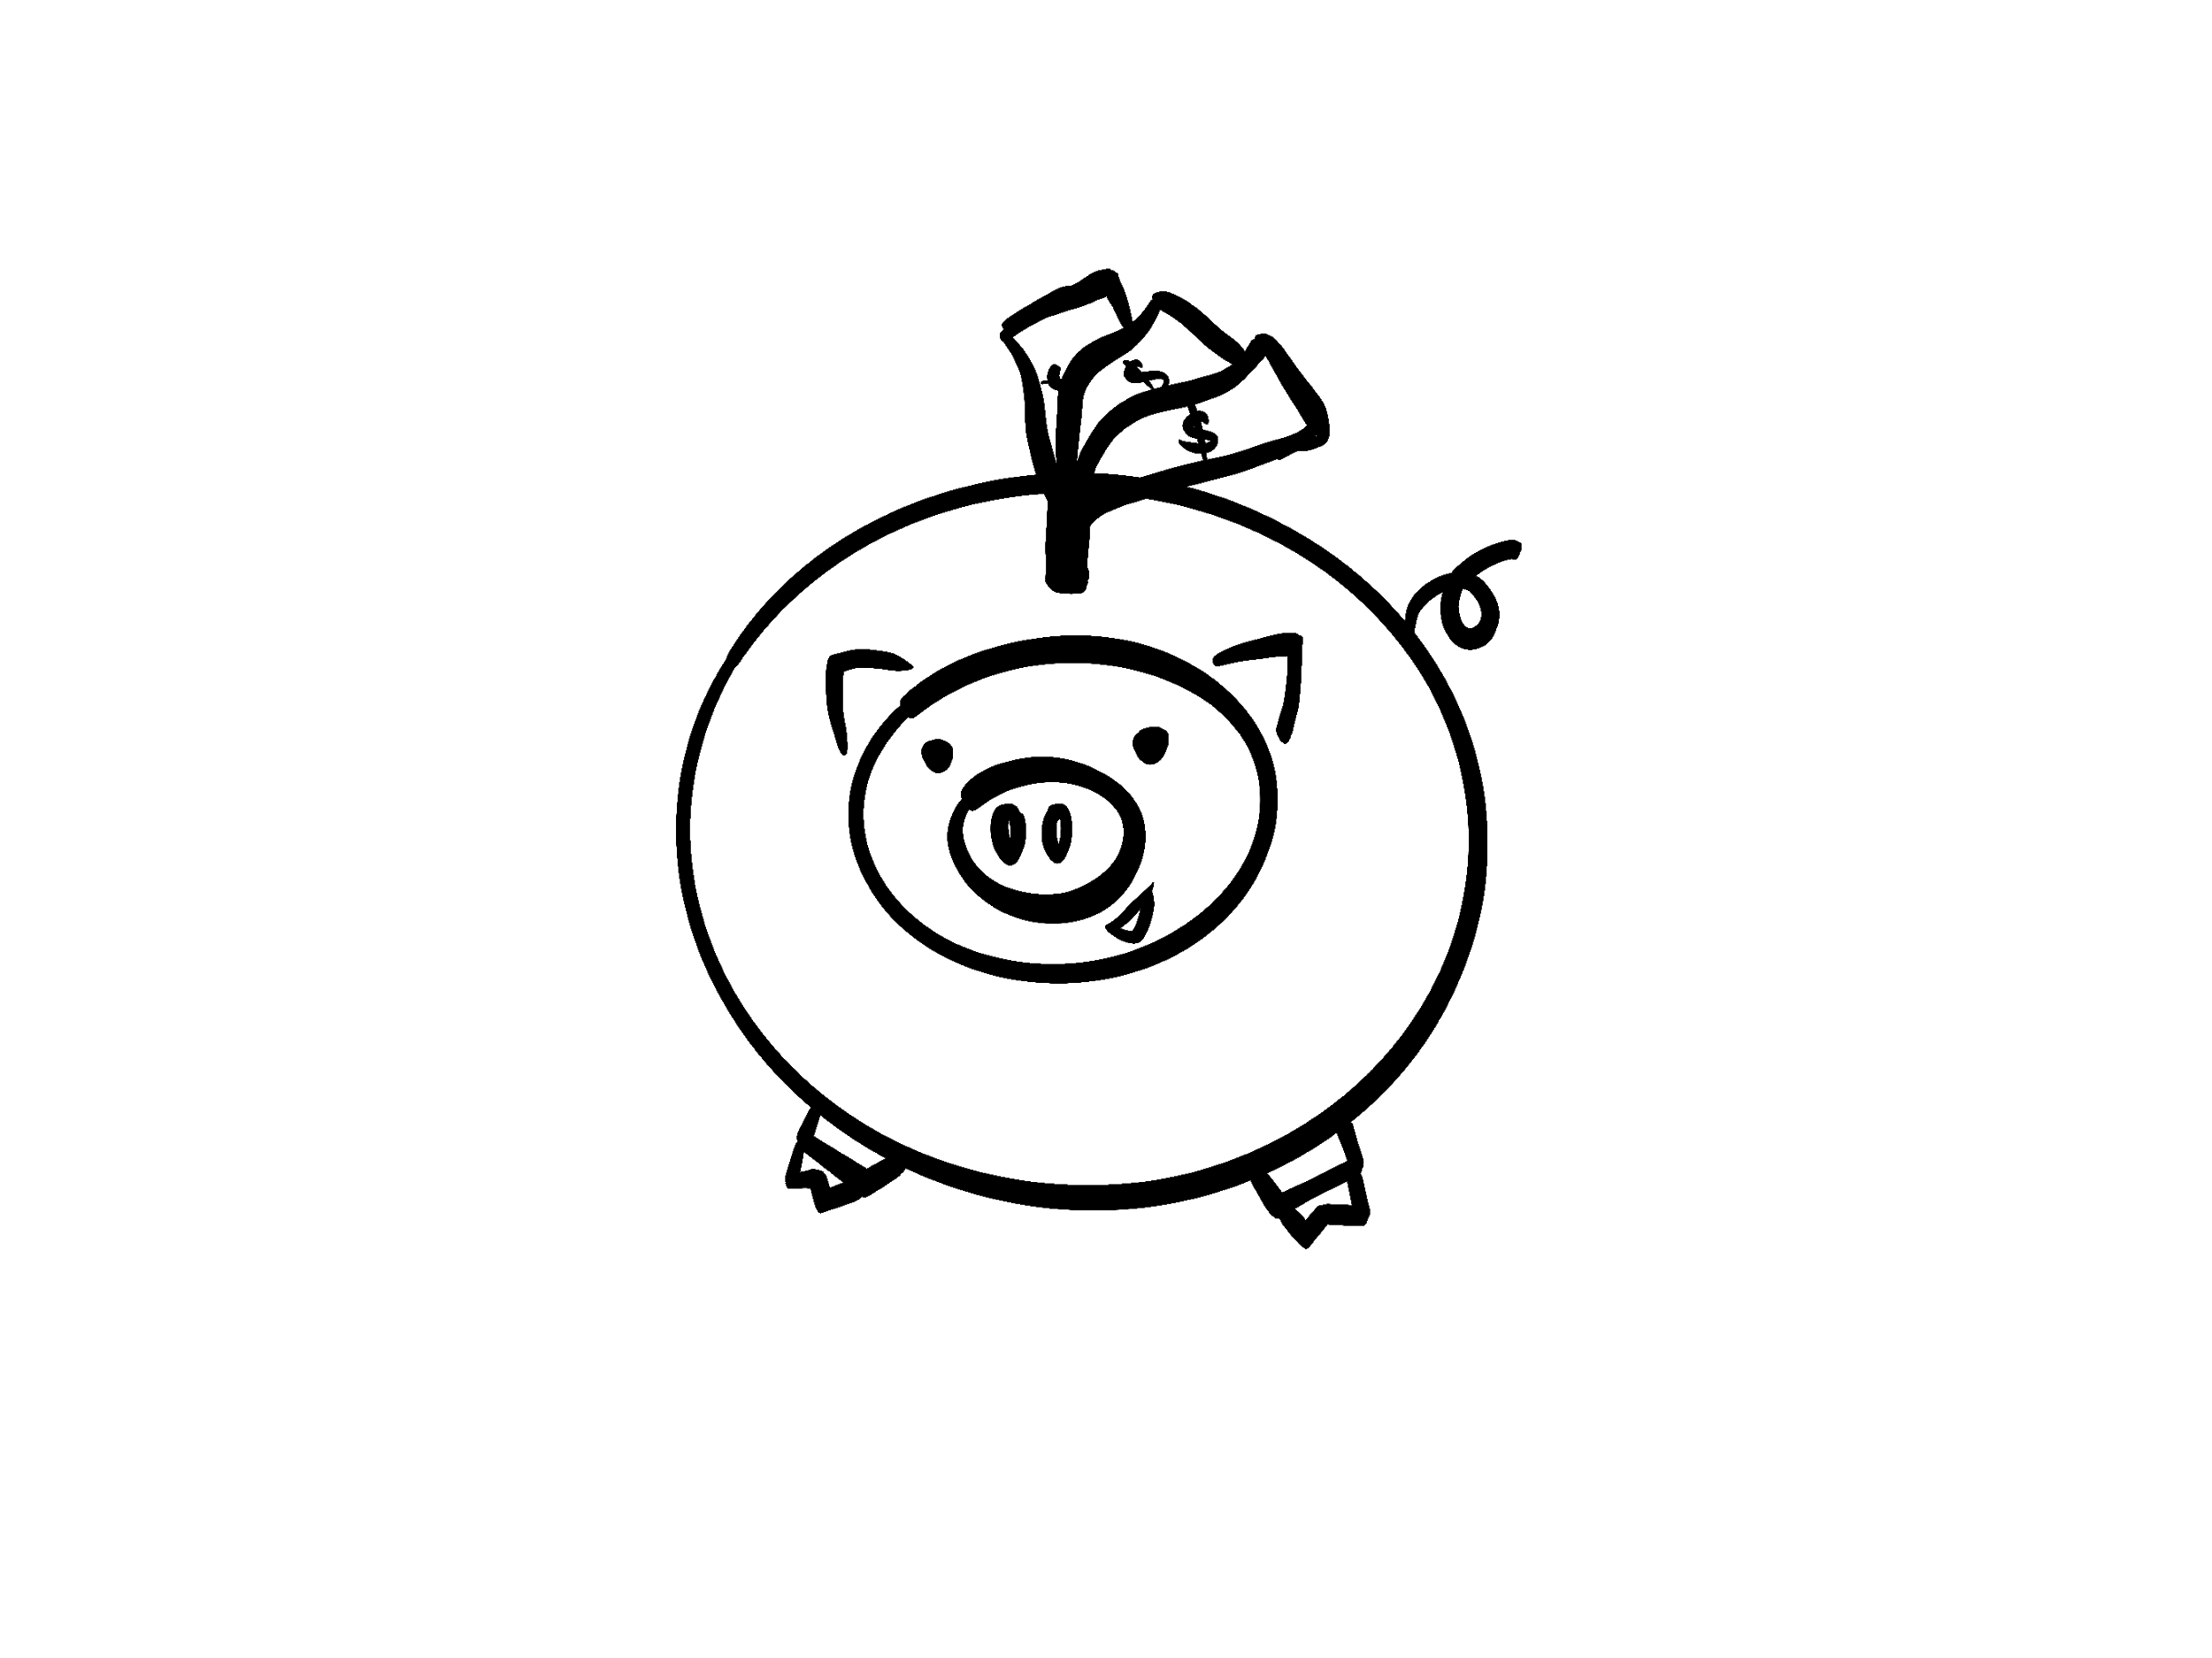





Slide 7












