Slide 1
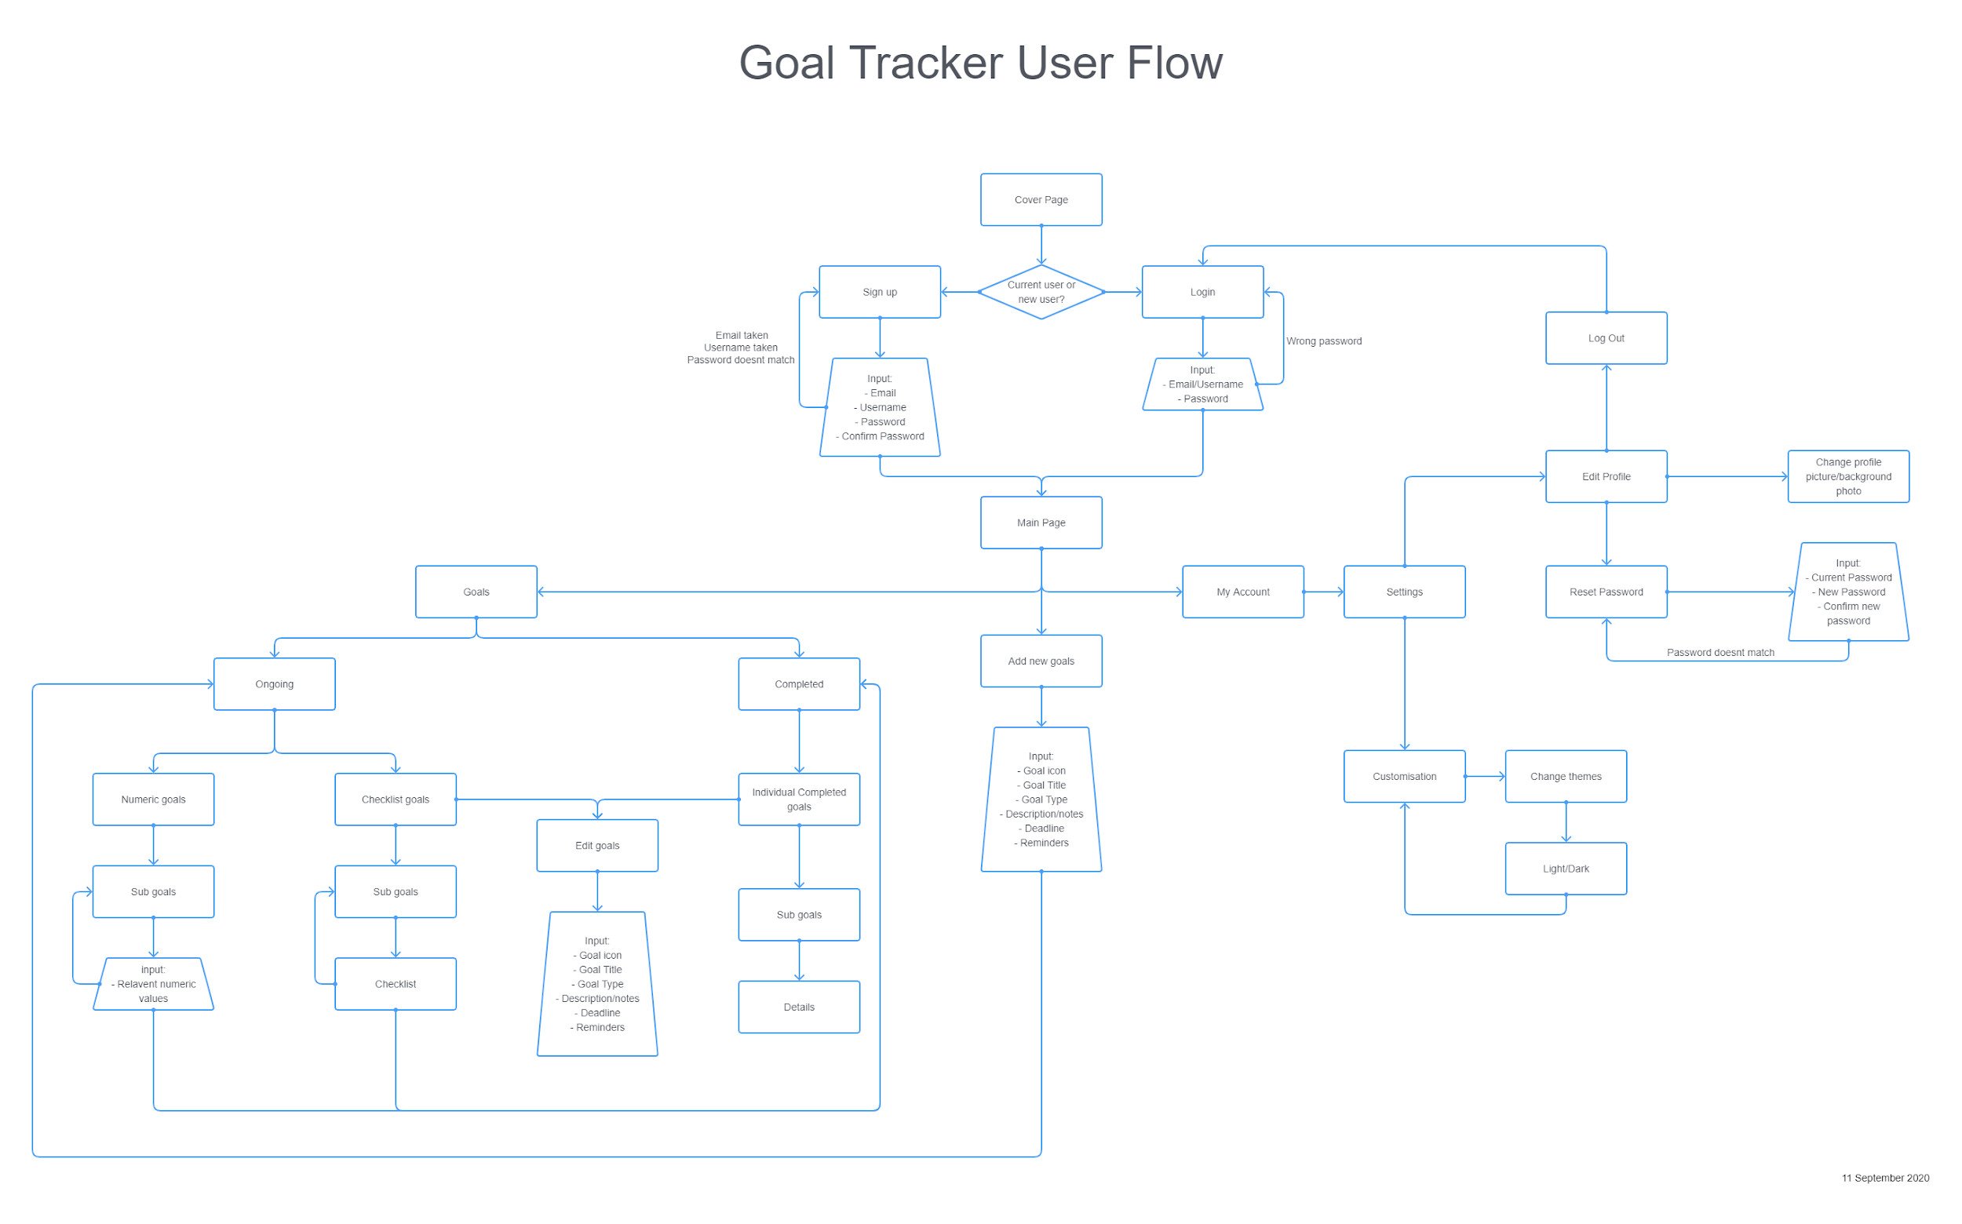

Slide 3
“Login” : clicked
verify() : failed
“Login” : clicked
verify(e, p)/(u, p) : success
getUserData(e, p) : user object
Main Page
Login
“Logout” : clicked
My Account
“Change Password” : clicked
“Sign Up”: clicked
create(e, u, p) : success
Reset Password
“Sign Up” : clicked
Sign Up
“Sign Up”: clicked
create(e, u, p) : failed
Sitemap - Login Process

