Slide 1
CPU & Memory Logs EDA
.
報告者：曾秋旺 .
報告日期：2017/10/31.

Slide 2
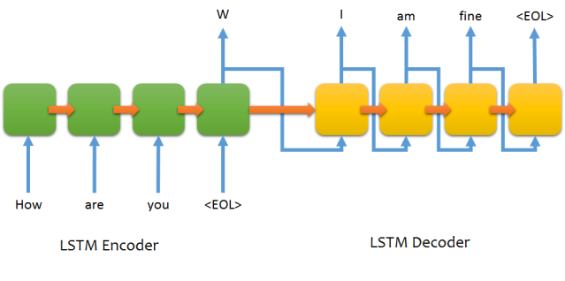
LSTM → Sequence to Sequence
Input Length
?
Output Length
Source: http://suriyadeepan.github.io/2016-06-28-easy-seq2seq/

Slide 3
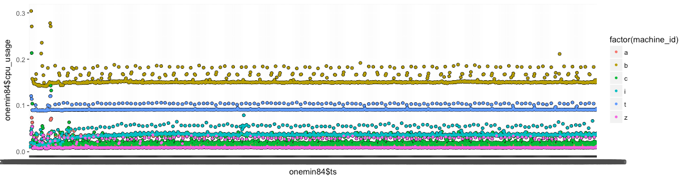
Observation

Slide 4
Observation
每一段時間算一筆平均及標準差

Slide 5
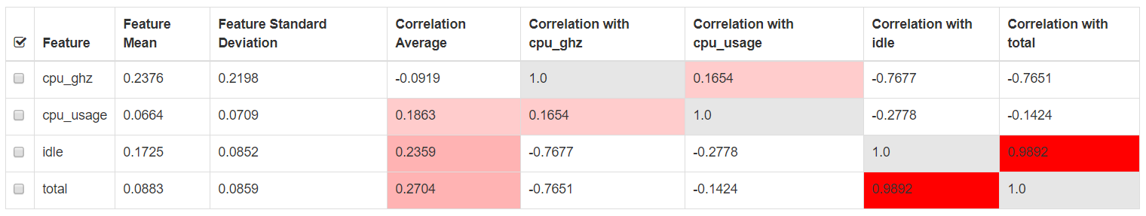
Correlation

Slide 6
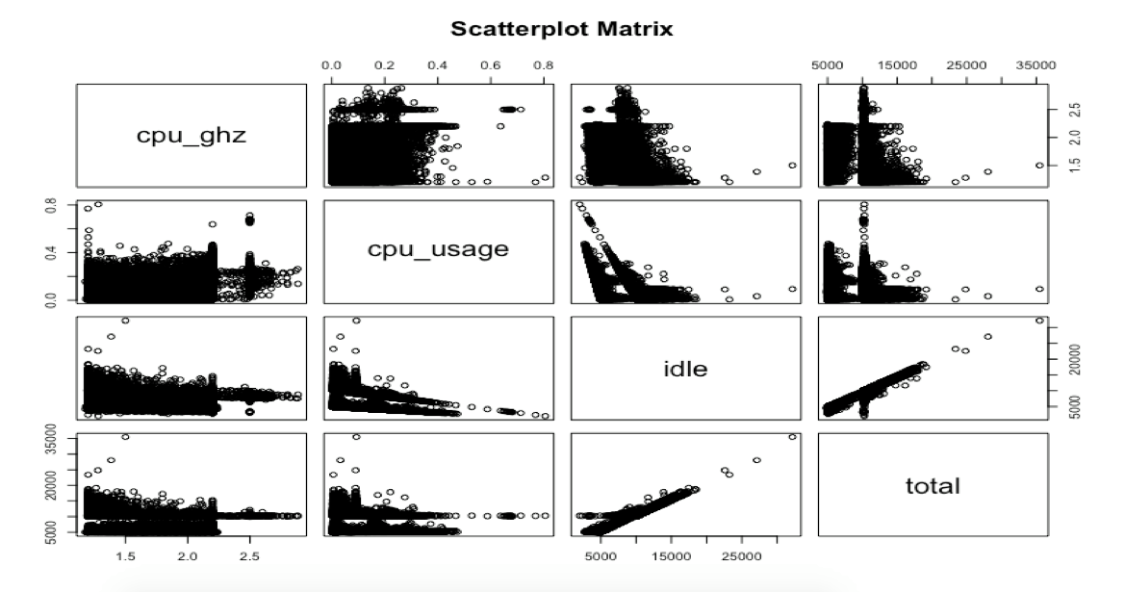
Correlation

Slide 7
InAnalysis
https://inanalysis.github.io/

Slide 8
Thanks for your attention

